Slide 1
Data-Driven Political Campaign
Thiruvidaimaruthur Constituency (2006–2024)

Slide 2
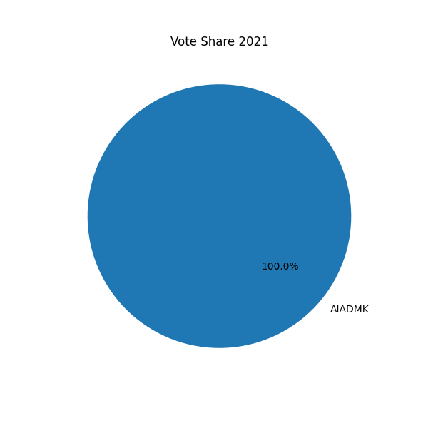
Vote Share 2021

