Slide 1
Deploying and running in Mule Standalone (For beginners )
By Anirban Sen Chowdhary

Slide 2
I often find people get confused when it comes to Mule Standalone server.
I thought of giving a demo on deploying and running a simple Mule application on Mule Standalone server

Slide 3
Mule Standalone Server :- Mule Standalone Server is a proprietary application server that hosts Mule-specific application.
This server can host any Java specific code, web services and Mule application.
It can also host web application with the help of embedded Jetty server in Mule application.

Slide 4
To deploy an application on Mule Standalone server we require Mule application in deployable zip format, just like a .war file in case of tomcat server .

Slide 5
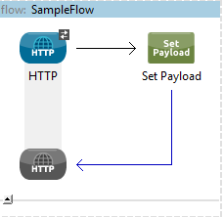
Now, let us create a simple application in our Anypoint studio. This application we will be deploying and running in our Mule Standalone Server
You can see a very simple flow which will send a message payload in our browser

Slide 6
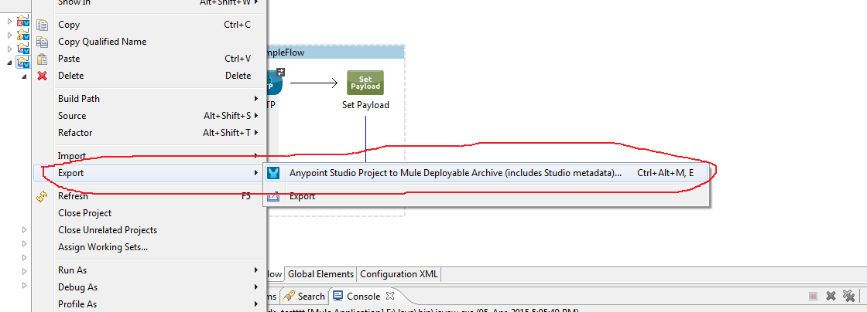
To deploy this application in Mule Standalone we need to create a deployable Zip file and we can create it by right click on the Mule application, and then select Export option, and then select Anypoint studio project to Mule deployable Archive option from the menu as given below:-

Slide 7
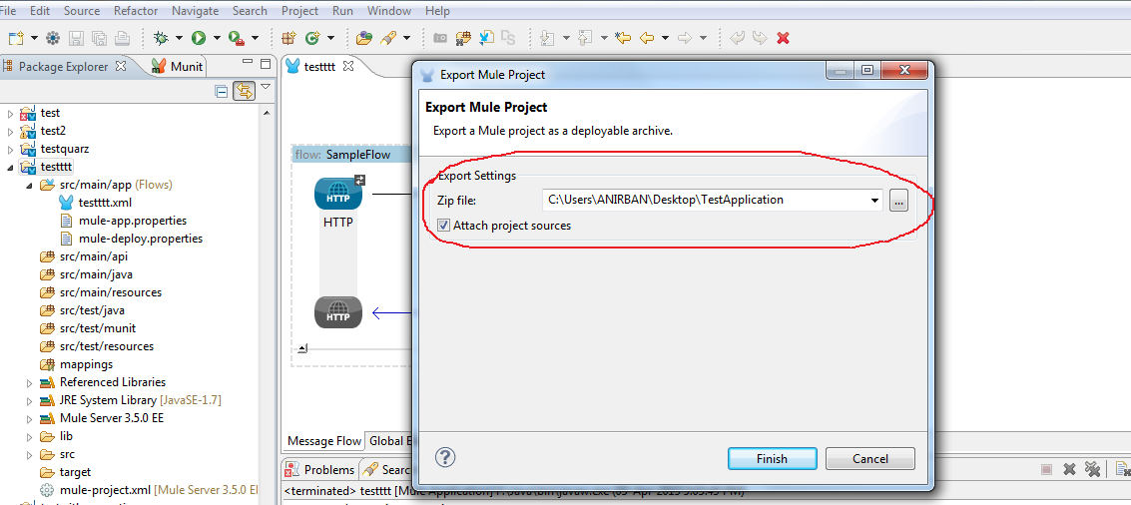
Then select a location and name of the application to deploy and click finish as follows:-

Slide 8
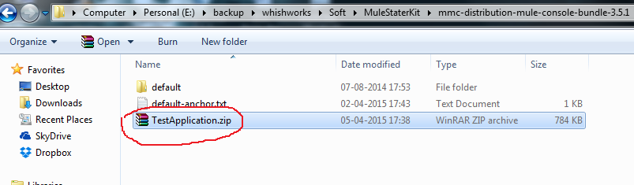
The application Zip file will be created and we now need to deploy that.
Now, we need to copy the zip file and paste it into app folder under Mule Standalone folder as shown below:-
This app folder will contain all the Mule application to be deployed under the server

Slide 9
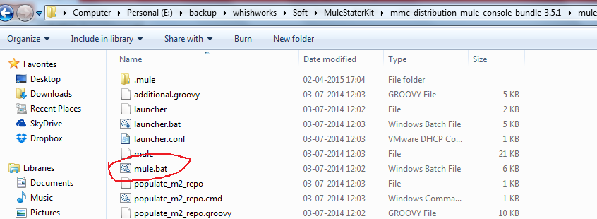
Once done , we need to start our mule standalone server. We need to come into bin folder under Mule Standalone folder, and there we will find mule.bat ( for windows ) as shown below:-

Slide 10
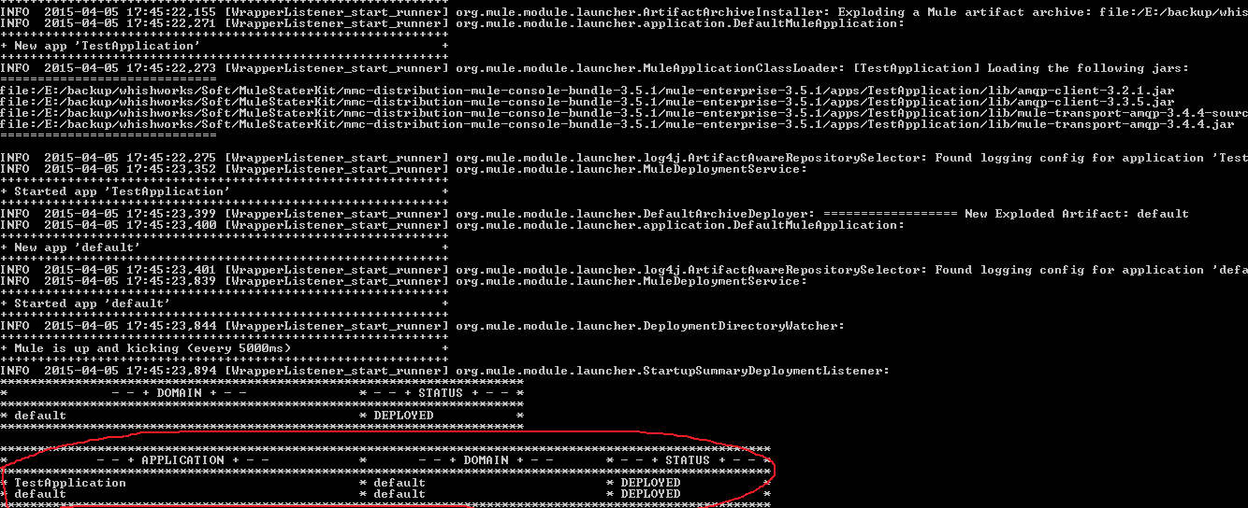
We can now click mule.bat to start our standalone server and our server will be started as follow :-
You can see the server got started and our TestApplication got deployed successfully

Slide 11
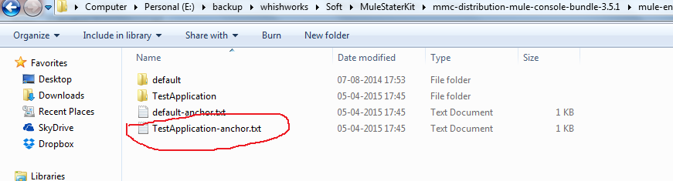
If we go back to the app folder of Mule Standalone server, we will find our TestApplication is deployed and generated a TestApplicat-anchor.txt which shows it’s successful deployment in the server :-
You can see the server got started and our TestApplication got deployed successfully

Slide 12
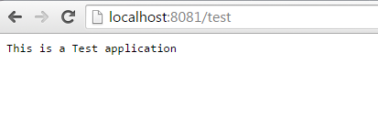
If we hit the url http://localhost:8081/test in our browser we can find the response in our browser which shows our application is running fine under Mule Standalone server ☺ :-

Slide 13
In my next slide I will bring some other techniques in Mule implementation .
Hope you have enjoyed this simpler version.
Keep sharing your knowledge and let our Mule community grow ☺

Slide 14

Thank You

