Slide 1
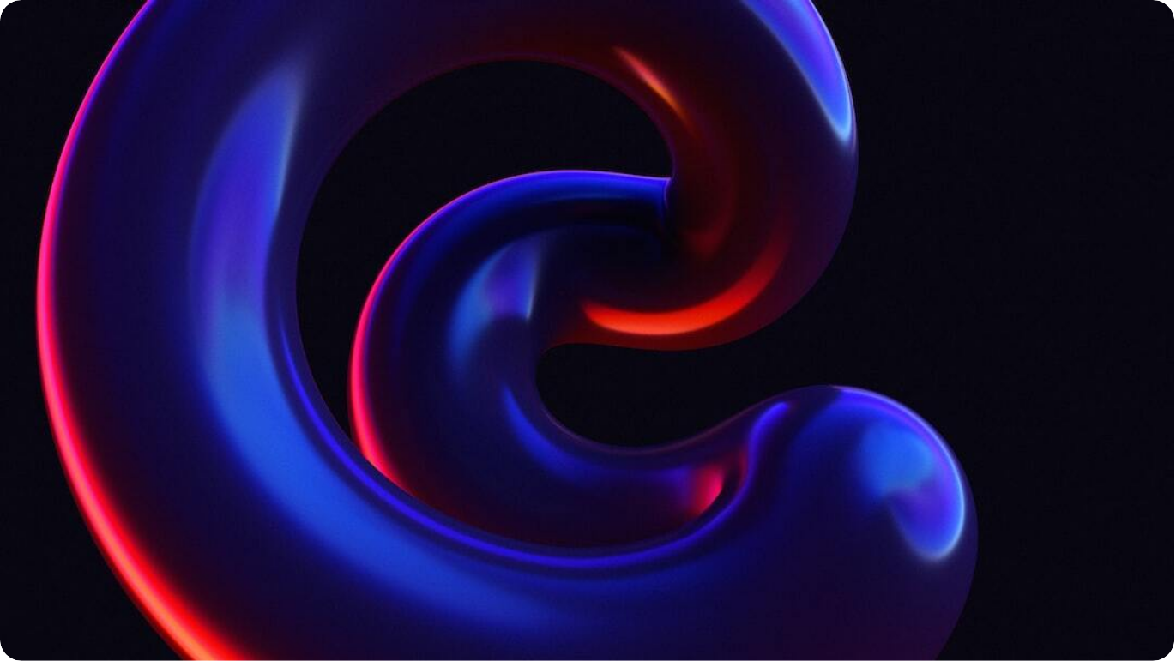
Advanced RAG: Query Expansion for Insurance Intelligence
Enhancing Retrieval Accuracy through Multi-Variant Queries
Query Expansion via LLM: When a user submits a question, the LLM generates four semantically varied versions of the query while keeping the core meaning intact—optimized for the insurance and underwriting context.
  Contextual Diversity: These variations explore related phrasing and synonyms, improving the system’s ability to capture relevant but differently worded information in the vector database.
  Deduplication of Results: All five queries (original + four expanded) are passed to the vector store. Overlapping or duplicate chunks are automatically filtered out to maintain unique contextual coverage.
  Comprehensive Response Generation: The final set of unique contexts is combined and sent back to the LLM, ensuring that the generated response integrates multiple perspectives without redundancy.
Photo by Voicu Apostol on Unsplash

Slide 2

Advanced RAG: Multi-Query Intelligence
Boosting Precision and Depth in AI-Driven Insurance Insights
Dynamic Query Expansion: The LLM automatically creates four contextual variations of each user query, exploring multiple ways of phrasing the same intent to uncover deeper document matches.
  Insurance Domain Alignment: Each variation is tailored to insurance and underwriting terminology, ensuring domain relevance and higher retrieval accuracy across industry-specific datasets.
  Smart Deduplication: After retrieving results for all query variants, duplicate content is filtered out to maintain unique and high-value insights for the next stage.
  Comprehensive AI Response: The unique, high-relevance contexts are combined and passed to the LLM to generate a well-rounded, evidence-grounded answer—rich in perspective and accuracy.
Photo by Denis Sebastian Tamas on Unsplash

Slide 3
Advanced RAG: Query Expansion Workflow
A Handwritten-Style Overview for Insurance Context
Step 1: User Query: A user asks a question related to underwriting or insurance appetite.
  Step 2: Query Expansion via LLM: The Large Language Model generates four rephrased variations of the same question to capture multiple angles of meaning.
  Step 3: Vector Search: All five queries (original + four expansions) are sent to the vector store to retrieve relevant chunks from documents.
  Step 4: Deduplication: Duplicate or overlapping contexts are removed, leaving a unique set of information pieces.
  Step 5: Final Response Generation: The cleaned, diverse contexts are fed into the LLM again to craft one unified, accurate, and rich answer for the user.

