Slide 1
Advanced C#
Eric Gunnerson
Program Manager
Visual C# .NET
Microsoft Corporation
Notes:
These slides were originally given at ASP.NET Solutions in May of 2002. They’re based on a similar deck I gave at TechEd 2002.
There are some explanatory notes throughout the deck.
Eric Gunnerson
EricGu@microsoft.com

Slide 2
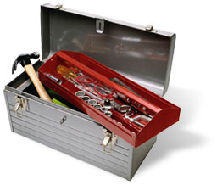
Advanced C# Topics
Visual Studio “Everett” Features
Designing a New Type
Object Destruction
Exception Handling
Unsafe Code

Slide 3
Advanced C# Topics
Visual Studio “Everett” Features
Designing a New Type
Object Destruction
Exception Handling
Unsafe Code

Slide 4
Everett Demo

Slide 5

Designing a New Type
C# has both reference and value types
Which is the right one to use?

Slide 6
What are they?
Reference types:
  Heap allocated
  Tracked by the GC
  Support inheritance, polymorphism, etc.
Value types:
  Stack or inline allocated
  Not tracked by the GC
  No inheritance, limited polymorphism

Slide 7

Other Languages
Smalltalk only supports reference types
  Simple, consistent model
  Disadvantages
    “int j = 5;” does a heap allocation
    100 ints in an array is 100 allocations
    Doesn’t interop well with existing primitive types

Slide 8
Value Types
Advantages:
  Allocation is very fast
  Arrays involve a single allocation
  Reduced memory pressure
    Less work for the GC
Disadvantages:
  No inheritance
  Only polymorphic when boxed
  Boxing involves overhead

Slide 9
Reference Types
The basic type in .net
Advantages:
  All object-oriented goodies
    polymorphism, etc.
  Good performance
Disadvantages:
  Always requires heap allocation

Slide 10
Guidelines
Use value types for:
  Building a new data type (ie Complex)
  Lots of small objects
    Only really useful if they’re in an array
    If not, boxing often means this isn’t worth it
Size of type
  Framework guidelines say <= 16 bytes
  Depends on usage of the type
  Benchmark to validate for your app
If you hit limitations, you’re using it wrong
Notes:
4:00

Slide 11
Advanced C# Topics
Visual Studio “Everett” Features
Designing a New Type
Object Destruction
Exception Handling
Ref and foreach
Unsafe Code

Slide 12
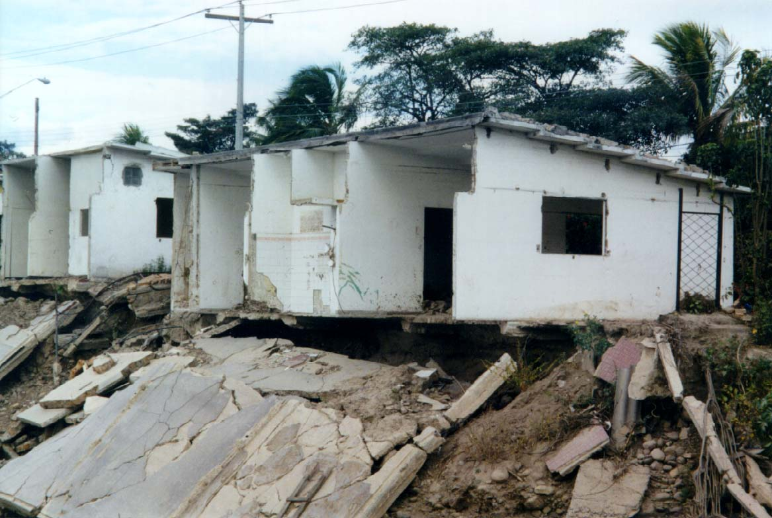
Object Destruction
Goal: Be able to control exactly when objects are destroyed
You want it
You can’t have it
  A very complicated discussion
    See http://www.gotdotnet.com/team/csharp/information
      Look for article on Resource management

Slide 13
Object Destruction
Garbage collection means you aren’t in control
GC chooses:
  When objects are destroyed
  Order of destruction
Garbage collector can’t clean up unmanaged objects

Slide 14
How Bad is It?
Mostly an issue for wrapper objects
  Database handles
  Files
  GDI objects (fonts, pens, etc.)
  Any object the GC doesn’t track
All objects get cleaned up
  Some may take a bit longer

Slide 15
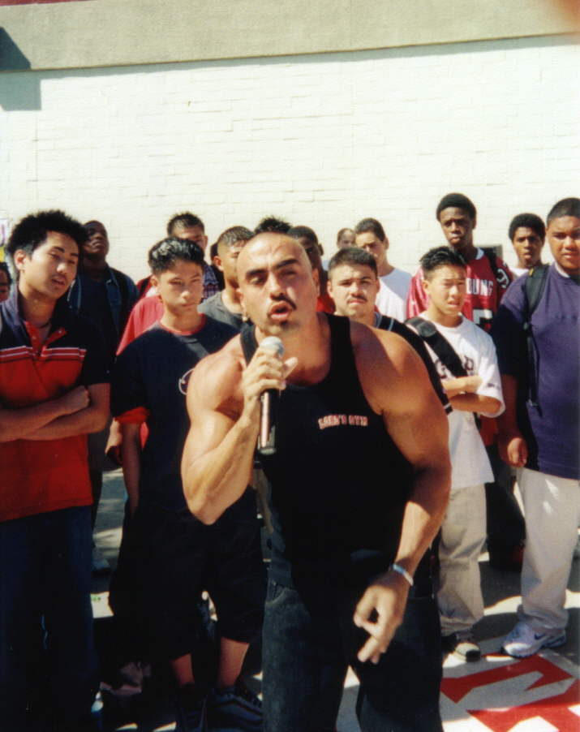
Wrapper objects
Cleanup at GC time
  Objects with unmanaged resources implement a finalizer to free those resources
Early Cleanup
  Objects implement IDisposable, users call Dispose() to clean up

Slide 16
Scenario 1
User Calls Dispose()
Dispose()
IntPtr myResource;
Font font;
free
Unmanaged Resource
Dispose()
Font object
Dispose() means free my resources, and call Dispose() on any contained objects

Slide 17
Scenario 2
Object Finalized by GC
Finalize()
Finalize()
IntPtr myResource;
Font font;
free
Unmanaged Resource
X
Dispose()?
Font object
Finalize() means free my resources only; other managed resources will also get finalized

Slide 18
Implementing IDisposable
Design pattern for early cleanup
Only required when you:
  Wrap unmanaged resources
    You’ll need a destructor too
  or
  Need to be able to clean up early

Slide 19
Destructors
Object.Finalize is not accessible in C#
public class Resource: IDisposable
{
~Resource() {...}
}
public class Resource: IDisposable
{
protected override void Finalize() {
try {
...
}
finally {
base.Finalize();
}
}
}

Slide 20
Doing the Implementation
public class Resource: IDisposable
{
IntPtr myResource;
Font font;
protected virtual void Dispose(bool disposing) {
if (disposing) {
font.Dispose();
GC.SuppressFinalize(this);
}
FreeThatResource(myResource);
}
public void Dispose() {
Dispose(true);
}
~Resource() {
Dispose(false);
}
}

Slide 21
Advanced C# Topics
Visual Studio “Everett” Features
Designing a New Type
Object Destruction
Exception Handling
Unsafe Code

Slide 22
Exception Handling
Provides tremendous benefits
Requires a different way of thinking

Slide 23
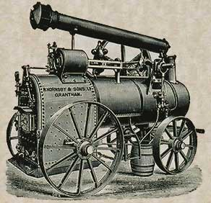
The old way
RETVAL Process(int a, int x, int y, int z)
{
RETVAL retval;
if ((retval = function(x, y, z)) != OK)
return retval;
if ((retval = function2(a, y)) != OK)
return retval;
}
Notes:
This is how you’d write error code handling in a language without exception handling.

Slide 24
Option 1
void Process(int a, int x, int y, int z)
{
try
{
function(x, y, z);
  }
  catch (Exception e)
  {
  throw e;
  }
try
{
function2(a, y);
  }
  catch (Exception e)
  {
  throw e;
  }
}
Notes:
Here’s a first try at translating it to a C# version. Wherever there was a test on an error code, a try-catch is used. This is much harder to read than the first example.

Slide 25
Option 2
void Process(int a, int x, int y, int z)
{
try
{
function(x, y, z);
function2(a, y);
  }
  catch (Exception e)
  {
  throw e;
  }
}
Notes:
Here’s a second try, merging the two try-catch blocks into one.

Slide 26
Option 3
void Process(int a, int x, int y, int z)
{
function(x, y, z);
function2(a, y);
}
Notes:
Here’s the real way to duplicate the original routine. In that routine, all the code was involved in taking an error code and propagating that to the caller.
With exception handling, that happens automatically, so you don’t have to write any code.

Slide 27
Exception Handling
You get correct behavior by default
Only catch an exception when you can do something useful for the user
  You can write lots of unnecessary code, but at least your code will be less robust
Notes:
By “make it worse”, I mean things like swallowing exceptions when you shouldn’t.

Slide 28

When to catch
Something specific happens, and we can help
try
{
StreamReader s = File.OpenText(filename);
}
catch (Exception e)
{
Console.WriteLine(“Invalid filename: {0}”, filename);
}
try
{
StreamReader s = File.OpenText(filename);
}
catch (FileNotFoundException e)
{
Console.WriteLine(e);
}
Notes:
The first example here is not a very good one, as it catches the type Exception, and the issues a very specific error. The OpenText() method can throw many different exceptions, and this code will eat them all.
The second example is better; it catches a specific exception and then writes it out to the user.

Slide 29
When to catch
We need to log or wrap an exception
try
{
ExecuteBigProcess();
}
catch (Exception e)
{
log.WriteLine(e.ToString());
throw;
}
try
{
ExecuteBigProcess();
}
catch (Exception e)
{
throw new
MyException(“Error executing BigProcess”, e);
}
Notes:
There are two versions here. The first one logs the exception, and then re-throws it.
The second wraps the exception in a new one, and throws that new exception.

Slide 30
When to catch
We’d die otherwise
public static void Main()
{
while (true)
{
try
{
MainLoop();
}
catch (Exception e)
{
Console.WriteLine(“Exception caught, trying to continue”);
Console.WriteLine(e);
}
}
}
Notes:
This is a main-loop sort of thing. Typically, if you get an uncaught exception, you’d like to give the user a chance to save their work.

Slide 31
Finally statement
If an exception is thrown and
  There’s something to clean up
    Close a file
    Release a DB handle
Using statement makes this easier
  Works on anything that implements IDisposable

Slide 32
Using Statement
Acquire, Execute, Release pattern
Works with any IDisposable object
  Data access classes, streams, text readers and writers, network classes, etc.
using (Resource res = new Resource()) {
res.DoWork();
}
Resource res = new Resource(...);
try {
res.DoWork();
}
finally {
if (res != null) ((IDisposable)res).Dispose();
}

Slide 33
Using Statement
static void Copy(string sourceName, string destName) {
Stream input = File.OpenRead(sourceName);
try {
Stream output = File.Create(destName);
try {
byte[] b = new byte[65536];
int n;
while ((n = input.Read(b, 0, b.Length)) != 0) {
output.Write(b, 0, n);
}
}
finally {
output.Close();
}
}
finally {
input.Close();
}
}
static void Copy(string sourceName, string destName) {
Stream input = File.OpenRead(sourceName);
Stream output = File.Create(destName);
byte[] b = new byte[65536];
int n;
while ((n = input.Read(b, 0, b.Length)) != 0) {
output.Write(b, 0, n);
}
output.Close();
input.Close();
}
static void Copy(string sourceName, string destName) {
using (Stream input = File.OpenRead(sourceName))
using (Stream output = File.Create(destName)) {
byte[] b = new byte[65536];
int n;
while ((n = input.Read(b, 0, b.Length)) != 0) {
output.Write(b, 0, n);
}
}
}
Notes:
This slide shows:
Code without correct exception handling
Ugly code with correct exception handling
Identical code written with the using statement rather than try-catch blocks.

Slide 34
Exceptions vs Return Codes
Exceptions are meant for exceptional cases
  Invalid parameters
  Can’t perform operation
Should not occur during normal program operation
  User interaction is a grey area

Slide 35
Using Return Values
Okay if your caller always will have to check and recover from something
  Make sure you don’t force them to write:
Shouldn’t be possible to do the wrong thing
  File.Open() returns null on file not found
  You can’t ignore this
bool success = TryOperation(param1, param2);
if (!success)
return success;

Slide 36
Summary
Understand how the model works
Don’t work too hard
If you can’t do something useful, don’t catch

Slide 37
Advanced C# Topics
Visual Studio “Everett” Features
Designing a New Type
Object Destruction
Exception Handling
Unsafe Code

Slide 38

Unsafe Code
When pointers are a necessity
  Advanced COM and P/Invoke interop
  Existing binary structures
  Performance extremes
Low-level code without leaving the box
Basically “inline C”

Slide 39
Existing Binary Structures
struct COFFHeader {
public ushort MachineType;
public ushort NumberOfSections;
…
public ushort Characteristics;
}
private COFFHeader fileHeader;
void ReadHeader(BinaryStream InFile)
{
fileHeader.MachineType = inFile.ReadUInt16();
fileHeader.NumberOfSections = inFile.ReadUInt16();
// …
fileHeader.Characteristics = inFile.ReadUInt16();
}
private COFFHeader fileHeader;
unsafe void ReadHeader(BinaryStream InFile)
{
byte[] buffer = InFile.ReadBytes(sizeof(COFFHeader));
fixed (byte* headerPtr = buffer)
{
fileHeader = *((COFFHeader*)headerPtr);
}
}
Notes:
This slide shows two ways of reading in a binary header. The first one works, but is tougher to write correctly, and has some additional overhead.
The unsafe version is a bit faster.

Slide 40
demo
Image Processing
Notes:
11:30

Slide 41

Additional Resources
C# Community Sites
  http://www.csharp.net
    See information page for my columns
    Sign up for C# Community Newsletter
C# newsgroup
  microsoft.public.dotnet.languages.csharp
Me: EricGu@Microsoft.com

Slide 42
Thank You
Questions?

