Slide 1
Microsoft .NET
Object Oriented Software Engineering
Based on a presentation
by Murat Can Ganiz

Slide 2
Agenda
.NET
C#
.NET vs. J2EE (C# vs. Java)
Any .NET or C# programmers here?

Slide 3
Definition…
“Microsoft .NET is a set of Microsoft software technologies for connecting information, people, systems and devices.”
Microsoft’s explanation of .NET: http://www.microsoft.com/net/basics/whatis.asp
  More of an emphasis on web services (self-describing self modules wrapped in Internet protocols (XML and SOAP)
In real terms to the developer:
  A new platform for building applications that run in stand-alone mode or over the Internet
Notes:
The term .NET covers a lot of bases.
The official marketing line from Microsoft can be seen on the slide here. Pretty vague don’t you think?
I’d define it more succinctly as xxx.
To you and me, as software developers, I would consider the above to be a good definition of the .NET framework.
Not that it allows both standalone windows applications and distributed applications. You can guess which you’ll be building most, as nearly everything has some distributed component these days.
Notice I also say Internet. That’s because .NET has embraced internet standards and protocols in a big way. This essentially means web services standards such as SOAP are used a lot. Although you can use your own protocols in your distributed applications using .NET.
So, what does this platform offer us to develop with?

Slide 4
Evolution
Next Generation of COM:
  Component oriented software:
    Win32/C-style APIs are outdated
    COM was step in right direction, but painful to program with
    COM was restricted to VB, C++
    Binary compatibility/portability an issue: x86 version of COM component needed to be compiled for e.g. PowerPC
    Memory management also a pain
Common Object Runtime:
  An execution environment for components written in any language:
    Eventually became .NET with incorporation of Web Services
    Standardised API
Web Services:
  Interoperability is key in the connected world:
    Require open standards for interoperability and leveraging legacy code
Notes:
Component oriented development has long been recognised as a sensible way of doing large scale development. So little commercial and indeed academic development is done from scratch, we all use other people’s code in some way or another, be it class libraries that come with dev envs, or purchased fro msome vendor, or that we wrote ourselves. Microsoft went a good deal of the way to realising true component oriented development with it’s COM technology…

Slide 5
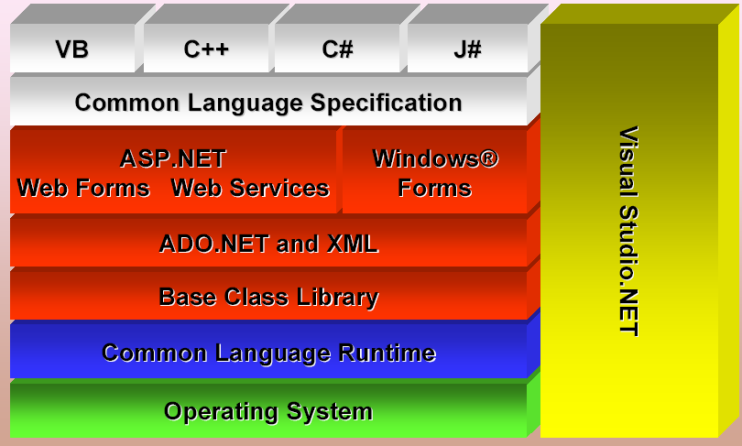
Architecture

Slide 6
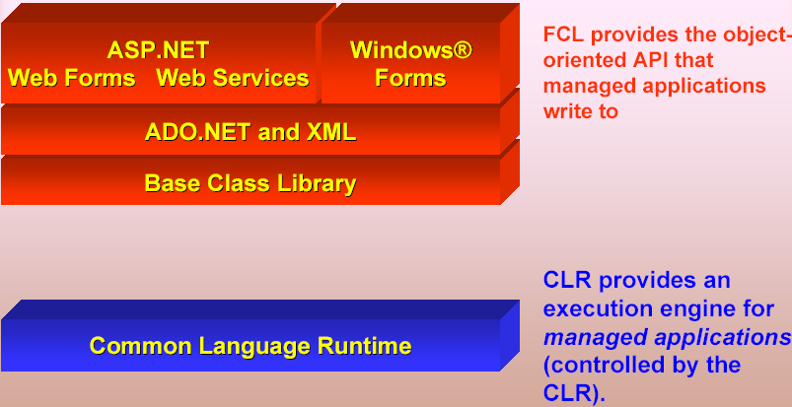
.NET Core Components
FCL is Framework Class Library, comparable to JDK’s library

Slide 7
Java and .NET: Runtime environments
Java
  Intermediate language is bytecode
  Original design targeted interpretation
  Java VMs with JIT compilation are now also used
.NET Framework
  Intermediate language is MSIL
  Provides JIT compilation
  What is JIT?
  Just-In-Time compilation: translates a bytecode method
  into a native method on the fly, so as to remove
  the overhead of interpretation

Slide 8
Common Language Runtime
CLR sits on top of OS to provide a virtual environment for hosting managed applications
  What is CLR similar to in Java?
  Java Virtual Machine (JVM)
CLR loads modules containing executable and executes their code
Code might be managed or unmanaged
  In either case the CLR determines what to do with it
Managed Code consists of instructions written in a pseudo-machine language called common intermediate language, or IL.
IL instructions are just-in-time (JIT) compiled into native machine code at run time

Slide 9
Compiling and executing managed code
Compilation
Microsoft Intermediate Language (MSIL)
Source Code
Language Compiler
The first time each method is called
Native
Code
JIT Compiler
Execution

Slide 10
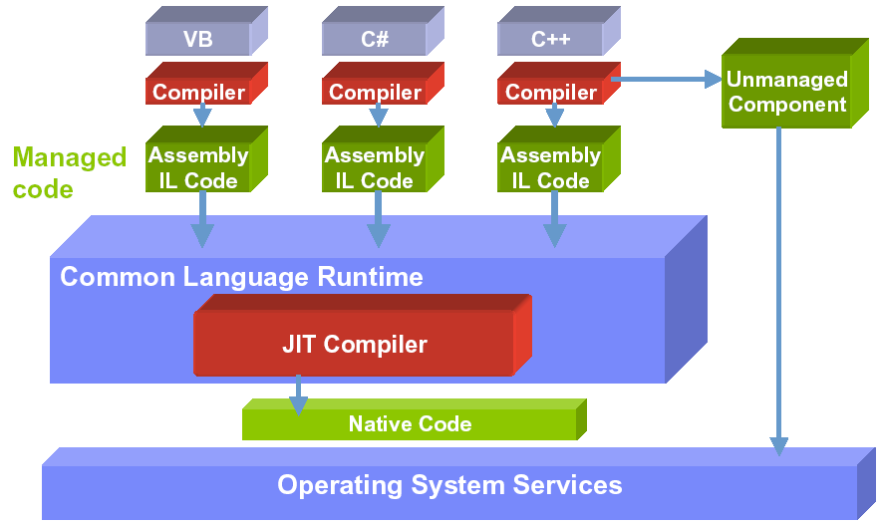
Common Language Runtime

Slide 11
C#

Slide 12
.NET languages
Over 20 .NET-compatible languages
  Most are provided by 3rd parties
.NET languages provided by Microsoft
  C++
  Visual Basic
  C#

Slide 13
Language Compiler List
Ada
APL
Basic (Visual Basic)
C#
C
C++
Java
COBOL
Component Pascal
(Queensland U Tech)
ECMAScript (JScript)
Eiffel (Monash U.)
Haskell (Utrecht U.)
lcc
(MS Research Redmond)
Mondrian (Utrecht)
ML
(MS Research Cambridge)
Mercury
(Melbourne U.)
Oberon
(Zurich University)
Oz (Univ of Saarlandes)
Perl
Python
Scheme (Northwestern U.)
SmallTalk

Slide 14
Why C# ?
Unofficially: because Sun owns Java
Important features are spread out over multiple languages
  Example: do you think developers should have to choose between pointers (C++) or garbage collection (Java)?
Old languages + new features = poor syntax
  Garbage collection in C++?
  Event-driven GUIs in Java?
Increase developer productivity!
  Type safety
  Garbage collection
  Exceptions

Slide 15
The safety of Java
100% object oriented
Automatic garbage collection
Array bounds checking at runtime
Strict type checking
Structured exception handling

Slide 16
The ease of Visual Basic
First class support for properties
First class support for events
foreach loops

Slide 17
The power of C++
Enumerations
Operator overloading
  Mathematical, Indexing, and Casting
Function pointers
  Called “delegates”
  Type safe
Structs

Slide 18
The power of C++
Option to pass parameters by reference or by value
Can disable type-safety, garbage collection, and bounds checking
Can directly manipulate memory with pointers

Slide 19
“foreach” loops
Iterates over arrays or any class that implements the IEnumerable interface
Does this feature look familiar?
  JDK 5.0 imitates, though with different syntax
Int32[] myArray = new Int32[]{10, 20, 30, 40};
foreach(Int32 i in myArray){
Console.WriteLine(i);
}

Slide 20
Automatic “boxing”
Automatically converts primitive values to objects as needed
Stack s = new Stack();
s.push( new Integer( 42 ) );
...
int x = ((Integer)s.pop()).intValue();
Stack s = new Stack();
s.push( 42 );
...
int x = (int)s.pop();

Slide 21
Inheritance and interfaces
C++ syntax
  Simply use a colon and separate by commas
Can inherit from one base class
Can implement any number of interfaces
class ArrayList : Collection, IEnumerable
{
…
}

Slide 22
Fruit example: class Fruit & constructor
using System;
namespace FruitProject1
{ public abstract class Fruit
{ protected string color;
protected double size;
protected Point center;
/// <summary>
/// Constructor with parameters
/// </summary>
/// <param name="color"></param>
/// <param name="size"></param>
/// <param name="center"></param>
protected Fruit(string color,double size,Point center)
{ MyException ex = new MyException();
if (validColor(color)) this.color = color;
else { ex.whatError = "Invalid color"; throw ex; }
if (validSize(size)) this.size = size;
else { ex.whatError = "Invalid size"; throw ex; }
this.center = center;
}

Slide 23
Fruit example: a few Fruit methods
public void changeSize(double size)
{ MyException ex = new MyException();
if (validSize(size)) this.size = size;
else { ex.whatError = "Invalid size"; throw ex; }
}
public double getSize()
{ return size; }
public abstract bool validSize(double size);
public abstract bool validColor(string color);
public abstract void print();
/// <summary>
/// For identifying object types
/// </summary>
/// <returns>Type of the object</returns>
public override string ToString() //Is the keyword a good idea?
{ return "Fruit"; }

Slide 24
A couple of methods from class Apple
public override bool validSize(double size)
{ if ((size>500) || (size<10)) return false;
else return true;
}
public override void print()
{ // Automatically invoke ToString methods of object parts
Console.WriteLine("Type:" + this + "- size:" + this.size +
"- color:" + this.color + "- center" + this.center);
}

Slide 25
Snippets from class Bowl
using System;
using System.Collections;
namespace FruitProject1
{ /// <summary>
/// class Bowl models a bowl of fruit
/// </summary>
public class Bowl
{ private int capacity;
private ArrayList fruitList = new ArrayList();
public Bowl(int capacity)
{ this.capacity = capacity; }
public int getCapacity() { return capacity; }
public int getNumberofFruits() { return fruitList.Count; }
public bool addFruit(Fruit f)
{ if (fruitList.Count<capacity) fruitList.Add(f);
else return false;
return true;
}
//More methods…
}

Slide 26
.NET vs. J2EE

Slide 27
Basic Truths
J2EE
    Java-centric and platform-neutral
    J2EE is not a product you buy from Sun.
    J2EE is a set of specifications which indicate how various J2EE functions must interoperate
    If I don’t buy J2EE from Sun, how does Sun make money?
    J2EE 1.4 released with features to completely support web services – JAX-RPC 1.1 API, J2EE Management 1.0 API, web service endpoints etc.
    (Hard to learn, hard to implement!)

Slide 28
Basic Truths
.NET
    Windows-centric and language-neutral
    .NET is a Microsoft product strategy that includes a range of products from development tools and servers to end-user applications.
  Platform-neutral version of .NET is available
    Mono –Novell-sponsored, open source implementation of the .NET development environment
    ( http://www.go-mono.com )

Slide 29
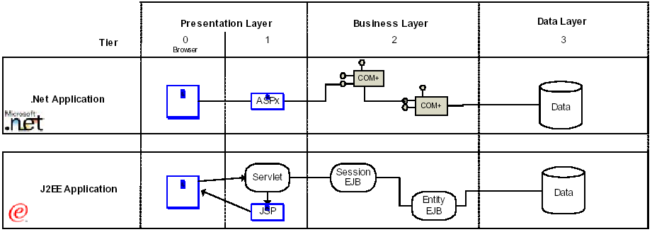
Typical N-tier application architecture

Slide 30
.NET and Java: application platforms
.NET
  The .NET Framework
Java
  Java application servers
  Products include:
    IBM WebSphere Application Server
    BEA WebLogic Application Server
    Sun iPlanet Application Server
    Oracle Application Server
    Many others

Slide 31
.NET vs. Java: standard libraries
.NET Framework class library
  Defined by Microsoft
  Somewhat Windows-oriented
  Organized into a hierarchy of namespaces
J2SE, J2EE
  Defined by Sun and the Java Community Process
  Not bound to any operating system
  Defined as packages and interfaces

Slide 32
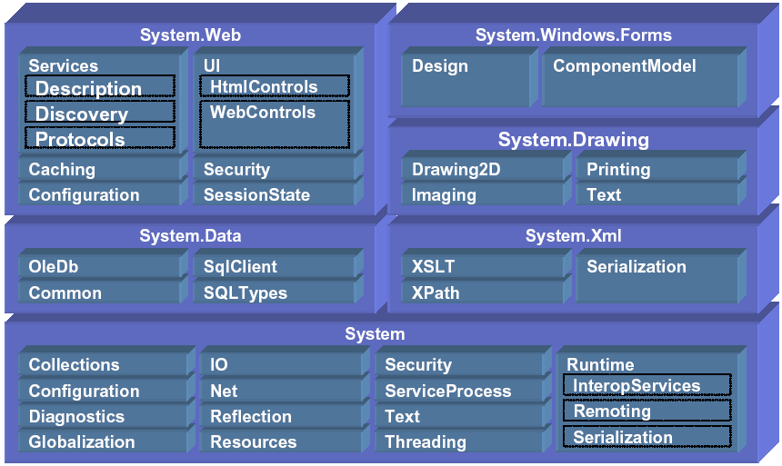
Class Libraries

Slide 33
.NET Class Library
IO
GUI Programming
System Information
Collections
Components
Application Configuration
Connecting to Databases (ADO.NET)
Tracing and Logging
Manipulating Images/Graphics

Slide 34
Class Library
Interoperability with COM
Globalization and Internationalization
Network Programming with Sockets
Remoting
Serialization
XML
Security and Cryptography
Threading
Web Services

Slide 35
Thanks…
This presentation available at:
www.cse.lehigh.edu/~glennb/oose/Csharp_dotNET.ppt
Questions?
murat@lehigh.edu (Murat Ganiz)

