Slide 1
C# Threads
Jim Fawcett
CSE681 – Software Modeling and Analysis
Fall 2005

Slide 2
Thread Class
Every Win32 thread is passed a function to run when created.
  When the thread returns from the function it terminates.
In C#, Threads are managed by the System.Threading.Thread class.
  C# threads are passed a static or instance function of some C# class using a standard delegate of type ThreadStart.

Slide 3
Starting C# Threads
Thread thread =
new Thread(new ThreadStart(ThreadFunc));
thread.Start();
ThreadFunc can be:
  Static or instance member of the class instance that created the thread
  Static or instance member of some other class, e.g.:
  ThreadStart(SomeClass.aStaticFunction);
  ThreadStart(someClassInstance.aNonStaticFunction);

Slide 4
Thread States
A thread that has been started, but not yet terminated can be in one of the following states:
  Running
  Waiting to run
  Suspended
  Blocked

Slide 5
Thread Properties
IsBackground – get, set
  Process does not end until all Foreground threads have ended.
  Background threads are terminated when application ends.
CurrentThread – get, static
  Returns thread reference to calling thread
IsAlive – get
  Has thread started but not terminated?
Priority – get, set
  Highest, AboveNormal, Normal, BelowNormal, Lowest
ThreadState – get
  Unstarted, Running, Suspended, Stopped, WaitSleepJoin, ..

Slide 6
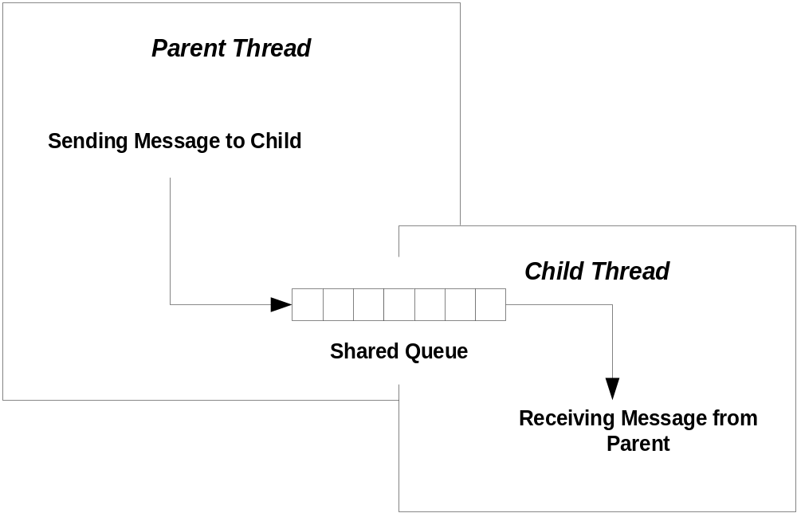
Sharing Resources
A child thread often needs to communciate with its parent thread. It does this via some shared resource, like a queue.

Slide 7
Synchronization
When two or more threads share a common resource access needs to be serialized - a process called synchronization.
  Consider the shared queue on the previous slide. Should the parent start to enqueue an element in an empty queue, but have its time-slice expire before finishing, the queues links are in an undefined state.
  Now, if the child thread wakes up, and attempts to dequeue an element the result is undefined.

Slide 8
Synchronization with C# Lock
// send messages to child thread
string msg = "";
for(int i=0; i<50; ++i)
{
msg = "message #" + i.ToString();
Console.Write("\n Sending {0},",msg);
// Enqueuing changes links so must lock
lock(demo.threadQ) { demo.threadQ.Enqueue(msg); }
// control writer speed - twice as fast as reader
Thread.Sleep(50);
}
lock(demo.threadQ) { demo.threadQ.Enqueue("end"); }
child.Join();
Console.Write(
"\n\n child thread state = {0}\n\n",child.ThreadState.ToString()
);

Slide 9
Demonstration Program
QueuedMessages folder
  Illustrates communication between parent and child threads using a queue.
  Also illustrates use of C# lock operation.

Slide 10
Other Locking Mechanisms
The .Net Threading Library also provides:
  Monitor
    Locks an object, like C# lock, but provides more control.
  Interlocked
    Provides atomic operations on 32 bit and 64 bit data types, e.g., ints, longs, pointers.
  Mutex
    Guards a region of code.
    Can synchronize across process boundaries.
  AutoResetEvent and WaitOne
    Allows fine-grained control of the sequencing of thread operations.
  ReaderWriterLock
    Locks only when writing, allowing free reads.

Slide 11
Locking Certain Collections
ArrayList, Hashtable, Queue, Stack, and other collections provide Synchronized() function, supporting high performance locking.
ArrayList unsync = new ArrayList();
ArrayList sync = ArrayList.Synchronized(unsynch);
Your code needs no lock constructs with sync.

Slide 12
Method Decoration
Methods can be decorated with a MethodImpl attribute, synchronizing access much like a Win32 critical section.
[MethodImpl (MethodImplOptions.Synchronized)]
string myMethod(string input)
{
…
}
Note that this synchronizes a region of code, while lock and Monitor synchronize objects.

Slide 13
WinForms and Worker Threads
A UI thread is a thread that creates a window. A worker thread is a thread spawned by a UI thread to do work in the background while the UI thread services UI messages.
A worker thread must never access UI functions directly. It accesses them through Form’s Invoke, BeginInvoke, and EndInvoke functions, passing a delegate as an argument.

Slide 14
BeginInvoke Example
for (i = 1; i <= 25; i++)
{
s = "Step number " + i.ToString() + " executed";
Thread.Sleep(400);
// Make asynchronous call to main form.
// MainForm.AddString function runs in main thread
// because we activated the delegate through form's
// Invoke (synchronous) or BeginInvoke (asynchronous) functions.
// To make synchronous call use Invoke.
m_form.BeginInvoke(m_form.m_DelegateAddString, new Object[] {s});
// check if thread is cancelled
if ( m_EventStop.WaitOne(0, true) )
{
// clean-up operations may be placed here
// ...
// inform main thread that this thread stopped
m_EventStopped.Set();
return;
}
}
Delegate arguments passed as an array of objects

Slide 15
Demonstration Programs
ProcessDemo and ProcessDemoWin32
  Illustrates creating a child process
QueuedMessages
  Illustrates communication between threads using queues and the C# lock operation.
FormInvokeDemo folder
  A more interesting demonstration of the above.
WorkerThread folder
  Simple Demonstration of UI and Worker thread communication using Form.Invoke(…)
ThreadPoolDemo folder
  Illustrates how to use the ThreadPool to run functions

Slide 16
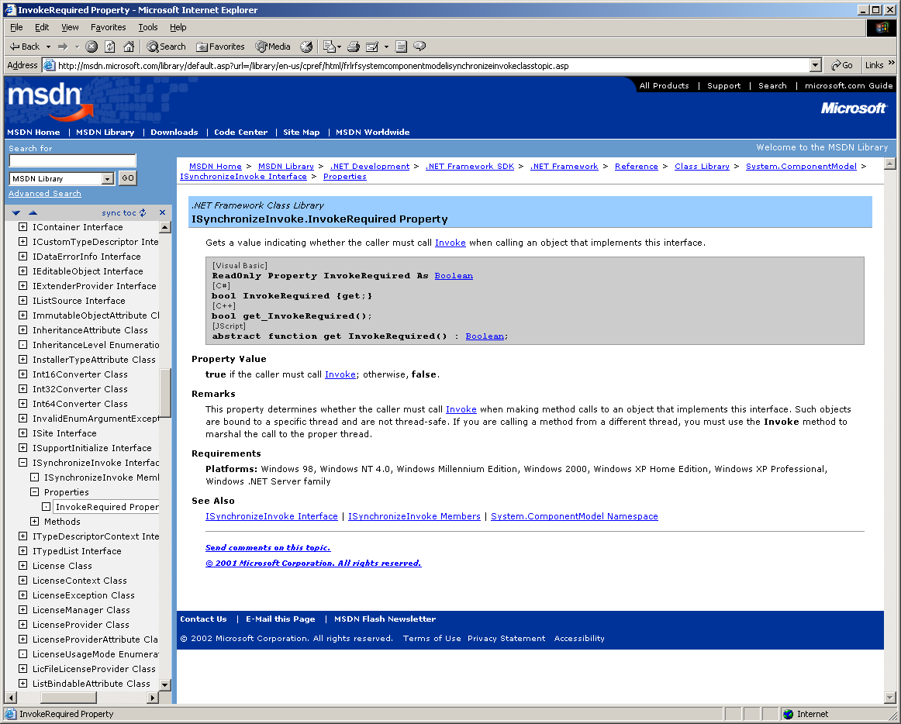

Slide 17
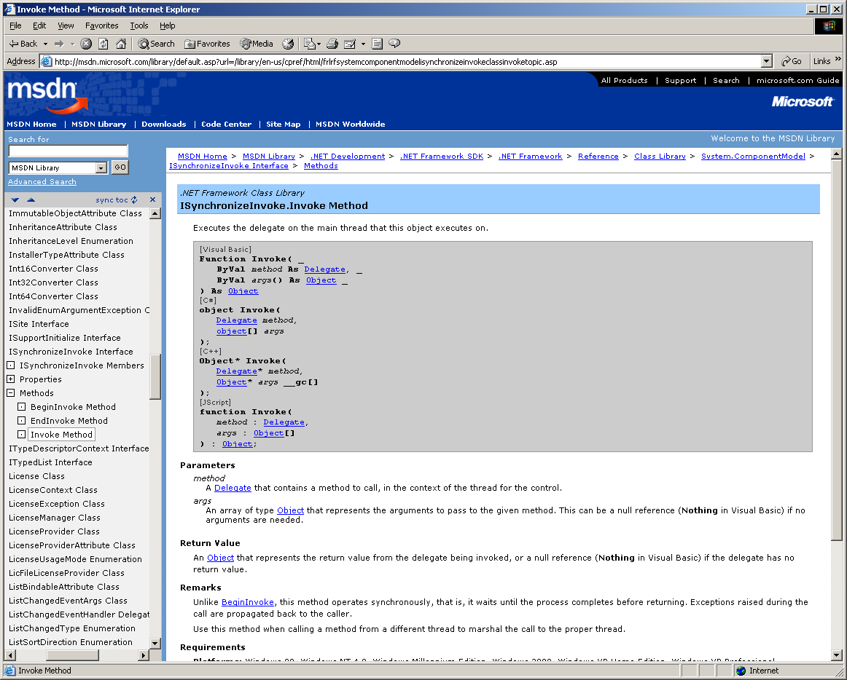

Slide 18
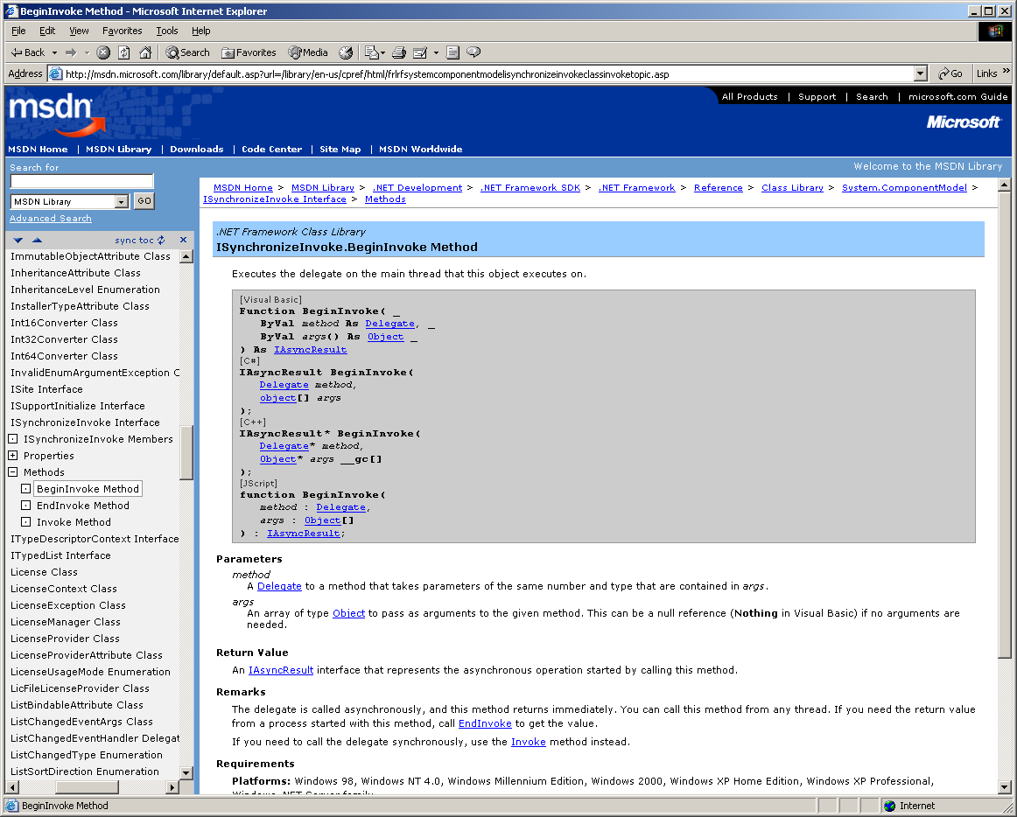

Slide 19
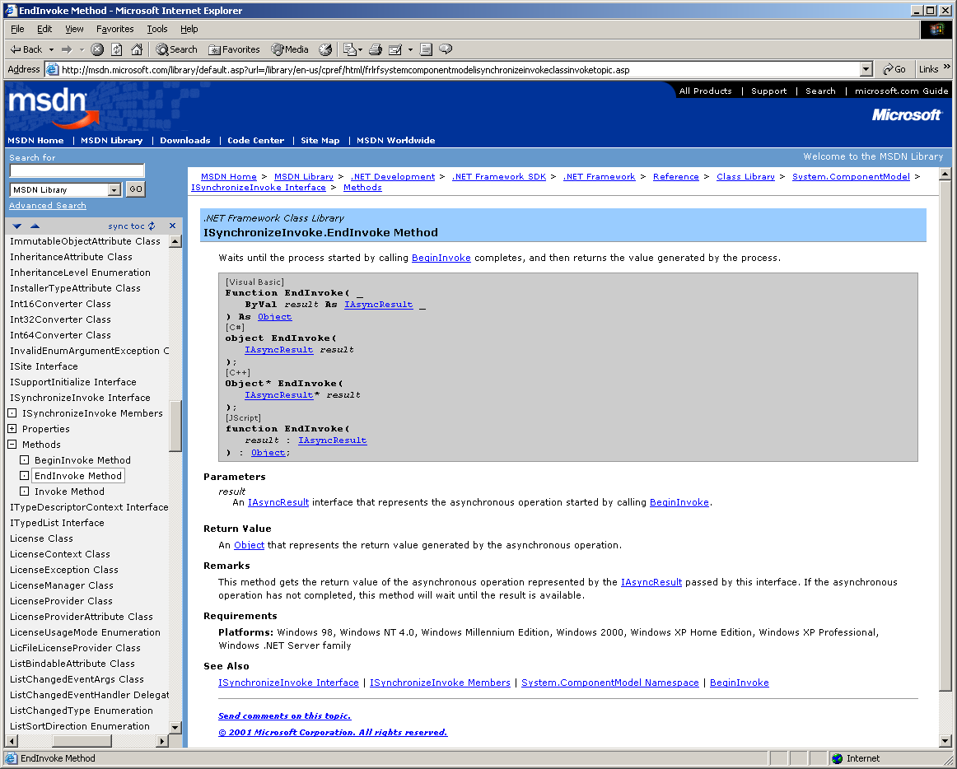

Slide 20
End of Presentation

