Slide 1
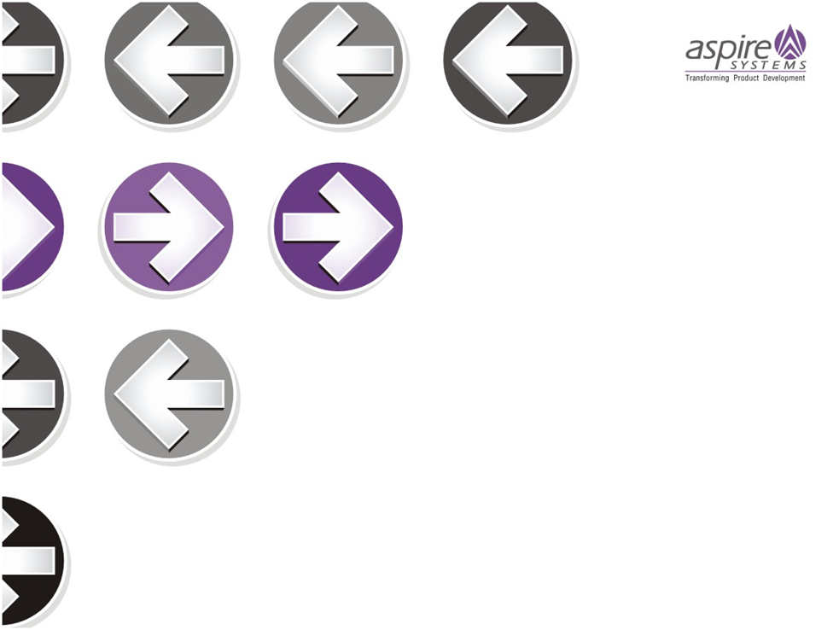
Knockout Js

Slide 2

Knockout ??

Slide 3
Agenda
What is Knockout js ?
MVVM Design Pattern
Features
  Declarative Binding
  Dependency Tracking
  Templating
  Extending
Why and When ?
Knockout vs. jQuery
References

Slide 4
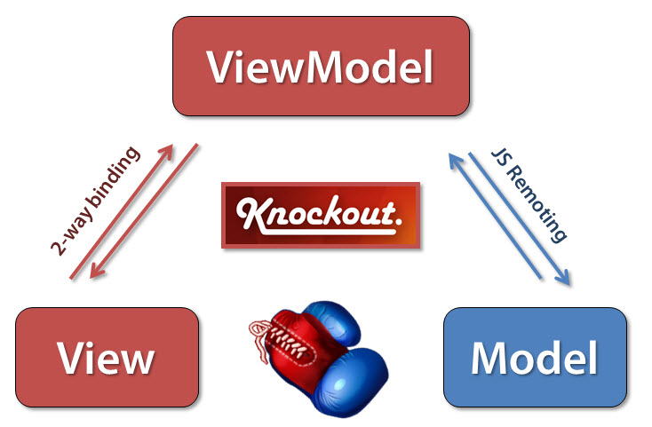
What is Knockout js ?
JavaScript library
bind html elements against data model
two way binding
create rich, responsive display and editor interfaces with a clean underlying data model
clean underlying data model ?
  a clear separation between domain data, view components and data to be displayed

Slide 5
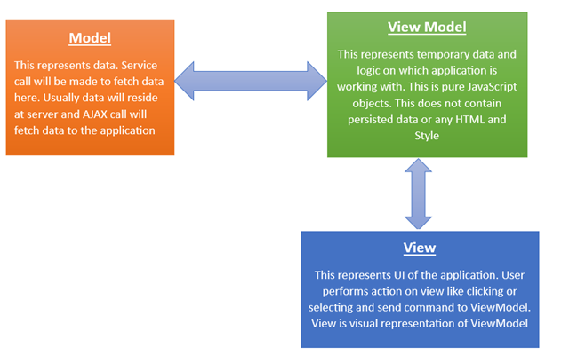
MVVM Design Pattern

Slide 6


Observables and Subscribe
Observables
  How does KO know when parts of your view model change?
  notify subscribers about changes
  myViewModel.personName() will return 'Bob’
  data-bind="text: personName"
Subscribing

Slide 7
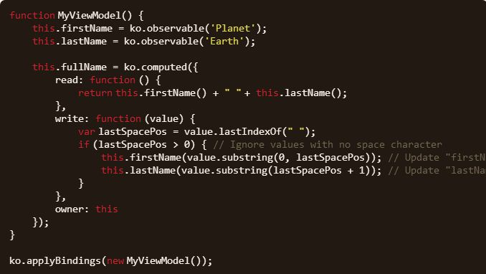
Writable Computed Observables
Is Computed Observables are read only ?

Slide 8
How dependency tracking works ?
invoke the evaluator function to get the initial value
keep log of any observables that evaluator reads the value of
set up subscriptions to each of the observables logged
subscription callback causes the evaluator to run again, looping the whole process back to step 1
notify any subscribers about the new value of the computed observable.

Slide 9
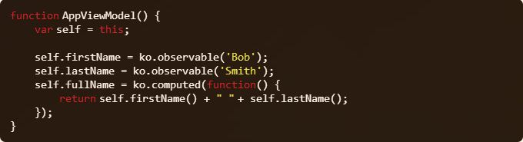
Managing ‘this’ & UnwrapObservable
noticed ‘this’ in the earlier examples ?
What would happen to ‘this’ inside an even handler or ajax success handler?
UnwrapObservable
  ko.utils.unwrapObservable()

Slide 10
Questions
What would happen if I assign a value to a computed observable which doesn’t has ‘write’ method
What would happen if there exist a cycle in computed observable i.e. A ia computed observable uses B in turn B is a computed observable uses A
Dependent observables

Slide 11
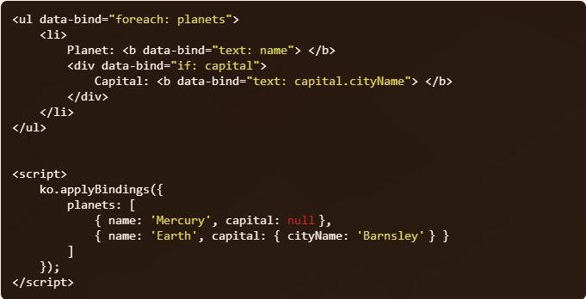
Control flow Bindings
If
  the if binding really is vital to make code work properly
If Not

Slide 12
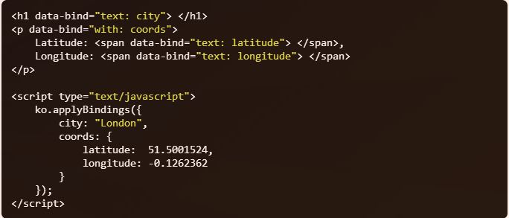
Control flow Bindings
With
  dynamically add or remove descendant elements depending on whether the associated value is null/undefined or not

Slide 13
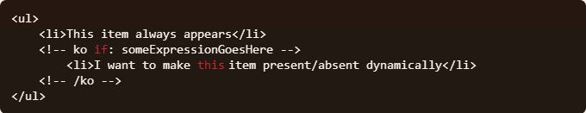
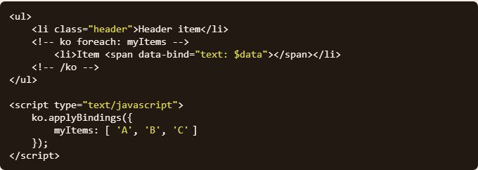
What if I don’t have a Container ?
IF
For Each

Slide 14
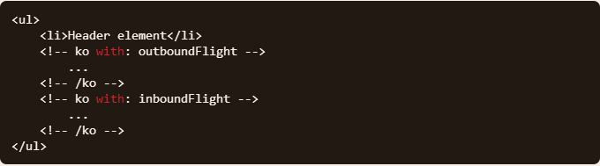
What if I don’t have a Container ?
With
<!-- ko --> and <!-- /ko --> comments act as start/end markers

Slide 15

Binding Context
Knockout creates and manages a hierarchy of binding contexts
$parent
  the one immediately outside the current context
$parents
  an array representing all of the parent view models
  $parents[0] - parent context
  $parents[1] - grandparent context
  $parents[2] - great-grandparent context
$root
  the topmost parent context
$data
  don’t want to reference a property on the viewmodel, but instead want to reference the viewmodel itself ?

Slide 16
Binding Context
$index
  index of the current array entry being rendered by a foreach binding
  Zero based
$parentContext.$index
  to access the index value of an outer foreach item from an inner context
$element
  to access an attribute of the current element

Slide 17
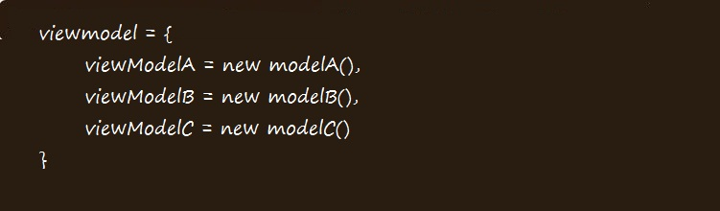
Can have Multiple View models ?
Yes, it is possible
two ways to achieve this,

Slide 18
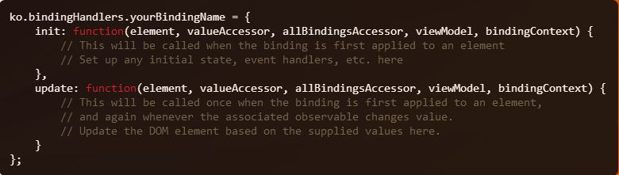
Can you create your own binding ?
Yes, you can.

Slide 19
What are all those parameters ?
element
  The DOM element involved in this binding
valueAccessor
  function to get the current model property
allBindingsAccessor
  function to get all the model properties
viewModel
  view model object
  inside a with: person ,viewModel will be set to person.
bindingContext
  includes properties including $parent, $parents, and $root
What about events responding to DOM actions ?

Slide 20
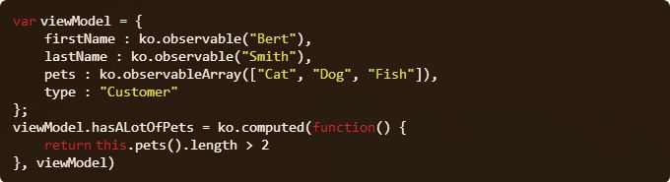
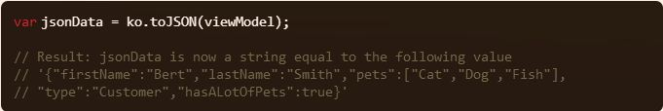
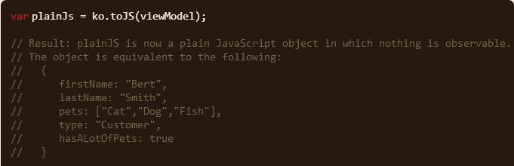
How do we communicate with Model ?
JSON – a convenient way

Slide 21
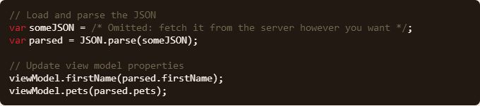
How to update view model using JSON ?
json2.js for IE 7 or earlier
The mapping plug-in

Slide 22
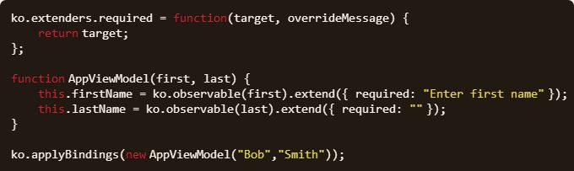
Extending observables
wish to add additional functionality to an observable ?

Slide 23
When , what ?
Computed Observables
Writable Computed Observables
Extending Observables
Custom Bindings

Slide 24
Features of Knockout Js
Declarative Binding
  bind the elements of UI to the data model in a simple and convenient way
  using JavaScript to manipulates DOM ?
    what will happen if you later change the DOM hierarchy or element IDs ?
  data-bind attribute
Dependency Tracking
  updates the right parts of your UI whenever your data model changes
  achieved by the two way bindings
  observables

Slide 25
Features of Knockout Js
Templating
  application becomes more complex ?
  Native templating
    does not require any library other than Knockout itself
    underpins foreach, if, with, and other control flow bindings
  String-based templating
    way to connect Knockout to a third-party template engine
    works only when you reference a suitable template engine, such as jQuery.tmpl or the others.
    pass model values to the external template engine and inject the resulting markup string into your document.
Extensible
  Custom binding
  Extending observables

Slide 26
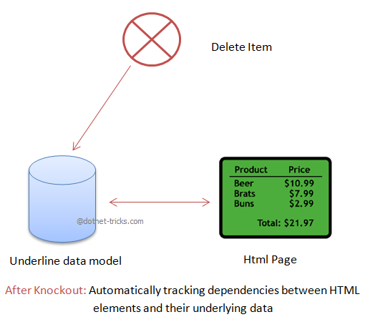
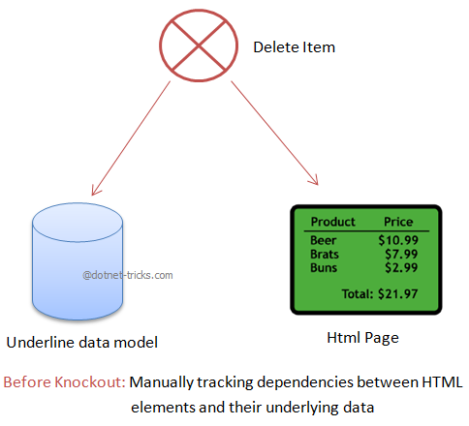
Why and When Knockout js ?
consider the example,
  “displaying a list of items, stating the number of items in that list, and want to enable an ‘Add’ button only when there are fewer than 5 items” (or) “delete an item from the list and recalculate total price”

Slide 27
Knockout vs. jQuery & Browser Support
Knockout vs. jQuery
  not a replacement for jQuery
  doesn’t attempt to provide animation, generic event handling, or AJAX functionality
  high-level way to link a data model to a UI
  Works along with jQuery
Browser Support
  Mozilla Firefox 2.0+
  Google Chrome (tested on version 5 for Windows and Mac)
  Microsoft Internet Explorer 6, 7, 8, 9, 10
  Apple Safari (tested on Windows Safari version 5, Mac OS X Safari version 3.1.2)
  Opera 10 for Windows

Slide 28
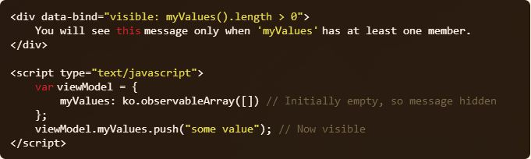
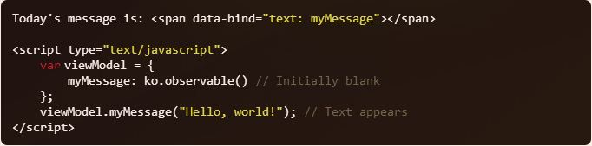
Text and Appearance Bindings
Visible
Text

Slide 29
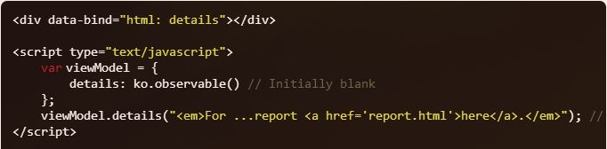
Text and Appearance Bindings
Html
Css

Slide 30
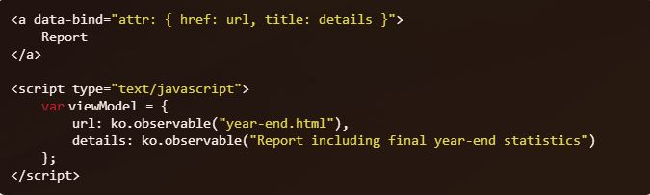
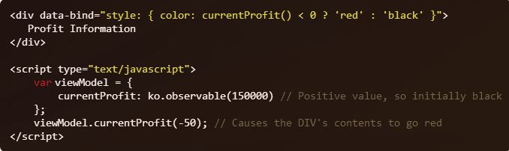
Text and Appearance Bindings
Attr
Style

Slide 31
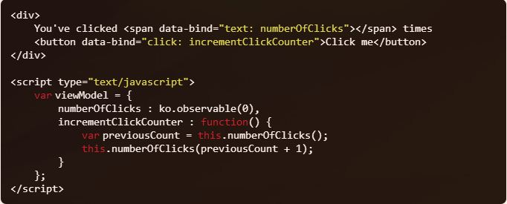
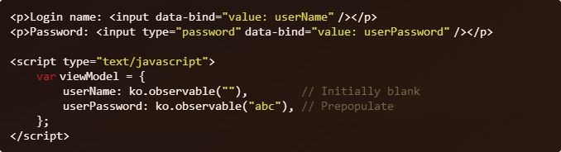
Working with Form Fields
Click
Value

Slide 32
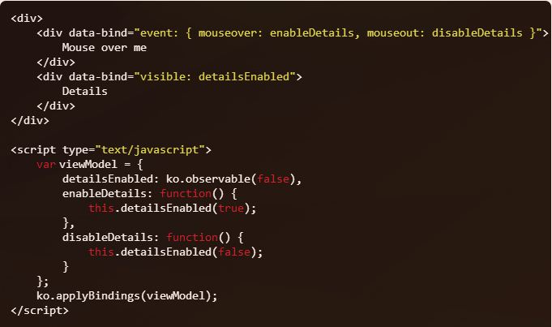
Working with Form Fields
Event

Slide 33
References
http://www.dotnet-tricks.com/Tutorial/knockout/FDM8160313-What-is-Knockout.js-and-how-it-is-different-from-jQuery.html
http://knockoutjs.com/documentation/introduction.html
http://knockoutjs.com/documentation/*.html
http://www.knockmeout.net/2011/07/another-look-at-custom-bindings-for.html
http://www.knockmeout.net/2011/06/10-things-to-know-about-knockoutjs-on.html
http://www.knockmeout.net/2011/03/reacting-to-changes-in-knockoutjs.html

Slide 34


