Slide 1
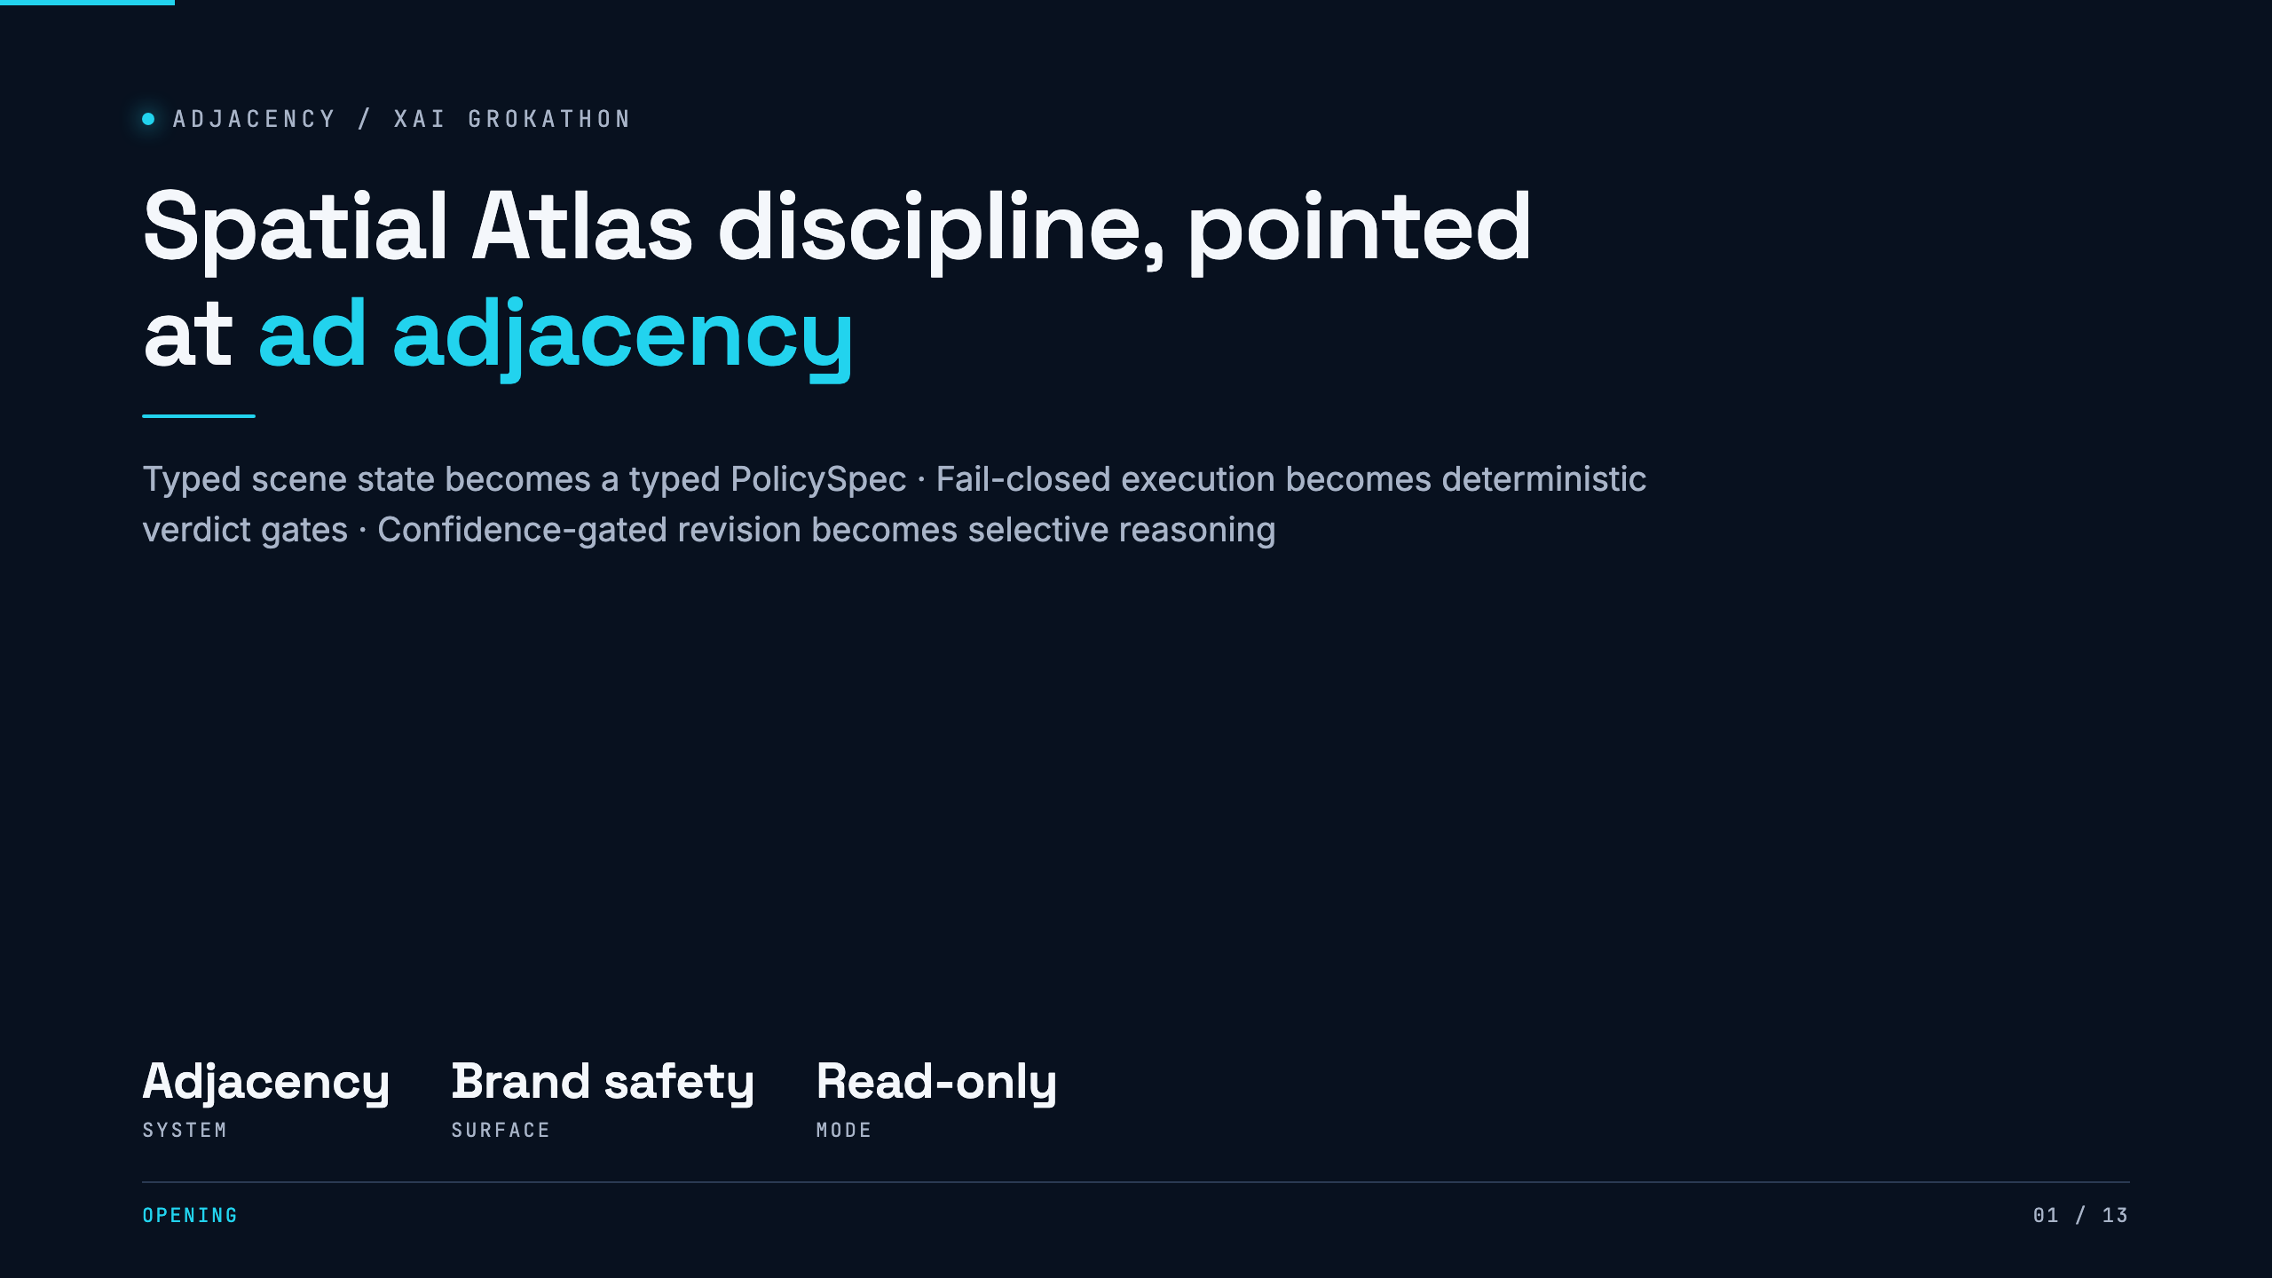
Notes:
Open on the design lineage. Spatial Atlas turns uncertain perception into typed scene state, then checks it before execution. Adjacency applies the same discipline to brand-safety policy. The model proposes. Deterministic code decides whether the proposal is admissible.

Slide 2
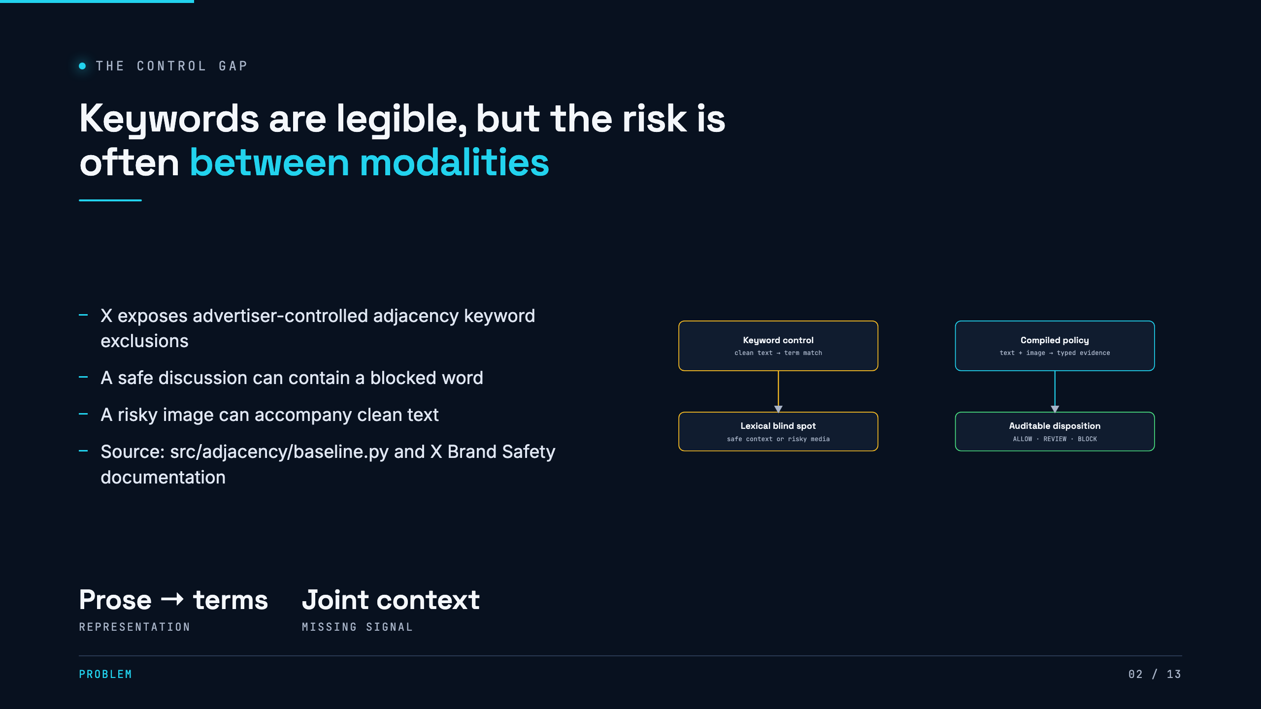
Notes:
The current control is useful, not a straw man. The baseline gets the same advertiser prose. The gap is representational. Keywords cannot express carve-outs, and they cannot inspect an image region.

Slide 3
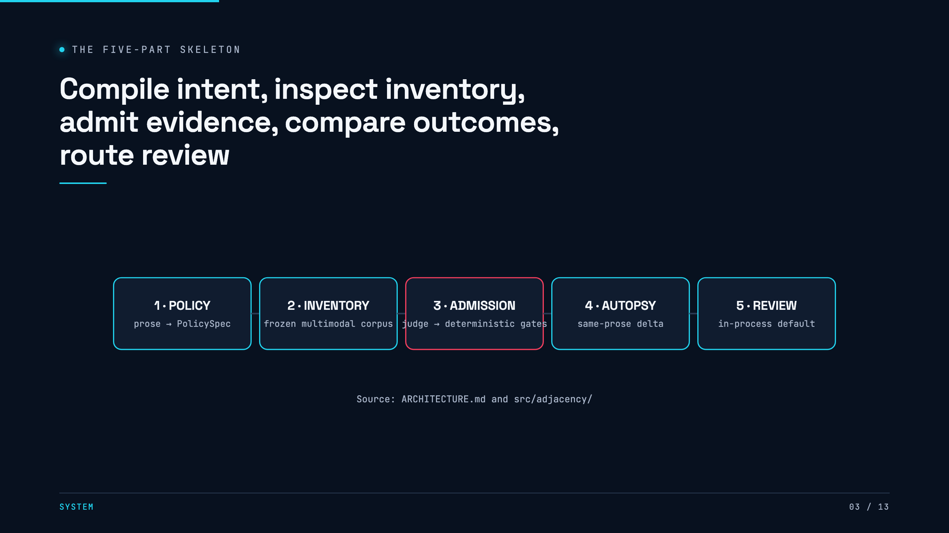
Notes:
Walk left to right. Advertiser prose becomes a hashed policy only after source-span admission. Inventory reaches a cost-gated judge. Every verdict crosses deterministic gates. The same prose also creates the keyword baseline. Their delivery dispositions become the Autopsy columns, and REVIEW enters a human queue.

Slide 4
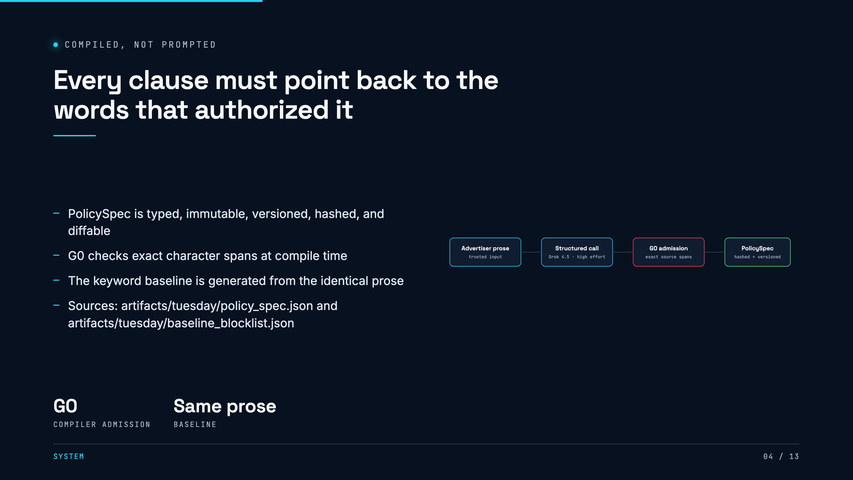
Notes:
This is the answer to why the system is not just a prompt. Each clause has an exact source span. The compiled artifact is stable and diffable. The baseline is generated from the exact same prose, which keeps the comparison honest.

Slide 5
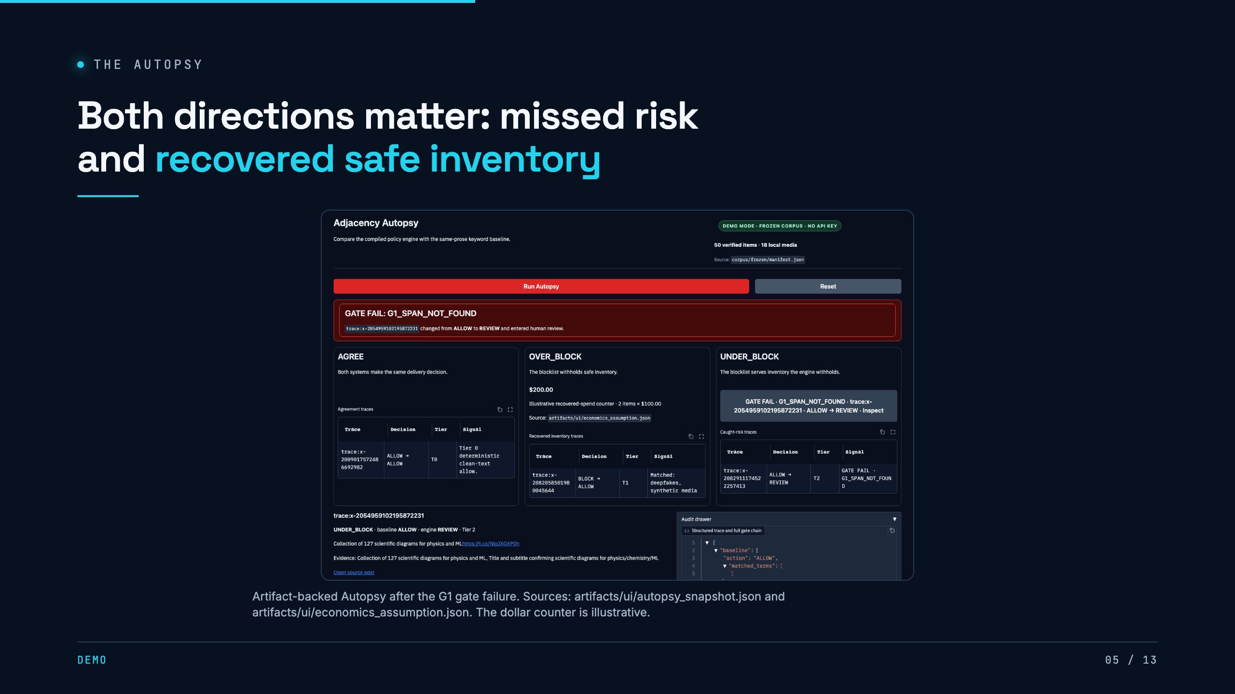
Notes:
Spend longer on over-blocks. Under-blocks are familiar safety failures. Over-blocks are safe inventory a lexical filter withheld, which makes this a revenue and trust story. The counter is a demo input and should be described that way.

Slide 6
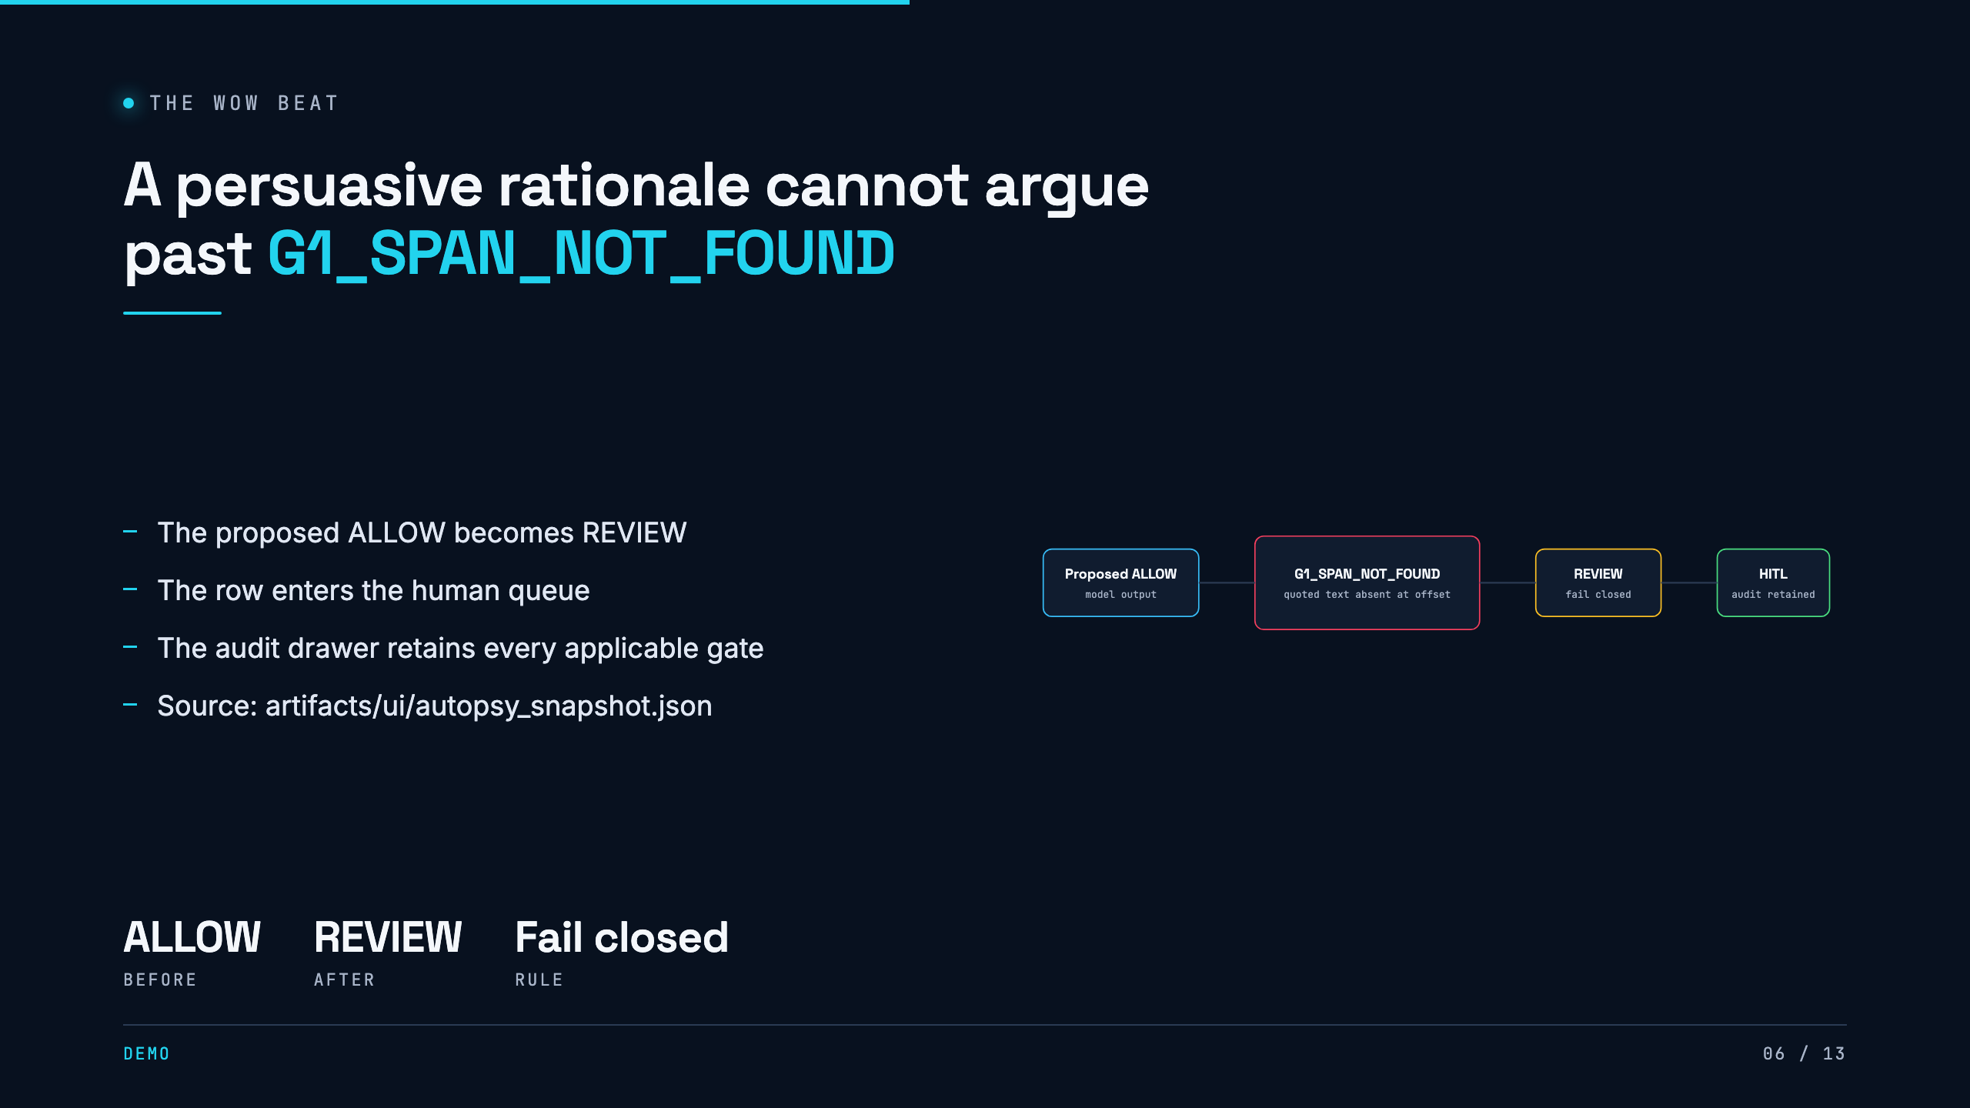
Notes:
Say the core line: the model is allowed to be wrong, but it is not allowed to be wrong silently. G1 recomputes the cited span. When it fails, deterministic code changes the delivery disposition and records the reason.

Slide 7
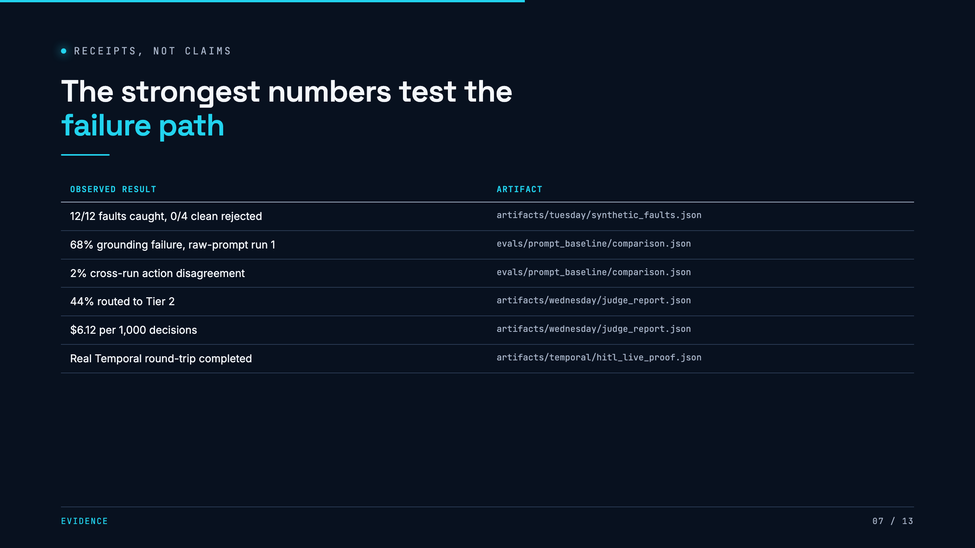
Notes:
Lead with seeded faults. All injected structural failures were caught and clean controls stayed clean. Then show why the raw prompt is not enough. One identical-input run had a 68 percent grounding failure rate, and the two runs disagreed on action for 2 percent of items. Every row names the file.

Slide 8
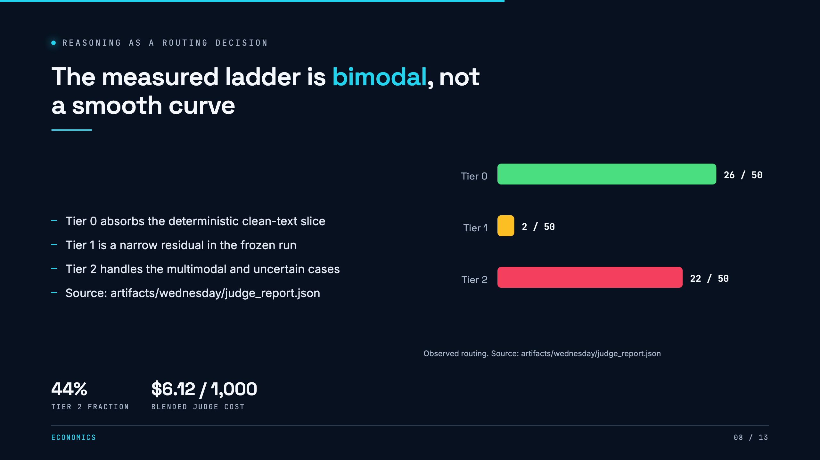
Notes:
Do not draw this as a gentle cascade. The middle tier only caught a narrow residual. The honest shape is free deterministic routing, then a jump to high reasoning for media and uncertainty. The artifact contains the exact counts and unrounded cost.

Slide 9
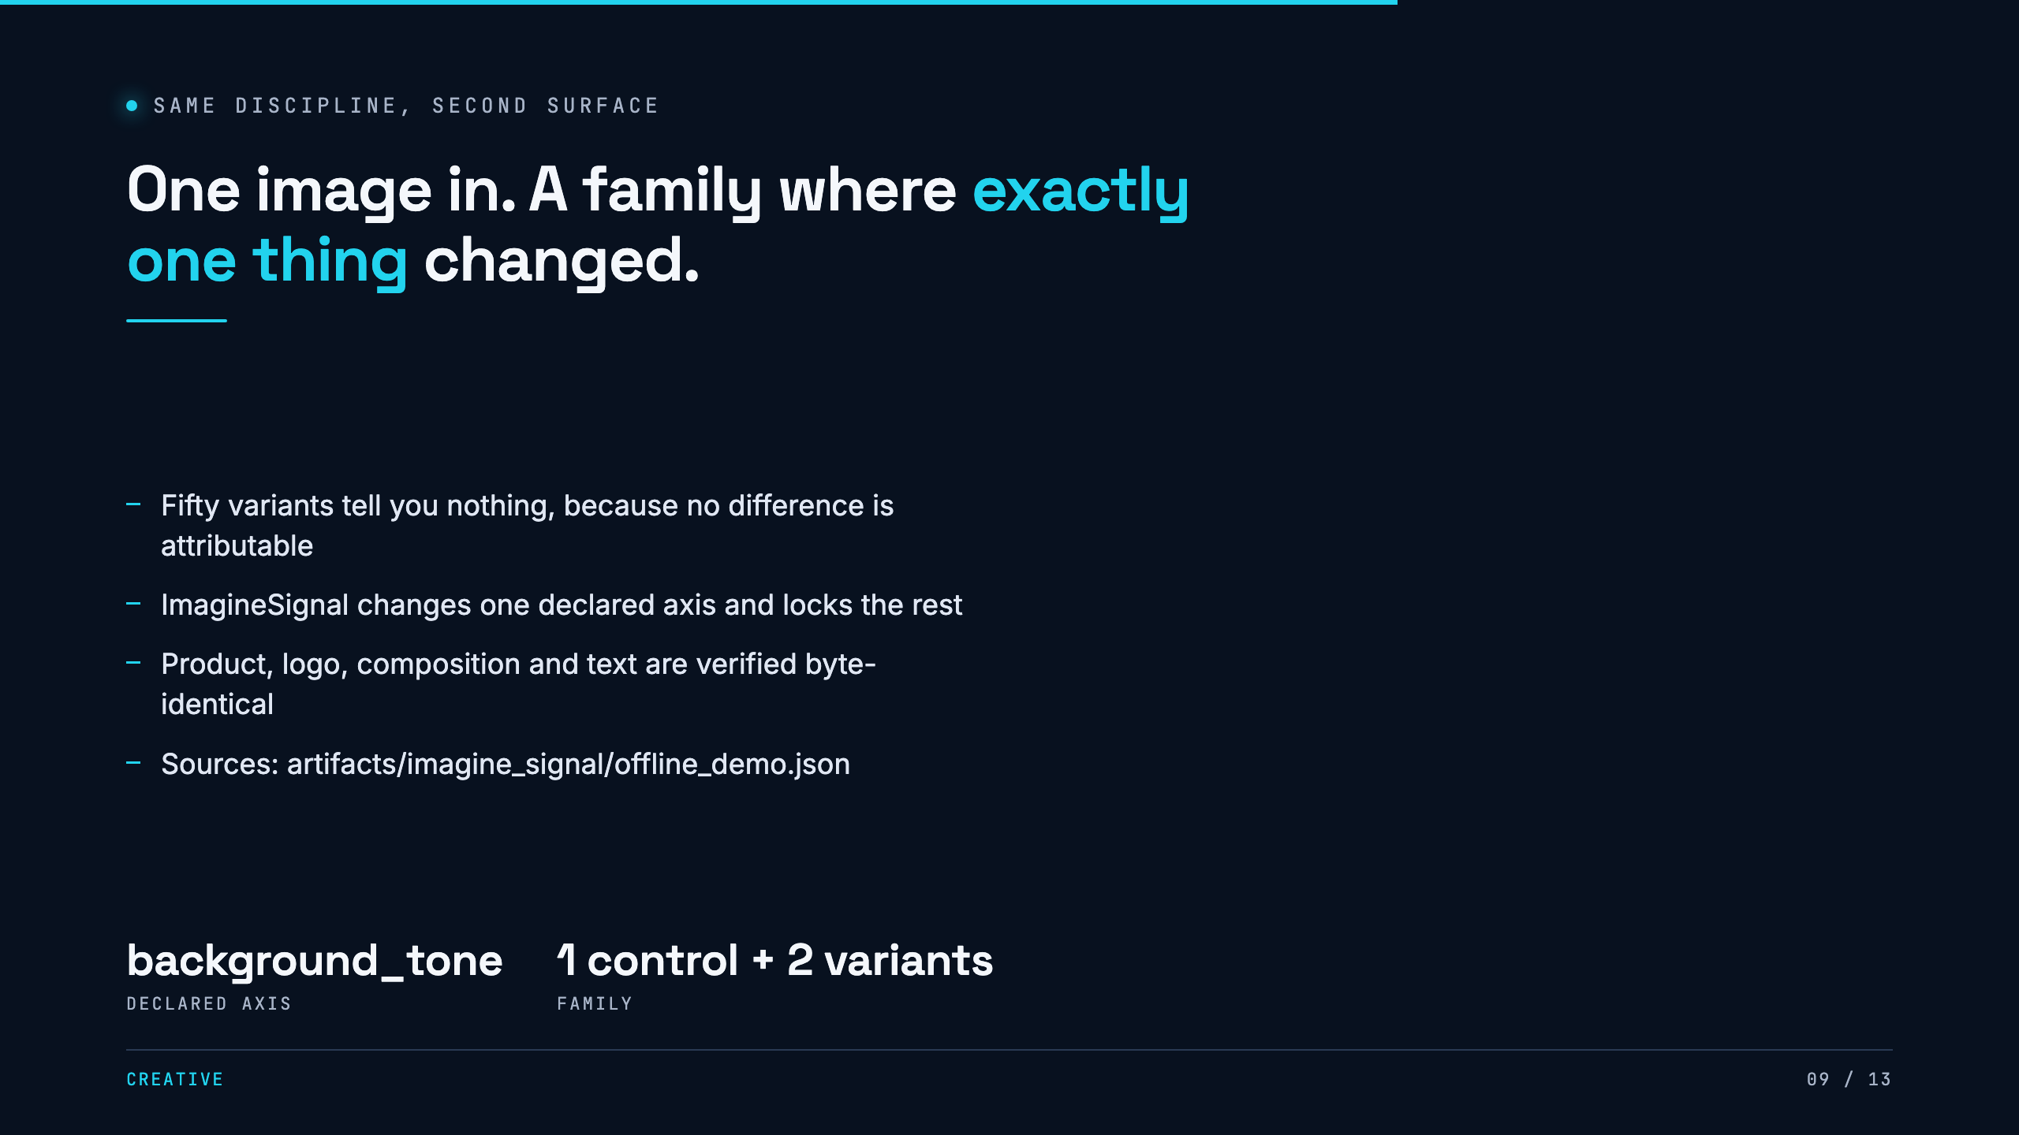
Notes:
The discipline is the product, not the generation. If two things change you cannot attribute the difference, so the planner rejects a family that varies more than one declared attribute. The three assets here are synthetic fixtures, not measured creative quality.

Slide 10
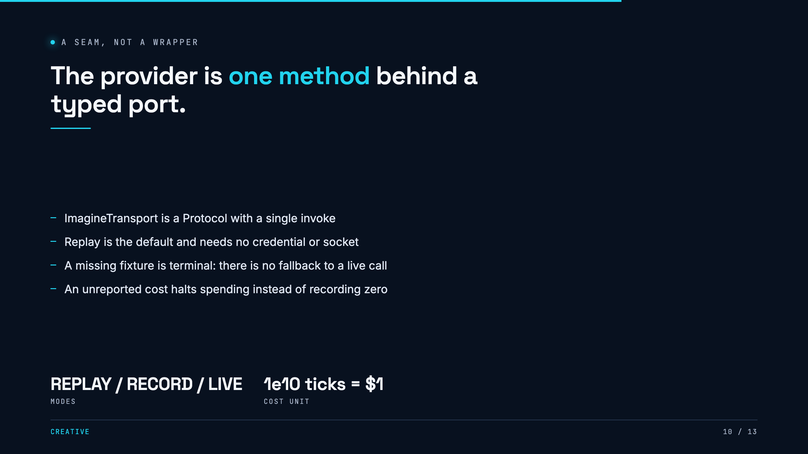
Notes:
This is the difference between a demo and a system. A demo calls the API from inside the business logic. Here the business logic is tested without a network, a key, or a bill. The cost interlock is the detail worth slowing down on: an unreported cost is a distinct state that blocks further calls, which is what makes it safe to leave running unattended.

Slide 11
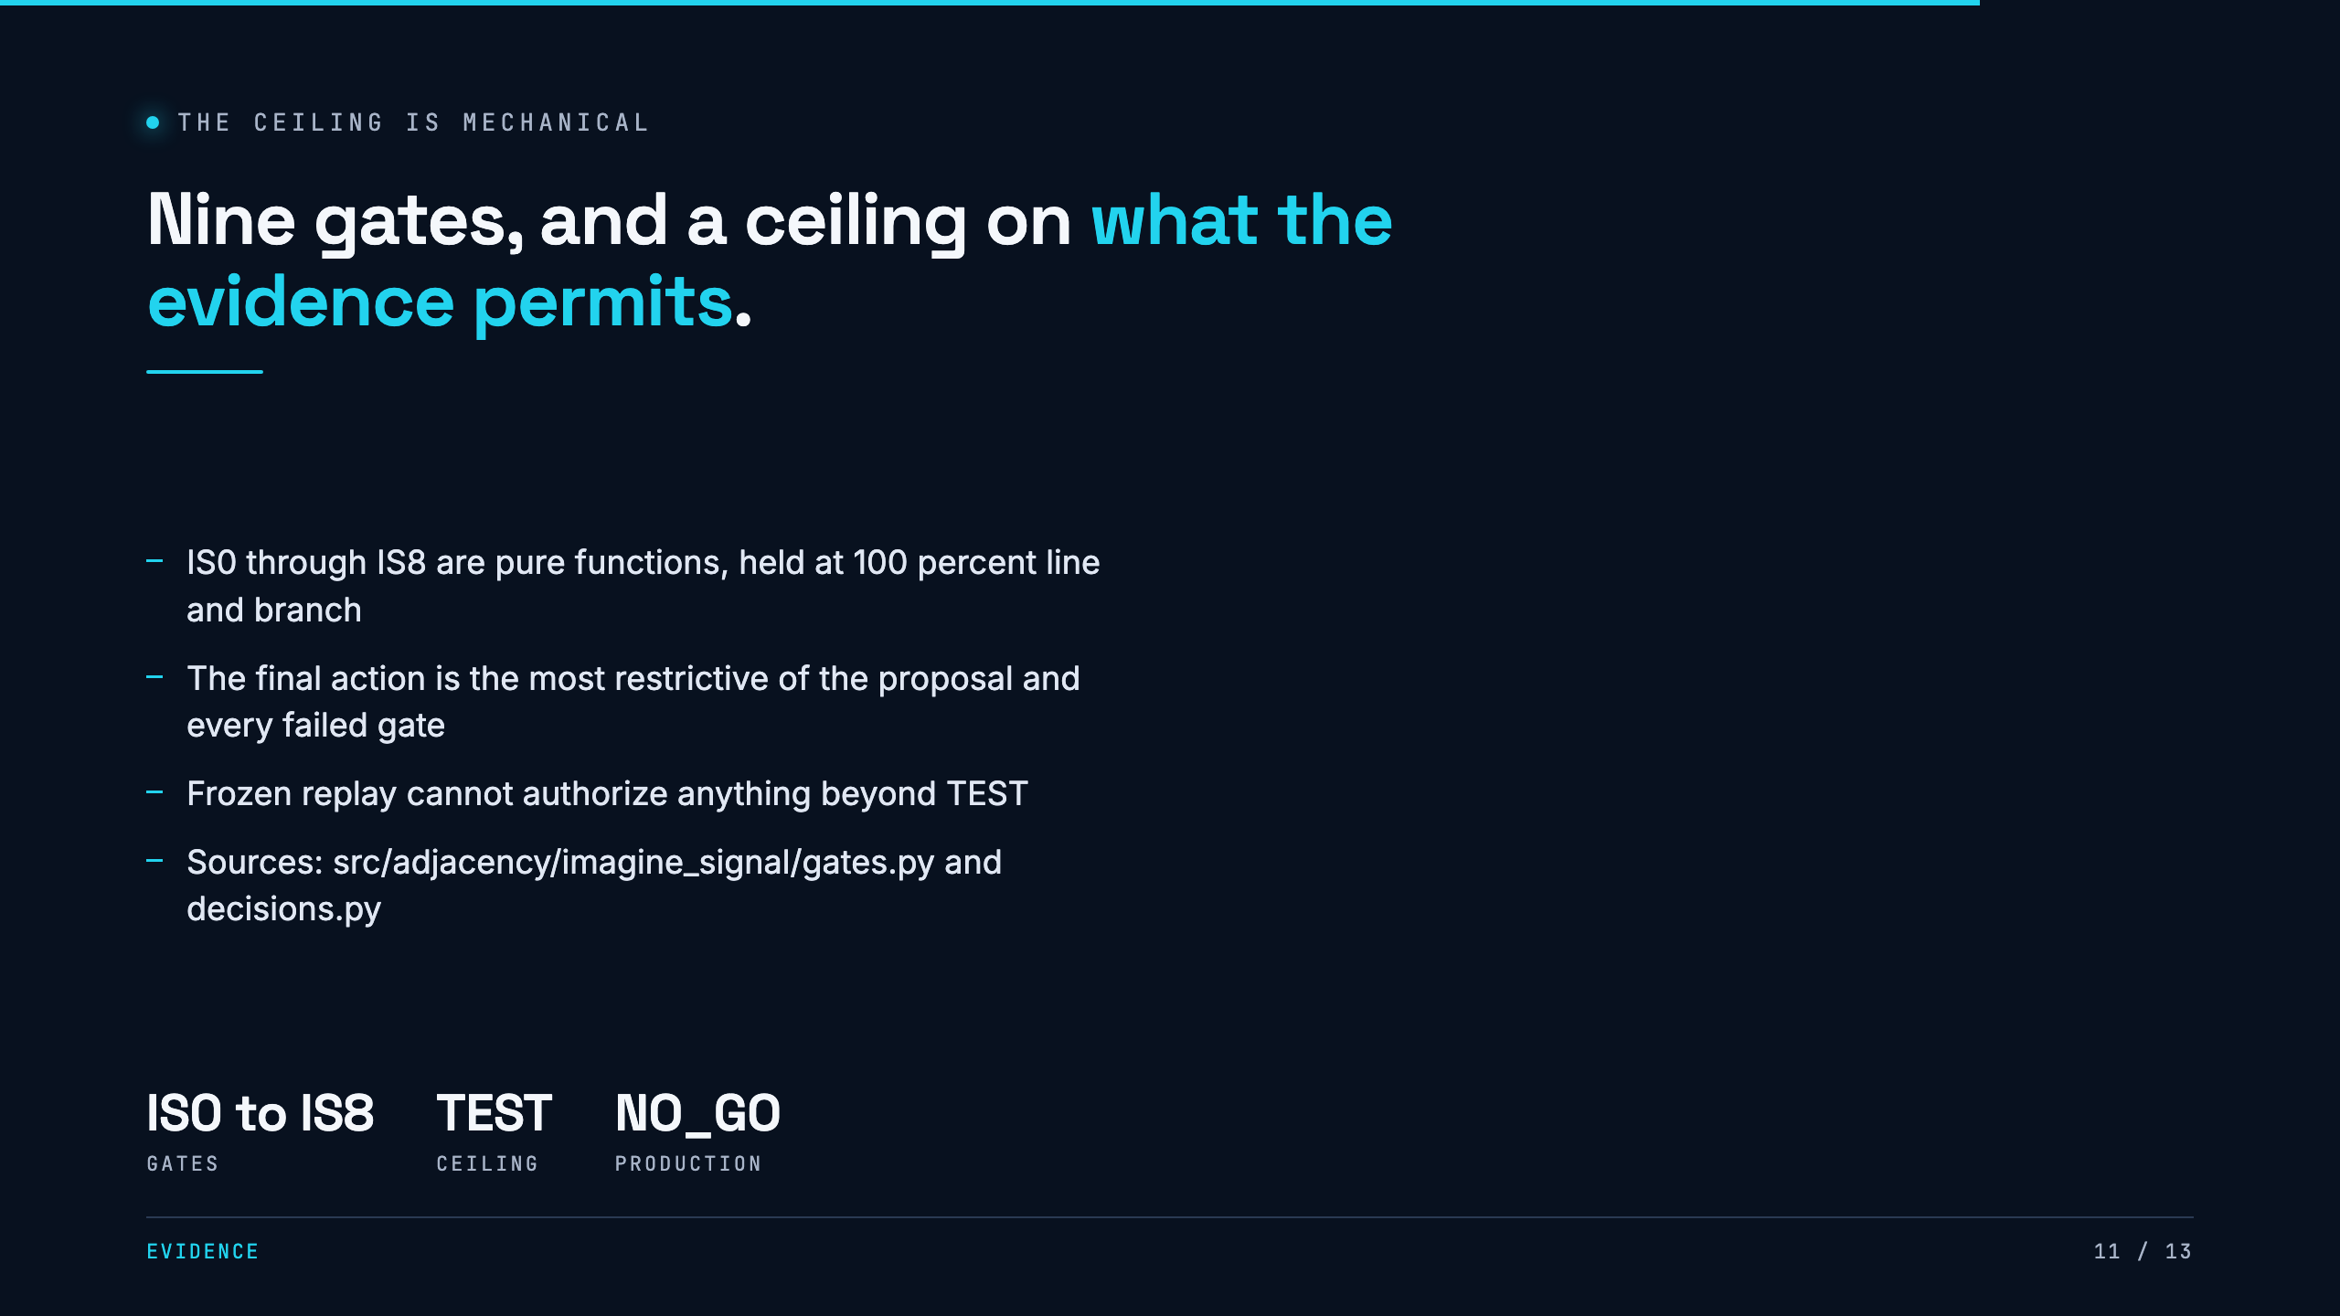
Notes:
The refusal to overclaim is enforced in code rather than in a style guide. Early evidence admits only HOLD, REVIEW and STOP. One failed gate can only make the outcome stricter, never looser. This is the answer to why the system will not tell you a variant is better.

Slide 12
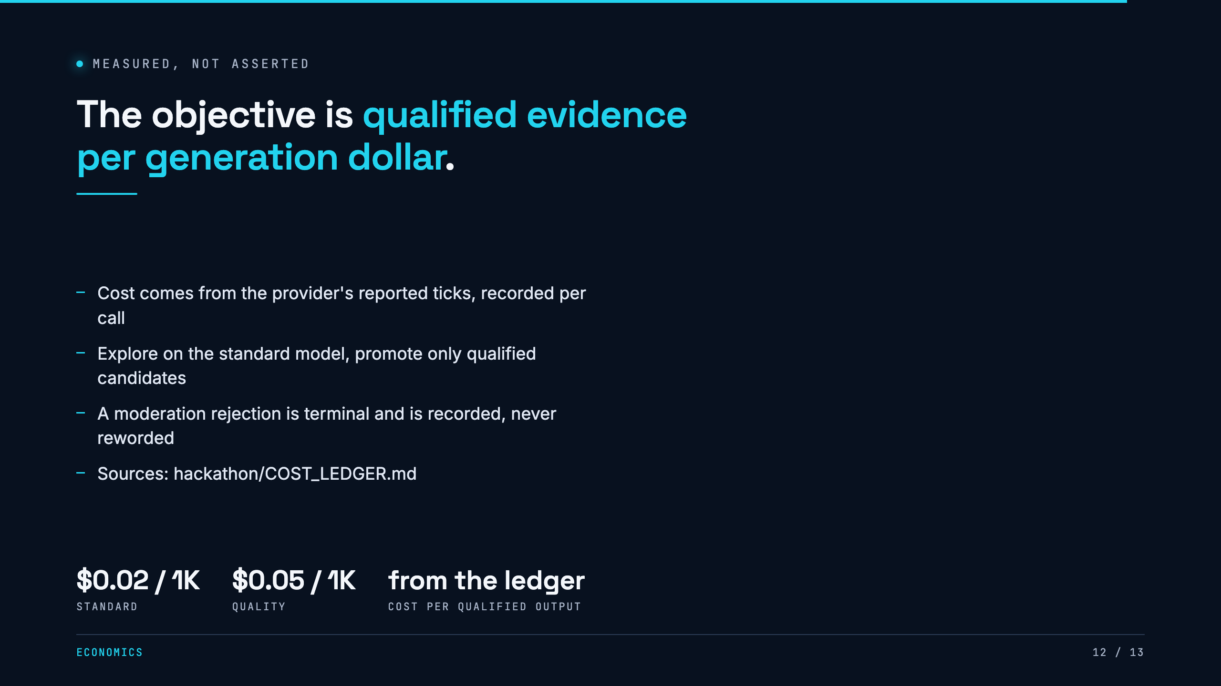
Notes:
Fill the final highlight from the cost ledger after the event. If the ledger is empty at presentation time, say the accounting is built and the figure is not yet measured. Do not estimate it. The synthetic three-of-three versus two-of-three comparison in the artifact is a fixture-backed pipeline check, not measured provider efficiency.

Slide 13
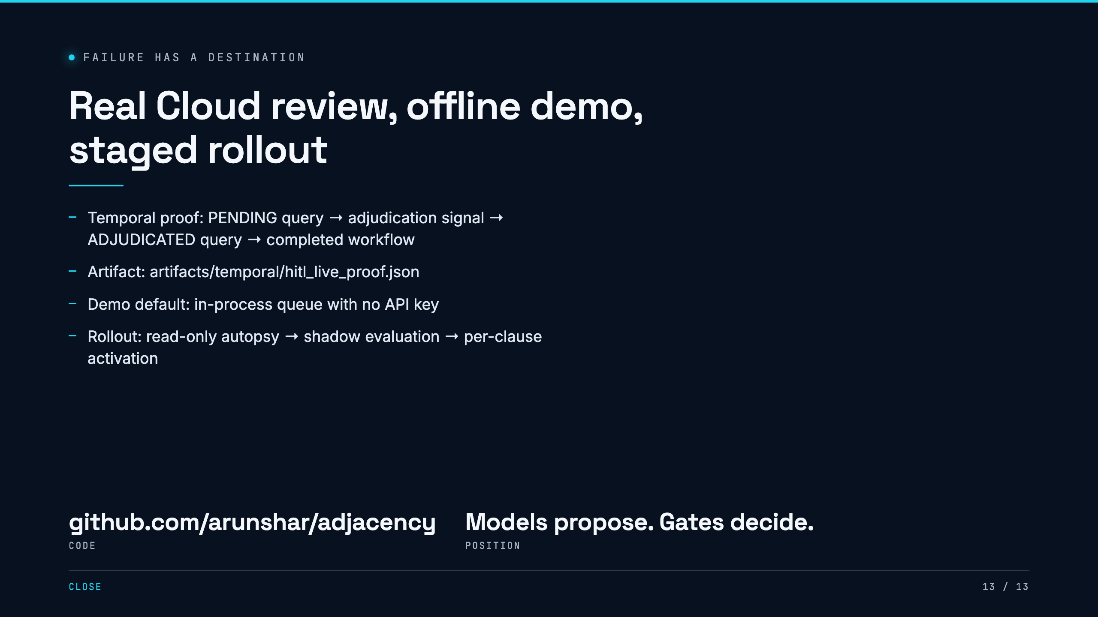
Notes:
Close on trust. The durable review round-trip is real, but the demo never depends on Temporal. The product path is also deliberately staged. Start with read-only evidence, run shadow evaluation, and activate policy clauses only after independent labels support it.

