Slide 1
Durable Execution Around a Sampler
Temporal for Physics-Checked Inference
Arun Sharma, University of Minnesota, Twin Cities
Notes:
Hello, I am Arun Sharma from the University of Minnesota, Twin Cities. This talk follows a generative model sampler that a Temporal Workflow calls, and it measures what each kind of failure costs on my laptop.

Slide 2
A Worker died 3 seconds in
A test script ended the Worker with SIGKILL.
The replacement Worker was ready in about 5 seconds.
The next attempt still waited for a timeout.
Arun Sharma | Durable Execution Around a Sampler | 2
Mac CPU, demo-scale model, five runs
Notes:
This talk starts with a Worker failure scenario from my tests. A script sent SIGKILL to the Worker, the process that runs my Workflow and Activity code, about 3 seconds after the request started. The Worker died in the middle of a model call, and the script started a replacement after a set delay. It was ready about 5 seconds after the kill. [pause] The retry was not ready that fast. A Heartbeat Timeout is the longest that Temporal waits for a sign of life from a running call. The failure to next attempt had a median of 9.953 seconds, which is consistent with the Heartbeat Timeout of 10 seconds. With no Heartbeat Timeout, it began a median of 117.873 seconds after the kill, which is consistent with a Start-To-Close Timeout of 2 minutes. In both groups, a timeout ended the first attempt before the next attempt could start. Every kill in these runs was a SIGKILL, so I say nothing yet about a graceful shutdown. I chose both timeout settings, so the question is how to choose them.

Slide 3
Four decisions set what failure costs
Retry: The Retry Policy selects another attempt.
Stop: A failure can end further attempts.
Notice: A timeout can end a silent attempt.
Replay: Saved histories test changes to Workflow code.
Arun Sharma | Durable Execution Around a Sampler | 3
Notes:
That question breaks into four decisions, and the rest of the talk takes them in turn. The first decision sets what to retry. A lost Worker deserves another attempt, but a sample that breaks a physics check does not. The second decision sets when to stop retrying a service that remains unavailable. The third sets how fast to notice. A dead Worker sends no message, so the Temporal Service learns about it only through a timeout. The fourth sets what to replay. A saved Event History, which is Temporal's record of a Workflow, can test new Workflow code before it ships. [pause] Each decision comes with a measurement from my laptop, and each measurement needs a stated scope.

Slide 4
What this is, and what it is not
Every run used one Apple M4 Pro laptop CPU.
The demo-scale model uses a 64 by 64 tile.
The model trained briefly on synthetic data.
The Temporal dev server used a local database file.
Each scenario has five runs.
This is a research system, not a commercial production deployment.
Arun Sharma | Durable Execution Around a Sampler | 4
Mac CPU, demo-scale model, five runs
Notes:
These measurements describe a research build on my laptop, and their scope matters before we compare the failure cases. This is a research build that I measured myself, and I have not deployed it anywhere. [pause] Every test ran on one Apple M4 Pro laptop CPU, which reported 14 cores. The model is a demo-scale export with a 64 by 64 tile, base width 32 and two levels, and it has no attention layers. It was trained briefly on synthetic data, so its outputs do not establish climate accuracy. The Temporal dev server, a single local server for development, kept its Event History in a local database file. Each Worker polls the system's one Task Queue for work. Each scenario ran five times, and the timing summaries show medians with their observed ranges. When I say that a Worker died, I mean that a test script killed a Worker process on this laptop. With that scope in place, the next slides can show what each failure cost.

Slide 5
A sampler is a long, checkable call
1500
4
16.130
sampler steps in the standard request
ensemble members in the standard request
median seconds for a baseline call
The physics gate checks the ensemble mean only.
NVR is the negative-value rate, and its limit is 0.
MCE is the mass conservation error, and its limit is 1e-3.
Arun Sharma | Durable Execution Around a Sampler | 5
Mac CPU, demo-scale model, five runs
Notes:
PC-RF is a physics-constrained generative model for climate downscaling. This demo-scale export gives the Workflow a call with measurable runtime and checkable output. The standard request asks the sampler for 1500 steps and 4 ensemble members, and only the invalid-output test used fewer steps. In the five baseline runs with no failure, the model call had a median of 16.130 seconds on this laptop CPU. A retry that reaches the sampler repeats this long call. [pause] The call is also checkable. The model service returns the NVR and MCE metrics with its answer, and the Activity compares them with fixed limits. The negative-value rate, NVR, must be 0. The mass conservation error, MCE, must stay below 1e-3. The gate reads the ensemble mean only, so a passing result does not establish that each member is valid on its own. A repeated sampler call has this cost, and the check helps separate a bad sample from a lost call.

Slide 6
One request, two Activities
Worker runs the code
Temporal Service
Infer Activity
calls the sampler
gRPC
Rust ONNX Runtime
inference service
Gateway
Go
Task Queue
pcrf-downscale
Workflow
orders steps
Report Activity
template fallback
HTTP
LLM agent
returns a summary
One request went through the gateway. The campaign started Workflows with the Temporal CLI.
Arun Sharma | Durable Execution Around a Sampler | 6
Notes:
The diagram locates the Retry Policy and the physics check within the request path. A request reaches a gateway, a Go service, and the gateway starts a Workflow. A Workflow is the code that lays out the steps of a job, and Temporal saves the progress of each step. The Temporal Service records the Event History and schedules tasks on a Task Queue, which Workers poll. The Worker runs both the Workflow code and the Activity code. Durable Execution lets saved progress survive crashes through that Event History. An Activity is a function that does a single piece of work that can fail. [pause] This Workflow runs two Activities in order. The Infer Activity calls a Rust inference service over gRPC, and that service runs the sampler with ONNX Runtime. The Report Activity then calls a language model agent over HTTP, and it falls back to a fixed template when the agent is not reachable. I need to state a limit of the evidence. Only a single request went through the gateway, and the whole campaign started its Workflows with the Temporal CLI. The numbers in this talk therefore describe Workflows and not the gateway.

Slide 7
Two Activities, one difference
options := workflow.ActivityOptions{
StartToCloseTimeout: 2 * time.Minute,
RetryPolicy: &temporal.RetryPolicy{MaximumAttempts: 3},
}
reportCtx := workflow.WithActivityOptions(ctx, options)
if !job.DisableHeartbeat {
options.HeartbeatTimeout = 10 * time.Second
}
inferCtx := workflow.WithActivityOptions(ctx, options)
Only the Infer Activity gets a Heartbeat Timeout. The Report Activity has none.
Arun Sharma | Durable Execution Around a Sampler | 7
Notes:
This code builds the options for both Activities, and it shows the difference between them. Both get a Start-To-Close Timeout of 2 minutes, which is the longest that an attempt may run. I chose that value, and the tests never varied it. Both also share a Retry Policy, the rule set that tells Temporal whether and when to start a failed Activity again. Here the Retry Policy allows at most 3 attempts, while the Temporal default would allow unlimited attempts. [pause] The Heartbeat Timeout appears only in the options for Infer. A Heartbeat is a small signal that a running Activity sends to show that it is alive. The options for Report are copied before the Heartbeat Timeout line runs, so Report gets no Heartbeat Timeout. The condition in the middle of the panel reads a switch from the job, and the Heartbeat Timeout is skipped when the switch is on. I used that switch to build the group with no Heartbeat Timeout, and the Activity still records Heartbeats in that group. So the comparison tests the timeout setting alone.

Slide 8
Same Retry Policy, two outcomes
The first retry start is UNVERIFIED.
Service down briefly
sampler runs
completed in 19.466 s
recovers in time
first attempt
last attempt
The first retry start is UNVERIFIED.
Service down throughout
every attempt fails
failed in 3.026 s
first attempt
every attempt used
seconds since the request started, axis broken
Both lanes allow at most 3 attempts. The first retry start time is UNVERIFIED.
Arun Sharma | Durable Execution Around a Sampler | 8
Mac CPU, demo-scale model, five runs
Notes:
This slide holds that Retry Policy fixed and changes only how long the service stays down. Here the Workflow code allows at most 3 attempts, and Temporal supplied the defaults of a 1 second first interval and a backoff coefficient of 2.
In the brief outage, the test stopped the inference service before the request and restarted it during the retry window. The last attempt reached the service, the sampler ran, and the Workflow completed in a median of 19.466 seconds after 3 attempts.
In the outage throughout, every attempt failed fast, and the Workflow failed in a median of 3.026 seconds when the Retry Policy ran out of attempts.
[pause] The early attempts ended between the polls of the test runner, so the start time of the first retry is UNVERIFIED, and I give no number for it. The same rules gave a success and a fast failure, so the next question is which failures deserve a retry at all.

Slide 9
A physics gate decides what to retry
maxNVR, maxMCE := float32(0), float32(1e-3)
...
if math.IsNaN(float64(nvr)) || math.IsInf(float64(nvr), 0) ||
math.IsNaN(float64(maxNVR)) || math.IsInf(float64(maxNVR), 0) ||
maxNVR < 0 || nvr < 0 || nvr > maxNVR {
failed = append(failed, "NVR <= max_nvr")
}
if math.IsNaN(float64(mce)) || math.IsInf(float64(mce), 0) ||
math.IsNaN(float64(maxMCE)) || math.IsInf(float64(maxMCE), 0) ||
maxMCE <= 0 || mce < 0 || mce >= maxMCE {
failed = append(failed, "MCE < max_mce")
}
The code below this panel returns a Non-Retryable Error named PhysicsCheckFailed. The gate checks the ensemble mean only.
Arun Sharma | Durable Execution Around a Sampler | 9
Notes:
This code is the physics gate inside the Infer Activity, and it decides which failures Temporal should retry. A lost Worker or an unavailable service is a transient fault, so a later attempt can succeed. This implementation treats a failed physics check as a reason to stop. The Infer Activity applies that domain policy to the returned metrics.
The gate reads the NVR and MCE metrics from the model service. NVR is the negative-value rate, and its default limit is zero. MCE is the mass conservation error, and its default limit is 1e-3. The checks also reject a value that is not a number or is infinite.
When a check fails, the code just below this panel builds an error message and returns it as a Non-Retryable Error named PhysicsCheckFailed. A Non-Retryable Error stops the Activity retries. This Workflow returns the Infer error, so the Workflow fails too.
[pause] The gate checks the ensemble mean only, and it does not check each member. A member could break the physics while the mean passes. The next slide shows what this gate did with an invalid sample.

Slide 10
Invalid output stops after one attempt
All five runs of a 20-step request failed the physics gate.
Each run stopped after one attempt, in a median of 0.224 seconds.
Physics check failed for NVR <= max_nvr, MCE < max_mce. NVR=0.107666016, MCE=4.189112, max_nvr=0, max_mce=0.001.
The gate checks the ensemble mean only.
Arun Sharma | Durable Execution Around a Sampler | 10
Mac CPU, demo-scale model, five runs
Notes:
An invalid sample stopped the Workflow with no retry. The test sent a seed whose unprojected sample fails the gate, with 20 sampler steps and projection turned off.
All five runs failed the gate, and the Workflow failed in a median of 0.224 seconds. That time belongs to a 20-step request, so it does not compare with the other groups. The check runs after the model service returns, so a full-length request that fails the gate would fail only after it finished sampling.
The error names both checks, with a negative-value rate of 0.107666016 against a limit of zero and a mass conservation error of 4.189112 against a limit of 0.001.
[pause] These metrics describe the ensemble mean only, so a passing mean does not show that each member is valid. The seed behind this sample travels with every request, which is the next slide.

Slide 11
The seed travels with the request
0.214
0.108
4.19
divergence error
negative-value rate
mass conservation error
Both calls returned the same values.
The same seed gave matching ensemble metrics on this CPU.
Full field identity and other hardware are UNVERIFIED.
Arun Sharma | Durable Execution Around a Sampler | 11
Mac CPU, demo-scale model, five runs
Notes:
A retry runs the sampler again, so it matters whether the same seed gives the same answer. Each request carries its seed. I repeated a call with seed 7, with 20 sampler steps and projection turned off, and the repeat matched the first call on the metrics for the ensemble mean.
[pause] That match is narrow. It covers the divergence error, the negative-value rate and the mass conservation error on this laptop CPU. Full field identity is UNVERIFIED, because I did not compare the full output fields, and I did not test other hardware.
The invalid physics output group returned the same negative-value rate and mass conservation error, because it used this seed. These matching metrics support the decision to stop retrying this request, while full field identity remains UNVERIFIED. After a lost Worker, the Temporal Service can end the attempt through a timeout, which brings us to the next decision.

Slide 12
A dead Worker does not announce itself
recorded every 2 s
Worker killed (SIGKILL)
attempt times out
With Heartbeat Timeout
Heartbeat Timeout 10 s
attempt times out
No Heartbeat Timeout
schematic, not to scale
Start-To-Close Timeout 2 minutes
The test ended the Worker with SIGKILL. A killed Worker sends no message.
Arun Sharma | Durable Execution Around a Sampler | 12
Notes:
A killed Worker sends no message, so the Temporal Service ended these attempts through a timeout. This diagram is a schematic and it is not to scale. In both lanes the Activity records a Heartbeat every 2 seconds, and then a test script ends the Worker with SIGKILL. Recall that a Heartbeat is the alive signal from the running Activity.
In the top lane, the Activity has a Heartbeat Timeout of 10 seconds. The Temporal Service ends the attempt when no Heartbeat arrives within that time, and then the Retry Policy may start another attempt. In the bottom lane, the Activity has no Heartbeat Timeout, so the attempt runs until the Start-To-Close Timeout of 2 minutes ends it.
[pause] The SDK may throttle Heartbeats before it sends them, and I did not measure when the Temporal Service received each Heartbeat. Every Worker kill in these tests was a SIGKILL, and the brief outage test stopped the inference service with SIGTERM instead. These Heartbeats come from a few lines of Activity code, which I show next.

Slide 13
Heartbeat from inside the RPC wait
ticker := time.NewTicker(2 * time.Second)
defer ticker.Stop()
var resp *pb.DownscaleResponse
waitForRPC:
for {
select {
case out := <-done:
resp, err = out.response, out.err
break waitForRPC
case <-ticker.C:
activity.RecordHeartbeat(ctx, p.Seed)
The panel shows the start of the wait loop. The loop closes a few lines below it, and the Heartbeat records only the seed.
Arun Sharma | Durable Execution Around a Sampler | 13
Notes:
This code records that the Infer Activity wait loop is alive. It does not show that the Rust sampler is making progress. The Activity starts the call to the model service in a goroutine, which is a lightweight Go thread, and then it waits in a loop. A ticker in this loop fires every 2 seconds, and each tick calls the SDK function that records a Heartbeat.
[pause] The Heartbeat carries only the seed. That is a small payload and it holds no partial result, so a retry has nothing to resume from. The next attempt starts the sampler again from the beginning, and a later slide shows that cost.
I say records and not sends, for the reason on the last slide. The SDK may throttle Heartbeats, so the Temporal Service may see fewer than this loop records, and my tests did not measure what it received. The first branch of the select takes the result when the call finishes and leaves the loop. This loop is what lets a Heartbeat Timeout work, and the next slide shows what that timeout changed.

Slide 14
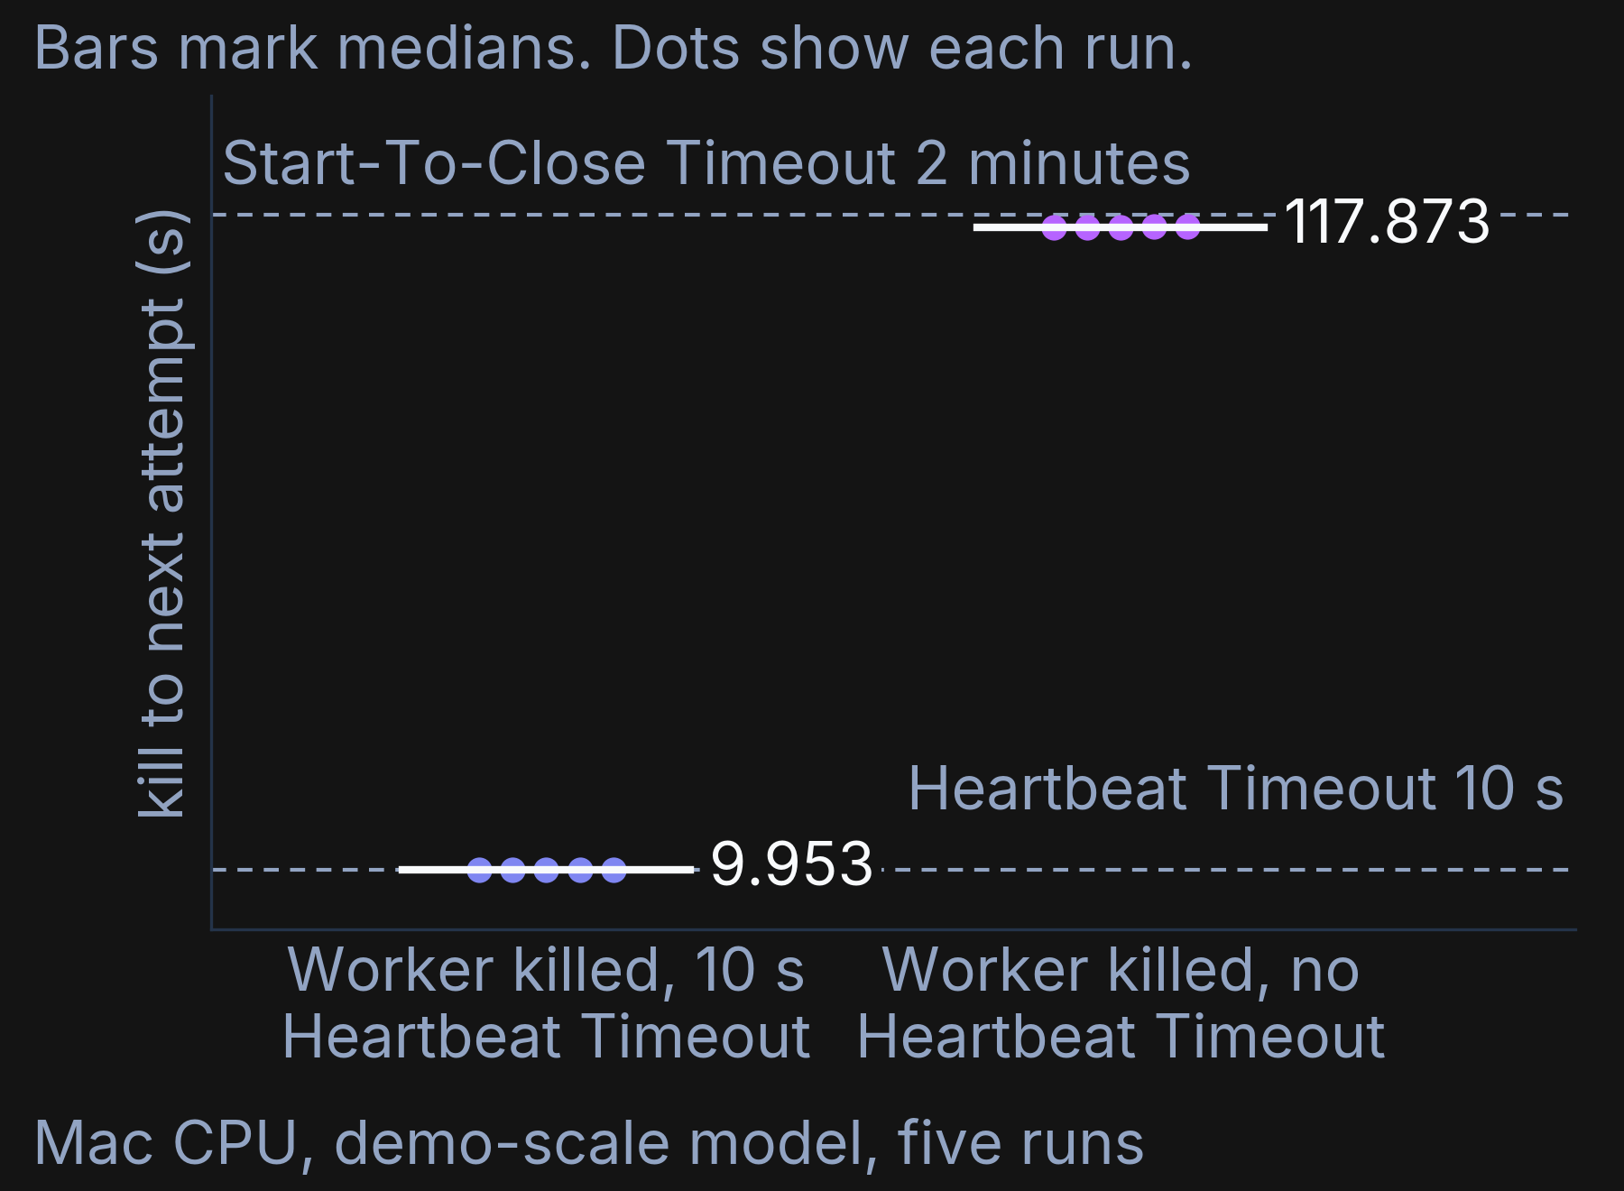
9.953 seconds against 117.873 seconds
Both groups record Heartbeats.
Only the timeout setting differs.
The test ended the Worker with SIGKILL.
Both medians are consistent with the timeout settings. The interval includes retry backoff, Worker availability and dispatch delay.
Arun Sharma | Durable Execution Around a Sampler | 14
Mac CPU, demo-scale model, five runs
Notes:
These groups show what the Heartbeat Timeout changed. In both groups a test script sent SIGKILL to the Worker about 3 seconds after the Workflow started, and the replacement Worker that the script started was ready about 5 seconds later. With a Heartbeat Timeout of 10 seconds, the failure to next attempt had a median of 9.953 seconds. With no Heartbeat Timeout, the median was 117.873 seconds. Each dot is a run, and the five dots in each group sit close together. [pause] Both values are consistent with the settings I chose, and that phrase matters. The measured interval starts at the kill and ends at the next Activity start, so it includes retry backoff, Worker availability and dispatch delay. It does not time the server's detector. The Heartbeat Timeout also counts from the last Heartbeat before the kill, so the interval is not the timeout itself. Both groups still recorded Heartbeats, and only the Heartbeat Timeout setting changed. The Start-To-Close Timeout of 2 minutes was my choice, and the tests never varied it. The Event History records which timeout ended the first attempt, and I show that record next.

Slide 15
The Event History names the timeout
Event 6 | Worker killed, 10 s Heartbeat Timeout | Worker killed, no Heartbeat Timeout
lastFailure message | activity Heartbeat timeout | activity StartToClose timeout
timeoutType | TIMEOUT_TYPE_HEARTBEAT | TIMEOUT_TYPE_START_TO_CLOSE
source | Server | Server
Event 6 of each Worker-killed Event History names the timeout that ended the first attempt.
Arun Sharma | Durable Execution Around a Sampler | 15
Mac CPU, demo-scale model, five runs
Notes:
Event 6 of each Worker-killed Event History gives the reason that the first attempt ended. That event starts the second attempt, and its lastFailure field carries the failure of the first. In the group with a Heartbeat Timeout, the message says activity Heartbeat timeout. In the group with no Heartbeat Timeout, the message says activity StartToClose timeout.
[pause] The source field of both failures says Server, so the Temporal Service raised the timeout and not my code. The histories of the Worker-replaced group show the same Start-To-Close failure as the group with no Heartbeat Timeout. This record supports the settings on the last slide. It names the timeout type, and the interval there still does not isolate the server's detector. The second attempt also repeated the sampler work, and that cost is the next point.

Slide 16
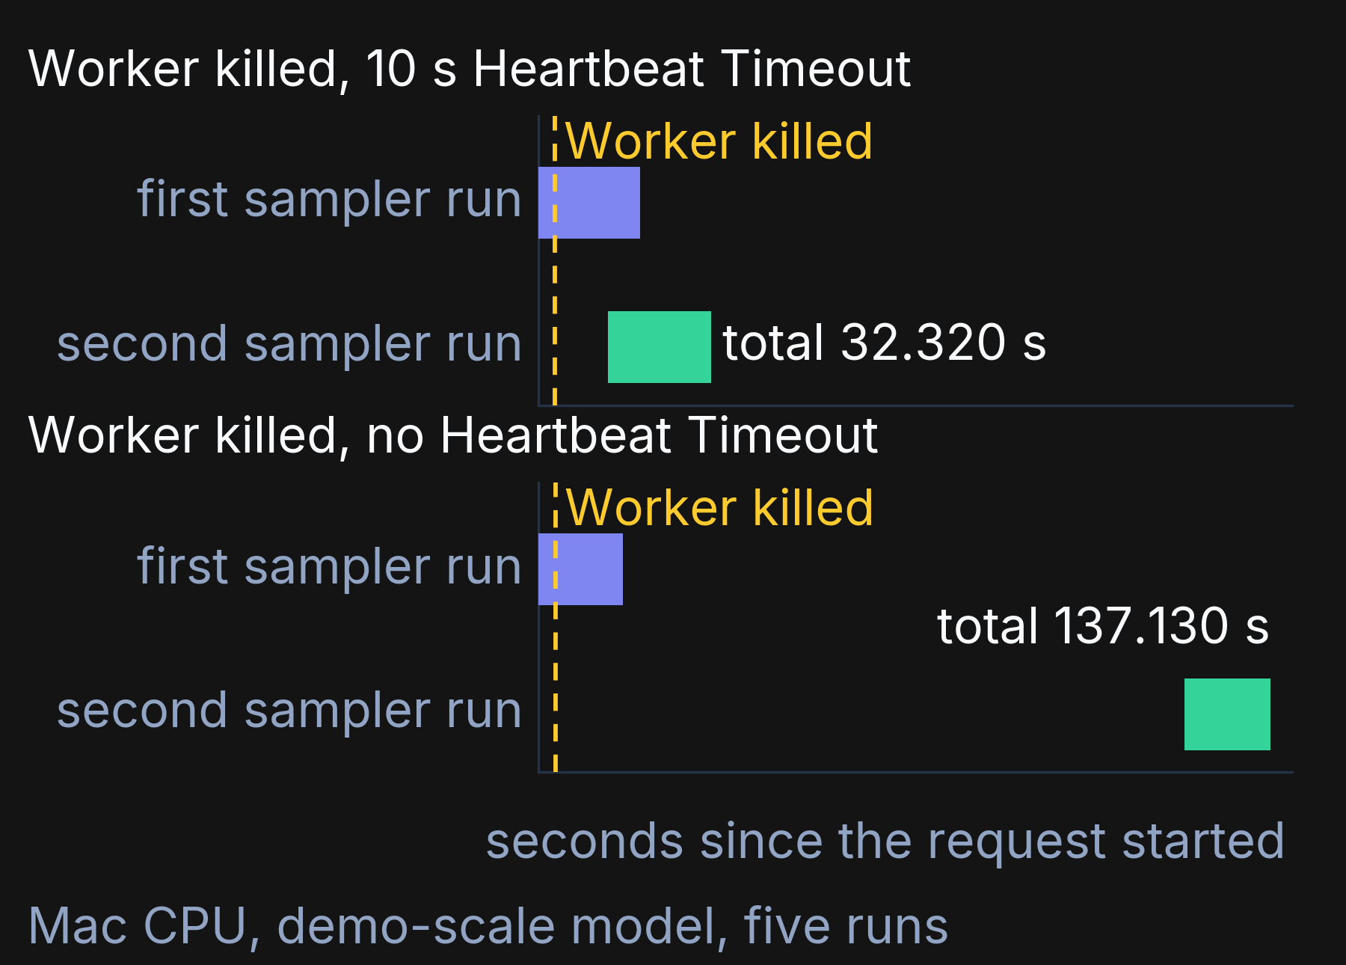
Every recovery ran the sampler twice
Recovery ran the sampler twice.
This held in all 15 worker-kill runs.
The test ended the Worker with SIGKILL.
A Heartbeat Timeout saves waiting time and does not save compute.
Arun Sharma | Durable Execution Around a Sampler | 16
Mac CPU, demo-scale model, five runs
Notes:
This chart shows the cost that a Heartbeat Timeout does not remove. Each lane is a typical run, and each bar is a run of the Rust sampler. Each kill marker belongs to the selected run in its lane. The first sampler run kept going because its task continues after a client disconnects. The replacement Worker ran Infer again, which asked the Rust service to start another sampler run. That happened in all 15 worker-kill runs. With a Heartbeat Timeout, the sampler runs overlap, and the selected Workflow took 32.320 seconds. The lane without a Heartbeat Timeout shows a much longer wait before the repeated sampler call. That selected Workflow took 137.130 seconds. [pause] So a Heartbeat Timeout shortens the wait, and the sampler work still happens twice. An expensive sampler makes repeated work a cost that the retry design must account for. Every kill in these runs was a SIGKILL, so a graceful shutdown might behave differently, and I did not test that case. The next slide asks what happens to a saved Event History when the Workflow code changes.

Slide 17
Replay a saved history before shipping
func TestReplayR2History(t *testing.T) {
replayer := worker.NewWorkflowReplayer()
replayer.RegisterWorkflow(DownscaleWorkflow)
The next line replays the saved Event History through the Replayer. The replay test covers one code transition and one saved history.
A Replayer runs a saved history against new code.
It fails when the commands no longer match.
Arun Sharma | Durable Execution Around a Sampler | 17
Notes:
Before you ship new Workflow code, you can replay a saved Event History against it. The Replayer is a test tool that runs a saved Event History through the current Workflow code, and it fails when the code issues different commands than the history recorded. Replay reconstructs Workflow decisions from the saved Event History and uses the recorded Activity results. It does not run the completed sampler again. This panel creates a Replayer and registers the Workflow with it. The line below the panel hands the saved history file to the Replayer and requires that no error comes back. The history is a saved run of this system, so the test checks new code against something that really happened.
[pause] The test has a narrow scope, and I want to state it plainly. It covers one code transition and one saved history, and it uses no GetVersion guard. I also did not use Worker Versioning, the Temporal feature for deploying changed Workflow code. So a passing replay here says little about other code changes. The next slide shows a replay that fails.

Slide 18
An inserted timer fails the replay
A deliberate edit inserted a timer before Infer.
The saved history schedules Infer at event 5.
[TMPRL1100] lookup failed for scheduledEventID to activityID: scheduleEventID: 5, activityID: 5
The replay test covers one code transition and one saved history.
Arun Sharma | Durable Execution Around a Sampler | 18
Mac CPU, demo-scale model, five runs
Notes:
This slide shows what a failing replay looks like. I made a deliberate edit that inserted a timer before the Infer Activity, and then I replayed the saved history against the edited code. In that history, event 5 is where Infer gets scheduled. The edited code asked for a timer at that point, so the Replayer found that the commands no longer matched. It returned the exact error in the last line, and the error names event 5. [pause] The code that you ship has to issue the same commands that the history recorded, or the Replayer fails. I undid the edit by hand afterward, the repository showed no difference from the commit, and the restored test passed. The edit was a scratch change and was never committed. It was a single code transition against a single saved history, so it shows that the Replayer catches this particular change and not that it catches every change.

Slide 19
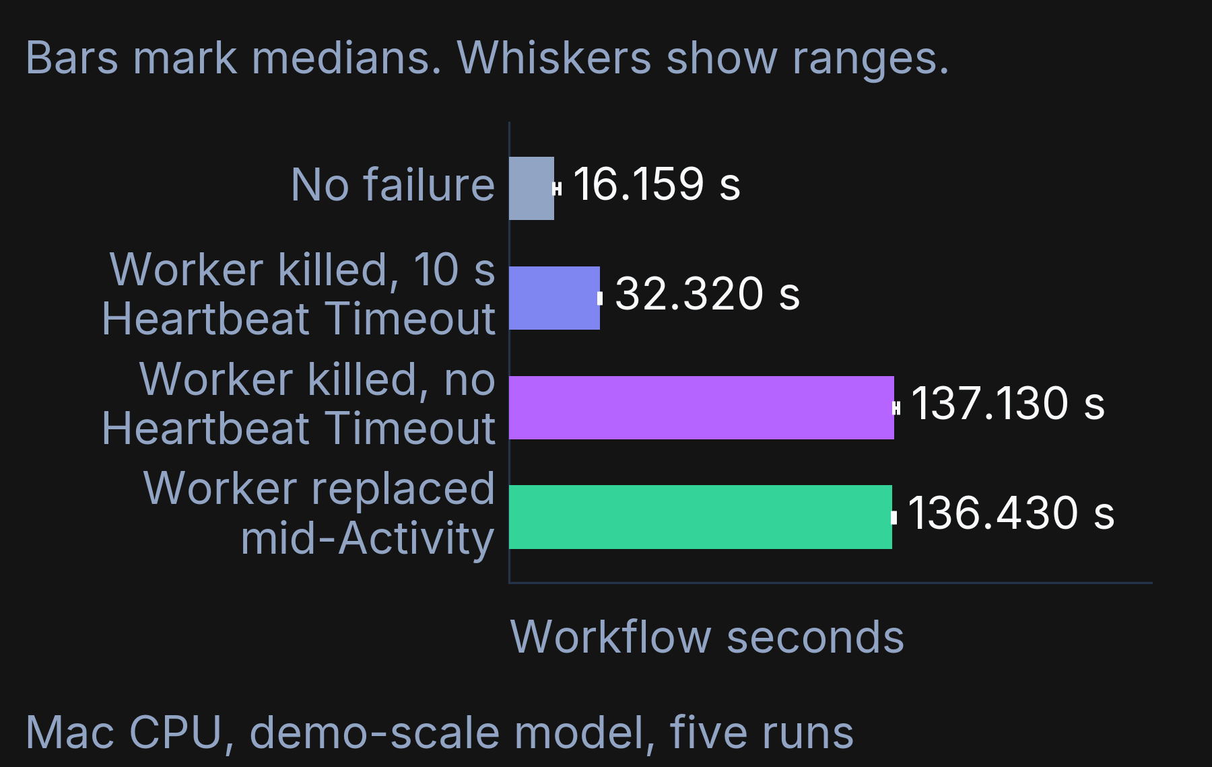
New code, old Activity options
A newer Worker build took over.
The old Heartbeat Timeout of 0 s stayed.
The median wait to retry was 117.873 seconds.
The 117.873 seconds is consistent with the 2-minute Start-To-Close Timeout. The replay test covers one code transition and one saved history.
Arun Sharma | Durable Execution Around a Sampler | 19
Mac CPU, demo-scale model, five runs
Notes:
The Worker-replaced test asks what happens when new Workflow code meets an Activity that old code scheduled. The test started a Workflow on an older Worker build, killed that Worker with SIGKILL during Infer, and started a newer build that sets a Heartbeat Timeout. The Activity had already been scheduled with the old options, so it kept a Heartbeat Timeout of 0 seconds, which means none. The failure to next attempt had a median of 117.873 seconds, which is consistent with the Start-To-Close Timeout of 2 minutes. On the chart, the Worker-replaced bar has a median of 136.430 seconds, next to 137.130 seconds for the group with no Heartbeat Timeout and 32.320 seconds for the group that had a Heartbeat Timeout. [pause] The lesson is narrow. In this test, the fix in the newer build did not reach the Activity that the older build had already scheduled. The replacement runs exercised this code transition without a GetVersion guard. The separate replay check used a single saved history. Neither check establishes what happens after other code changes.

Slide 20
The LLM report is optional
if a.AgentURL != "" {
if txt, err := callAgentReport(ctx, a.AgentURL, r); err == nil {
return txt, nil
}
}
return fmt.Sprintf(
"Downscaled a %dx%d field on %s in %.0f ms. Physics validity: "+
"DE=%.4f, NVR=%.4f, MCE=%.4f.",
r.Height, r.Width, r.Backend, r.LatencyMs, r.DE, r.NVR, r.MCE), nil
}
This is the body of the Report Activity.
All five runs completed with the template report.
Only a mocked test reached the unavailable branch.
Arun Sharma | Durable Execution Around a Sampler | 20
Mac CPU, demo-scale model, five runs
Notes:
The Report Activity turns the metrics into a short text. If an LLM agent address is set, Report asks the agent first. If that call fails, or no address is set, Report returns a fixed template. In this test the agent address pointed at an unused local port, so the call failed and Report returned the template in every run. All five Workflows completed, with a median of 16.271 seconds. [pause] There is a limit here. Report never returns an error in the current code. The Workflow would keep the metrics if it did, but that branch ran only in a mocked unit test. I also tested only the unreachable-agent path, and not a slow agent or a bad reply.

Slide 21
What this does not show
Every run used the Temporal dev server.
The replay test covers one saved history.
The physics gate checks the ensemble mean only.
Cancellation ran only against a fake service.
I have not run this in production.
This is a research system, not a commercial production deployment.
Arun Sharma | Durable Execution Around a Sampler | 21
Notes:
This slide lists what the measurements do not show. I have never run this in production, and it has never served real users. Every measurement came from the Temporal dev server on my laptop, so I cannot say how a Temporal Service under real load would behave. The replay test covers a single saved history and a single code transition, so it says nothing about other code changes. The gate in the Infer Activity reads only the mean of the ensemble, so it does not check each member on its own. I did not measure when the Temporal Service received each Heartbeat, and the SDK may throttle Heartbeats before it sends them. The Activities have no idempotency key, and my only cancellation test used a fake service. Worker Versioning was not part of any test. [pause] I put these limits on a main slide because each limit changes what a result means for your own system. They also set the next tests, and the next slide turns the findings into checks.

Slide 22
Four checks before you ship
Retry: Domain checks identify Non-Retryable Errors.
Stop: Maximum Attempts bounds the attempt count.
Notice: A Heartbeat Timeout needs a plan for repeated work.
Replay: Saved Event Histories test Workflow changes.
Arun Sharma | Durable Execution Around a Sampler | 22
Notes:
The four decisions from the start of the talk become four checks that you can run before you ship. The first check covers what to retry. Your domain policy decides which failed checks should end retries. This build treats a failed physics check as a Non-Retryable Error. The second covers when to stop. Maximum Attempts limits how many attempts the Activity can make. The unavailable service failed quickly here because each connection was refused. Slow calls and time spent waiting for a Worker need separate timing tests. The third covers how fast to notice a lost Worker. Set a Heartbeat Timeout on a long Activity, and plan for the work to run again, because in my tests the old sampler run kept going. The fourth covers what to replay. Keep saved Event Histories as test fixtures, and replay them before you change Workflow code. Each check comes from a measurement on this laptop, so treat it as a starting point for your own tests.

Slide 23
What I would test next
I would test real traffic, graceful shutdown and sampler cancellation.
Arun Sharma, University of Minnesota, Twin Cities
Arun Sharma | Durable Execution Around a Sampler | 23
Notes:
I have shown four decisions, and I want to finish with three things. The first is load that matches real traffic, because the runner started each run only after it saved the previous run. [pause] The second is a graceful SIGTERM shutdown, since every Worker kill in these runs was a SIGKILL. The third is cancelling the orphan sampler, the sampler run that a dead Worker leaves behind. I would also like your feedback on which of these tests would help you most.

Slide 24
Backup slides
Arun Sharma | Durable Execution Around a Sampler | 24
Notes:
These backup slides hold the scenario codes, the full tables and the evidence trail. I open them only when a question needs them.

Slide 25
Scenario names and their codes
Scenario | Code | Group key
No failure | baseline | baseline
Worker killed, 10 s Heartbeat Timeout | F1 | f1-hb
Worker killed, no Heartbeat Timeout | F1 | f1-nohb
Service down briefly | F2 | f2
Service down throughout | F3 | f3
Invalid physics output | F4 | f4
LLM agent unavailable | F5 | f5
Worker replaced mid-Activity | F6 | f6
Arun Sharma | Durable Execution Around a Sampler | 25
Notes:
This table maps each plain scenario name in the talk to the code that the test campaign used. The main slides use plain scenario names, and this appendix provides the codes for questions about the saved runs.
Both Worker-killed groups share the code F1, and they differ only in the Heartbeat Timeout setting. The group key is the label in the runs table and in the saved histories, so a question about a single run can start from this row.

Slide 26
All eight groups, medians and ranges
Group | Median (s) | Range (s)
baseline | 16.159 | 15.767 to 18.080
f1-hb | 32.320 | 31.829 to 32.483
f1-nohb | 137.130 | 136.808 to 138.523
f2 | 19.466 | 19.347 to 20.541
f3 | 3.026 | 3.025 to 3.026
f4 | 0.224 | 0.222 to 0.232
f5 | 16.271 | 15.926 to 16.437
f6 | 136.430 | 136.338 to 137.164
Arun Sharma | Durable Execution Around a Sampler | 26
Mac CPU, demo-scale model, five runs
Notes:
This table lists all eight groups with the median Workflow seconds and the observed range of five runs each. Workflow time runs from the start event to the final event of the Event History. Slide A2 maps each group key to its plain name. The Worker-kill groups without a Heartbeat Timeout take 137.130 and 136.430 seconds, and their Event Histories show that the Start-To-Close Timeout ended the first attempt. The service-down-throughout group fails in 3.026 seconds after 3 attempts. The invalid physics output group fails in 0.224 seconds, but those requests used 20 sampler steps, so that time is not comparable with the others.

Slide 27
The ten runs behind the headline
Run with Heartbeat Timeout | Seconds | Run without it | Seconds
f1-hb-1 | 9.973 | f1-nohb-1 | 117.958
f1-hb-2 | 9.961 | f1-nohb-2 | 117.873
f1-hb-3 | 9.926 | f1-nohb-3 | 117.899
f1-hb-4 | 9.953 | f1-nohb-4 | 117.860
f1-hb-5 | 9.926 | f1-nohb-5 | 117.850
Each value runs from the kill to the next attempt. The test ended the Worker with SIGKILL. The interval includes retry backoff, Worker availability and dispatch delay.
Arun Sharma | Durable Execution Around a Sampler | 27
Mac CPU, demo-scale model, five runs
Notes:
This table lists the ten runs behind the headline medians. Each group had five runs, and each value is the failure to next attempt in seconds for a single run. The runs with a Heartbeat Timeout range from 9.926 to 9.973 seconds, with a median of 9.953 seconds. The runs without one range from 117.850 to 117.958 seconds, with a median of 117.873 seconds. The spread inside each group is small next to the gap between the groups. Every Worker kill in these runs was a SIGKILL. The interval starts at the recorded kill and ends at the next Activity start, so it includes retry backoff, Worker availability and dispatch delay. It does not time the detector inside the Temporal Service.

Slide 28
Recorded timeouts and Retry Policy
Setting | Infer | Report
Start-To-Close Timeout | 2 minutes | 2 minutes
Heartbeat Timeout | 10 s | none
Maximum attempts | 3 | 3
First retry interval | 1 s | 1 s
Backoff coefficient | 2 | 2
Maximum interval | 100 s | 100 s
Arun Sharma | Durable Execution Around a Sampler | 28
Notes:
This table lists the settings that the Event History records when the Workflow schedules each Activity. Both Activities have a Start-To-Close Timeout of 2 minutes, and I chose that value without varying it in any test. Only Infer has a Heartbeat Timeout, and it is 10 s in every group except the Worker-killed group without one. The original Activity in the Worker-replaced test had none either. The Workflow code sets Maximum attempts to 3. Temporal supplied the other Retry Policy values, which are a first interval of 1 s, a backoff coefficient of 2 and a maximum interval of 100 s. These are the defaults that I did not change.

Slide 29
The environment and the tests
Item | Recorded value
Machine | Apple M4 Pro, 14 cores
Model | 64 by 64 tile, base width 32
Temporal | CLI 1.7.2, Server 1.31.1
Go and Rust | Go 1.26.4, Rust 1.96.0
Go tests | 10 top-level tests passed
Rust tests | 6 passed on the private build
Remote CI | UNVERIFIED
Arun Sharma | Durable Execution Around a Sampler | 29
Notes:
This table gives the machine, the model, the tool versions and the tests that the build recorded. Every measurement came from an Apple M4 Pro laptop CPU that reported 14 cores. The model has a 64 by 64 tile and base width 32, with two levels and no attention, and it was trained briefly on synthetic data. The Temporal dev server is version 1.31.1 and the command line tool is version 1.7.2. The Go tests ran 10 top-level tests with none failed and none skipped. The Rust tests on the private build ran 6 tests. The remote CI and container builds are UNVERIFIED, so I make no claim about them.

Slide 30
What went wrong during the campaign
The Temporal CLI inherited settings that did not match the local server.
Flags now disable inherited settings and select the local server.
The first detached launch exited silently in the execution tool.
A restart interrupted a baseline run, and the runner recorded it separately.
A replacement run used a new Workflow Id.
Arun Sharma | Durable Execution Around a Sampler | 30
Notes:
This slide lists the setup problems that I met, so that nobody has to guess what happened. First, the connection settings that the Temporal CLI inherited did not match the local dev server. The runbook now passes flags that switch off the inherited settings and name the local server, without changing any user configuration. The first detached launch of a process exited silently in the execution tool, and a retained shell kept the process alive. A restart of the run tool interrupted a baseline run. The runner saved that run on its own, left it out of the comparison groups, and started a replacement with a new Workflow Id.

Slide 31
The evidence trail and how to rerun it
Commit 9aa337d is on a local, unpushed branch.
The runbook is experiments/temporal/RUNBOOK.md.
The runner saves each run, then starts another.
An audit script checked 40 runs and their logs.
This link opens PC-RF. The Temporal layer is not pushed yet.
github.com/arunshar/pc-rf
Arun Sharma | Durable Execution Around a Sampler | 31
Mac CPU, demo-scale model, five runs
Notes:
This slide gives the evidence trail and the way to rerun it. The measurements and the saved histories sit in a single commit of the private build. That commit is on a local branch that is not pushed, so you cannot open it today. The runbook inside the commit lists the build commands, the start commands for each local service and the stop commands that check which process they stop. The scenario runner starts and stops its own services and saves every completed run before it starts another. After an interruption the runner can resume, and it records the interrupted Workflow separately. An audit script then checked all 40 runs, and the histories and the sample logs match. A summary script regenerates the measured report from the saved runs.

