Slide 1
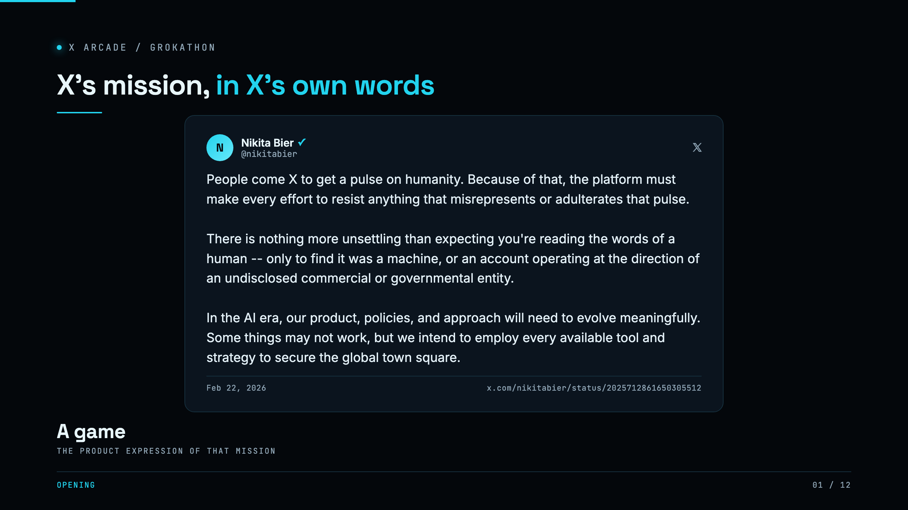
Notes:
SAY: This is X's head of product, writing in February. The platform exists to give people a pulse on humanity, and nothing is more unsettling than reading what you think is a person and finding it was a machine. We did not invent that problem. X wrote it down. We built the product for it. CUE: the quote is on screen, point and paraphrase, do not read it line by line.

Slide 2
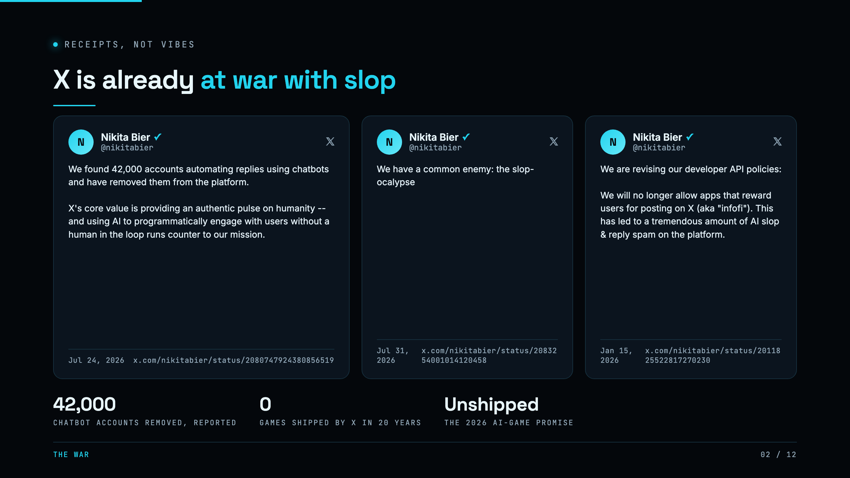
Notes:
SAY: And X is already at war with this. Forty-two thousand chatbot accounts removed in one sweep. The InfoFi ban, killing the apps that pay people to post slop. They named the enemy, the slop-ocalypse. But in twenty years X has never shipped a game, and the AI game they promised is still unshipped. That lane is open and the mission is already stated. CUE: point at the three cards, do not read them. The 62.9k likes figure is reported, not ours, keep it off the mic.

Slide 3
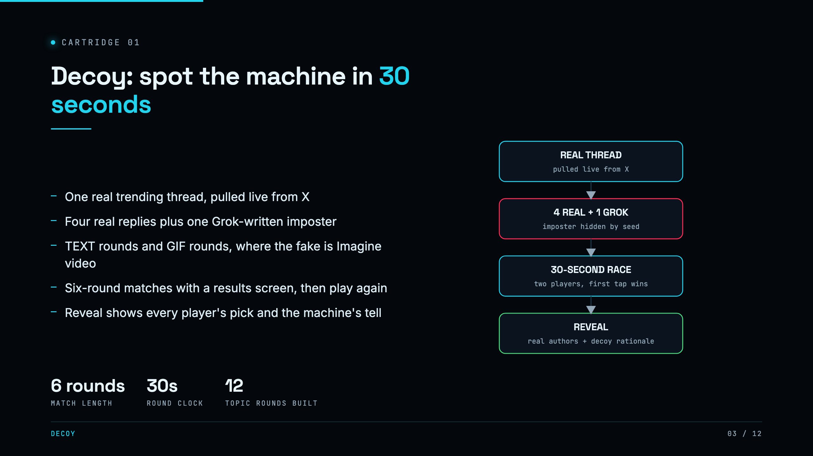
Notes:
SAY: Here is what we built. One real trending thread off X. Four of these replies are real people, one was written by Grok to blend in. Thirty seconds to find the machine. Matches run six rounds and end on a results screen. Some rounds are text, some are GIF rounds where the fake is an Imagine video. CUE: this is the shape of the game. We play it live at the end, not now.

Slide 4
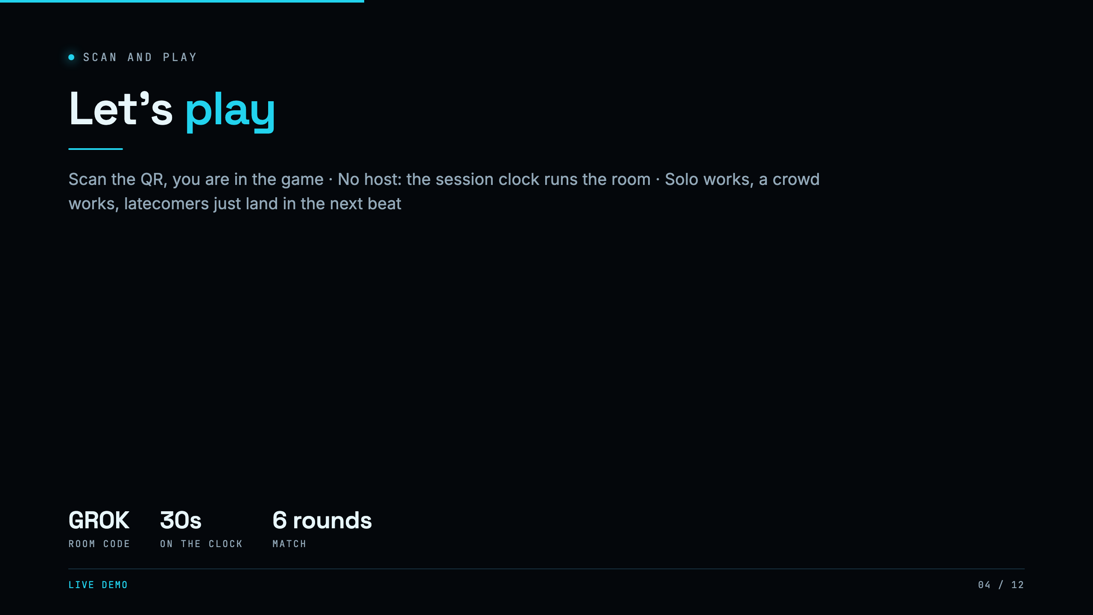
Notes:
SAY: Before we go further, take out your phone and scan this code. It drops you straight into the room. There is no host to wait for, the room runs itself on a clock. Get in now, and we will play a live round together at the end. CUE: THE QR MUST BE ON SCREEN HERE. The audience joins during the rest of the deck, so the room is full by slide 9. Do not tap START yet.

Slide 5
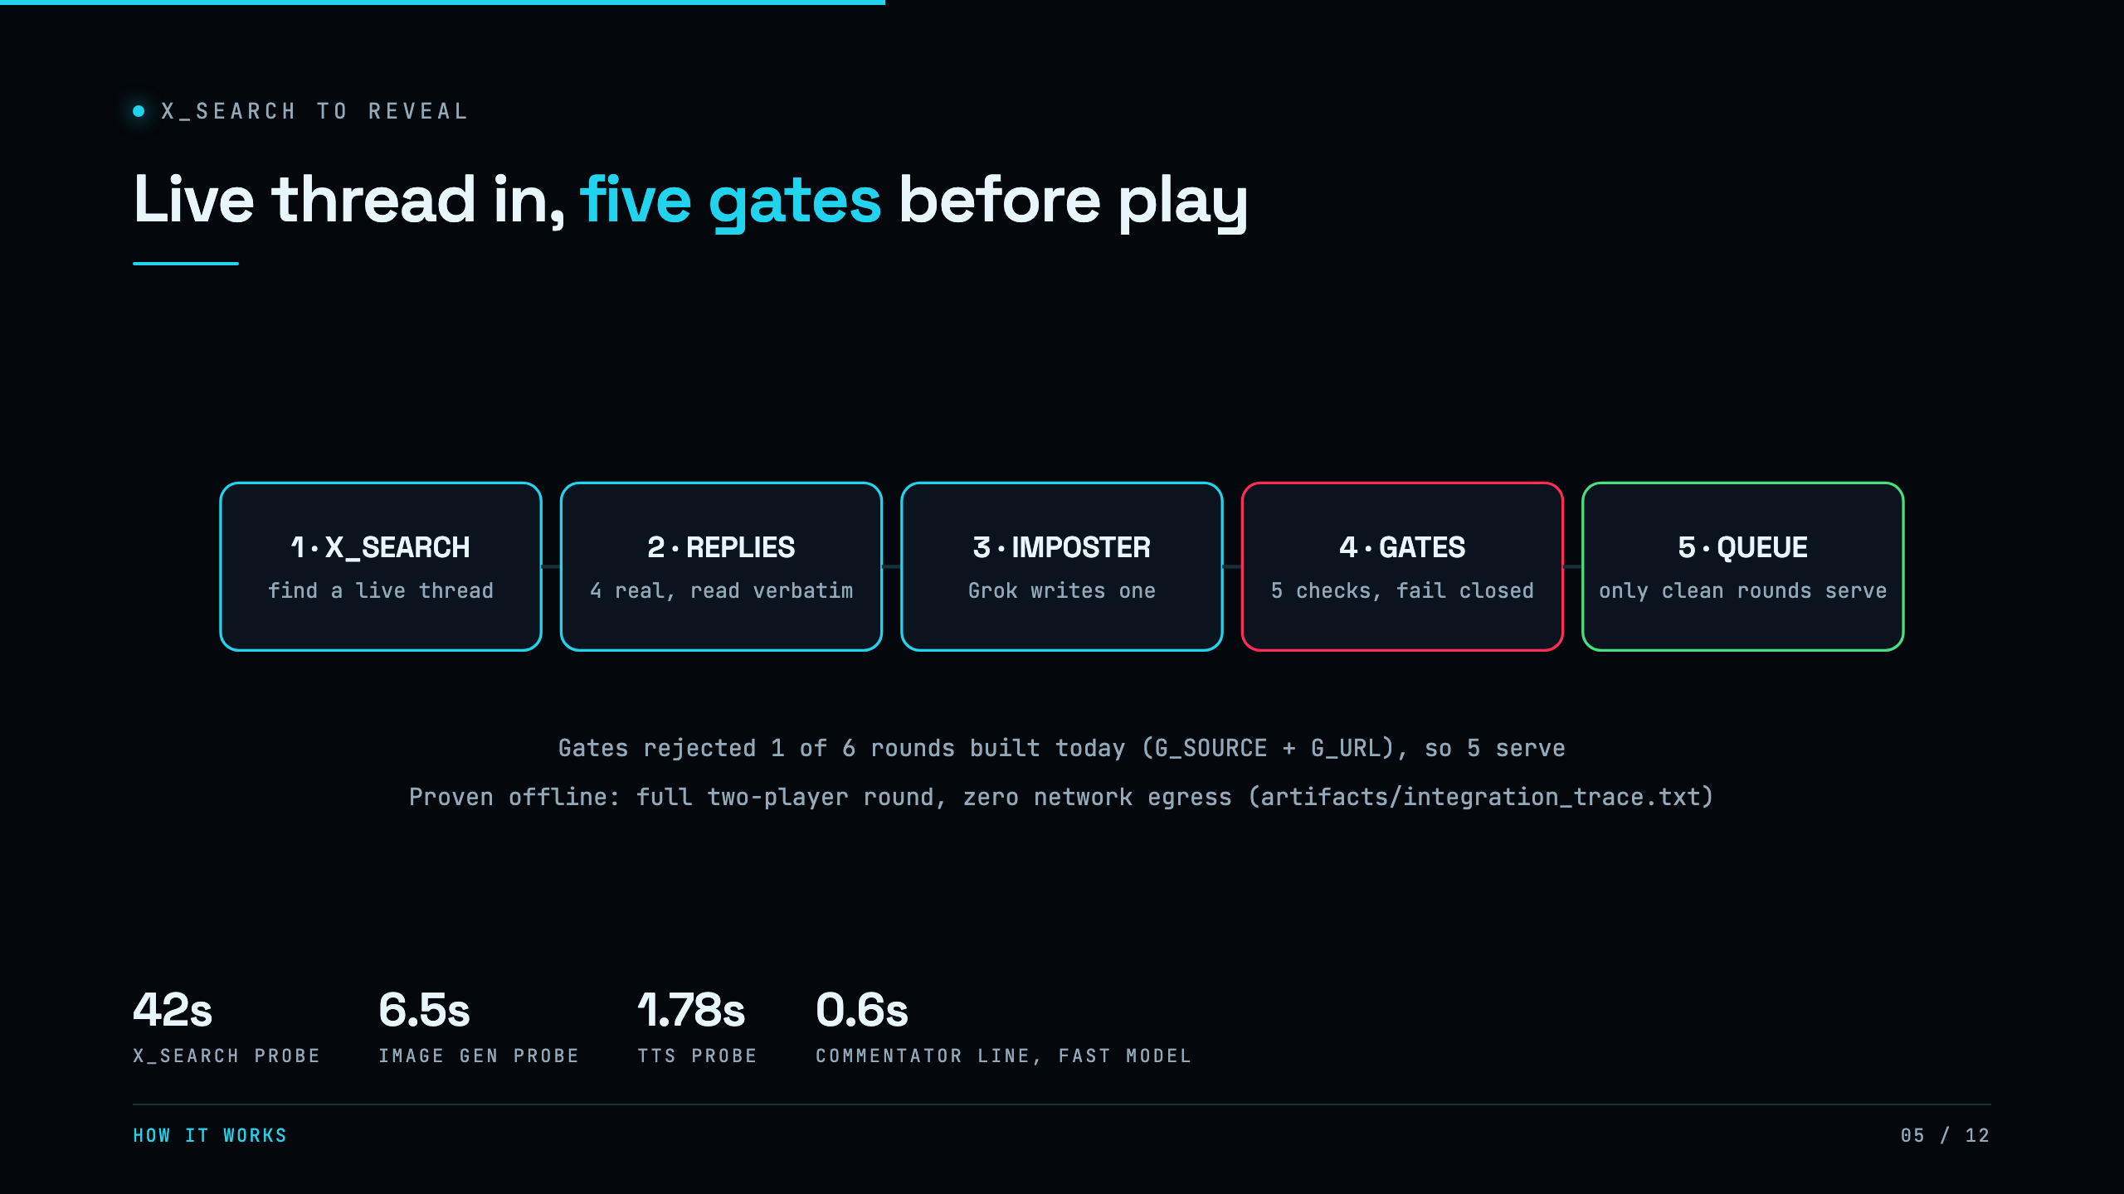
Notes:
SAY: Under the hood it is five beats. A search finds a live thread, a second grounded call reads the real replies, Grok writes the imposter, five deterministic gates screen the round and fail closed, and only clean rounds serve. One event-day pull was rejected for an embedded link and never served. And you cannot cheat: during guessing, the answer never leaves the server. CUE: only go deep here if the room is technical, otherwise one sentence and move on.

Slide 6
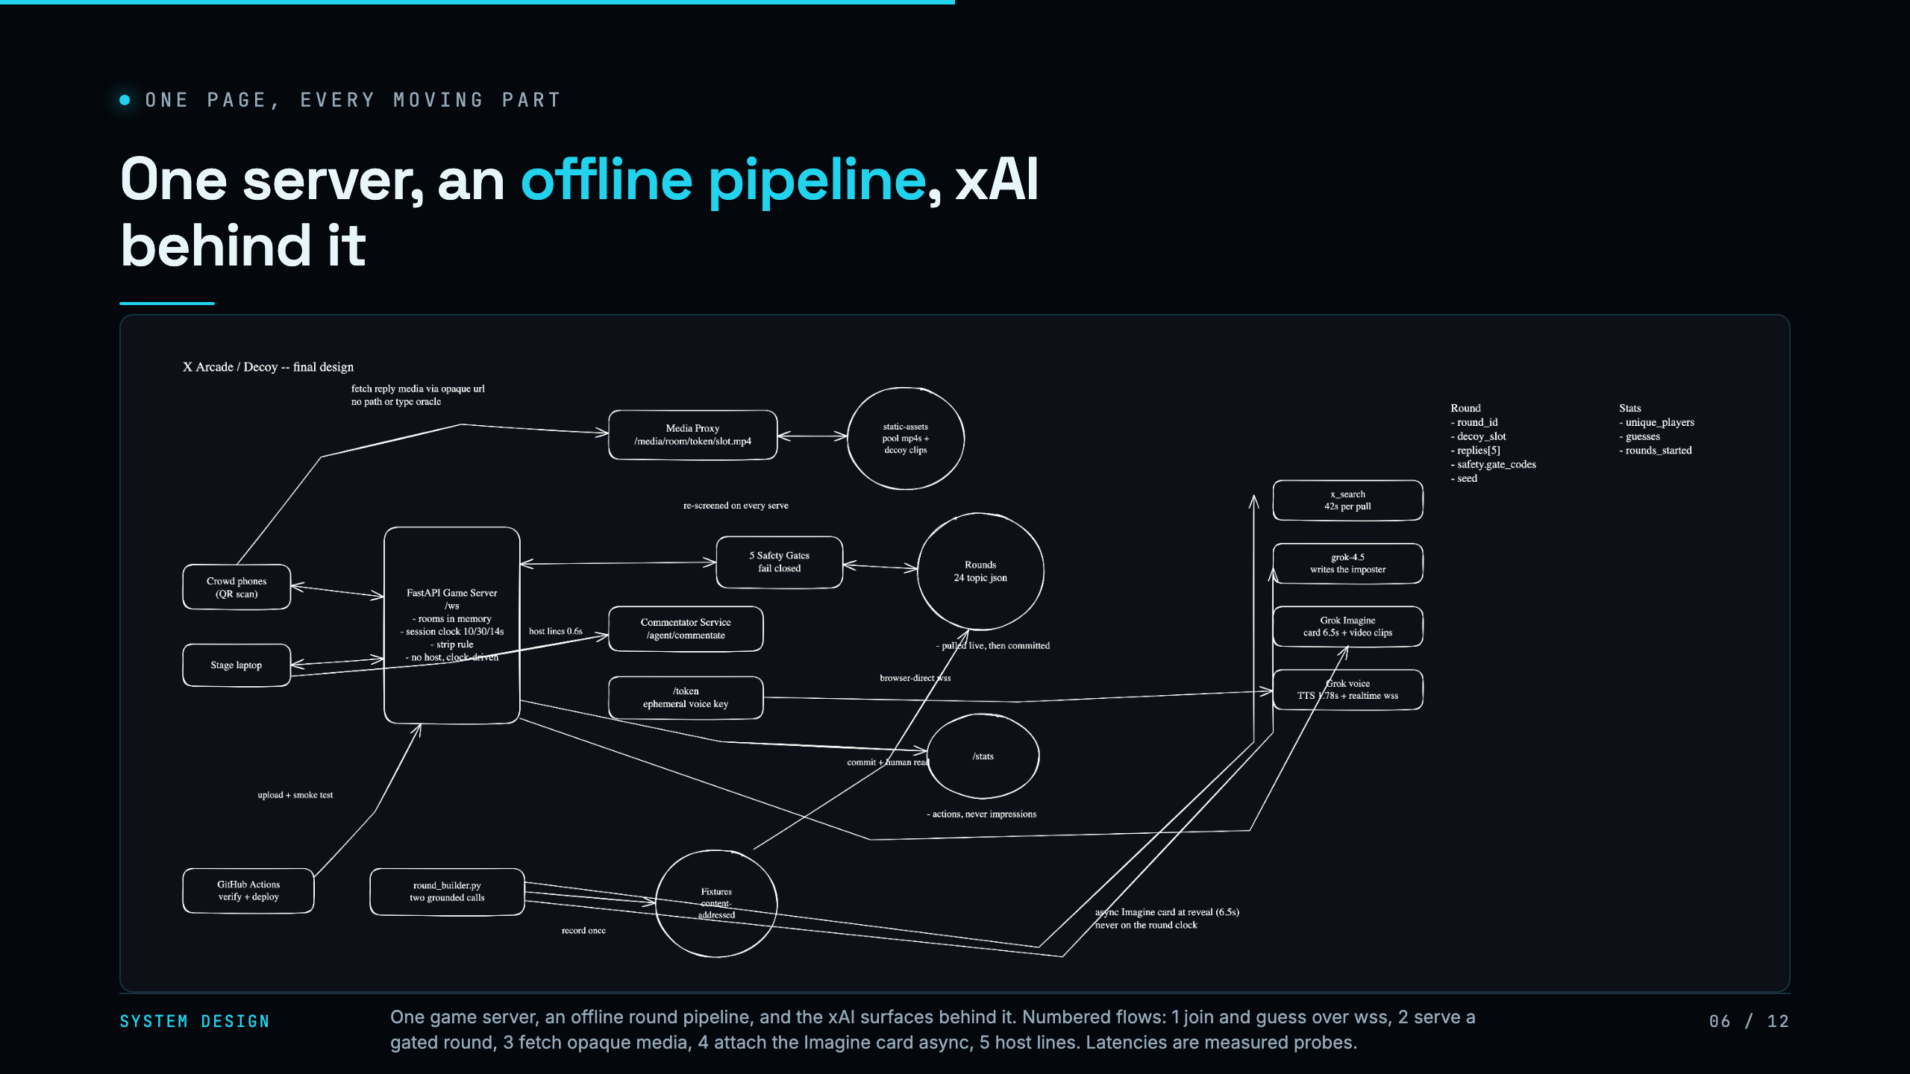
Notes:
SAY: Here is the whole system on one page. On the left, players join over a websocket. In the middle, one FastAPI server holds the rooms in memory, runs the clock, and serves rounds. The rounds are not pulled live during play, that is the offline pipeline at the bottom: a search finds the thread, Grok writes the imposter, it gets recorded to fixtures and committed. And the slow, expensive xAI calls on the right, Imagine and voice, are all off the round path, fired async so they never block a guess. CUE: trace the five numbered arrows if the room is technical, otherwise say the one line: everything slow is pre-built or async, nothing slow is on the clock.

Slide 7
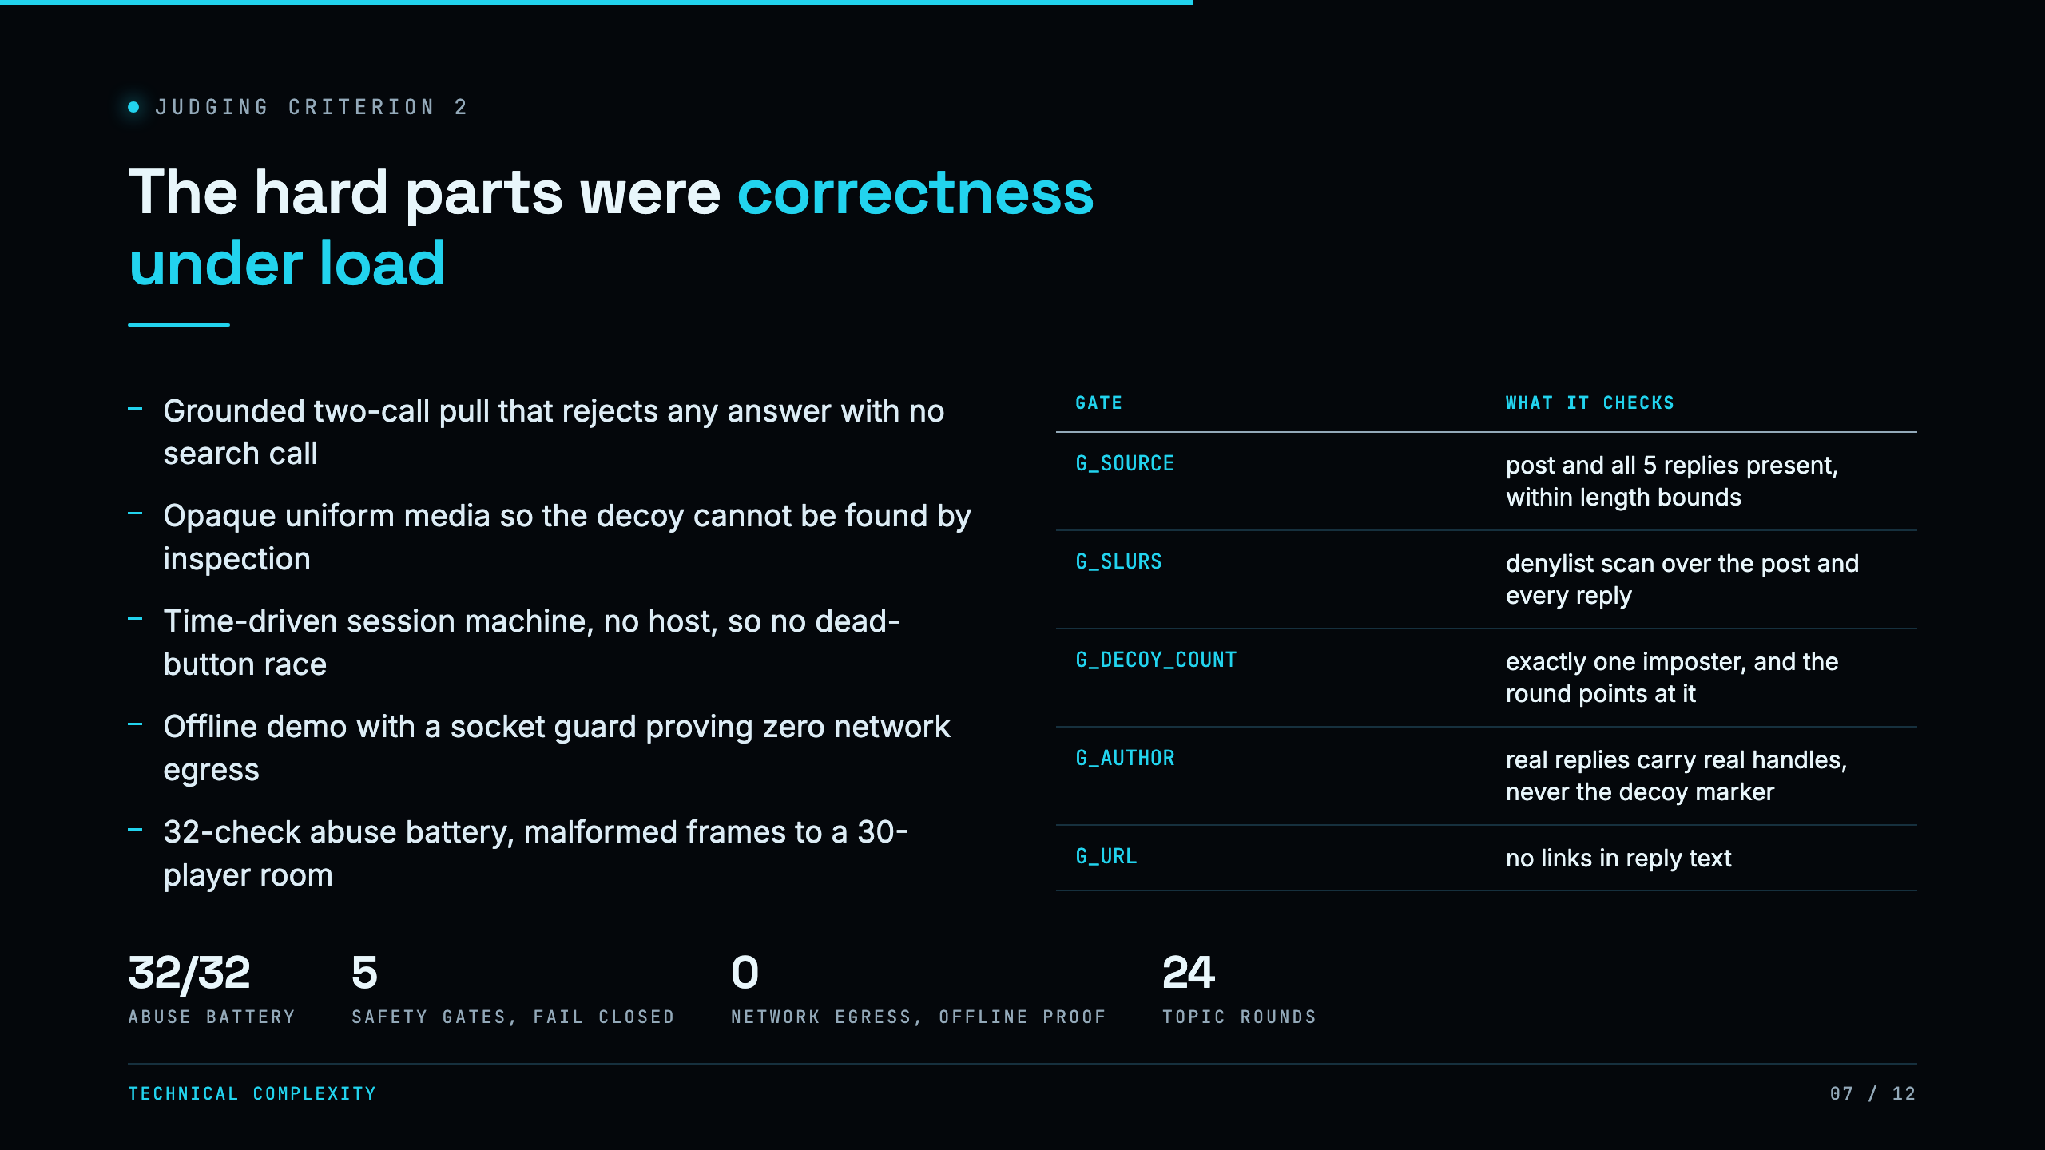
Notes:
SAY: The game is easy to describe and hard to make correct. Three things I would point a judge at. One, we do not trust the model to read the thread, we make two grounded calls and reject any response that did not actually search. Two, the anti-cheat: during guessing the answer never leaves the server, and every reply's media is served through an identical opaque URL, because the fake used to be findable in dev tools three different ways. Three, the whole thing runs offline from fixtures with a socket guard that fails on any network call, and a 32-check abuse suite, including a thirty-player room, passes against the live deploy. CUE: this is the technical-complexity slide, every number is from a committed run.

Slide 8
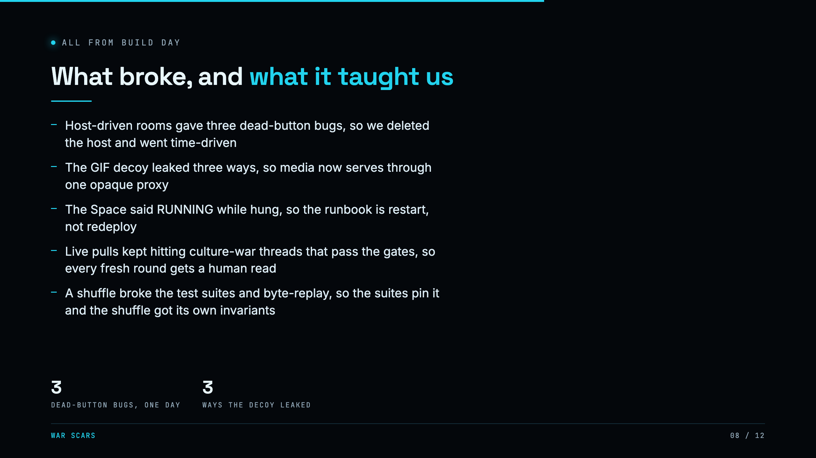
Notes:
SAY: A few honest scars, all from today. We built host-controlled rooms and it produced three separate dead-button bugs where the client and server disagreed on who could start, so we deleted the host entirely and made the room run on a clock. The GIF decoy leaked three ways at once, its URL said decoy, it was the only mp4, and the client even labeled it, so now every reply's media serves through one identical opaque URL. And the gates check integrity, not taste, so live pulls kept landing on divisive threads that passed every gate, which is why a human still reads a fresh round before it serves. CUE: tell one of these as a story if you have time, the dead-button one lands best.

Slide 9
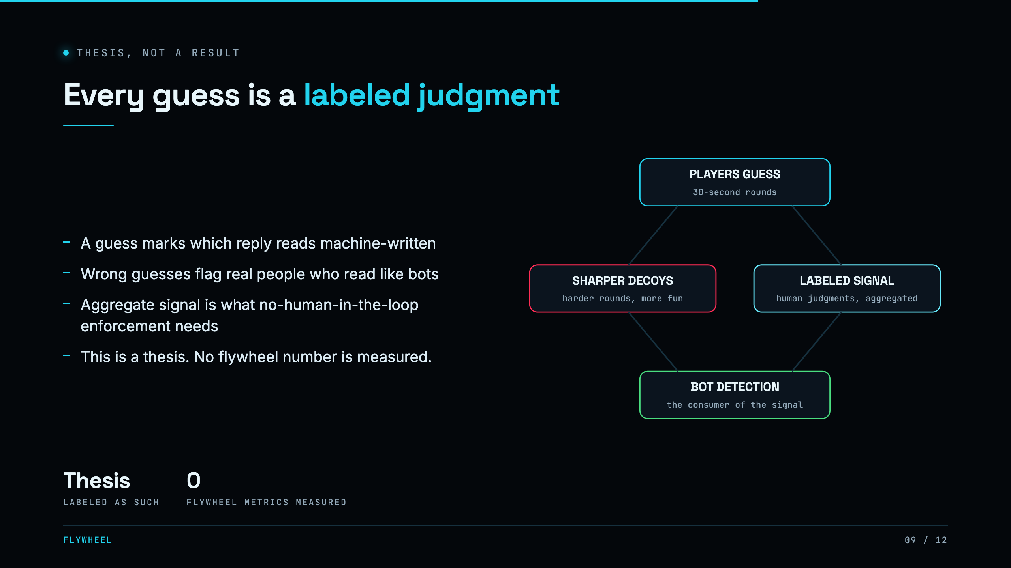
Notes:
SAY: Here is the thesis. X drew a bright line at AI with no human in the loop. Enforcing that line is starved for data about what reads as machine-written to real people. Every guess in the game is exactly that label, and the wrong guesses are the richest half, real people who read like bots. We have measured none of this yet, and it says so on the slide. CUE: say the word thesis out loud, it is your honesty anchor.

Slide 10
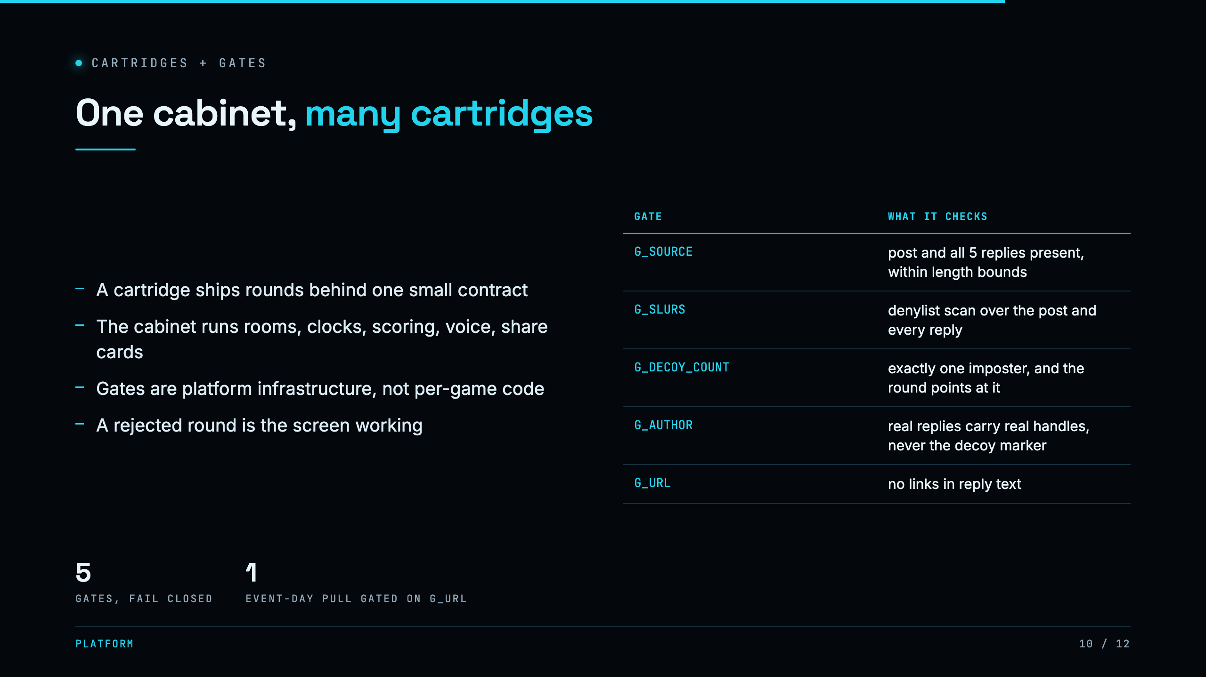
Notes:
SAY: This is a platform, not one game. A cartridge ships rounds behind one small contract, and the cabinet supplies the rooms, the clock, scoring, the voice host, and the share cards. The gates are infrastructure. A rejected round is not a bug, it is the screen working. CUE: keep this short unless a judge asks.

Slide 11
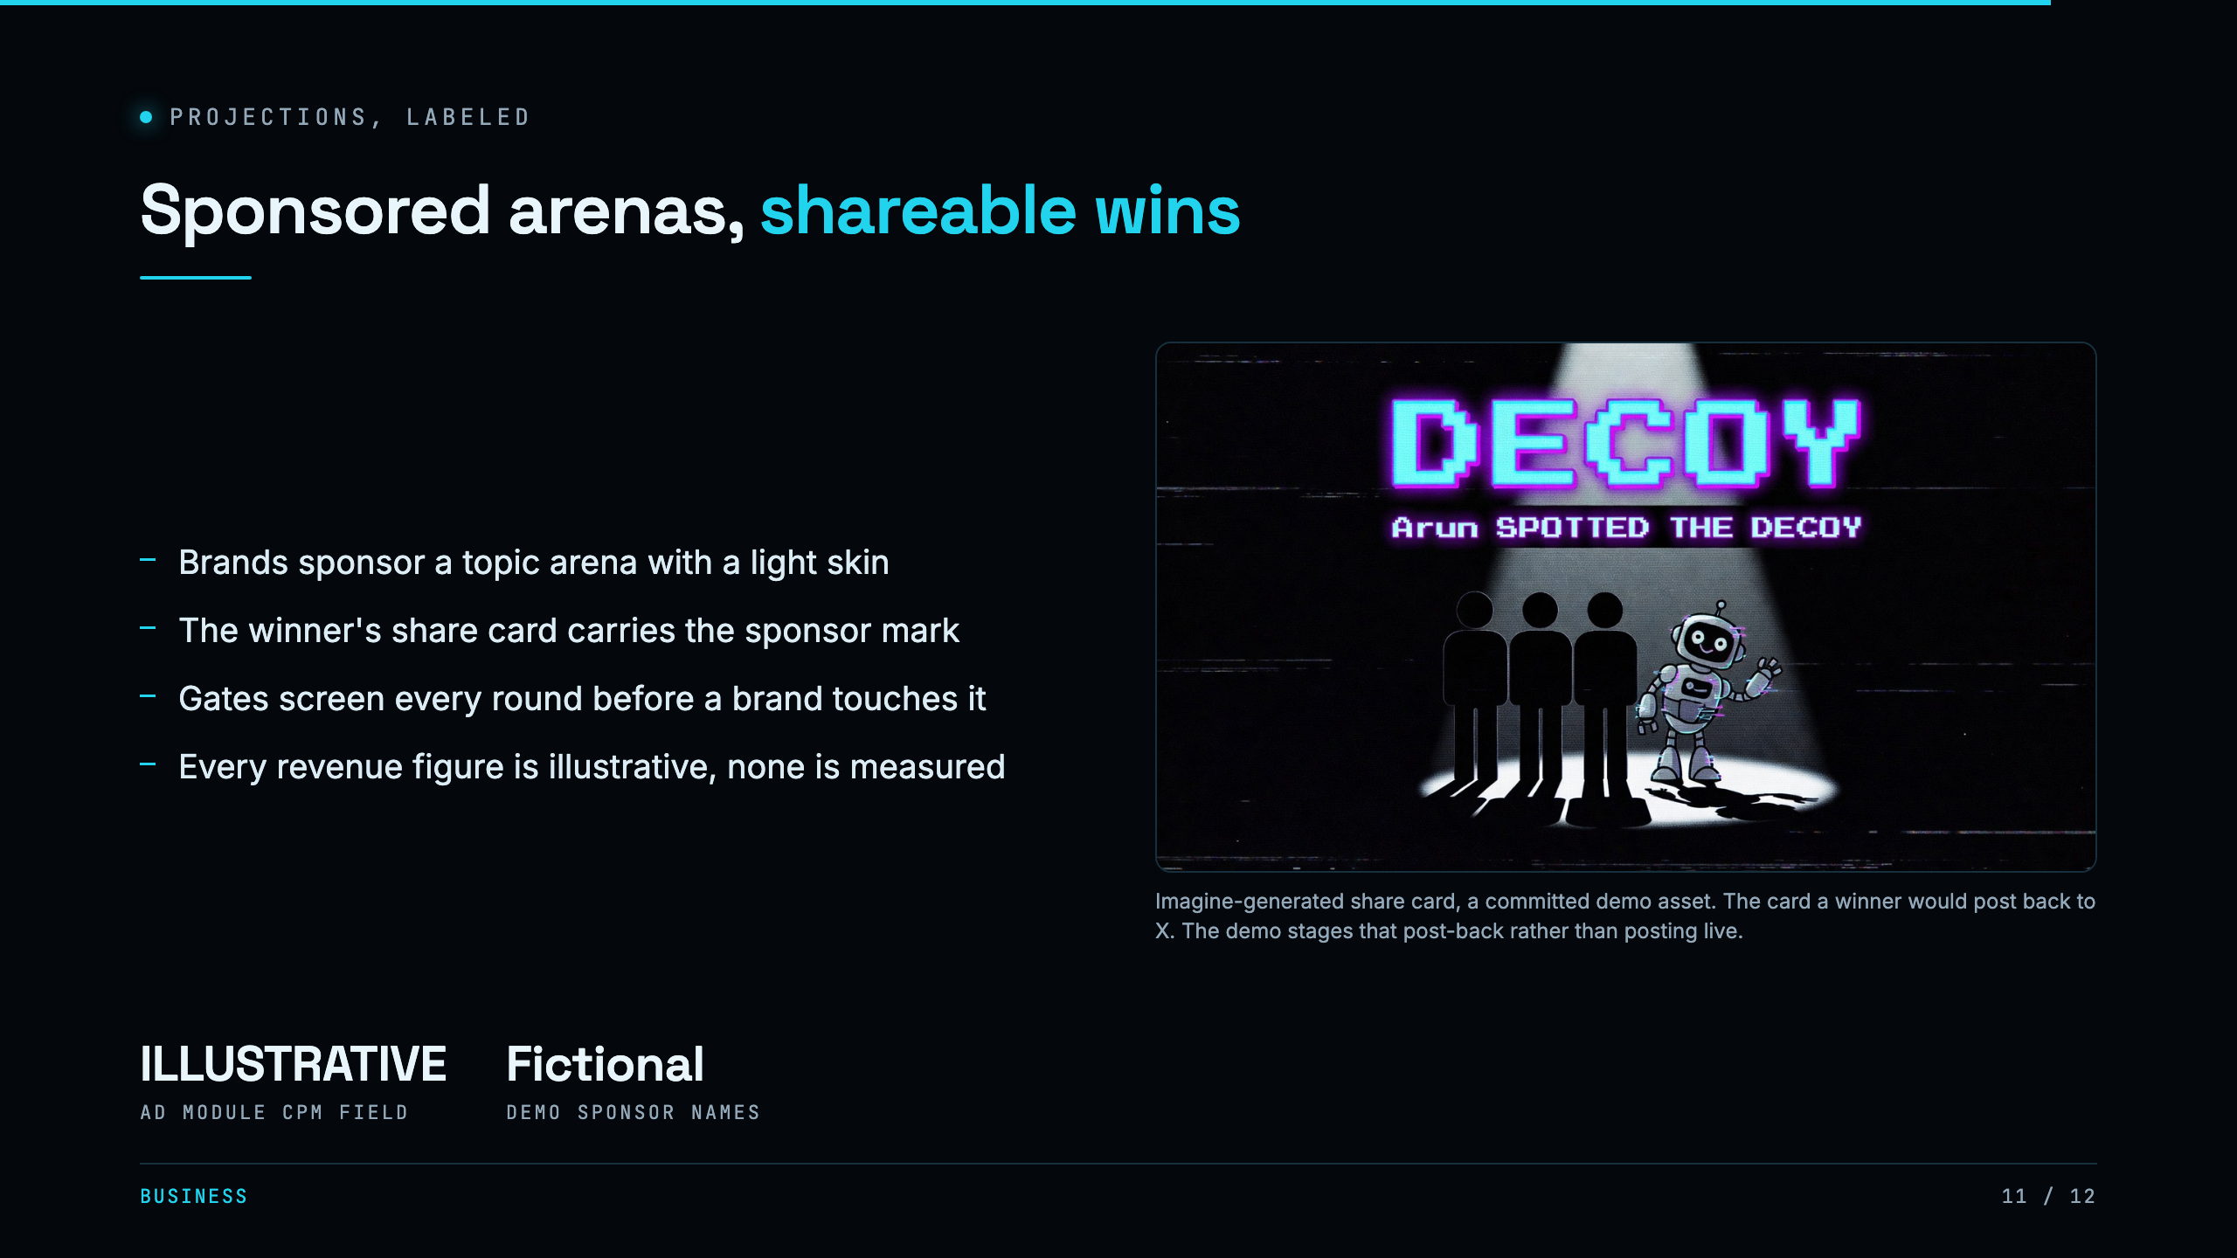
Notes:
SAY: The money is the sponsored arena. A brand picks a topic, the game stays identical, and the winner's share card carries the sponsor mark, so every share is brand reach next to a topic the brand chose. Tie it to the receipts: X killed pay-to-post because it makes slop, and this aligns the incentive with brand-safe human play. Every number here is illustrative and labeled as such. CUE: never quote a market size, there is not a real one.

Slide 12
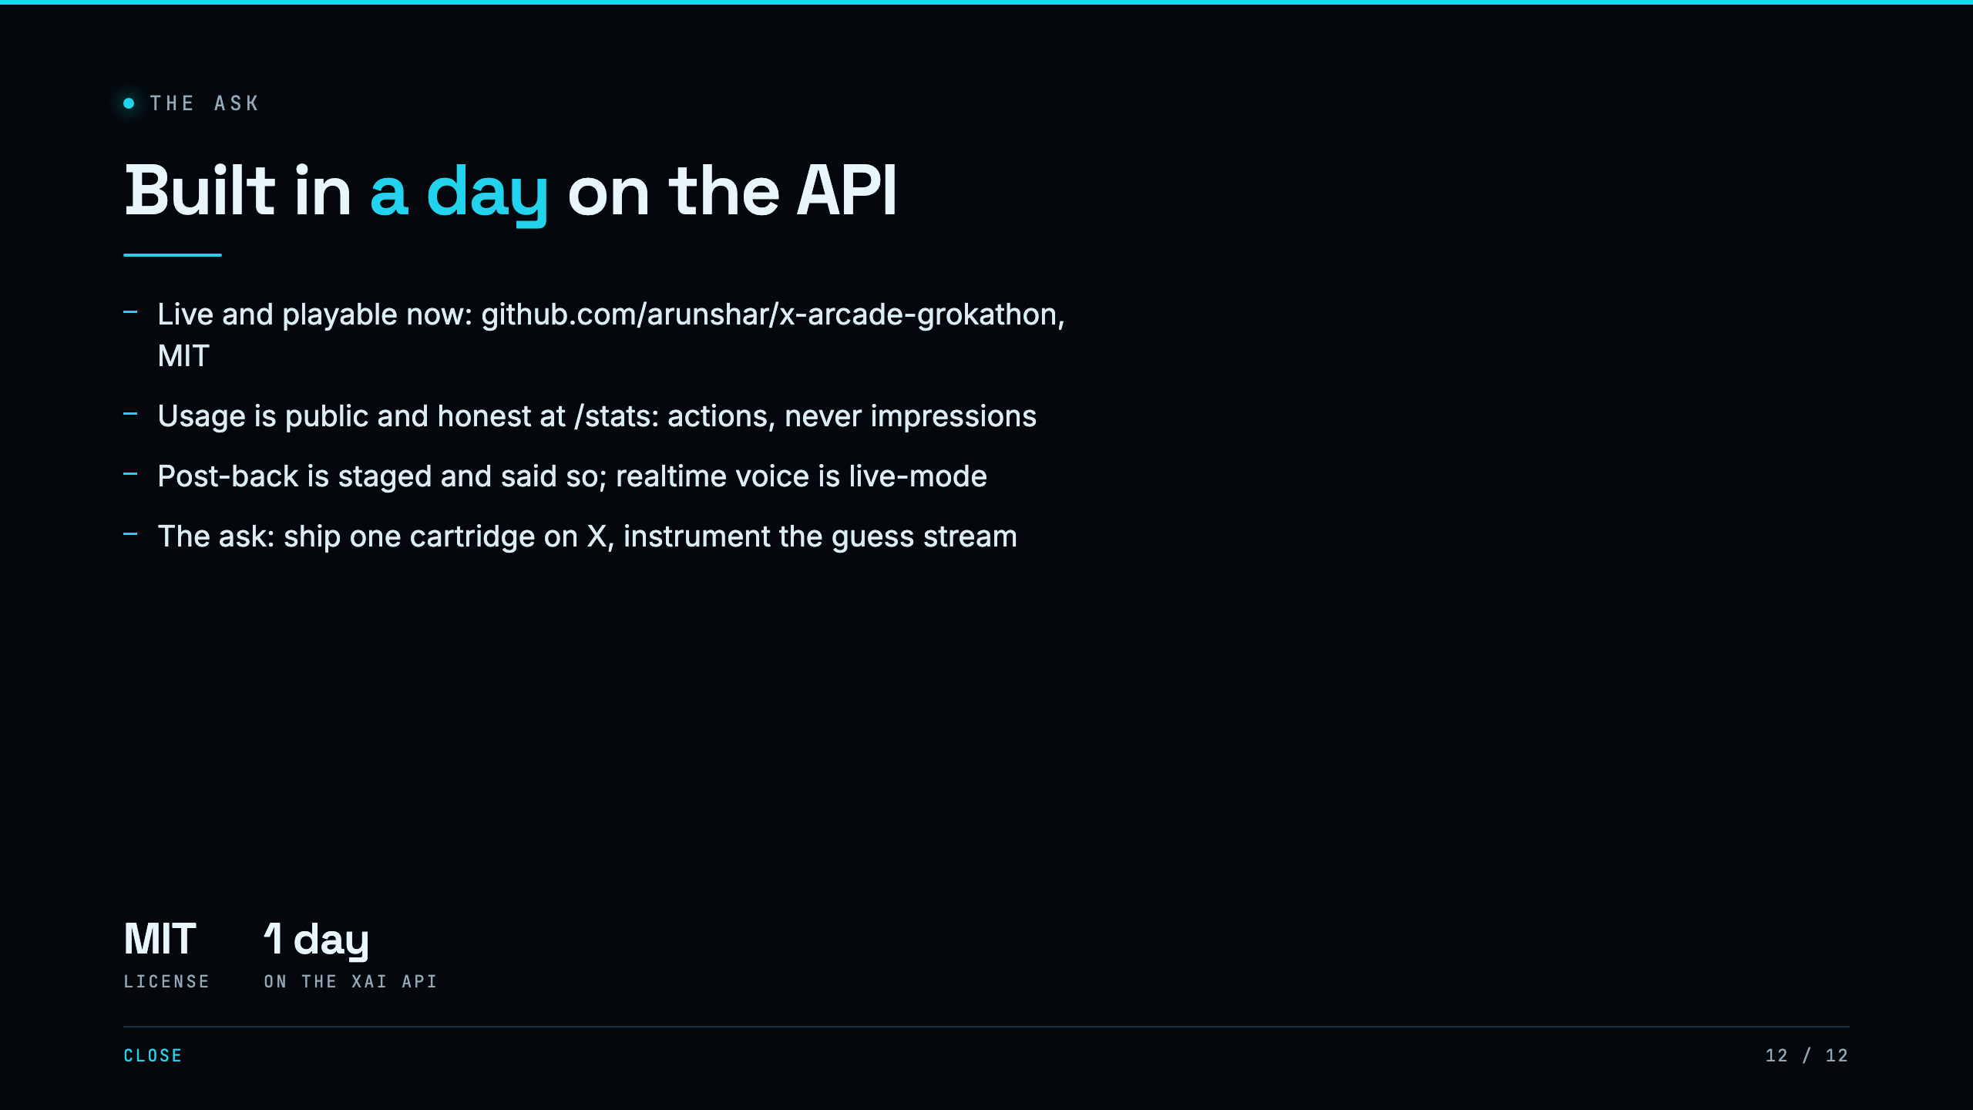
Notes:
SAY: Built in a day, on the xAI API, live and playable right now. Usage is public and honest at slash stats, real player actions, never impressions. What is staged, the post-back to X, we say so. The ask is small: ship one cartridge behind a real X surface and instrument the guess stream. And now, let us actually play. CUE: SWITCH TO THE APP. The room is already full from slide 4. Tap START, run one round, land the reveal. Done.

