Slide 1
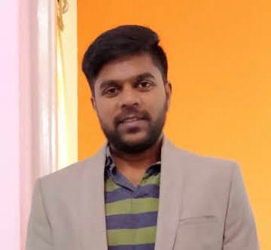

Arun Shetty
Cloud Tech Arch Delivery Assoc Manager
arun.siddappa,shetty@accenture.com
9035550309
PROFESSIONAL BACKGROUND
I have 13 plus years of total experience. 5+ years of experience in Python, Shell Scripting, SQL and Django
I have worked on designing and developing custom solutions for Order and inventory management for a retail client. Also, I have worked on CX products like Siebel and Oracle DX4C. I have contributed to various roles like - as a developer, in L2 Support team and in DevOps roles in different projects. I have experience in architecting and creating new assets and automation tools. I have managed teams from the last 4 years in both support and development projects.
I have worked on DevOps tools, RPA Tools (UiPath and Selenium), Shell Scripting, Python etc.
I am currently leading a team which is working on the Order Management and inventory management of an application for a retail client..
I have good experience in PLSQL and Python, Shell Scripting, Oracle Enterprise Data Quality and Qlik Sense Data visualization tool.
Worked on Oracle Cloud Infrastructure for more than a year and have these certifications - OCI Operations, OCI Architect Associate.
AREAS OF EXPERTISE
Python
SQL
Cloud Infrastructure (OCI)
DevOps
Shell Scripting
RPA (UiPath)
Relevant Project Experience
P&G Sales Samples :
Lead a team of developers in developing Sales Samples application for P&G
Architected the application for new modules – Order Management and Inventory Management
Worked on the migration of application from IAAS to PAAS
Designed the authentication strategy for users and APIs using Azure AD
Worked on the development of the application and integrations with external applications using Azure APIM
Successfully deployed the applications to Production
DX4C Cumulus :
Lead DevOps team of 6 resources and created DevOps Pipeline for Dx4C
Created a middleware kind of asset specific for Dx4C using Django and Python.
Created Automation Orchestrator using DevOps tools, RPA (UiPath and Selenium) and Django.
Worked as a scrum master internally using Jira to manage the sprint.
Vodafone UK:
Involved in Supporting Siebel Newco Stack . Triaging production defects, attending to incidents and supporting release activities.
Coordinating with the offshore team and helping them in resolving incidents.
Developed many automations for manual jobs which greatly reduced the amount of time required to run the jobs.
Execution of ad-hoc jobs on Production and supporting Critical Priority 1 incidents.
INDUSTRIES OF EXPERIENCE
Retail
Telecom
Healthcare
Banking
Energy
Certifications
Oracle Cloud Infrastructure Architect Associate
Oracle Cloud Infrastructure Operations Associate
Oracle Cloud Infrastructure Foundations
Copyright © 2019 Accenture. All rights reserved.

