Slide 1
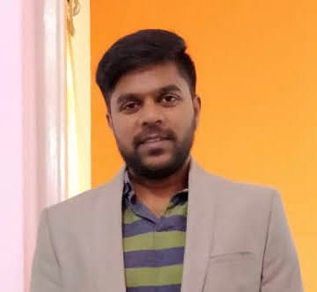

Arun Shetty
Cloud Tech Arch Delivery Assoc Manager
arun.siddappa,shetty@accenture.com
9035550309
PROFESSIONAL BACKGROUND
With over 13 years of comprehensive experience, I possess more than 5 years of expertise in Python, SQL, Shell Scripting, and Django. My focus has extended to Oracle Cloud Infrastructure (OCI) for over a year, backed by certifications in OCI Operations and OCI Architect Associate. I leverage tools such as Terraform for OCI resource provisioning and Ansible for efficient configuration management. My proficiency extends to various OCI services, including Oracle Functions, Object Storage, and Container Registry.
A significant part of my career involves designing and implementing tailored solutions for Order and Inventory Management within the retail sector. I've also engaged with CX products like Siebel and Oracle DX4C. My multifaceted contributions span roles as a developer, in L2 Support teams, and in DevOps capacities across diverse projects. I excel in architecting and developing new assets and automation tools. Over the past 4 years, I have successfully led teams in both support and development projects.
My skill set encompasses a wide array, including DevOps tools, RPA tools (UiPath and Selenium), Shell Scripting, and Python. Currently, I am at the forefront of leading a team dedicated to Order Management and Inventory Management for a retail client. Additionally, I bring substantial expertise in PLSQL, Python, Shell Scripting, Oracle Enterprise Data Quality, and proficiency in utilizing the Qlik Sense Data Visualization tool.
AREAS OF EXPERTISE
Python
SQL
Cloud Infrastructure (OCI)
DevOps
Shell Scripting
RPA (UiPath)
Relevant Project Experience
P&G Sales Samples :
Lead a team of developers in developing Sales Samples application for P&G
Architected the application for new modules – Order Management and Inventory Management
Worked on the migration of application from IAAS to PAAS
Designed the authentication strategy for users and APIs using Azure AD
Worked on the development of the application and integrations with external applications using Azure APIM
Successfully deployed the applications to Production
DX4C Cumulus :
Lead DevOps team of 6 resources and created DevOps Pipeline for Dx4C
Created a middleware kind of asset specific for Dx4C using Django and Python.
Created Automation Orchestrator using DevOps tools, RPA (UiPath and Selenium) and Django.
Worked as a scrum master internally using Jira to manage the sprint.
Vodafone UK:
Involved in Supporting Siebel Newco Stack . Triaging production defects, attending to incidents and supporting release activities.
Coordinating with the offshore team and helping them in resolving incidents.
Developed many automations for manual jobs which greatly reduced the amount of time required to run the jobs.
Execution of ad-hoc jobs on Production and supporting Critical Priority 1 incidents.
INDUSTRIES OF EXPERIENCE
Retail
Telecom
Healthcare
Banking
Energy
Certifications
Oracle Cloud Infrastructure Architect Associate
Oracle Cloud Infrastructure Operations Associate
Oracle Cloud Infrastructure Foundations
Copyright © 2019 Accenture. All rights reserved.

