Slide 1

Web Browsers Internals Under the Cover - Arun Singh | twitter: @aruns89

Slide 2
What happens? 1 Minute rundown
Parsing the URL
GET’ting the page
Browser re-entry
Parsing HTML
DOM
Rendering the page

Slide 3

Surfing www.google.com

Slide 4
Parsing the URL
http://www.google.com
Retrieve
Protocol: http or https
Resource: "/": Retrieve main (index) page
Check url with HSTS (HTTP Strict transport security) list
DNS mapping

Slide 5
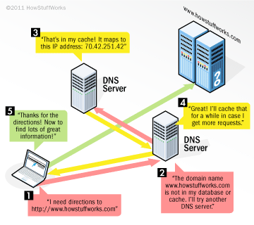
DNS lookup
Domain Name System
Sequence of checks
Browser Cache
OS Cache
Router Cache
ISP DNS cache

Slide 6

DNS Lookup Finding the IP

Slide 7
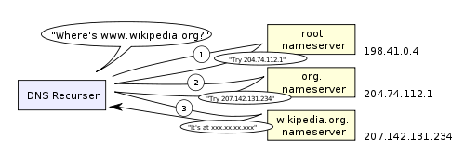
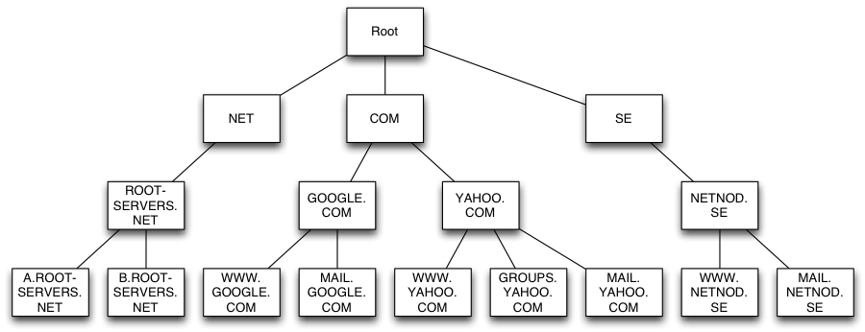
DNS hierarchy
Notes:
Round-robin DNS is a solution where the DNS lookup returns multiple IP addresses, rather than just one. For example, facebook.com actually maps to four IP addresses.
Load-balancer is the piece of hardware that listens on a particular IP address and forwards the requests to other servers. Major sites will typically use expensive high-performance load balancers.
Geographic DNS improves scalability by mapping a domain name to different IP addresses, depending on the client’s geographic location. This is great for hosting static content so that different servers don’t have to update shared state.
<number>

Slide 8

The handshake…

Slide 9
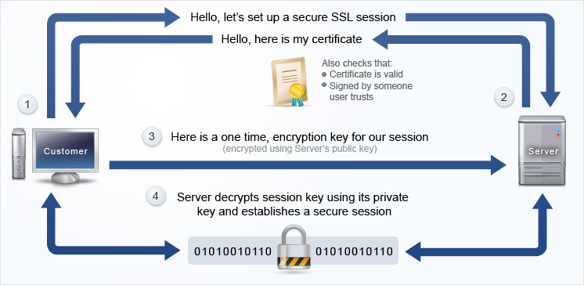
The handshake
Notes:
Once the browser receives the IP address of the destination server, it takes that and the given port number from the URL (the HTTP protocol defaults to port 80, and HTTPS to port 443), and makes a call to the system library function named socket and requests a TCP socket stream.
The client computer sends a ClientHello message to the server with its TLS version, list of cipher algorithms and compression methods available.
The server replies with a ServerHello message to the client with the TLS version, selected cipher, selected compression methods and the server's public certificate signed by a CA
<number>

Slide 10
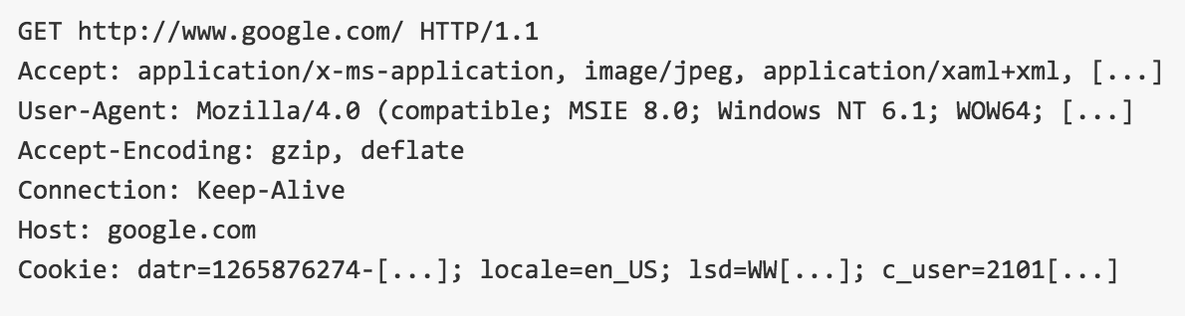
GET’ting the page
Identify the browser
Accepted response
Supported encoding
Cookie info

Slide 11
Server response handler
HTTP Daemon server (Apache or nginx)
Breaks down the request headers (methods/path)
Pull content based on requested path (/)
The server parses the file according to the request handler.
Eg. PHP, ASP.NET etc
In the case of PHP interpret the index file and stream the output

Slide 12
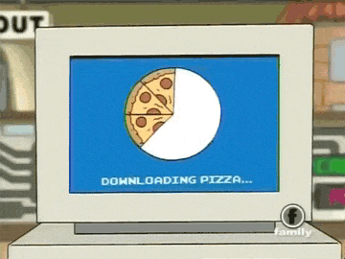
Downloading page……

Slide 13
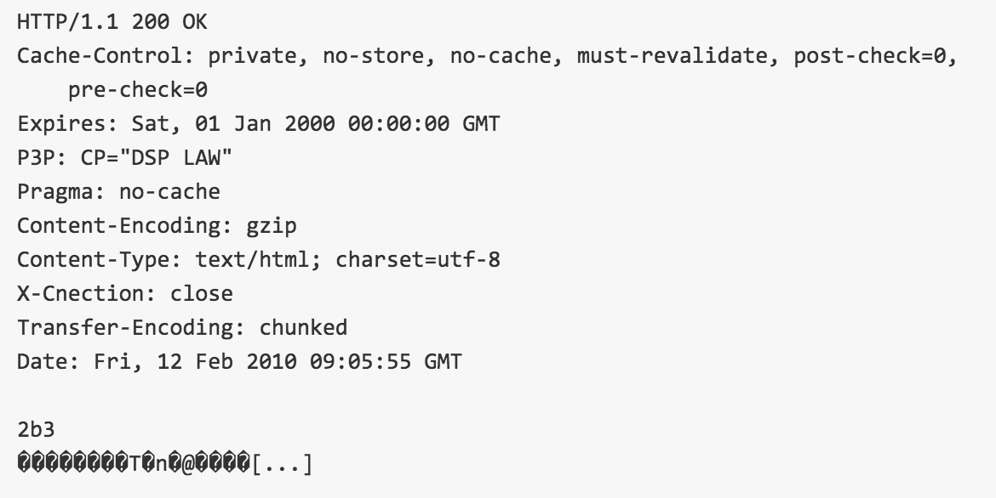
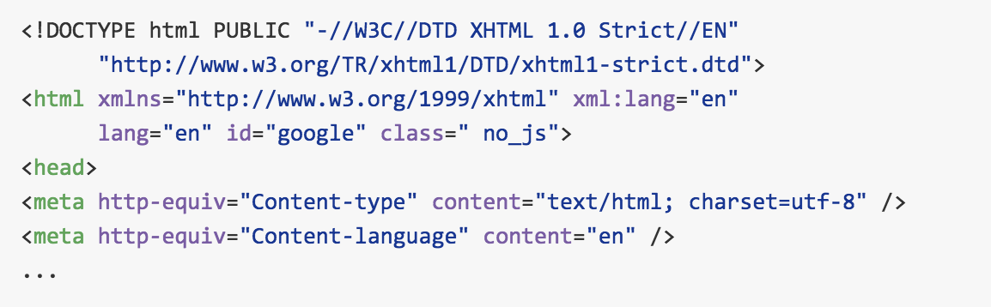
Server Response
Decompressed gzip

Slide 14

Browser Re-entry
Tasks
Parsing
HTML, CSS, JS
Rendering

Slide 15
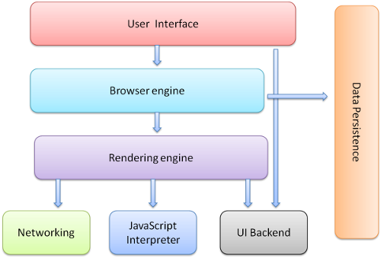
Browser: High Level
Notes:
User Interface: Includes the address bar, back/forward button, bookmarking menu, etc. Every part of the browser display except the window where you see the requested page.
Browser Engine: Marshals actions between the UI and the rendering engine.
Rendering Engine: Responsible for displaying requested content. For eg. the rendering engine parses HTML and CSS, and displays the parsed content on the screen.
Networking: For network calls such as HTTP requests, using different implementations for different platforms (behind a platform-independent interface).
UI Backend: Used for drawing basic widgets like combo boxes and windows. This backend exposes a generic interface that is not platform specific. Underneath it uses operating system user interface methods.
JavaScript Engine: Interpreter used to parse and execute JavaScript code.
Data Storage: This is a persistence layer. The browser may need to save data locally, such as cookies. Browsers also support storage mechanisms such as localStorage, IndexedDB and FileSystem.
<number>

Slide 16
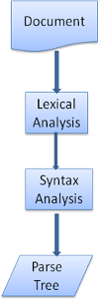
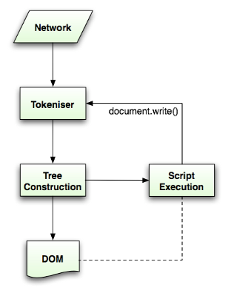
HTML Parsing

Slide 17
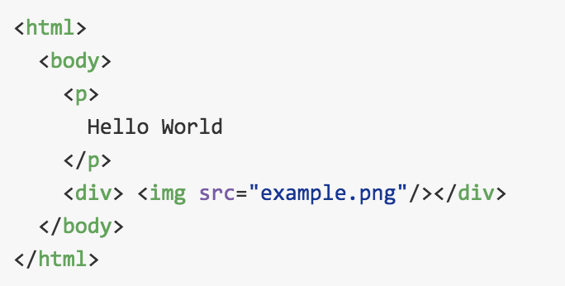
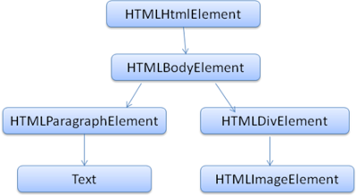
DOM tree

Slide 18
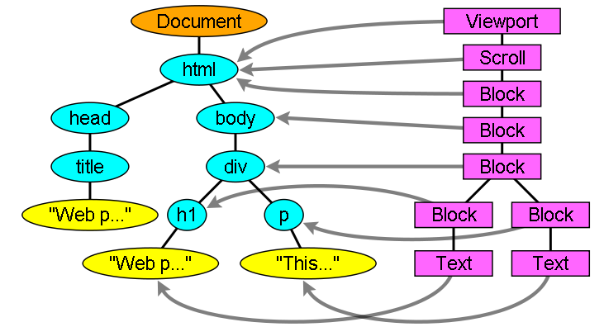
Render tree
Visual representation of DOM (Boxes with geometry)

Slide 19
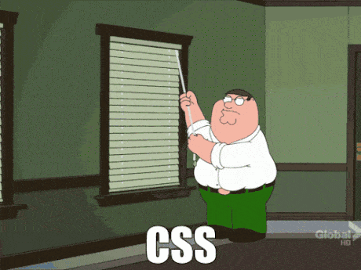
Layout

Slide 20
CSS-OM + Layout
Layout
Maps elements to co-ordinates in the viewport
When the renderer is created and added to the tree, it does not have a position and size. Calculating these values is called layout or reflow.
In order not to do a full layout for every small change, browsers use a "dirty bit" system. A renderer that is changed or added marks itself and its children as "dirty": needing layout.

Slide 21

Painting

Slide 22
Painting
The render tree is traversed and the renderer's "paint()" method is called to display content on the screen. Painting uses the UI infrastructure component.
Like layout, painting can also be global–the entire tree is painted–or incremental.
Before repainting, WebKit saves the old rectangle as a bitmap. It then paints only the delta between the new and old rectangles.
Color changes: only repaint
Element position changes: Layout and repaint of the el + children
Major changes, like increasing font size of the "html" element, will cause invalidation of caches, relayout and repaint of the entire tree.

Slide 23
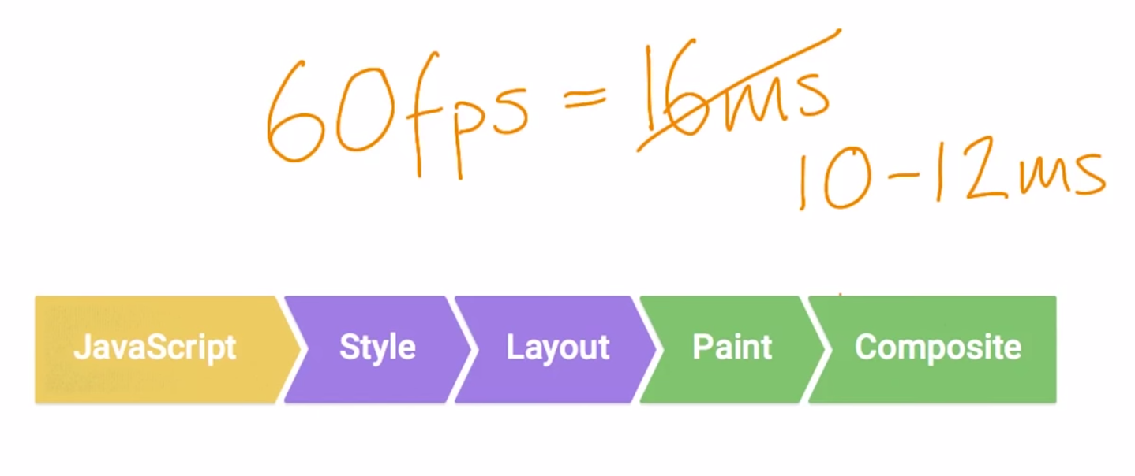
Smooth rendering

Slide 24


Slide 25
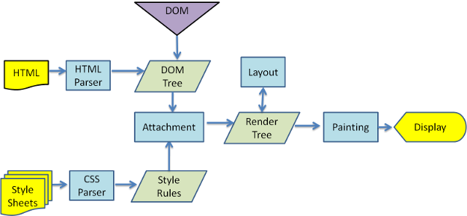
Browser Rendering recap

Slide 26
References
What really happens when you navigate to a URL http://igoro.com/archive/what-really-happens-when-you-navigate-to-a-url/
How Browsers Work: Behind the scenes of modern web browsers
http://www.html5rocks.com/en/tutorials/internals/howbrowserswork/
What happens when https://github.com/alex/what-happens-when
Github public Repo of my detailed learnings on this topic
How Web works?
https://github.com/arunsingh/web_underhood

Slide 27


