Slide 1




SolidFire Healthtool

Slide 2

Element Health Tools Overview
The Element HealthTools suite includes the components required for upgrading Element software on the NetApp HCI and SolidFire AFA storage cluster.
Currently the tools included in this suite are: - sfupdate-healthtools - sfupgradecheck - sfinstall
Support site -> "https://mysupport.netapp.com/products/p/healthtools.html"

Slide 3
Prerequisites for using HealthTools
The management node is running Element version 10.3 or later.
All storage nodes in the cluster are running Element version 9.3 or later.

Slide 4
Running sfupdate-healthtools
To run sfupdate-healthtools, log in to the Management node.
Run this command with <options> in a command-line interface
sudo /sf/bin/sfupdate-healthtools <options>
sfupdate-healthtools ensures that the latest HealthTools are installed.
Run this prior to executing sfupgradecheck and sfinstall so it can update the HealthTools package on all storage nodes in the cluster.

Slide 5
sfupdate-healthtools options
<install file>: Install new healthtools tarball
-l, --latest-version: Show latest version on NSS
-v, - -version: show version installed
-s, --show-versions: Show all previously installed versions
-r, --revert-version <VERSION_NUMBER>: Revert healthtools to this previously installed version (as seen in -s)
--metadata <metadata file URI>: Use this metadata file instead of looking up the NSS file.
-n, --no-validate

Slide 6
sfupdate-healthtools folder structure
SF_BIN = "/sf/bin”
LOCAL_BIN = "/usr/local/bin”
SF_DOC = "/sf/doc”
STAGING = "/sf/healthtools-staging"

Slide 7
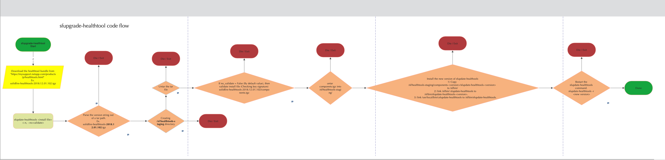
sfupdate-healthtools Code Flow
https://cloud.smartdraw.com/share.aspx/?pubDocShare=3014CBE041870EADBF6E8D138CDECFBDF05
https://bitbucket.ngage.netapp.com/projects/HEAL/repos/solidfire-healthtools/browse

Slide 8
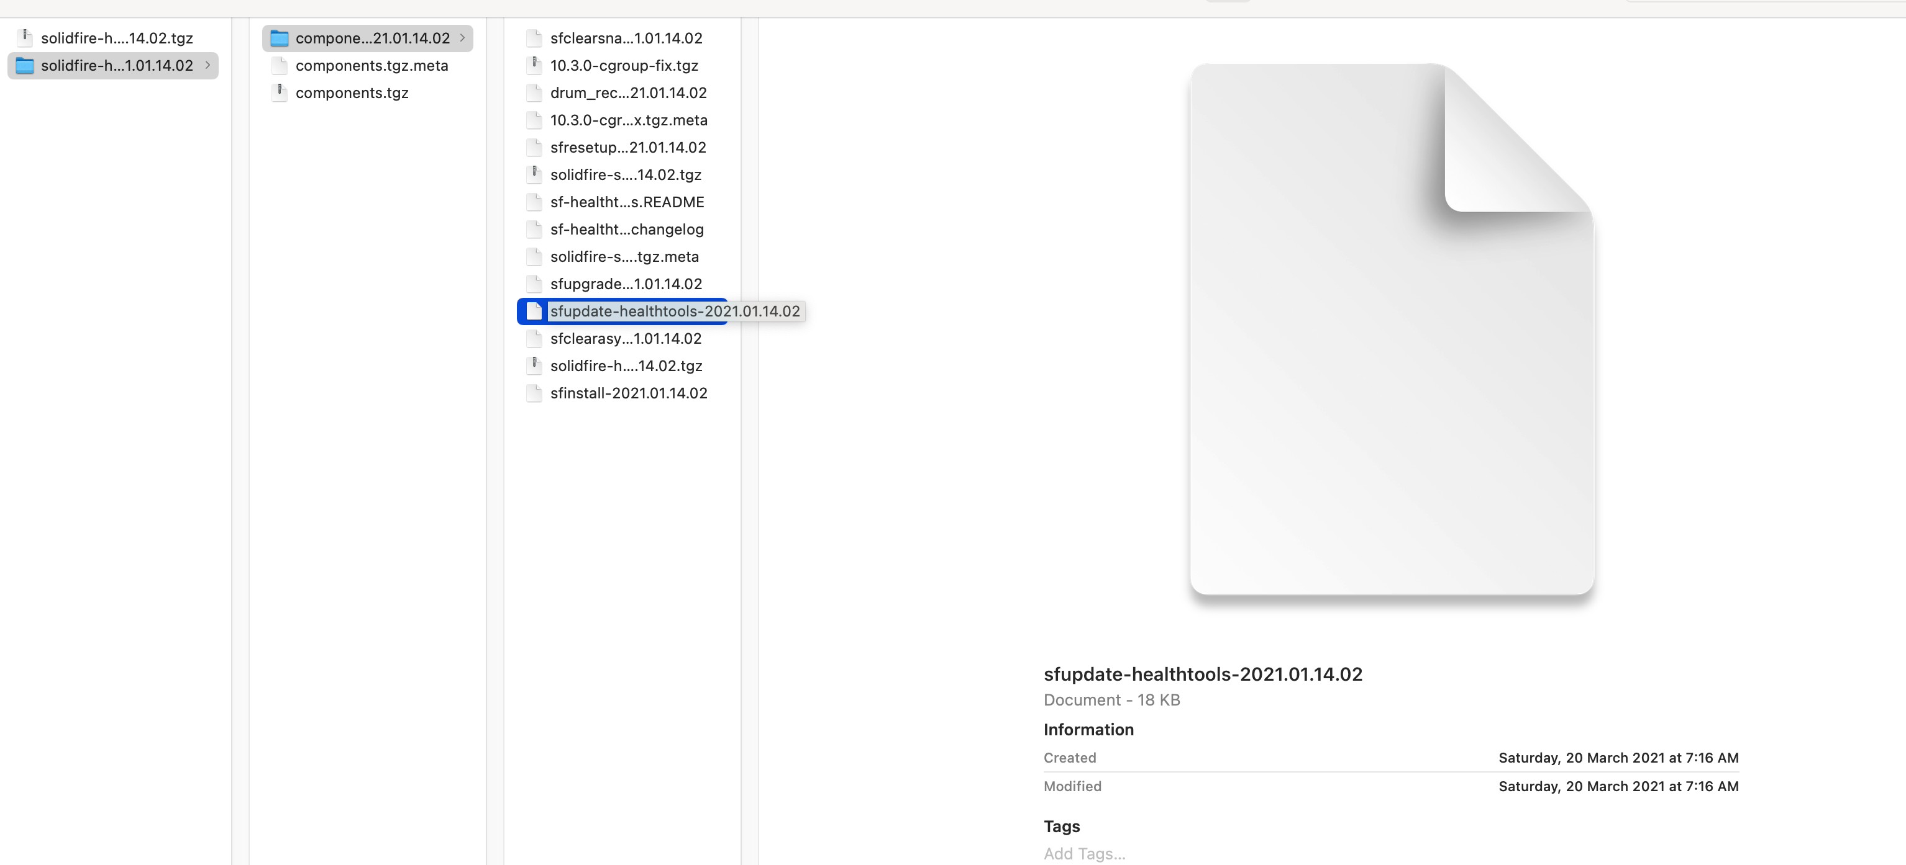
sfupdate-healthtools untar files

Slide 9
sfupdate-healthtools for neon mNode
Checking the mNode version with the help of /sf/bin/sfconfig –Version command
Neon is defined as any version <= 10 of mNode.

Slide 10
sfupdate-healthtools for neon mNode steps
Move the solidfire-healthtools-neon-<version>.tgz from the component's directory to /tmp and rename solidfire-healthtools-<version>.tgz
Remove the /sf/healthtools-staging/components-<version> directory
Rename /sf/bin/sfupdate-healthtools-<version> to /sf/bin/sfupdate-healthtools-0.0.0.0 and relink it.
sfupdate-healthtools /tmp/solidfire-healthtools-<version>.tgz running this command to restart the sfupdate-healthtools.

Slide 11
Thank you
Any Questions?

