Slide 1


PROFESSIONAL JSP
nagendra.yadav@hcl.in

Slide 2
What is JSP
Java Server Pages (JSP) is a technology used to create dynamic content on the Web.
The component of JSP
HTML code
Java Script
JSP tags
JSP implicit objects
For whole appliation

Slide 3
hello.jsp
<html>
<body>
<h2>This is my first jsp page</h2>
</body>
</html>

Slide 4
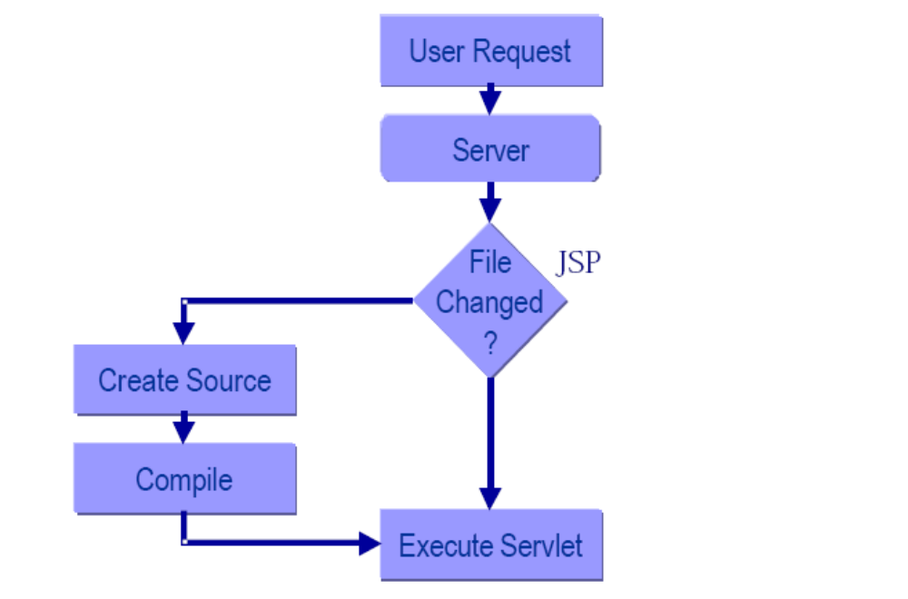
How Does JSP Work?

Slide 5
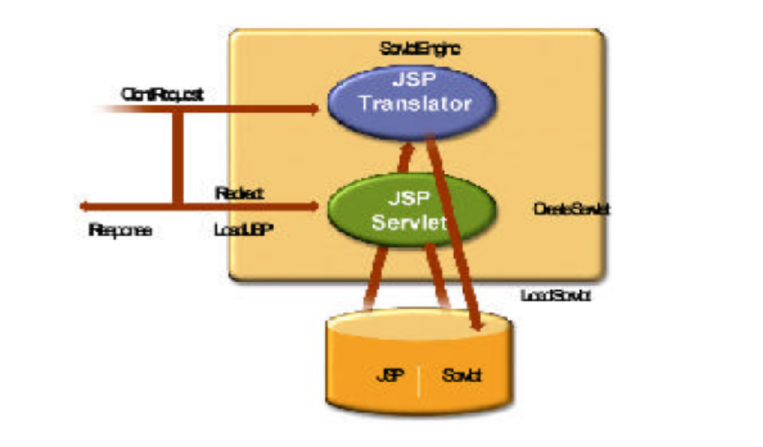
JSP Architecture

Slide 6
JSP life cycle
<%!
public void jspInit(){
Syste.out.println(“inside the jspInit() ”);
}
public void jspDestroy(){
Syste.out.println(“inside the jsp destroy()”);
} %>
<html><body>
<h2>This is for _jspService method of jsp<h2>
</body></html>

Slide 7
What is JSP Tags
JSP tags are used to embed
programming logic in JSP pages. JSP tag enable us to include java code snippets in the JSP page.

Slide 8
JSP Tags
Declaration tags
Expression tags
Scriptlet tags
Directive tags
Comment tags
Action tags

Slide 9
Declaration tags
JSP declaration tags are used to declare variables & methods that are accessible to the rest of JSP page.
<html>
<body bgcolor=“#CCCCFF”>
<p>Now declaring variables</p>
<%!
int ctr=0;
String name=“sharukh”; %>
<p>Now declaring methods</p>
<%!
String showMessage(){
name=“rahul”;
return name;
}
%>
</body></html>

Slide 10
Expression tags
The expressions are a combination of constants & references to variables and methods. expressions can exits either inside a JSP scriptlet or in a JSP expression tag.
<html>
<body bgcolor=“#CCCCFF”>
<p>Now declaring variables</p>
<!%
int ctr=0;
String name=“sharukh”; %>
Name is <%=name%>
</body></html>
expression tag
no space between “%” and ” =“

Slide 11
The Scriptlet Tags
Scriptlet tags are used to embed java code in JSP pages. Therefore ,using the scriptlet tags, Web developers can use the features of java programming language in JSPs.
<html>
<body bgcolor=“#CCCCFF”>
<%!
String name=“Nagendra”; %>
<%
if(name.eqauls(“Nagendra”)) { %>
<h2>welcome Nagendra</h2>
<%
}else %>
<h2> You are not registered.
</body></html>

Slide 12
Mixing Scriptlets and HTML
<HTML>
<BODY>
<TABLE BORDER=2>
<%
for ( int i = 0; i <20; i++ ) {
%>
<TR>
<TD>Number</TD>
<TD><%= i+1 %></TD>
</TR>
<%
}
%>
</TABLE>
</BODY>
</HTML>

Slide 13
Simple JSP page (hello.jsp)
<%!
int count=0;
public String showMsg(){
return “good morning” ;
} %>
<html><body>
<%
int var=10;
var=var+2;
out.println(“value of var is “+var);
out.println(“function calling :”+showMsg());
%>
<h2>Number of hits for this page is :<%=++count%><h2>
</body></html>

Slide 14
hello_jsp.java
public class hello_jsp extends HttpJspBase {
int count=0;
public String showMsg(){
return “good morning” ;
}
public void _jspService(HttpServletRequest reg,HttpServletResponse res) throws IOException,ServletException {
int var=10;
var=var+2;
out.println(“value of var is “+var);
out.println(“function calling :”+showMsg());
out.write(“\r\n”);
out.write(“<h2>Number of hits for this page is ”);
out.write(++count);
out.write(“<h2>”);
out.write(“\r\n”);
out.write(“</body></html>”); } }}

Slide 15
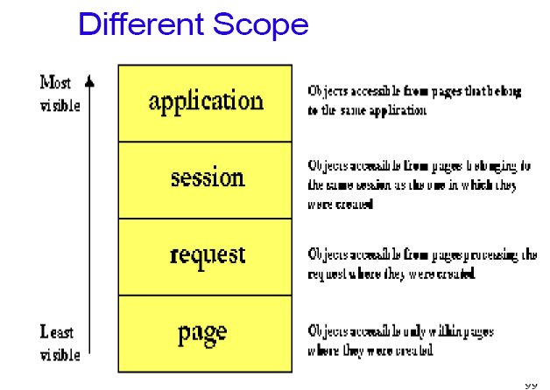
Scope Objects

Slide 16
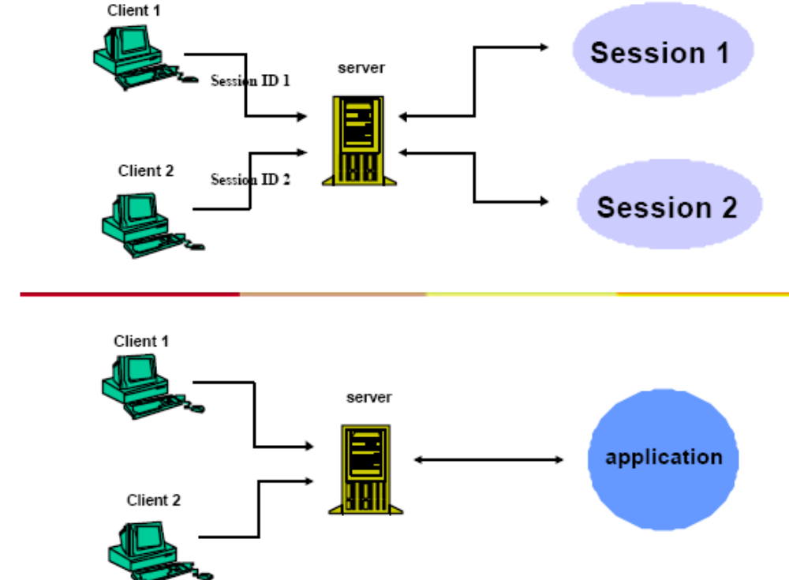
Session, Application Scope

Slide 17
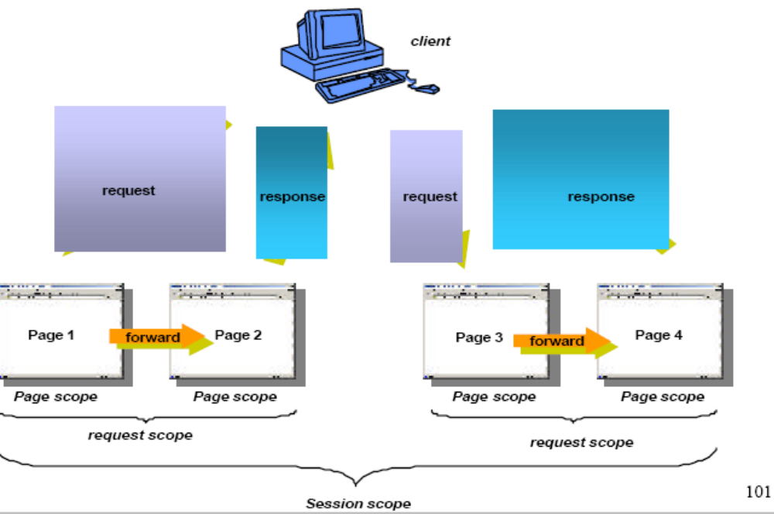
Session, Request, Page Scope

Slide 18
The Directive Tags
The directive tags are used to command JSPs to perform certain steps or behave in a specified way. There are three kind of JSP directives.
page
include
taglib

Slide 19
Attributes to the page directive
isThreadSafe(true)
Import
contentType(text/html)
isELIgnored(true)
isErrorPage(false)
errorPage
language :define scripting language used in scriplets,expression,and declarations.
extends
session(true)
buffer
autoFlush(true)
info( can get using getServletInfo())
pageEncoding:defines the character encoding for the JSP

Slide 20
<%@ page language="lang"%>
Sets the JSP script language to lang. Defaults to Java. All JSP 1.0 implementations must support Java. Some implementations, like Resin, may support other scripting languages, e.g. JavaScript.

Slide 21
<%@ page import="package" %>
<%@ page import=“java.util.Date" %>
<html>
<body>
Current data is :<%=new Date()%>
</body>
</html>

Slide 22
<%@ page errorPage="path" %>
Defines a page to display if an error occurs in the JSP page.
Robust applications can return informative error pages when something goes wrong in a file, for example if a database is overloaded. path is returned as the response file. The error page can use the additional implicit variable exception containing the thrown exception.
<%@ page errorPage=“myError.jsp" %>
<html>
<body>
<% int a=444;
int b=0;
int result=a/b; %>
<h2>result is <%=result%>
</body>
</html>

Slide 23
myError.jsp
The error page itself can be a JSP page. If the error page is a JSP page, it can use the implicit variable exception to get information about the thrown exception
Gives an error page access to the exception implicit variable. Default to false.
<%@ page isErrorPage="true" %> <h1>Received error
<%= exception.getMessage()%></h1>

Slide 24
<%@ include file="path" %>
Includes the raw file path at translation time.
The include directive is a replacement for an SSI include (or the C '#include'). It includes the contents of the file at path into the JSP file. The included file is parsed as JSP, so it can have active elements like expressions, declarations and scriptlets.
(header.jsp)
<html><head> <title><%= title %></title> </head> <body color=white>
(page.jsp)
<% var title = "Hello, World"; %>
<%@ include file='header.jsp' %>
<h1><%= title %></h1>

Slide 25
<%@ page buffer=sizekb %>
Gives the size of the page buffer in kb or none for no buffer. Default 8kb. If buffer is none, all output is immediately flushed.
<%@ page autoFlush="true" %>
Tells JSP to flush the page buffer when it fills. Default is true.
If autoFlush is false, the JSP engine will throw an exception if the buffer overflows.

Slide 26
<%@ page session="true" %>
Tells JSP that the page participates in a session. Defaults to true.
The session declaration makes the session implicit variable available to a JSP page.
If the page doesn't use sessions, it should set session to false.

Slide 27
<%@ page isThreadSafe="true" %>
Tells the JSP that multiple pages can execute in parallel. Defaults to true .
JSP pages are always responsible for synchronization of shared variables, such as the session and application variables. In some rare cases, a page may use servlet variables (created with a declaration), and be too lazy to handle the synchronization.

Slide 28
<%@ page info="description" %>
Gives a brief description for the page.
We can access information regarding jsp.
<%@ page info=“page for database connection" %>
<html>
<body>
This page info <%=getServletInfo()%>
</body>
</html>

Slide 29
<%@ page contentType="description" %>
Sets the content type and character encoding of the page.
contentType can also set the character encoding, for example to utf-8.
<%@ page contentType="text/plain; charset=utf-8" %>
<%! var count = 0; %>
<h1>Welcome, visitor <%= count++ %>

Slide 30
<%@ page extends="Java class" %>
Changes the generated servlet's class.
In general, a filter is a better solution than using the extends directive.
<%@ taglib prefix="x" uri="foo" %>
Configures tags with prefix x to use the tag library foo.
<%@ taglib prefix='x' uri='http://www.caucho.com/mytag/test' %>
<x:mytag/> (We will discuss in detail)

Slide 31
include tag
We can create a separate HTML page then give the command in the JSP page to include the output of the HTML in the JSP output.we can give this command by using the include directive.
[includeJSP.jsp]
<html><body> <%! int ctr=0 %>
<% for(;ctr<=5;ctr++)
{
%>
<h2>The value of ctr is <%=ctr%>
<% } %>
</body></html>

Slide 32
include tag
<html>
<body>
<%@ include file=“includeJSP.jsp”%>
<p>The above content is generated by another jsp.
</body>
</html>

Slide 33
The Comments Tags
Comments tags are used to insert comments in JSP code.There are three types of comments.
HTML
JSP
Java
<!-- This is html comment -->
<%-- This is jsp comment --%>
and java comments are used to comment the java code embedded in a JSP.
// & /*java comment */

Slide 34
Using <scripting-invalid> putting in DD
<web-app …>
<jsp-config>
<jsp-property-group>
<url-pattern>*.jsp</url-pattern>
<scripting-invalid>
true
</scripting-invalid>
</jsp-property-group>
</jsp-config>
</web-app>

Slide 35
Using the isELignored page directive attribute
<%@ page isELIgnored=“true” %>
<%
String name=“Hi Nagendra!”;
request.setAttribute(“name”,name);
%>
This is use of EL ${name}

Slide 36
The Action Tags
The action tags extends the functionalities of JSPs.The action tags allow JSPs to use objects created in java ,include other jsps,forward request to other JSPs,and interact with java plugins.There are six action tags:
useBean
setProperty
getProperty
include
forward
plugin

Slide 37
Scripting-free pages
With standard actions (no scripting)
JSP code :
<html><body>
<jsp:useBean id=“user” class=“wizard.User” scope=“request”/>
user is : <jsp:getProperty name=“user” property=“name” />
</body></html>

Slide 38
Detail description of <jsp:useBean> tag
<jsp:useBean id=“user” class=“wizard.User” scope=“request”/>
Turns into this code in the _jspService() method
Wizard.User user=null;
synchronize(request) {
user=(wizard.User)_jspx_page_context.getAttribute(“user”,PageContext.REQUEST_SCOPE)
If(user==null){
user=wizard.User();
_jspx_page_context.setAttribute(“user”,user,PageContext.REQUEST_SCOPE);
}
}

Slide 39
<jsp:useBean> can have a body
<jsp:useBean id=“user” class=“wizard.User” scope=“page”>
<jsp:setProperty name=“user” property=“name” value=“rajesh”/>
</jsp:useBean>
Note: With a <jsp:useBean> body,we can have code that runs conditionally ..ONLY if the bean attribute cann’t be found and a new bean is created.
Note : We can make polymorphic bean references?
<jsp:useBean id=“user” type=“wizard.User” class=“wizard.Employee” scope=“page”/>
The scope attributes defaults to “page”

Slide 40
use of setProperty() and getProperty() with <jsp:useBean>
<jsp:useBean id=“user” class=“wizard.User” scope=“page”>
<jsp:setProperty name=“user” property=“name” value=“rajesh”/>
</jsp:useBean>
Name is :<jsp:getProperty name=“user” property=“name” />

Slide 41
Going straight from the request to the JSP without going through a servlet
<html><body>
<form action=“testBean.jsp”>
Name : <input type=“text” name=“userName”>
ID#: <input type=“text” name=“userId”>
<input type=“submit”>
</form></body></html>
<jsp:useBean id=“user” class=“wizard.User” scope=“page”>
<jsp:setProperty name=“user” property=“name” value=“rajesh”/>
</jsp:useBean>
We can use combination of standard tag & scripting
<jsp:useBean id=“user” class=“wizard.User”/>
<% user.setName(request.getParameter(“userName”))%>
OR

Slide 42
connection with database though properties file
sql.properties file :
connection.url=jdbc:odbc:db
user=user
password=passwd
Properties propes=new Properties();
InputStream in=new FileInputStream(“sql.properties”);
Or
InputStream in=getServletContext().getResourceAsStream(“/WEB-INF/sql.properties”);
propes.load(in);
in.close();
Class.forName(propes.getProperty(“connection.driver”));
Conn=DriverManager.getConnection(propes.getProperty(“conn.usrl”),propes);

Slide 43
Going straight from the request to the JSP without going through a servlet
<jsp:useBean id=“user” class=“wizard.User” scope=“page”>
<jsp:setProperty name=“user” property=“name” value=“<%=request.getParamter(“userName”)%>”/>
</jsp:useBean>
User of param attributes
<jsp:useBean id=“user” class=“wizard.User”>
<jsp:setProperty name=“user” property=“name” param=“userName” />
</jsp:useBean>
In case of ,input field name matches the property name:
<jsp:useBean id=“user” class=“wizard.User”>
<jsp:setProperty name=“user” property=“name” />
</jsp:useBean>
Or in case of all fields matches:
<jsp:useBean id=“user” class=“wizard.User”>
<jsp:setProperty name=“user” property=“*” />
</jsp:useBean>
Note:Bean tags convert primitive properties automatically

Slide 44
The Action Tags
The action tags extends the functionalities of JSPs.The action tags allow JSPs to use objects created in java ,include other jsps,forward request to other JSPs,and interact with java plugins.There are six action tags:
useBean
setProperty
getProperty
include
forward
plugin

Slide 45
Forward action tag
The forward actin tag is used by aJSP page that accepts a request from a user and passes the request to another JSP page.
<html><body>
<%! int ctr=0;
%>
<%
if(ctr>101) {
%>
<jsp:forward page=“show1.jsp”/>
<% }
else { %>
<jsp:forward page=“show2.jsp”/>
<% } %> </body></html>

Slide 46
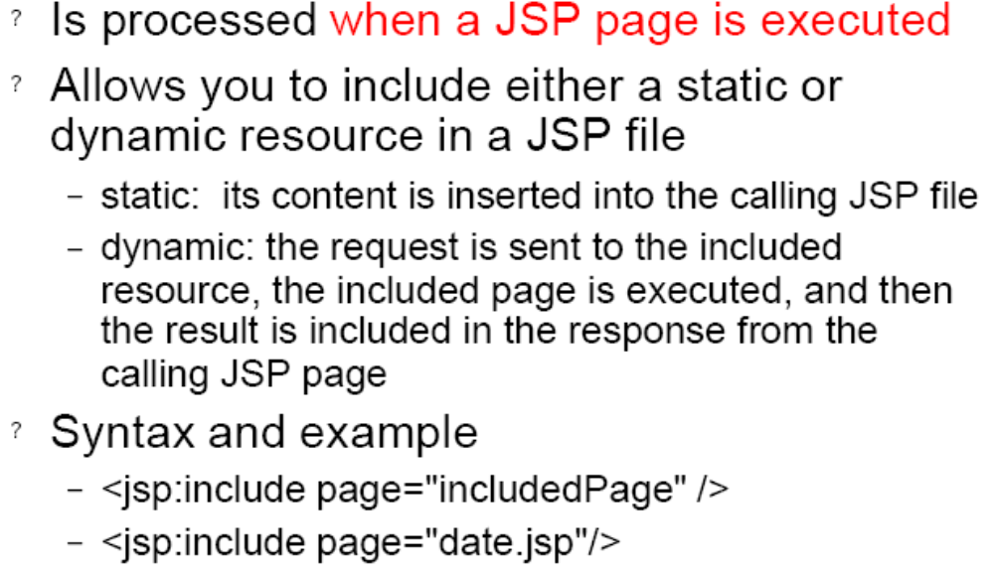
jsp:include Element

Slide 47
Forward action tag
<jsp:forward page="/main.jsp" />
<jsp:forward page="..." >
<jsp:param name="param1" value="value1"/>
</jsp:forward>

Slide 48
plugin action tag
The plugin action tag is used to insert Java applets in the JSP pages.
<html><body>
<h2>inserting a applet in jsp</h2>
<jsp: plugin type=“applet” code=“com.DemoApplet” width=“200” height=“200”
</jsp:plugin>
</body></html>

Slide 49
JSP Implicit Objects
Implicit objects are pre-defined variables that are accessible to all JSP pages.
API Implicit Object
JspWriter out
HttpServletRequest request
HttpServletResponse response
HttpSession session
ServletContext application
ServletConfig config
JspException exception
PageContext pageContext
Object page

Slide 50
request implicit object
Some of method of request object
String getPathInfo()
String getContextPath()
String getQueryString()
String getRequestURI()

Slide 51
Initializing your JSP
Configuring servlet init parameters
<web-app …>
<servlet>
<servlet-name>MyTestInit</servlet-name>
<jsp-file>/testInit.jsp</jsp-file>
<init-param>
<param-name>email</param-name>
<param-value>nky@yahoo.com</param-value>
</init-param>
</servlet>
</web-app>

Slide 52
Overriding jspInt()
Accessing configured parameter from the previous slide
<%!
public void jspInit() {
String email=config.getInitParameter(“email”);
request.setAttribute(“email”,email);
}
%>

Slide 53
Attributes in JSP
In a servlet
Application-> getServletContext().setAttribute(“foo’,temp);
Request->request.setAttribute(“foo”,temp);
Session->session.setAttribute(“foo”,temp);
In JSP
Application-> application.setAttribute(“foo’,temp);
Request->request.setAttribute(“foo”,temp);
Session->session.setAttribute(“foo”,temp);
Page-> pageContext.setAttribute(“foo”,temp

Slide 54
Using PageContext for attributes
we can use PageContext reference to get attributes from any scope. including page scope for attributes bound to the PageContext.
Some example using PageContext to get & set attributes
<% Float one=new Float(42.5);%>
<% pageContext.setAttribute(“foo”,one);
<%=pageContext.getAttribute(“foo”);%>
2) <% Float two=new Float(22.5);%>
<% pageContext.setAttribute(“foo”,two,PageContext.SESSION_SCOPE);
%>
<%=pageContext.getAttribute(“foo”, PageContext.SESSION_SCOPE);%>
Finding attributes using PageContext when we donot know the scope
<%=pageContext.findAttribute(“foo”)%>
first look for page context scope -> request->session->application and so on

Slide 55
Going straight from the request to the JSP without going through a servlet
Note: Automatic String-to-primitive conversion dose not work if you use scripting!! It fails even if an expression is inside the <jsp:setProperty>tag
But what if the Property is something OTHER than a String or primitive?
The <jsp:getProperty>lets you access only the properties of the bean attribute.There’s no capability for nested properties,where we want a property of a property rather than a property of the attribute.
Now Expression Language(EL) is solution for this problems
EL makes it easy to print nested properties…in other words,properties of properties
JSP code without scripting,using EL
Dog’s name is : ${user.dog.name} is equivalent to <%=((wizard.User)request.getAttribute(“user”)).getDog().getName() %>

Slide 56
Advantages of the Expression
Language (Continued)
Succinct access to request parameters, cookies,and other request data.
To access the standard types of request data, you can use one of several predefined implicit objects.
A small but useful set of simple operators.
-To manipulate objects within EL expressions, you can use any of
several arithmetic, relational, logical, or empty-testing operators.
Conditional output.
- To choose among output options, you do not have to resort to Java
scripting elements. Instead, you can use ${test ? option1 : option2}.
Automatic type conversion
- The expression language removes the need for most typecasts andfor much of the code that parses strings as numbers.
Empty values instead of error messages.
In most cases, missing values or NullPointerExceptions result in
empty strings, not thrown exceptions.

Slide 57
Preventing Expression Language Evaluation
Deactivating the EL in an entire Web application.
– Use a web.xml file that refers to servlets 2.3 (JSP 1.2) or earlier.
Deactivating the expression language in multiple JSP pages.
– Use the jsp-property-group web.xml element
Deactivating the expression language in individual JSP pages.
- Use <%@ page isELIgnored="true" %>
This is particularly useful in pages that use JSTL.
//use scripting –invalid in web.xml
<jsp-property-group>
<url-pattern>*.jsp</url-pattern>
<scripting-invalid>true</scripting-invalid>
</jsp-property-group>

Slide 58
EL saves the day
Jsp code without scripting
<html><body>
Dog’s name is : ${person.dog.name}
</body>
</html>
<%=((foo.Person)request.getAttribute(“person”)).getDog().getName()
%>

Slide 59
JSP Expression Language(EL)
EL expressions are always within curly braces and prefixed with the dollar sign
${user.name}
in above EL first named variable in the expression is either an implicit object or an attribute.

Slide 60
Using the dot(.) operator to access properties & map values
The first variable is either an implicit object or an attribute , and the thing to the right of the dot is either map value or bean property.
if the expression has a variable followed by a dot ,the left-hand variable MUST be a Map or bean.
The thing the right of the dot MUST be a map key or bean property And the thing on the right must follow normal java naming rules for identifiers.

Slide 61
The [ ] operator is like the dot only way better
The dot operator works only when the thing on the right is a bean property or map key for the thing on the left.But the [ ] op is a lot more powerful and flexible
this :
${person[“name”]} is the same as
${person.name}
Note :The dot operator version works because person is a bean and name is a property of person.But what if person is an Array or List

Slide 62
The [] gives more option
If the expression has a variable followed by bracket [ ], the left-hand variable can be Map,bean ,List,an Array
If the things inside the brackets is a String literal,it can be a Map key or a bean property, or an index into a List or array.

Slide 63
Using the [ ] operator with an array
In a Servlet
String [ ] fmusic={“A”,”B”,”C”};
request.setAttribute(“fmusic”,fmusic);
in Jsp :
First song is ${fmusic[0]}
Second song is ${fmusic[“1”]}

Slide 64
String index is coerced in an int for arrays and Lists
ArrayList al=new ArrayList();
al.add(“A”);
al.add(“B”);
al.add(“C”);
request.setAttribute(“al”,al);
Foods are : ${al}
First food is : ${al[0]}
Second food is ${al[“1”]}
But this will not work
${al[“one’]}
Note : For beans and Maps we can use either operators

Slide 65
If it’s NOT a String literal,it’s evaluated
Music is : ${musicMap[“Ambient”]}
find an attribute named “Ambient” use the value of that attribute as the key into the map,or return null;

Slide 66
You can not do ${foo.1}
${musicMap.Ambient}
Is same as ${musicMap.[“Ambient”]}
But this ${musicMap.[“1”]} not same as
${musicMap.1

Slide 67
EL IMPLICIT OBJECT:
pageScope
requestScope
sessionScope
applicationScope
Param
paramValues
Header
headerValues
Cookie
initParam
pageContext
Note:EL implicit objects are not same as the implicit objects available to JSP Scripting,except for pageContext;

Slide 68
Request parameter in EL
In a JSP:
Name is ${param.name}
Address is ${param.address}
${param.food} gives first value
Means same as ${paramVaues.food[0]}
And Second food is ${paramVaues.food[1]}

Slide 69
What is we want more information from the request
Getting the “host ” header
Host is :<%=request.getHeader(“host”)%>
But with EL
Host is : ${header[“host”]}
Host is : ${header.host

Slide 70
Getting the Http request Method
Method is <%=request.getMethod()%>
Above is fine..
The requestScope is not the request object
Use requestScope to get request attributes ,not request properties ,for request properties,you need to go throug pageContext
Use pageContext to get to everything else….
Method is :${pageContext.request.method}
In above pageContext has a request property & request has a method property

Slide 71
Some implicit object save you
${person.name} donot care for scope
${requestScope.person.name}
(from request scope)
***request.setAttribute(“foo.person”,p);
And this will not work:
${foo.person.name}
But ${requestScope[“foo.person”].name} will work

Slide 72
Getting Cookies and init params
Printing the value of the “userName” Cookie
we can do it with scripting
<% Cookie[] ookies=request.getCookies();
for(int i=0;i<cookies.length;i++){
if((cookies[i].getName()).equals(“userName”)){
out.println(cookies[i].getValue());
}
} %>
But with EL we can write
${cookie.userName.value}

Slide 73
Printing the value context init parameter
We have to configure the parameter in the DD.
<context-param>
<param-name>mainEmail</param-name>
<param-value>nk@yahoo.com</param-value>
</context-param>
We know we can do with scripting
Email is <%=application.getInitParameter(“mainEMail”) %>
And with EL
Email is : ${initParam.mainEMail}

