Slide 1
GraphQL
Introduction to GraphQL

Slide 2
Agenda
Introduction
How it works
Core Concepts
REST vs GraphQL
Architecture use cases
Demo
Tools & Ecosystem
Thoughts

Slide 3
Introduction
GraphQL is a query language for APIs and a runtime for fulfilling those queries with your existing data. GraphQL provides a complete and understandable description of the data in your API, gives clients the power to ask for exactly what they need and nothing more, makes it easier to evolve APIs over time, and enables powerful developer tools.

Slide 4
Introduction
Created by Facebook in 2012 to solve data fetching challenges on their native mobile apps
Open sourced in 2015
Language agnostic
Alternative to REST architecture style to design APIs
Used in production by big companies like GitHub, Facebook, Paypal..

Slide 5






Who is using GraphQL?
See https://graphql.org/users/

Slide 6
Core Concepts
Schema: defines the API structure/contract itself - Core concept
Type: definition of a model (Person, Band, Document..)
- Scalar types (default): Int, Float, Boolean, String, ID and custom scalar types
Query: definitions to query data (fetch)
Mutation: definition to mutate data (create, update, delete..)

Slide 7
Four important aspects
Specification: schema specifies the API contract.
Strongly Typed: all types and relationships are defined in schema.
Introspective: client can query details about the schema.
Hierarchical: query and response have same structure.

Slide 8
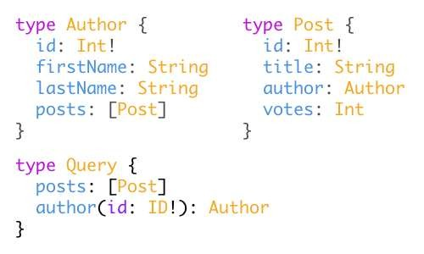
Schema definition
- To define a schema we use a Schema Definition Language (SDL)

Slide 9
Operation types
There are three types of operations in a GraphQL service:
Query: a read-only fetch
Mutation: a write followed by a fetch
Subscription: a long‐lived request that fetches data in response to source events

Slide 10
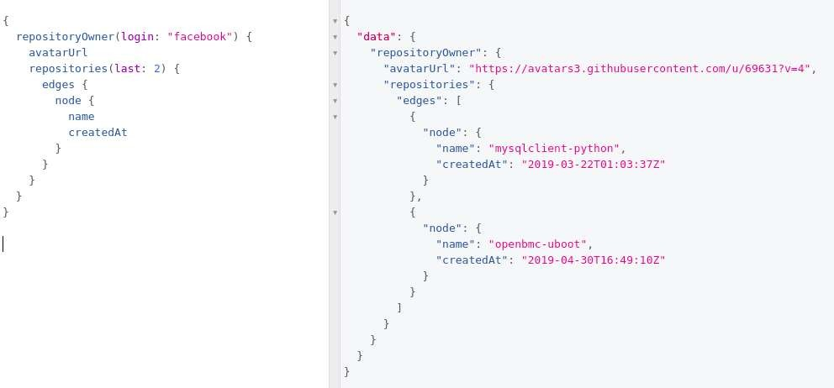
Query operation type - github graphQL API

Slide 11
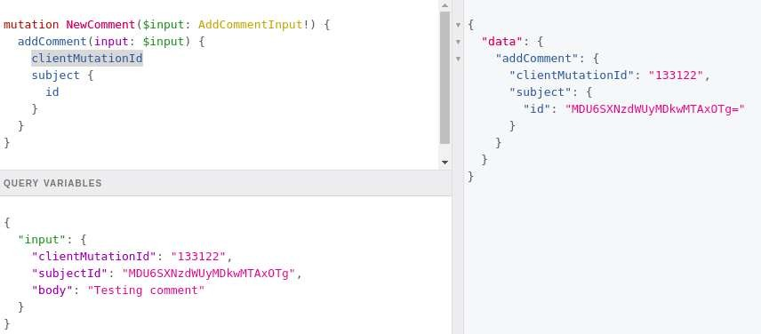
Mutation operation type - github graphQL API

Slide 12
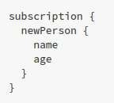
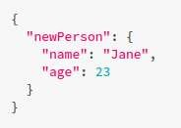
Subscription operation type
Client call
< connection opened >
Server
response
whenever a new mutation is performed that creates a new Person, the server sends the information about this person over to the client

Slide 13
REST
vs
GraphQL
ways to fetch data

Slide 14
USE CASE:
For a given blog API, get: person name, only posts title and name of last 3 followers

Slide 15
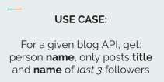
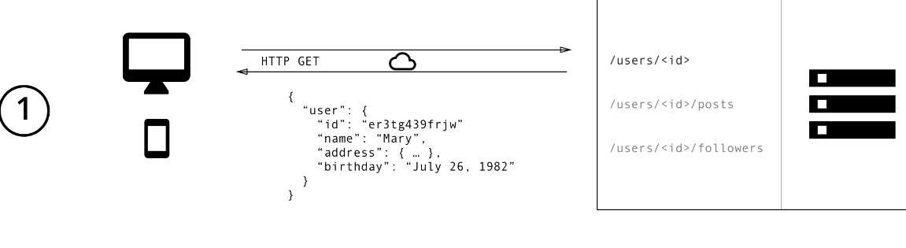
REST way to fetch data

Slide 16
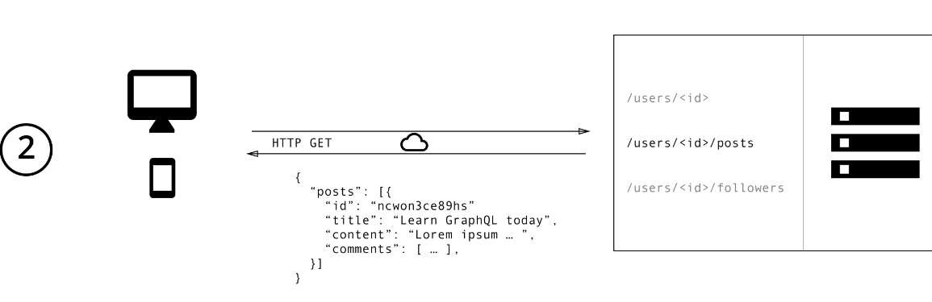
REST way to fetch data

Slide 17
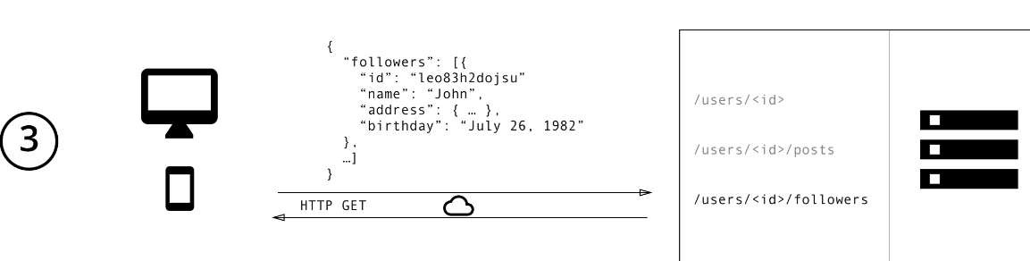
REST way to fetch data

Slide 18
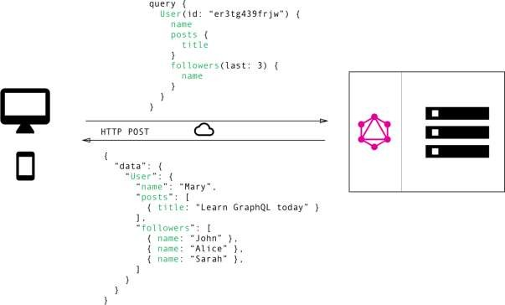

GraphQL: Fetch only data you want
Front end guy

Slide 19
REST vs GraphQL
REST way:
Fetch data from multiple endpoints
Overfetching: call too much data that won’t be all used
Underfetching: call an endpoint that has not enough data - forcing to call another endpoint
GraphQL way:
Ask for specific fields in a single API call

Slide 20
REST vs GraphQL
BUT:
GraphQL is not better because it is trending
Schema definition can become very complex in a big application
Support caching could be harder

Slide 21
Architecture use cases
GraphQL server with a connected database
GraphQL server in front of a number of third party or legacy systems and integrates them through a single GraphQL API
A hybrid approach of a connected database and third party or legacy systems
that can all be accessed through the same GraphQL API

Slide 22
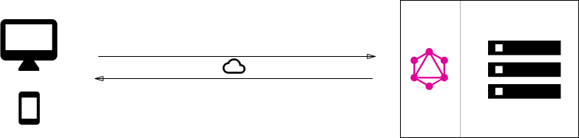
Architecture use cases
GraphQL server with a connected database

Slide 23
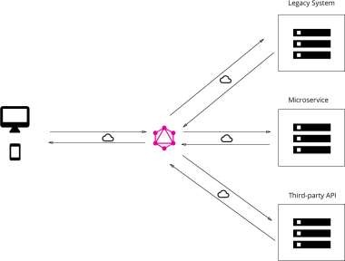
Architecture use cases
GraphQL server in front of a number of third party or legacy systems and integrates them through a single GraphQL API

Slide 24
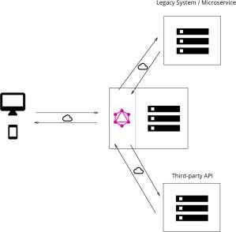
Architecture use cases
A hybrid approach of a connected database and third party or legacy systems that can all be accessed through the same GraphQL API

Slide 25
Demo

Slide 26
Tools & Ecosystem
Specification: http://facebook.github.io/graphql
GraphQL website: https://graphql.org/
GraphQL Reference Implementation in JS: https://graphql.org/graphql-js/
Many different language implementations: https://graphql.org/code/
Awesome GraphQL
https://github.com/chentsulin/awesome-graphql

Slide 27
Thoughts
From a client perspective, using GraphQL is amazing
From a server perspective, you gotta know what you are doing
- There are a massive number of tools and libs that we can use
Starting point to your project might be create GraphQL API in front of your
REST endpoints

Slide 28
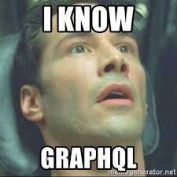
THANKS!

