Slide 1
DDI(Dealer Data Integration) PHI ERB Review

Slide 2
ERB summary
Item | Selection |  | Answer
1. Request to ERB team - Category | Solution Consultation for Future ERB or PoC Solution Pre-validation for ERB Solution Approval request to ERB for infra provision or CR for past ERB |  | C
2. Application information | A. New app / B. Existing app / C. Mixture |  | B
 | A. Global app / B. Regional app / C. Local app |  | A
3.Solution Summary | Platform | Mixture of On-premise/Cloud Cloud only On-premise only | A
 | Application Architecture | Package Software only Scratch only Mixture of PKG and Scratch | C
 | Technology Components | DTS-complied product only New product included | A
 | Interfaces | Internal only(No internet based I/F) External included(Internet based I/F) | B
4. Phase and Schedule | Project Current Phase |  | Initiation
 | Expected Go Live (YYYYMM) |  | Nov. 2021
5. Internal Review Status | Comment/Specific review points from App Owner Manager |  | E. PRAKASAN

Slide 3
Index
Problem Statement/Project Context -- 4 - 6
Solution Approach -- 7-8
Conceptual diagram & Data Sources -- 9-10
Data Flow & Deployment architecture -- 12-14
Security & Data Privacy – 14 – 17
Application Tech stack & NFR – 18 -22

Slide 4
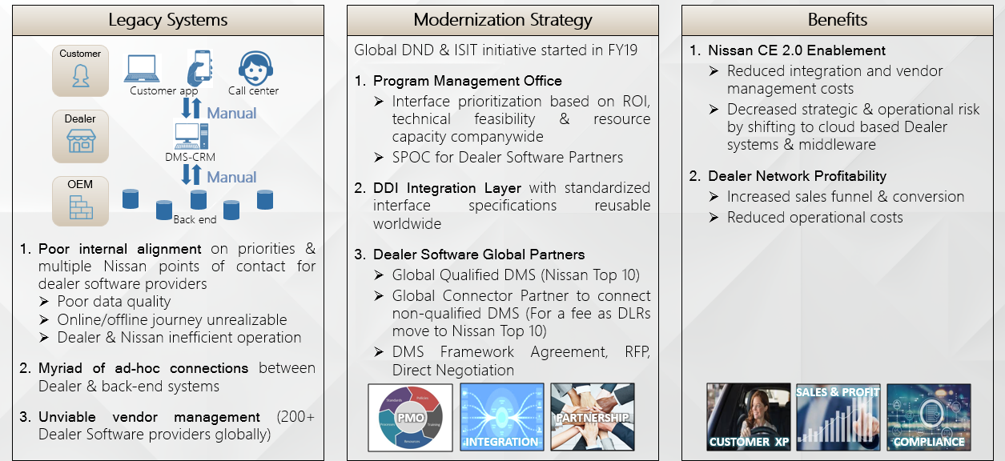
Project Background - DDI
DDI Background:
Until now, Nissan has not set a concrete scalable DMS strategy.
As a result:
Poor connections: Data exchange is inconsistent between DMS to Nissan backend systems.
More DMS vendors : Difficult to manage 200+ dms vendors across the region.
Data Quality issues : This situation left us with very limited interfaces between Nissan Philippines systems and DMS systems. Data quality issues due to manual entry of data.
DDI Objectives :
The objective of the project is to support seamless integration between
Dealer Management System (DMS) with Nissan backend Systems.
Progress:
In FY21
piloting in Nissan Europe to automate different invoices like vehicles, parts etc.
piloting in Nissan South Africa to consolidate customer data from CRM system.

Slide 5
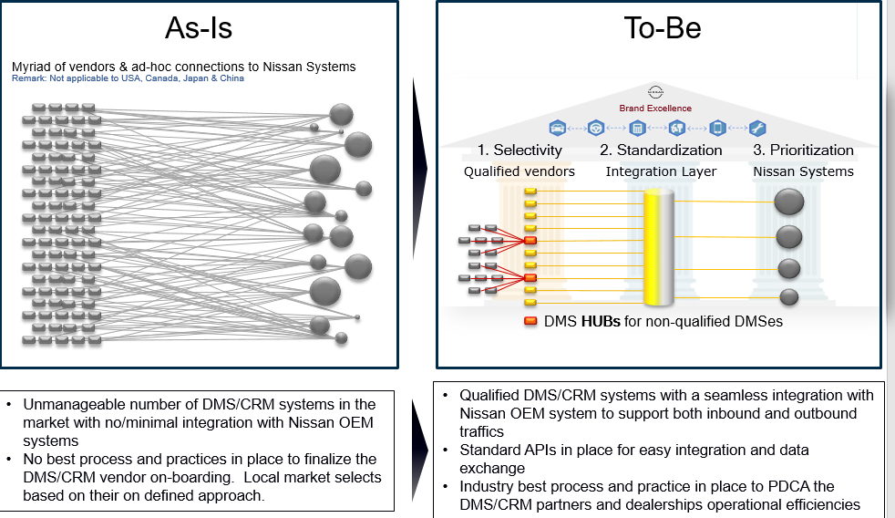
Project Background

Slide 6
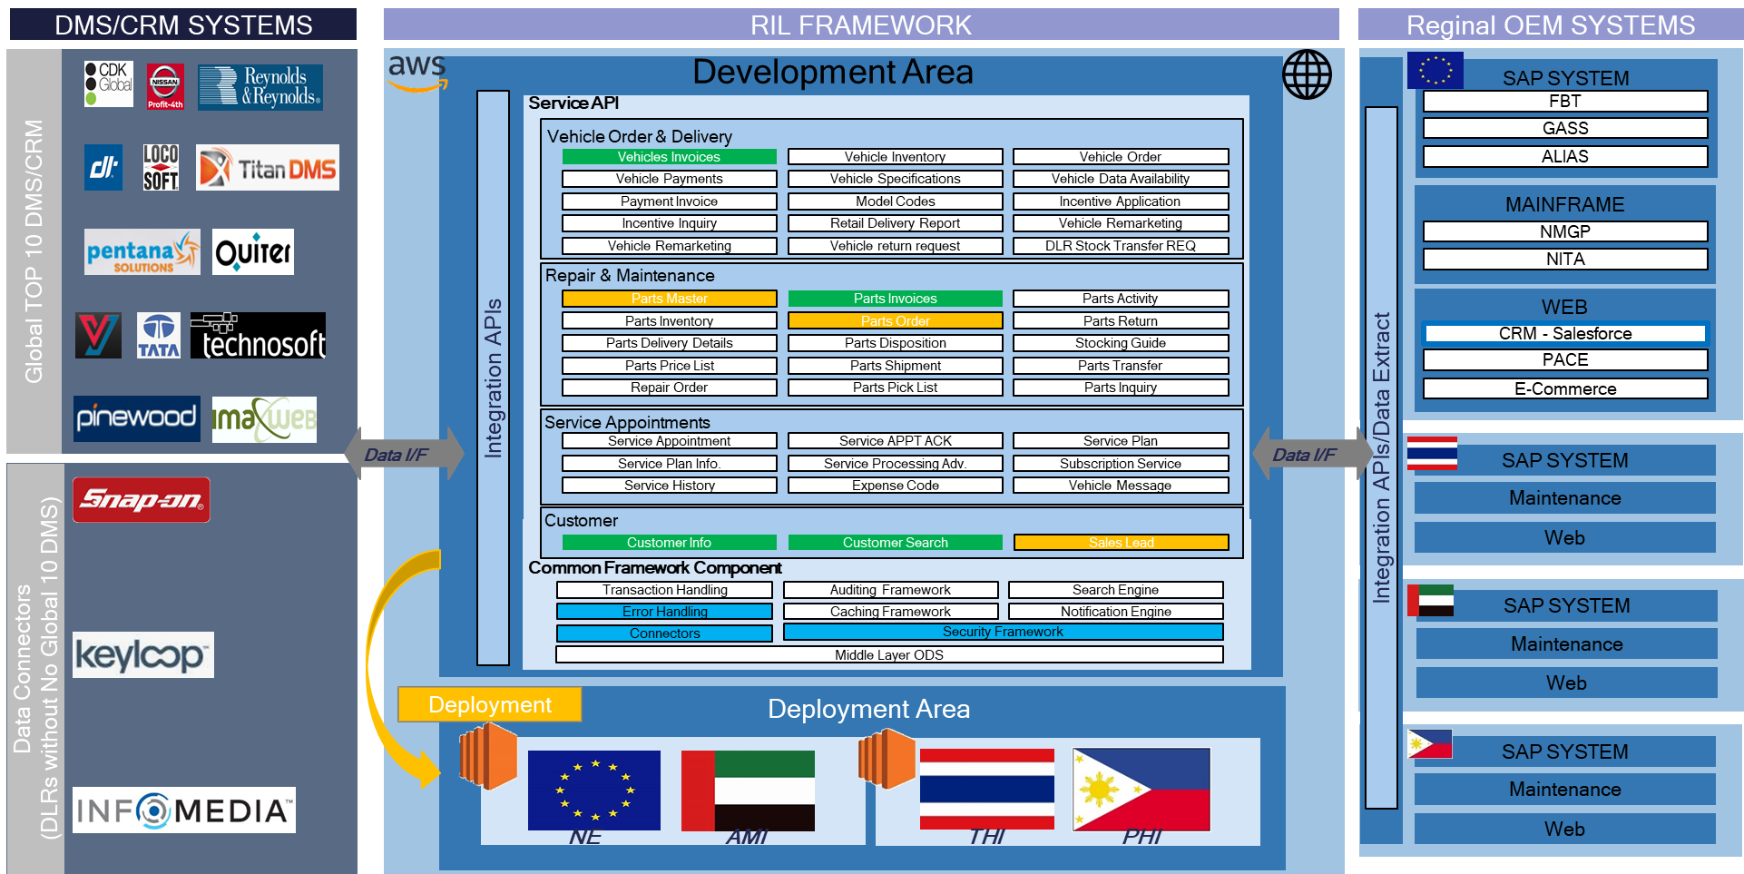
Global DDI Functional Architecture
This is the DDI functional architecture involves all the API’s

Slide 7


Conceptual Architecture
Vehicle, Parts Order & Warranty claim Entry
Rea time
Managed by Nissan
Vehicle and Parts Master
YANA DMS
Vehicle Delivery receipt
Access
Control
Data
Persist & access
Data transformation
Data storage (s3)
Warranty registration
Data persist & consumption
Real time
Batch

Slide 8
System Details
NIMS is Nissan Integrated Management System integrated with SAP. It is deployed in NPI Data center.
NIMS and SAP work as an ERP system for NPI and holds different data such as Vehicle & parts model data, Order details, warranty etc.
YANA is a DMS system deployed for all NPI dealerships.
Why DDI for NPI :
Model Master from NIMS is required for YANA to work properly, currently this data is uploading manually to YANA.
Dealer Order details are also manually inserted in to NIMS.
Vehicle Delivery receipt created in NIMS is also not available in YANA.
To overcome the above challenges Global business suggest to implement DDI for seamless integration of data between NIMS and YANA.

Slide 9
Project Context in scope
Project background:
This project is to integrate NIMS ( Nissan Integrated Management System with SAP & deployed in NPI Data center) system with YANA DMS(3rd party dealer management system)
The use cases for Philippines is given below.
SI.NO | Name | Description
1 | Vehicle Model Master | Model Codes provides Nissan vehicle Related information to dealers like, which Model, which Manufactures, Specification, which Variants etc. They will use these information for registering car in their country. Also used for new model launches, ordering vehicles from OEM, inventory management, pricing
2 | Parts Model Master | Parts master provide Nissan Model wise Parts information like Part number, Parts description, Supplier, superseded parts etc. for dealer to make parts order to Manufacturer. Inventory management, order management, pricing
3 | Vehicle Order | Vehicle Order refers to the placement of Vehicle Purchase Orders to manufacturer by a dealer and reporting order status back to Dealer, it's a real-time transaction
4 | Parts Order | Parts Order refers to the placement of Parts Purchase Orders to manufacturer by a dealer and reporting order status back to Dealer, it’s a real-time transaction
5 | Vehicle Delivery Receipt | It provides the information to dealers about the vehicle despatch status like Shipping details, Shipping party, vehicle delivery details like invoice number, invoice amount, quantity, specification, etc.
6 | Parts Delivery Receipt | It provides the information to dealers about the Parts despatch status like Shipping details, Shipping party, Parts delivery details like invoice number, invoice amount, quantity etc.
7 | Warranty Registration | Retailed vehicle information such as Model, specifications, Sold date, Sold customer information, Warranty condition applied etc. are registered with the manufacturer
8 | Warranty Claim Entry | Dealers raise the parts warranty claim to OEM with the information like Model, repair date, Customer issues etc. and the OEM shares warranty claim approved status back to dealer to proceed with repair.
9 | DMS Acknowledgement | This is API provides acknowledgement of every data DDI share with NIMS.

Slide 10












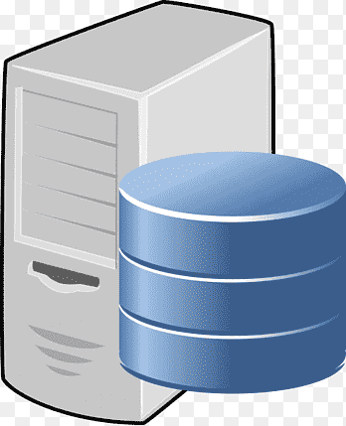









System Architecture & Data flow
Legend
Bi directional
WAF
S3
Aurora Postgresql
Aws batch
AWS app config
Cloud Watch
Secrets Manager
apigeest
DMS System
IIS Apache
One way
NLB
EC2
CLB
Api gateway
NML B2C Mode 2
HTTPS(443)
NPI Data Center – Regional system
Internet
HTTPS(443)
DDI Storage
Aws batch
HTTPS(443)
HTTPS(443)
HTTPS(443)
HTTPS(443)
VPC Link
HTTP(80)
DDI Batch framework
Postgres (5432)
NIMS
YANA
Nissan Europe Apigee
API services
Postgres (5432)
HTTPS(443)
HTTPS(443)
HTTPS(443)
REST API
SMTP(25)
HTTPS(443)
SFTP Server & Client
NML Mode 1
DMZ Internal
Transparent Proxy
SFTP(22)
NGDC
Mail Exchange Segment
SMTP Server
SFTP(22)
ESB

Slide 11
System Architecture – IF list
No | Source (From) | Destination (To) | VIA | Synchronous or Asynchronous | Communication Protocol | Message format | One way/Bi-Directional | Description
1 | YANA System | AWS Fargate (API Services) | Apigee, AWS API gateway & NLB | Synchronous | HTTPS | JSON | Bi-Directional | API access.
2 | AWS Fargate (API Services) | NIMS | CLB(Mod1 Transparent proxy) | Synchronous | HTTPS | JSON | Bi-Directional | NIMS Api access
3 | NIMS | AWS EC2 | ESB | Asynchronous | SFTP | JSON files | Bi-Directional | Transfer JSON files
4 | AWS EC2 | AWS S3 |  | Asynchronous | HTTPS | JSON files | Bi-Directional | Transfer JSON files
5 | AWS S3 | Aurora Database | AWS Fargate batch | Asynchronous | HTTPS | JSON | One Way
6 | AWS Fargate | SMTP Server |  | Asynchronous | HTTPS | JSON | One Way | Email service

Slide 12
Security & Data privacy
Authentication
DDI is an internet based application and YANA system is the user for this application.
Oauth2 client credentials is the authentication mechanism followed in DDI.
Yana DMS will be on boarded to Apigee edge and provide client credentials to connect to Nissan cloud systems.
SFTP communication between ESB & SFTP server’s is through key pairs i.e. public key & private keys
Authentication between EC2 & S3 is through IAM roles.
NIMS supports basic authentication for REST API’s.
Other Security measures
Uses only secure communication protocols like HTTPS
Encryption at rest shall be configured for all data stores.
AWS API Gateway will accept requests only from Apigee (WAF white listing)
All public endpoints are protected against DoS and DDoS attacks with the help of AWS WAF.

Slide 13
Authentication Flow between YANA & Apigee
YANA DMS
NE APIGEE
NML AWS
Authentication Flow
Apigee
Credentials
Token
Vehicle Model Master Flow
Request parts order
+Token
Validate Tokenc
Request model master data
Return model master
Return model master

Slide 14
Data Classification
Company information is classified by 4 levels according to the confidentiality and importance of the information. Data handled in DDI platform is Nissan Restricted B involves PII data.
 | Scope of Users | Impact when disclosed | Example
 | Access restricted to a small number of authorized persons | Risk of major loss or crisis, which may affect the financial result, the share value, the competitiveness or the legal liability | Strategic decisions of the Executive Committee Financial information liable to insider dealing Information regarding establishment of a new company, alliance, etc. prior to announcement
 | Access restricted to named individuals who require use of the information | Risk of significant loss for the company, due to commercial disadvantage or image crisis | Full picture of automotive projects Advanced technological innovation Information which bears major competitive advantage Important commercial negotiations (i.e. with suppliers) Mass customer database
 | Access restricted to a limited group (e.g. department, functional area, project) | Risk of real loss, disadvantage, confusion to the company | Partial information on automotive projects Forecasting short term commercial operations Operational department guidelines Day to day commercial transactions/negotiations Limited personal data
 | Any person with resident status on a site or access to the Intranet | Limited impact to the company, could affect the company’s external communication | General procedures In-house news bulletins
Nissan Secret A
Nissan Restricted B
Nissan Confidential C
Nissan Internal

Slide 15
Data privacy
Will the system contain Personal Identifiable Information (PII)? YES
Will financial information be recorded or accessible? YES, for vehicle , parts orders contains financial information like bill to address, shipping address, price details etc.
Would Nissan confidential or proprietary information be accessible? YES, vehicle details are available.
Would information be consumed from other Nissan services which already have authentication requirements established? Yes
Aurora DB is encrypted at rest
Data retention on S3 and Aurora DB will be 7 days and purged afterwards

Slide 16
Application Architecture – Technical Stack
IT Services | Sub Category
 |  | Type | Make | Package
AS-Orchestration | Platform | Platform Name | AWS ECS | Fargate
 |  | Runtime | Java, AWS | Java 11 (AWS corretto)
 |  | Middleware | Pivotal OSS | Spring Framework 5
 |  | Lang | Java | Java 11 (AWS corretto)
 |  | File Transfer | AWS | S3
 |  | Database | AWS | Aurora PostgreSQL
 |  | Data Backup | AWS | S3
Other | Network Infrastructure | Load Balancer | AWS | ALB
 | Docker Container Registry | Repository | AWS | ECS
 | Monitoring | Monitoring | AWS | CloudWatch,
 | Environment Security | Key Management | AWS | Secrets Manager
 | Service | Email Service | On-Premise | SMTP server

Slide 17
Application Architecture – Technical Stack contd.
IT Services | Sub Category
 |  | Type | Make | Package
Other | SFTP Server | QA Environment User Name: NGSRFTP27 SFTP Folder Name: NGSRFTP27 ESB_HOST= sfxgw201.qa.jp.nissan.biz IP address: 150.63.222.2
 |  | PROD Environment User Name: NGSRFTP27 SFTP Folder Name: NGSRFTP27 ESB_HOST= sfxgw101.jp.nissan.biz IP address: 150.63.222.1
 | NIMS | 119.92.205.222 for PROD & QA

Slide 18
Architectural Risks & Mitigation
Service unavailability
In case of a disaster on AWS hosted components (real-time front-end), the recovery strategy is to re-create a new environment in a different AWS AZ or Region using the Cloud Formation templates and restore data from the backups.
Non-AWS hosted components are used for non real-time. A delay should be acceptable for recovery.
Scalability
Front-end and DDI : AWS Server less architecture enable dynamic scale-up component by component. Micro Service pattern implementation for application instance scaling.
Data consistency
AWS DDI : Master slave pattern for DB replication via AWS Multi-AZ deployment
Application Security – No new component exposed to internet. Existing Apigee will act as internet facing entry point
Monitoring solution
AWS : Cloud watch will be used
NIMS: existing monitoring solutions will be reused

Slide 19
Non-Functional Requirements
For AWS Environment
Availability SLA
Target – 99.95%
Expected Volumes
1 GB / day
7 days of Storage in s3 & Aurora and purge afterwards.
1k requests/day after 6 months.
Disaster Recovery Strategy – Single region, Multi-AZ Deployment
Recovery Point Objective – 5 Minutes
Recovery Time Objective – 5 Hours

Slide 20
Open Points from ERB
1. Align with Global ERB stakeholders(Arnold Hahamyan & Rob Pearson) on the usage of Apigee for Dealer/DMS API’s. :
Project Teams Response : Captured an email confirmation from Arnold & Rob if DMS is not managed by Nissan. DMS system has to be treated as third party and need to use Apigee.
In Philippines Yana DMS is not managed by Nissan Philippines so Apigee has to be used for integration . Please find the attached email’s from Arnold & Rob

Slide 21
Thank you

