Slide 1
MIE 1624 Assignment 2:
Canadian Election Sentiment Analysis
Submitted by: Arun Shanmugam
Student No: 1005009884
UTORid: shanm159

Slide 2
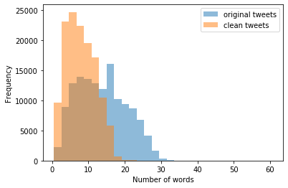
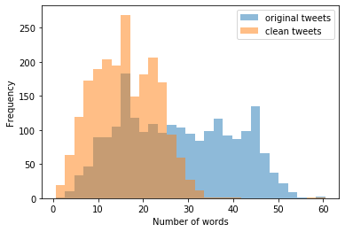
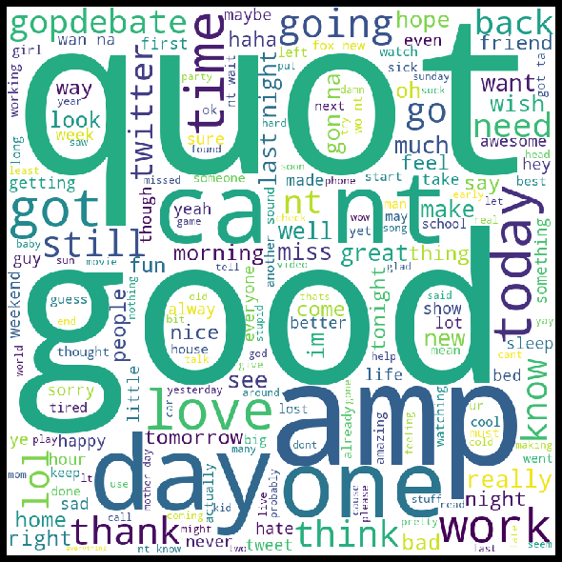
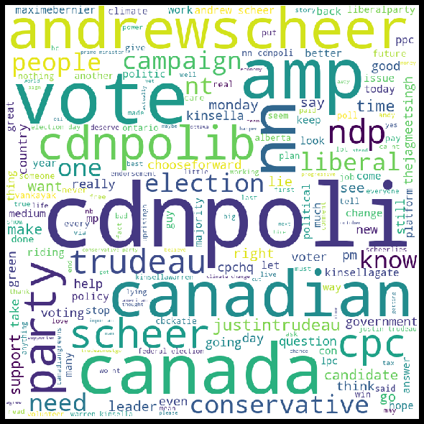
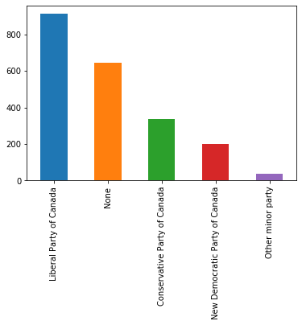
Exploratory Data Analysis
Raw Data vs Clean-up
Tweets from Sentiment.csv & Canadian Elections were cleaned up by removing special characters, punctuations, stop words, tokenizing & then lemmatizing.Cleaned up tweets were subject to various Exploratory Data Analysis for visualization as shown.
Word clouds generated after data cleaning
Sentiment Data
Canadian Election Data
A quick analysis of party affiliation of tweets
Sentiment Data
Canadian Election Data

Slide 3
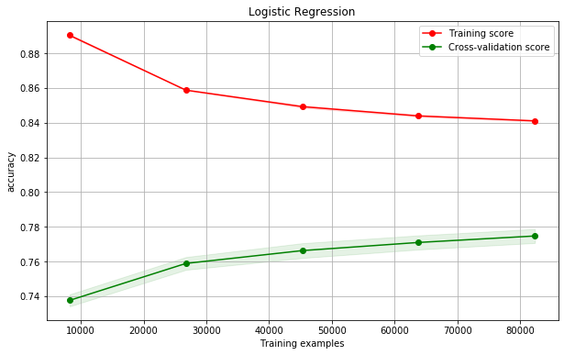
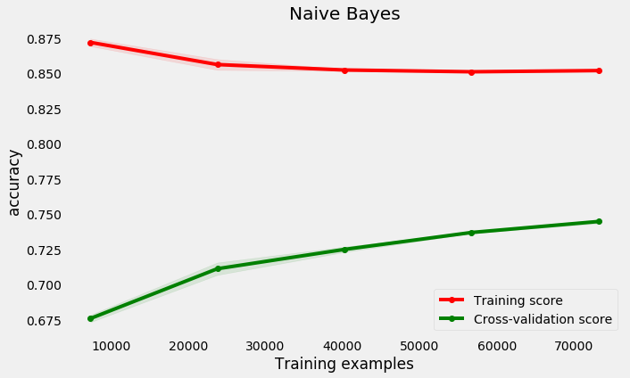
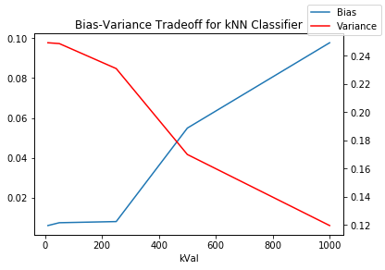
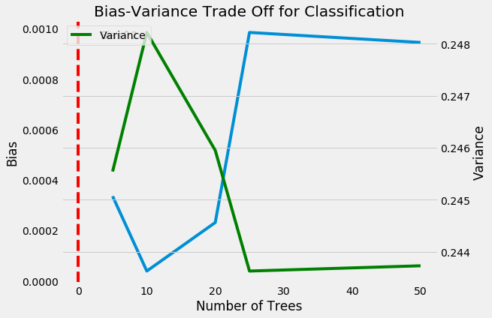
Data Preparation & Modelling
Cleaned Tweets were prepared for ML modelling using Word Frequency & TF-IDF vectorizers
The following models were tried out on the Sentiment.csv dataset:
Logistic Regression
k-Nearest Neighbours
Naive Bayes
SVM Classifier (long runtime)
Decision Trees
Random Forests
xGB Classifier
Logistic Regression performed best with an accuracy of 77.793% on the test set of Sentiment.csv after Cross Validation & Hyper Parameter Tuning using grid search
Bias Variance tradeoff curves were plotted for kNN, Decision Trees & Random Forest to understand relationship & better tune models
Learning curve for Logistic Regression
Learning curve for Naive Bayes
Bias Variance Tradeoff for kNN Classifier
Bias Variance Tradeoff for Random Forest Classifier

Slide 4
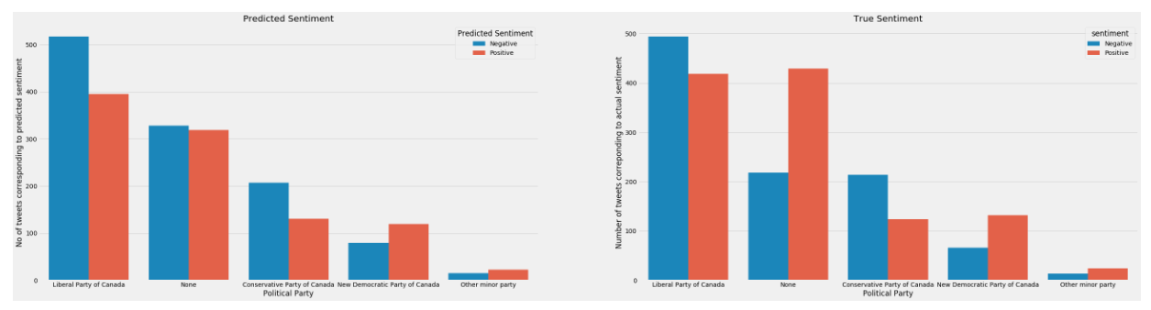
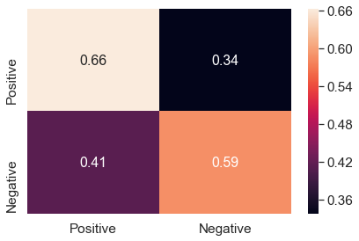
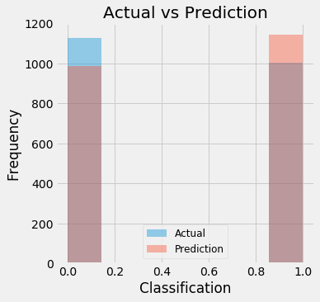
Model Implementation on Canadian Elections Data
Model choice: Logistic Classifier model with tuned hyperparameters along with TF-IDF vectorization for Feature Engineering
Training: Logistic classifier was trained on Sentiment data
Implementation: Model was implemented on the Canadian Elections data and an accuracy of 62.21%
We can see that the model does a good job of predicting the sentiment for the four categories with misclassification occuring in the None category.
Discussion on Predictions:
Misclassification can be attributed to the word frequency feature engineering that eliminates context, which greatly dictates sentiment of tweets
NLP analytics of elections is useful because voters vote with hearts than brains
Since liberals have garnered the most number of tweets, it can be inferred that they would then win the election

Slide 5
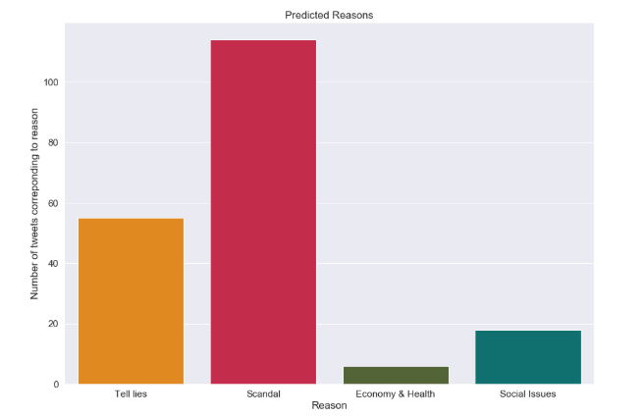
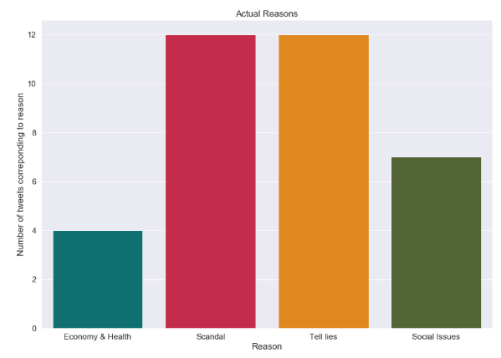
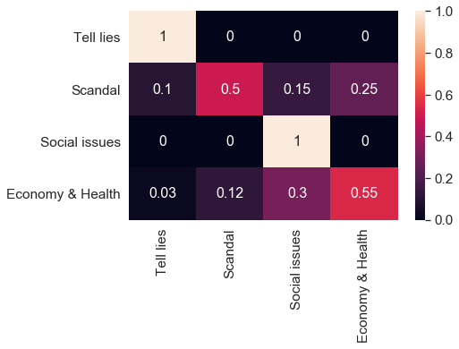
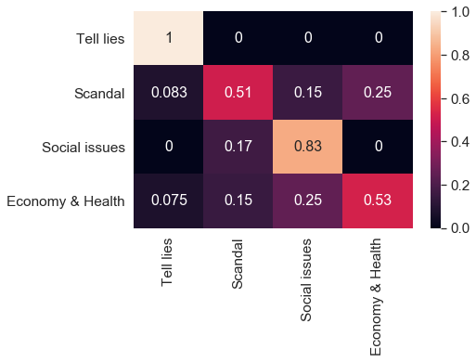
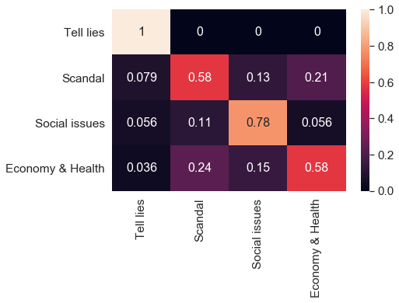
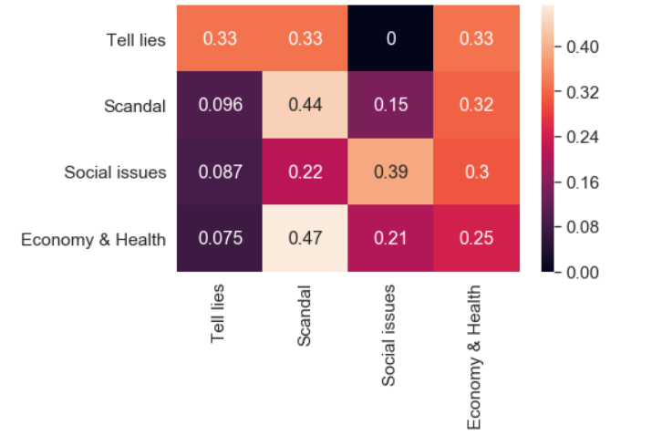
Predicting reason behind negative tweets
Logistic Regression
kNN Classifier
Prediction vs. Actual
Accuracy: 0.5182
Accuracy: 0.5337
Random Forest
Random Forest
(with Word Embeddings)
Discussion on reason predictions:
The Random Forest model performs best but still has a fair degree of misclassification as evidenced by the above figure
Misclassification can be attributed to:
Deletion of ‘Other’ tweets
Skewness to reasons that are more in number
Elimination of context
As a bonus, Word Embeddings was carried out with a relatively small corpus due to memory and time considerations, and was passed to the Random Forest model
Accuracy: 0.6114
Accuracy: 0.378248

