Slide 1
Lending Club Case Study Report
10/08/2022

Slide 2
Content
Lending Club Introduction
Data Analysis for New Loan Application
Insights on New Loan Application Processing
Report Conclusion

Slide 3
Lending Club Introduction
Lending Club is a marketplace for personal loans that matches borrowers with lenders who is seeking for loan.
Business problem is identify which loan application will have the possibility for defaulting to loan.
'loan.csv' dataset is used to analyse the application criteria.

Slide 4
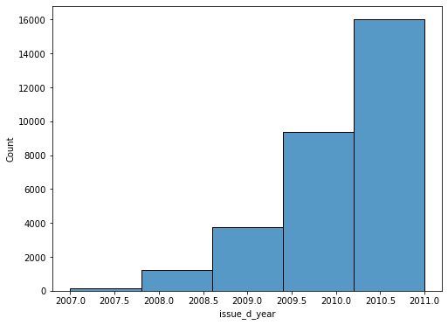
Data Analysis for New Loan Application
New Loan processed by the bank is increased drastic in 2011 compared to 2007 and it’s linearly increasing.

Slide 5
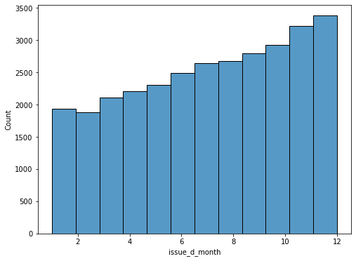
Data Analysis for New Loan Application
In December, high number of new loan application is processed.
February is the lowest.

Slide 6
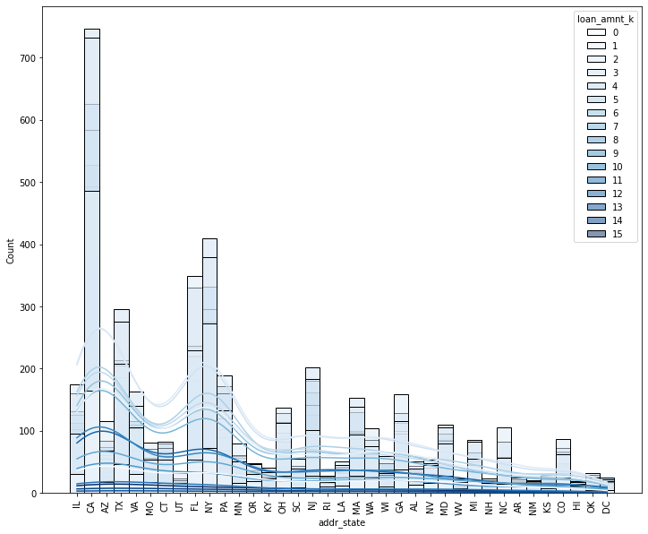
Data Analysis for New Loan Application
Overall the states CA, NY, FL, TX, NJ is processed more number of new loan application.

Slide 7
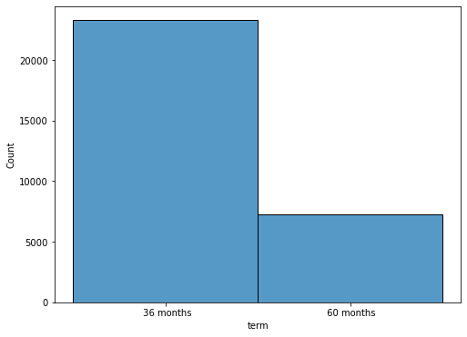
Data Analysis for New Loan Application
Huge number of loan applications are applied for short tenure (36 months) than long term (60 months).

Slide 8
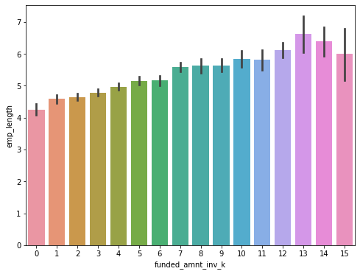
Insights on New Loan Application Processing
The applicant who has long employment length is applying for high loan amount than less than 3 years.

Slide 9
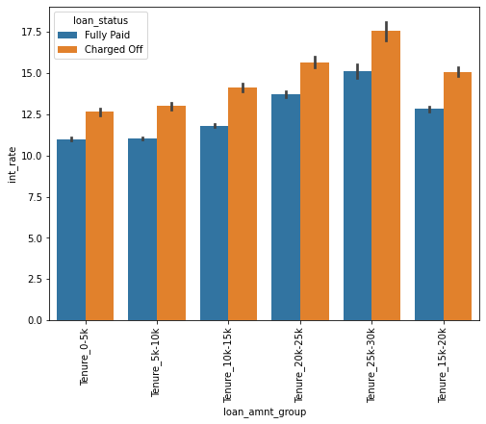
Insights on New Loan Application Processing
The applicants who got bigger loan amount & interest rate, there is high number of applicants are charged off.
In this scenario, the new loan applicant who apply for similar criteria has more chance to defaulting the loan.

Slide 10
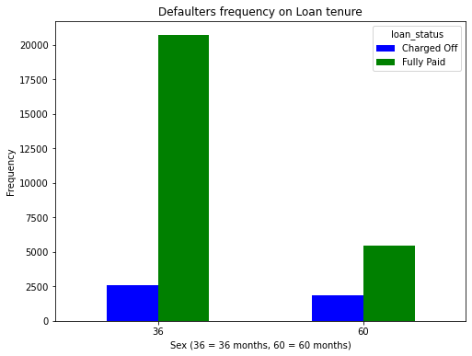
Insights on New Loan Application Processing
Loan application whose has 36 months tenure is high fully paid & charged off than 60 months.
For new loan application applies for short term needs better scrutinization to avoid charged off cases.

Slide 11
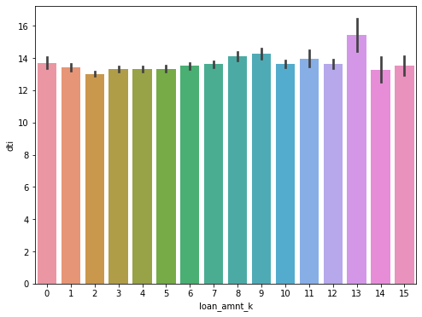
Insights on New Loan Application Processing
When the application has higher Debit to Income (DTI) and apply for high loan amount.
So the new loan application applies on similar criteria has more change for defaulting the loan.

Slide 12
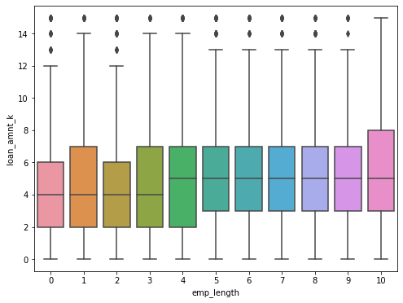
Insights on New Loan Application Processing
Applicant who has less than 3 year employment experience apply for high loan amount.
So such new loan application have chance for default to loan.

Slide 13
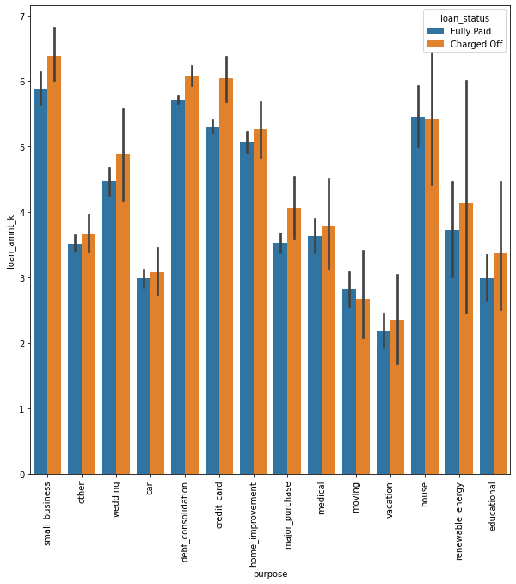
Insights on New Loan Application Processing
The applicants who apply loan for "small business, credit card, major purchase, renewable energy" purpose has high number of chance for defaulting the loan based on earlier data.

Slide 14
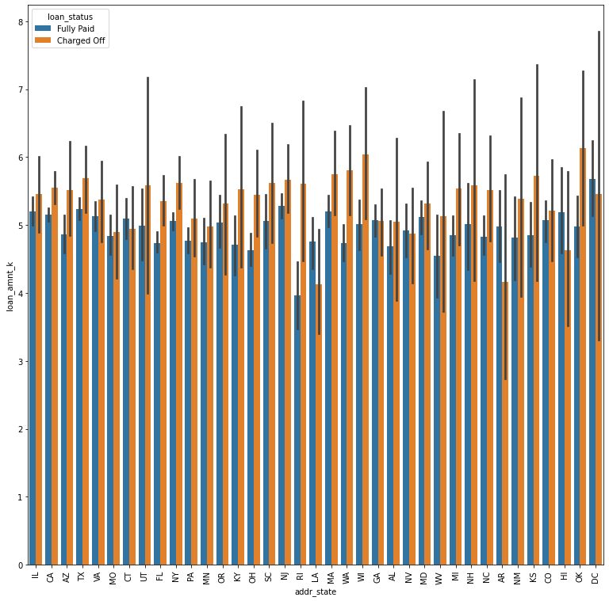
Insights on New Loan Application Processing
The loan applicants from these state WA, WI, OK, KS, RI has high number of charged off, so new application from these states needs more scrutinised to avoid charge off or default to loan.

Slide 15
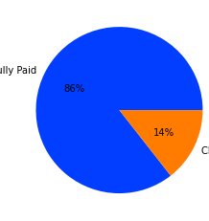
Conclusion
Around 86% of loan application is fully paid the loan & only 14% applicants has charged off and possibility to default for loan.
So the new loan application needs more scrutinization rather to reject.

