Slide 1
lastname, firstname PIN
date of birth, age at surgery: yyyy-mm-dd, years old
surgery date: yyyy-mm-dd
surgeon:
surgical target
left:
right:
stimulation settings (clinic: yyyy-mm-dd)
electrode: DL-330-3.5 | DL-330-10
implantable pulse generator: RNS-300 | RNS-320
current: left: mA, right: mA
frequency: left: Hz, right: Hz
pulse width: left: μs, right: μs
active contacts: left: , right:

Slide 2
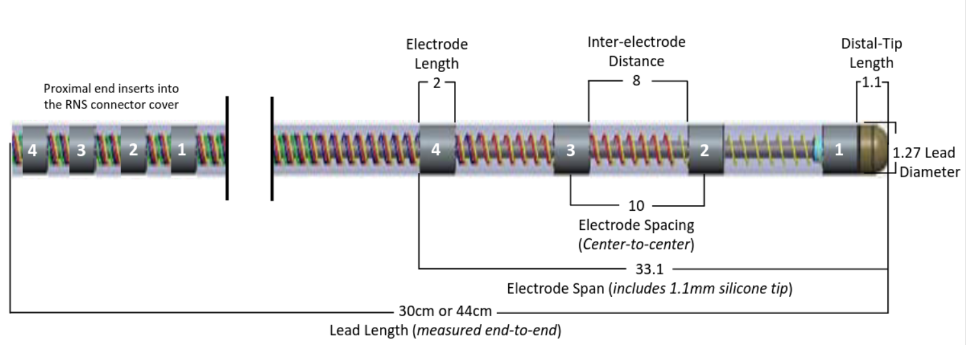
Left Brain: Level 1
actual lead
Sub
CA1
CA2
CA3
CA4
DG
SRLM

Slide 3
Left Brain: Level 2

Slide 4
Left Brain: Level 3

Slide 5
Left Brain: Level 4

Slide 6
Right Brain: Level 1

Slide 7
Right Brain: Level 2

Slide 8
Right Brain: Level 3

Slide 9
Right Brain: Level 4

Slide 10
Summary
Left Brain
option 1:
option 2:
Right Brain
option 1:
option 2:

