Slide 1
lastname, firstname PIN
date of birth, age at surgery: yyyy-mm-dd, years old
surgery date: yyyy-mm-dd
surgeon:
surgical target
left:
right:
stimulation settings (clinic: yyyy-mm-dd)
electrode: B.Sci. directional (db-2202)
implantable pulse generator: Vercise Gevia | Vercise PC | Vercise Genus
current: left: mA, right: mA
frequency: left: Hz, right: Hz
pulse width: left: μs, right: μs
active contacts: left: , right:

Slide 2
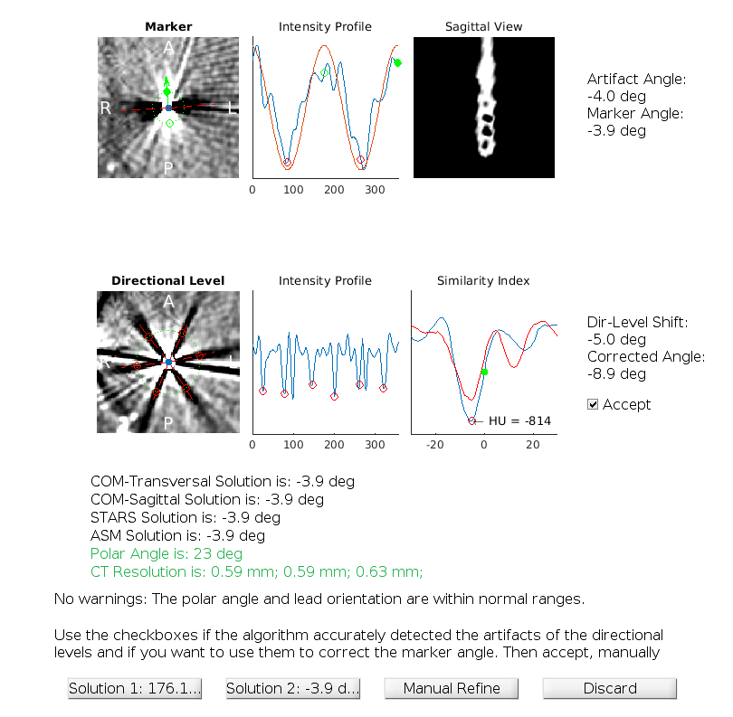
Electrode Rotation: Left Lead

Slide 3
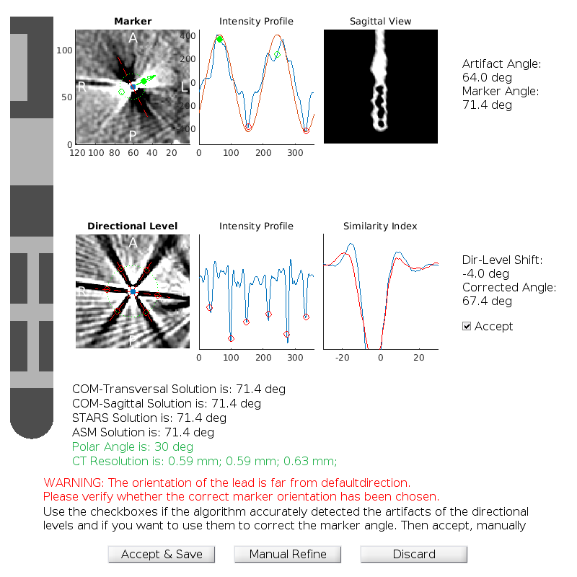
Electrode Rotation: Right Lead

Slide 4
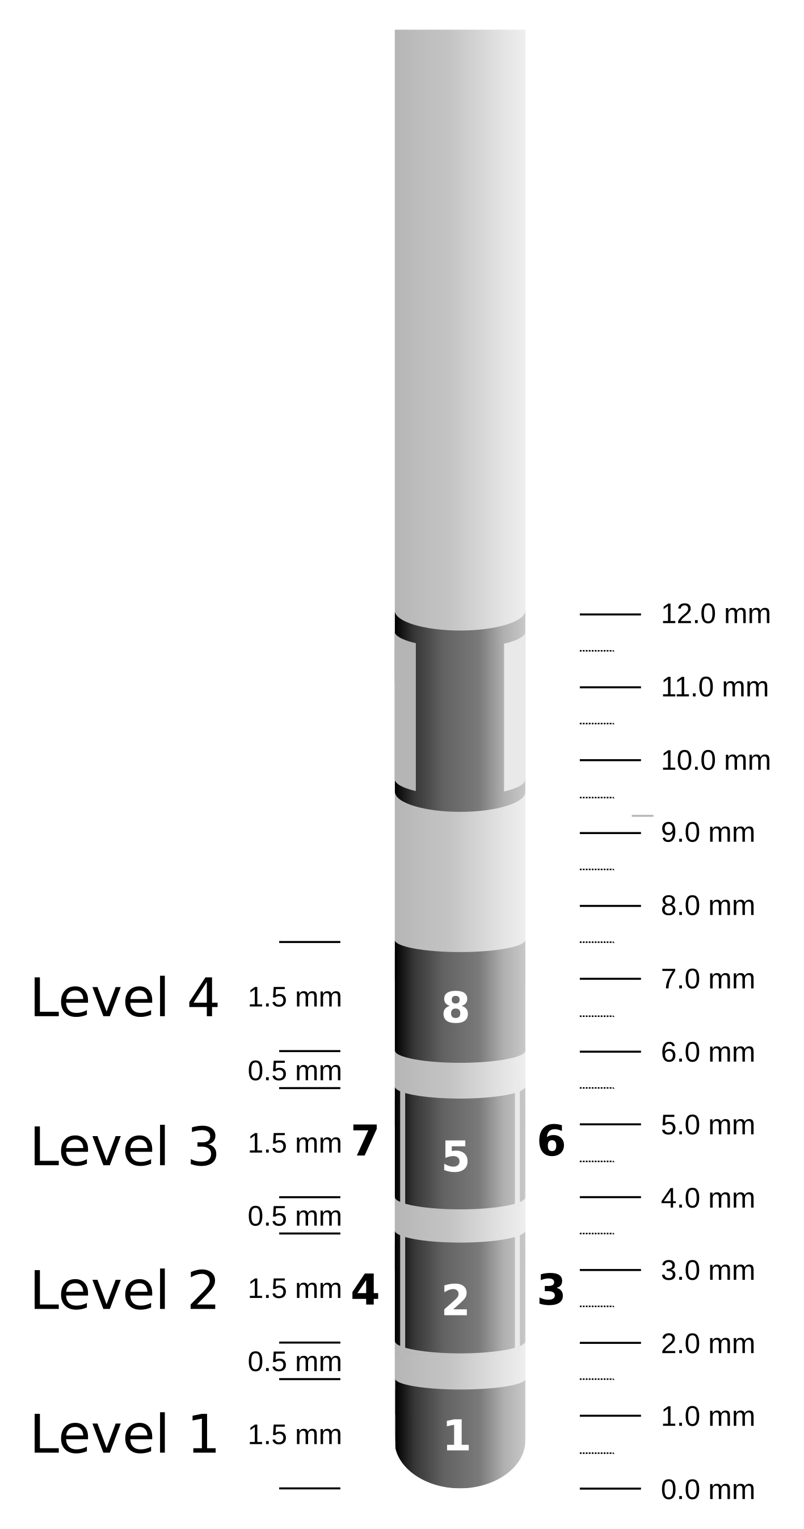
Left Brain: Level 1
actual lead
limbic STN
associative STN
motor STN
red nucleus

Slide 5
Left Brain: Level 1
actual lead
ANT
Mammillo. tract
mediodorsal
centromedian

Slide 6
Left Brain: Level 1
actual lead
caudate
putamen
GPe
GPi

Slide 7
Left Brain: Level 2

Slide 8
Left Brain: Level 3

Slide 9
Left Brain: Level 4

Slide 10
Right Brain: Level 1

Slide 11
Right Brain: Level 2

Slide 12
Right Brain: Level 3

Slide 13
Right Brain: Level 4

Slide 14
Summary
Left brain
option 1:
option 2:
Right brain
option 1:
option 2:

