Slide 1
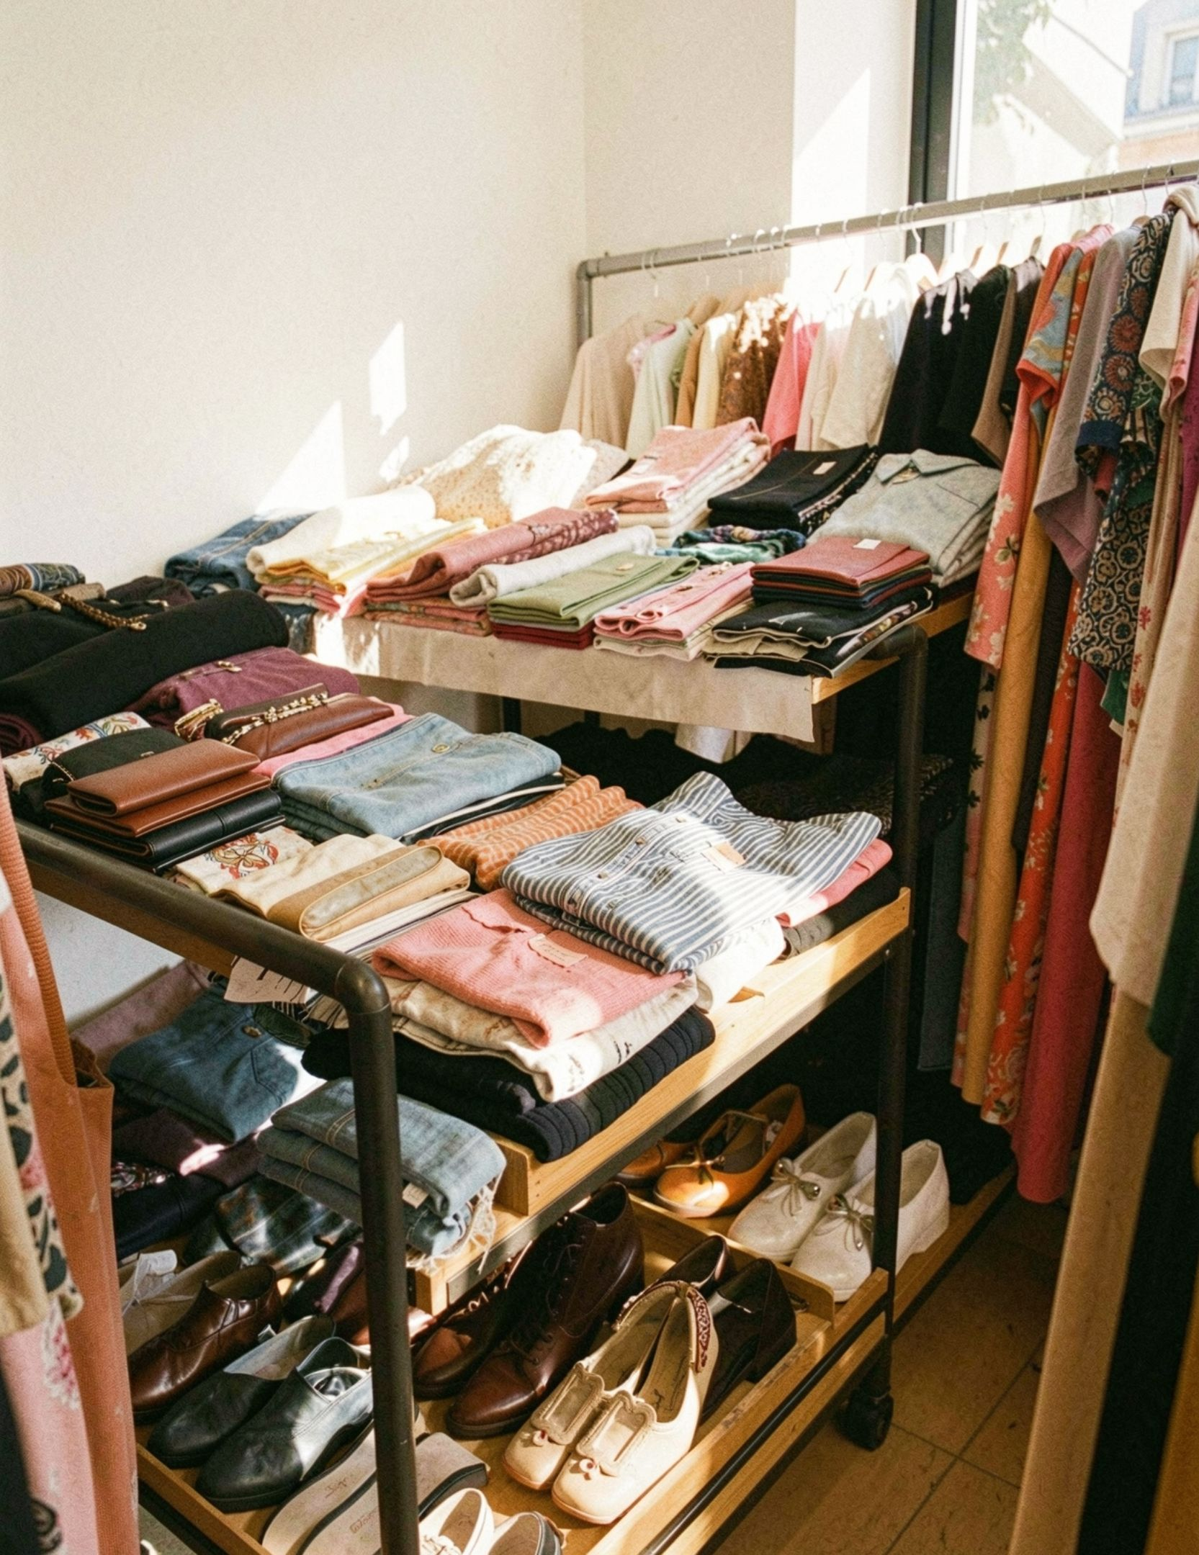
CUSTOMER SHOPPING BEHAVIOR
Customer
Shopping Behavior
What 3,900 purchases say about loyalty, baskets, products, and growth.

Slide 2
01 · THE BASE
3,900 purchases reveal a repeat-buyer market
DATASET
TYPICAL BASKET
HEADLINE
3,900
$59.76
Loyalty is already present.
purchases across 25 products, 4 categories, and 50 locations
average purchase amount
The growth question is how to activate it.

Slide 3
02 · LOYALTY VS. SUBSCRIPTION
Loyal customers dominate the base, but subscriptions lag
CUSTOMER SEGMENTS
SUBSCRIPTION SPLIT
3,116
27% Yes
1
Loyal
701
73% No
2
Returning
83
3
Non-subscribers contribute $170,436 versus $62,645 from subscribers.
The concentrated loyal base signals strong retention to protect; the 27% subscription rate shows room to convert repeat demand into recurring revenue through targeted subscriber benefits.
New

Slide 4
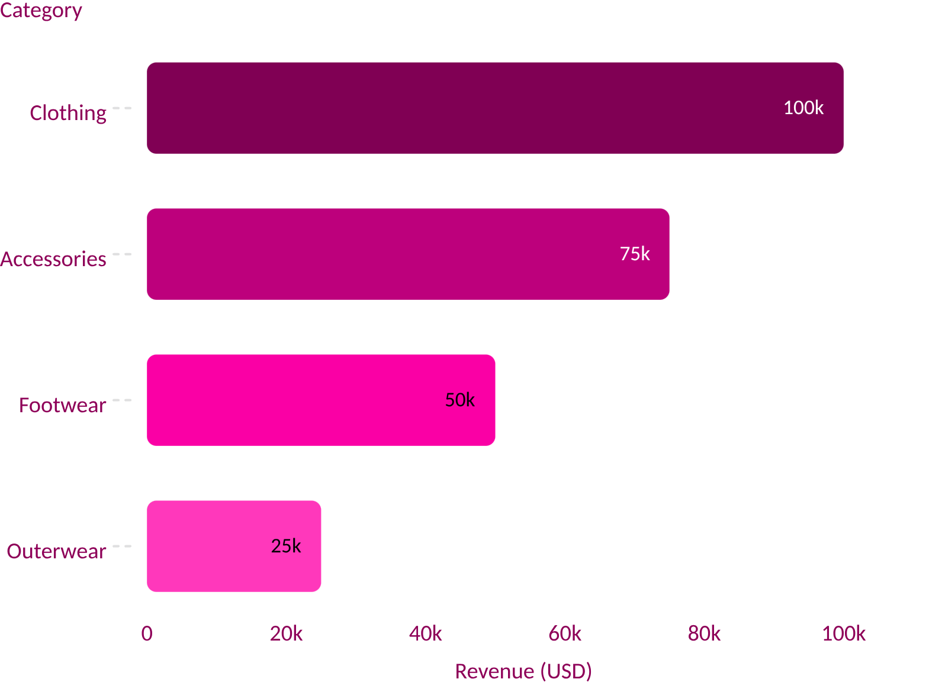
03 · CATEGORY MIX
Revenue is concentrated in clothing and accessories
Clothing leads revenue, followed by accessories, footwear, and outerwear.
This concentration favors deeper assortment and dependable availability in clothing and accessories. Paired with the age-group distribution, it points to a focused audience strategy: lead with the categories that drive value, then tailor depth and messaging to the strongest customer cohorts.

Slide 5
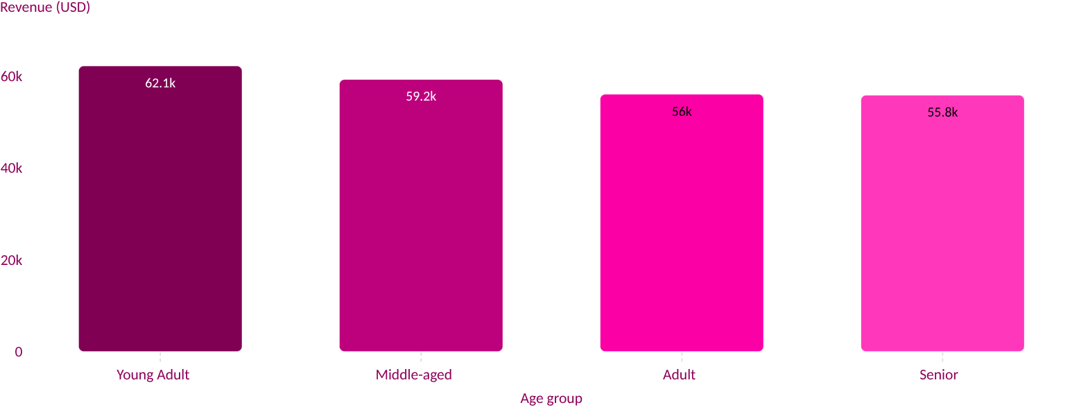
04 · AGE MIX
Young adults are the largest revenue cohort
Young Adults contribute the most revenue, with a gradual decline across Middle-aged, Adult, and Senior groups.

Slide 6
05 · DISCOUNT SIGNAL
Discounts can lift baskets without defining the whole purchase
HIGH-SPENDING DISCOUNT USERS
MOST DISCOUNT-DEPENDENT PRODUCTS
839
Product | Discount-dependent
Hat | 50.00%
Sneakers | 49.66%
Coat | 49.07%
Sweater | 48.17%
Pants | 47.37%
customers spent above the $59.76 average while using discounts
Discounting is strongest around selected products, not uniformly across the assortment.

Slide 7
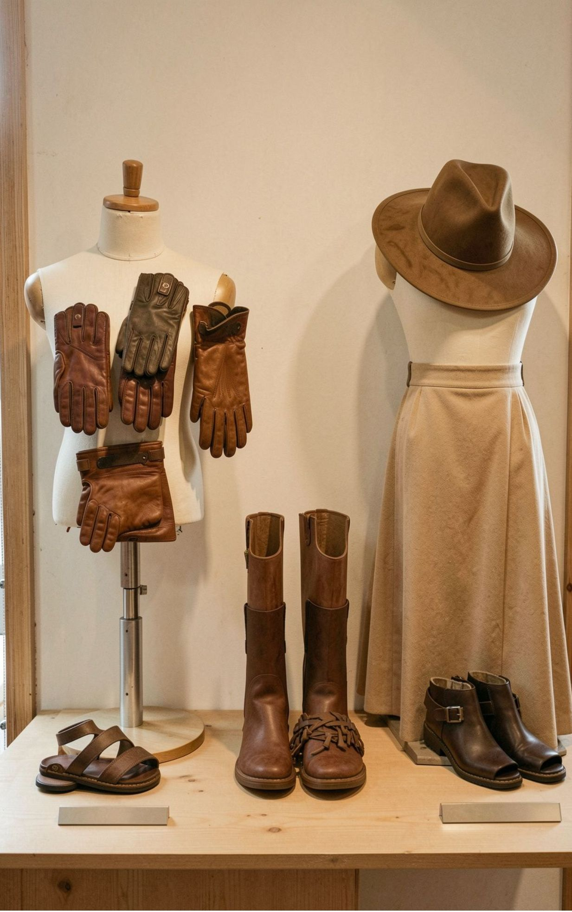
06 · PRODUCT SIGNALS
Product signals split between popularity and satisfaction
TOP-RATED PRODUCTS
BEST-SELLING EXAMPLES
OPPORTUNITY
Gloves 3.86 · Sandals 3.84 · Boots 3.82
Hat 3.80 · Skirt 3.78
Jewelry leads accessories; Blouse and Pants lead clothing; Sandals lead footwear; Jacket leads outerwear.
Use rating and order volume together when choosing hero products.

Slide 8
07 · SHIPPING SIGNAL
Express shipping correlates with a slightly higher basket
AVERAGE PURCHASE
READ THE SIGNAL CAREFULLY
Speed may be a useful value cue for higher-intent purchases.
$58.46
$60.48
Standard
Express
The dataset shows association, not proof that shipping speed causes higher spend.

Slide 9
08 · CONVERSION POOL
Repeat buyers are the bridge to subscription growth
The largest conversion pool is already familiar with the brand.
REPEAT BUYERS WITH SUBSCRIPTION
REPEAT BUYERS WITHOUT SUBSCRIPTION
958
2,518
already converted
the larger pool to activate

Slide 10
10 · THANK YOU
Thank you
Customer Shopping Behavior
Questions, reflections, and next steps.

