Slide 1



COVID-19 Watson Assistant for Citizens
Helping IBM Banking Customers Be Ready to Serve Their Customers In Time of Need
April 10, 2020
Phil Pillsbury
North America Sales Leader
Phil.Pillsbury@ibm.com
Anjali Shah Senior AI Scientist Anjali.Shah@ibm.com
Arun Wagle
Senior Data & AI Specialist
Arun.Wagle@ibm.com

Slide 2

COVID-19 Watson Assistant for Citizens in the News!
Recent Media Coverage:
Fox Business: IBM on Varney, with Rob Thomas
Yahoo! Finance (from Fox Business): Bot can answer all your coronavirus questions with AI: IBM exec
CNN.com: IBM's new virtual assistant will answer questions about Covid-19
ZDNet: IBM forms Watson Assistant for Citizens to handle COVID-19 queries
VentureBeat: IBM's Watson Assistant for Citizens answers coronavirus questions by phone or text
Australian Financial Review: IBM makes AI free for answering COVID-19 questions
CBS Raleigh: CBS 17 News
Economic Times (India): IBM offers Watson Assistant for Citizens on virus queries
IT Pro Portal (UK): IBM Watson will now answer all your coronavirus questions

Slide 3
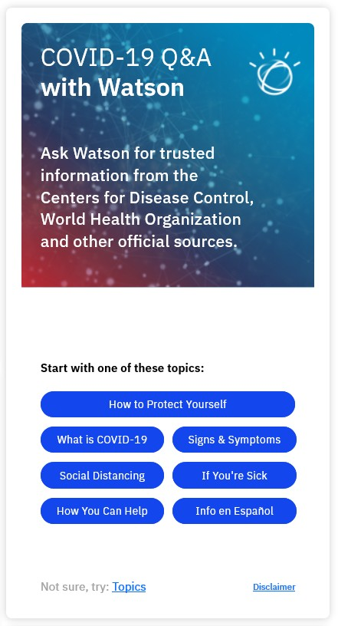
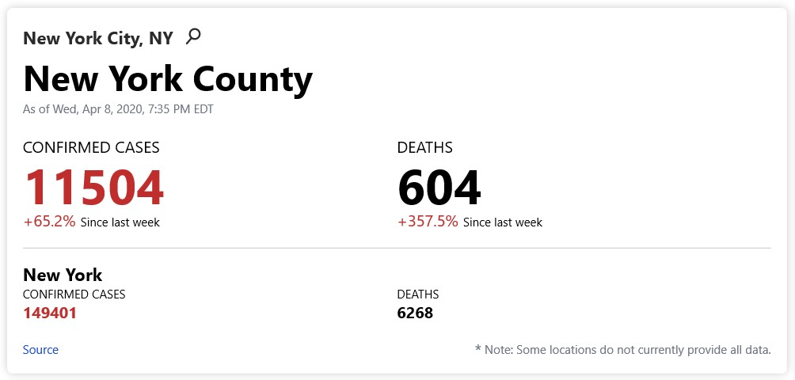
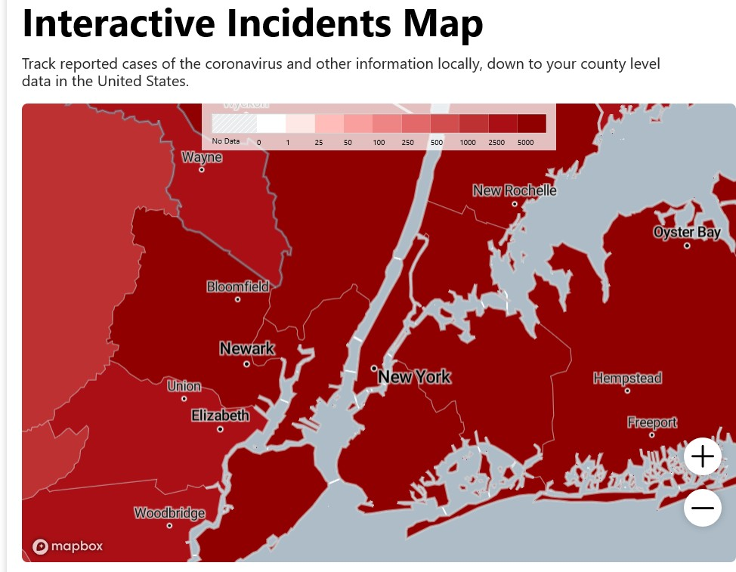
IBM’s Weather.com COVID-19 Dashboard
Source: Weather.com

Slide 4
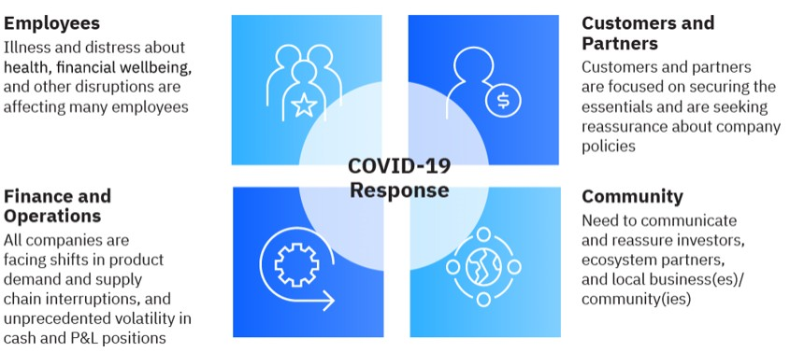
IBM COVID-19 Watson Assistant
4

Slide 5
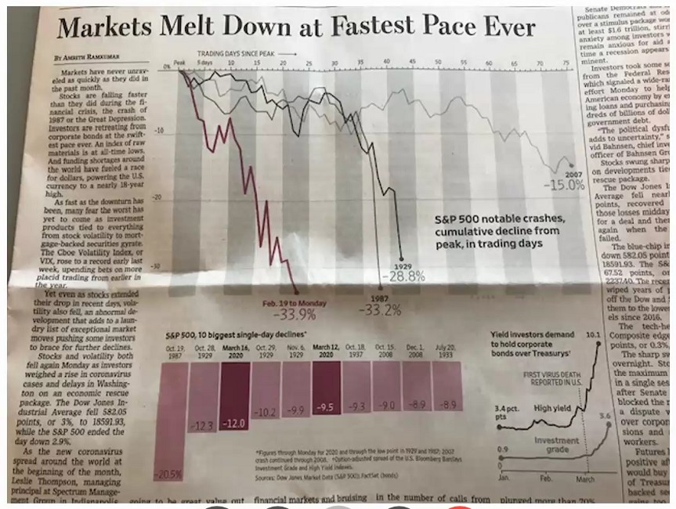
Today’s world
COVID-19 pandemic
Financial Services sector changing daily.
Financial Markets uncertainty
Potential job loss or furloughed
Consumer confidence is low
Brink of recession
Government financial assistance/relief ???
What Citizens Need:
Up to date
Accurate
Available anywhere
Easy to access/use
Scalable
Secure
Available quickly
Multilingual
Source: The Wall Street Journal
5
IBM Watson / © 2020 IBM Corporation

Slide 6
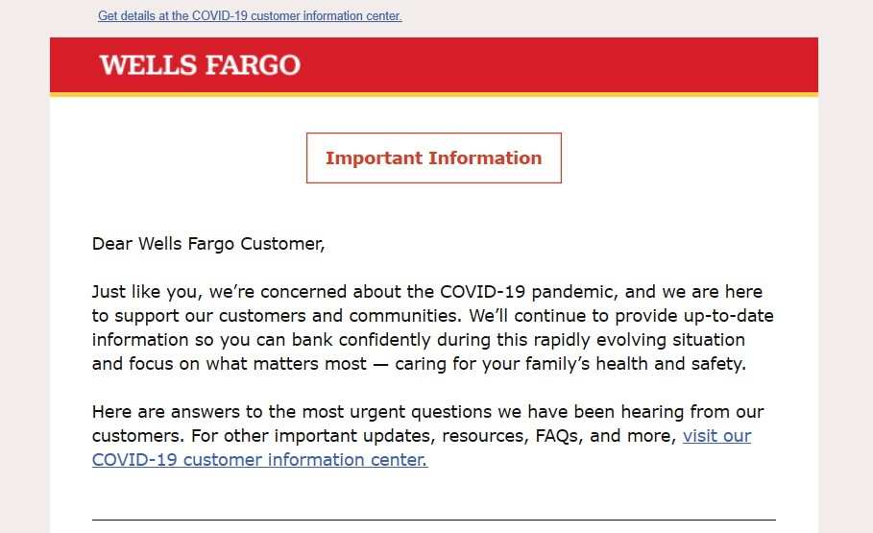

Unprecedented challenges for banks in serving their customers

Slide 7
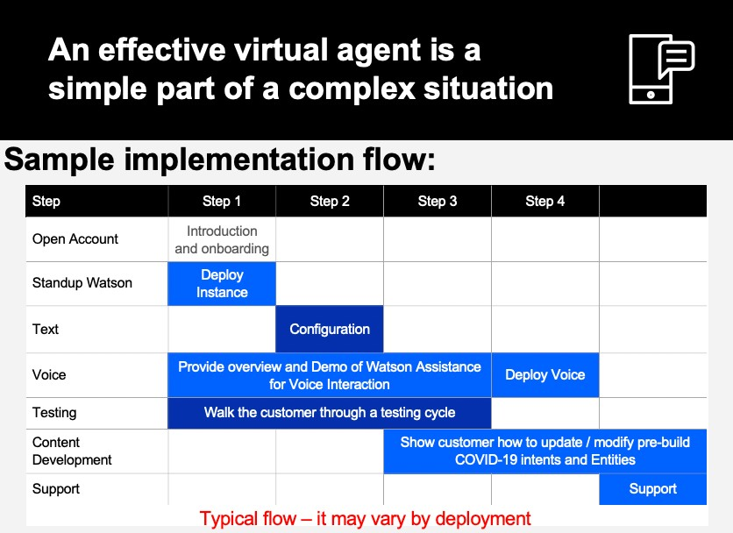
COVID-19 Assistant for Banks
Bank Contact Centers Face Unprecedented Volumes
Customers have questions about bank hours, availability of cash, etc.
Retail customers seek assistance with loans, mortgages, monthly payments
Commercial customers have issues making payroll
…contact center wait times are often excessive.
Solution – A COVID Assistant for the bank
Augment the existing bank customer channels with a Watson-powered virtual agent to respond to customer inquiries related to the COVID crisis. Provide web, voice, and/or SMS interactions with bank customers, avoid misinformation, and improve contact center responsiveness.
Example questions addressed in the COVID Assistant for Banks:
Is my bank open? Are there new hours of operation?
Will there be enough cash during the pandemic?
How can I protect against fraud or scams?
I am no longer working due to COVID-19. If I miss some loan payments, how will this affect my credit? Will I be charged late fees?
Offer (deploy in as little as 4 days):
– Unlimited capacity to IBM’s Watson Assistant, Voice Integration and Discovery services for initial 90 days
Access to 15+ pre-trained COVID-19 Banking intents
Access to the IBM Watson Content Catalog
Initial set up and deployment of pre-trained intents is FREE
Professional Design/Build services for customizations
to support an accelerated time to delivery for a fee
Access to self-paced & instructor-led education

Slide 8
IBM/Client Agreement to use program.
Email confirmation
IBM Watson Data and AI COVID 19 Support:
IBM will provide 90 days of free
SaaS and expert services to support your needs to quickly set up a digital and voice Assistant to mitigate the impacts of COVID19.
IBM provides executable contract
Day 81 Expected Contract Signature
Day 4: Voice enabled
Day 0
Day 1
Day 4
Day 45
Day 60
Day 80
Day 90
Expected Outcomes:
Consistent information available immediately to the public in natural language solution
Digital and voice available
Reduced wait times
Reduced Average Handle Times (AHT)
Can be expanded to support other areas in the organization (e.g. unemployment, emergency response)
Provision and start loading content; pre-built intents; digital chat available
Cloud account transitions from IBM ownership to client ownership
Usage and Consumption Review CSA Transaction Review
Throughout: Monitor situation, Assistant, needs, usage
Day 4 onward: Engage mobilization squad to deploy additional use cases for the state agencies
IBM Partnership with YOU!!!

Slide 9

Chatbot Demonstration
9

Slide 10

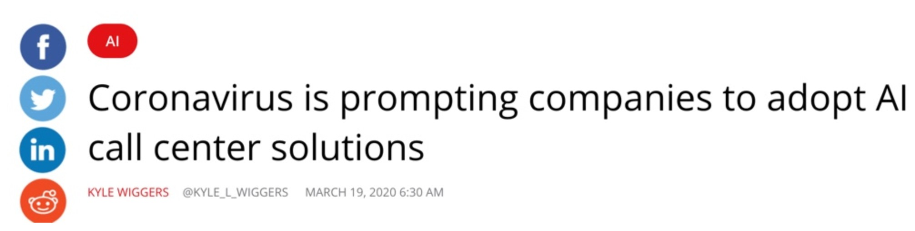
Banks have the opportunity for differentiated service through use of AI

Slide 11
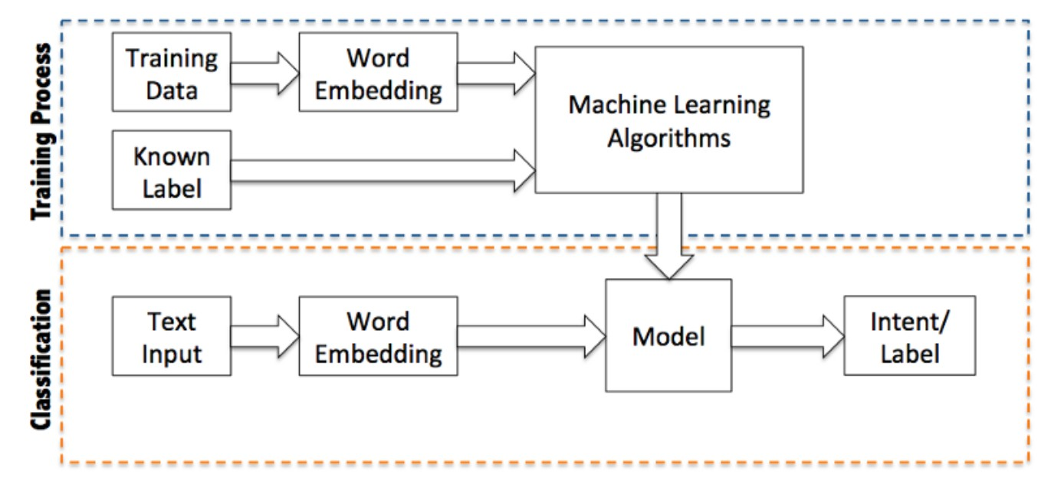
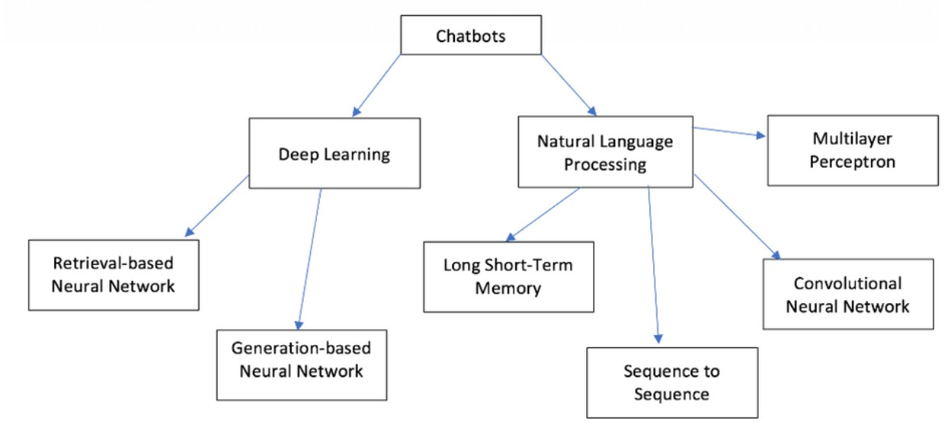
Developing a chat-bot requires deep expertise
IBM’s Watson Assistant significantly accelerates the development timeline of AI powered chatbot so you can focus on helping your customers
Inner Workings of Intent Identification Process
Conceptual Map of Chatbot Processes
Source: medium.com

Slide 12







Watson Assistant
is the AI-powered foundation of smart customer experiences.
Centralize your customer communication and problem resolution
Get started fast with your existing logs and web content
Go live without needing a developer
Dynamically manage vague questions
Assistant Skills
Dialog
Search
Agent
Customer
Channel
Resolution
Provides explicit answers
IBM Watson / © 2020 IBM Corporation

Slide 13
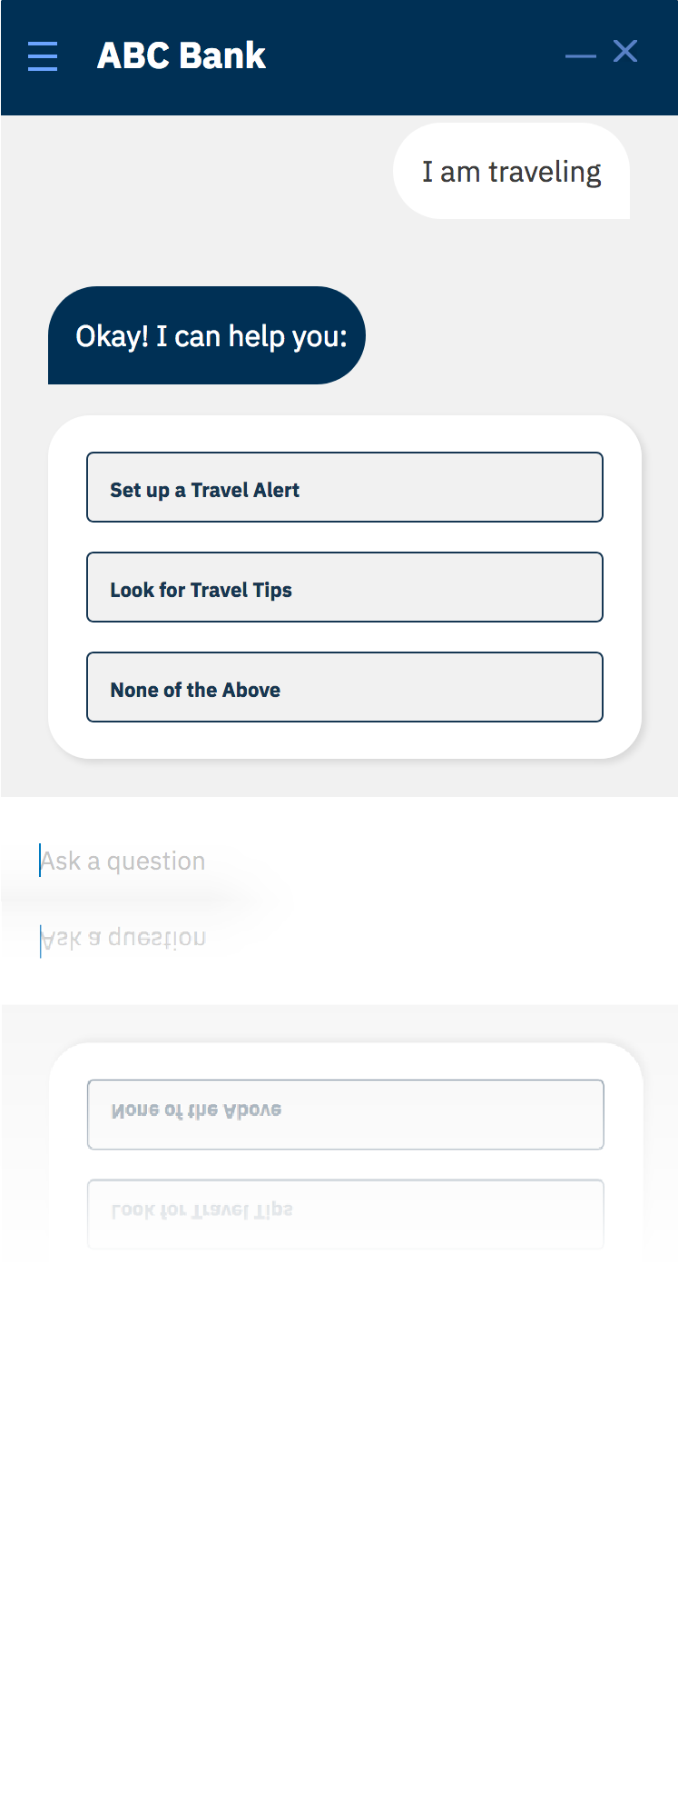
Watson Assistant
for Customer Self-Service
Transform your customer experience with the world’s #1 conversational computing platform.
Centralize disparate routes for customers to solve problems
Watson has multiple “skills,” including the ability to reach a human agent, meaning this is the only route your users need
Personalize your customer experience and improve CSAT
Watson can provide concrete and consistent responses based on its understanding of the request and of the end user
24/7 access on any channel
Watson has OOTB integrations and a conversational API to support custom apps, so it can connect to any communication channel
Let your human agents focus on solving higher value problems
Watson can deflect more than 50% of your inbound messages, meaning your agents get to focus on more nuanced issues
IBM Watson / © 2019 IBM Corporation

Slide 14









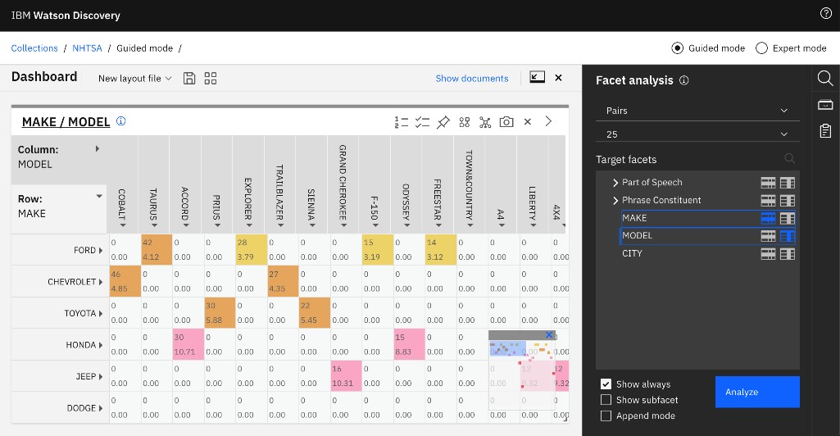


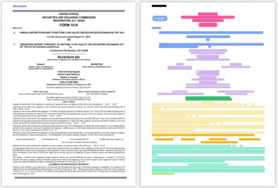













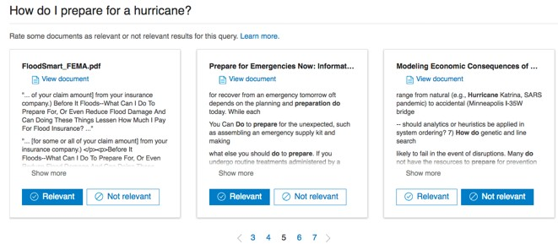
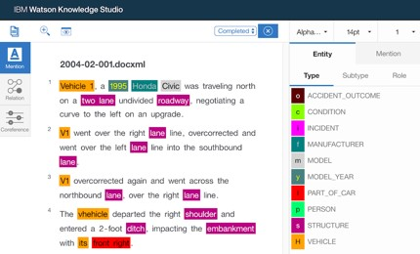




Watson Discovery
is the AI insights engine that outperforms traditional search.
Smart Document Understanding
Train AI to visually understand where answers live in documents
Content Mining
Analyze unstructured data to get insights you didn’t know to ask
Content Repository Connectivity
Watson Assistant Search Skill
Answer Retrieval
Extract and Identify Passages
Relevancy Training
Train AI to understand what documents are most relevant
Watson Knowledge Studio
Train AI to understand domain specific language
Easily connect Watson Assistant to surface answers in conversations
Experts Customers
IBM Public Cloud ● IBM Cloud Pak for Data ● Multi-Cloud

Slide 15






Watson Discovery
market leader for AI search
Q2 2019
Q2 2019
Q3 2019
AIconics names IBM Watson Discovery Best Innovator in Natural Language Processing
Forrester names IBM Watson Discovery a leader in AI search in “The Forrester Wave™ Cognitive Search Q2 2019" report.
Gartner names IBM a ‘Leader’ in Gartner’s Magic Quadrant for Insight Engines 2019 market research report.
IBM Watson / © 2020 IBM Corporation

Slide 16
Conceptual Architecture
16

Slide 17













Conceptual Architecture
Other Watson Services
Text-to-Speech
Watson Assistant
Speech-to-Text
User
Twilio
Interface
Web
Dialog Skill
Assistant Layer
Mobile
SMS
Voice Agent With Watson
Search Skill
SMS + Voice
Hosted end-to-end experience
Session State Management
Channel Integrations
Business benefit: shrink the effort and amount of time needed to bring
Assistant + Skills
an Assistant to market.
17
IBM Confidential 2019

Slide 18
Watson Platform
18

Slide 19















Watson Platform is designed for the Enterprise
Watson is changing the customer engagement lifecycle
Language
Speech Vision
Analytics
Speech to Text
Text to Speech
Visual Recognition
Watson Studio Watson ML
Watson Assistant
Language Classifier
Tone Analyzer
Data Insights
Natural Language Understanding
Language Translator
Watson Knowledge Studio
Personality Insights
Discovery
Discovery News
Empowering Associates Transforming Customer Interactions
Understanding The Voice of the Customer
19

Slide 20
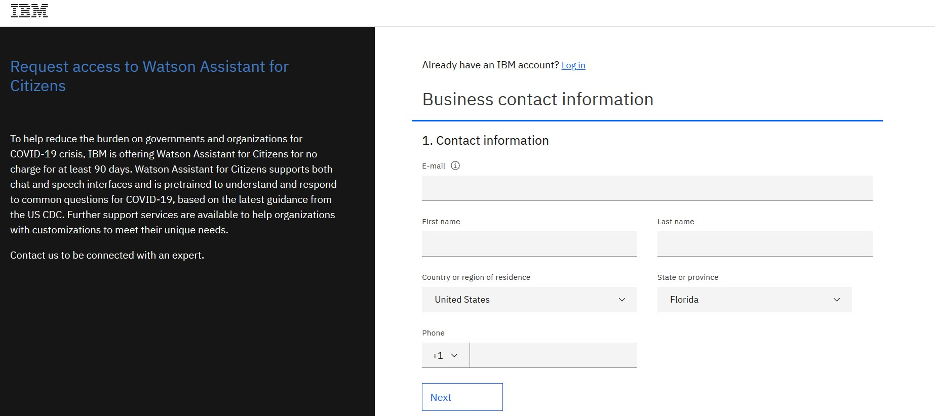
How to Register for COVID-19 Watson Assistant for Citizens (for Banking and Financial Services Customers)
https://www.ibm.com/watson/covid-response

Slide 21
Next Week FREE IBM Virtual Touch Webinars
Date | Topic | Link
April 16, 12:00 Noon (Eastern Time) Thursday | Open Source Data Repositories - Postgres Databases. IBM MongoDB and Enterprise DB Offerings. Where do they fit? | ibm.biz/BdqzVB
April 17, 12:00 Noon (Eastern Time) Friday | It's not too late to meet IFRS 16/ASC 842 with IBM Planning Analytics. | ibm.biz/BdqzVd

