Slide 1
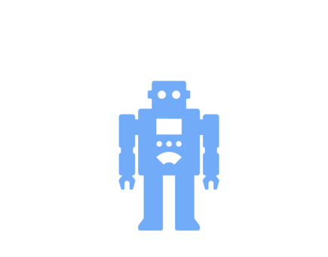
Watson Assistant
Key Features
1￼

Slide 2
Key Features
1
Assistant maintains session context and can connect to a number of managed integrations
2
Assistant references “skills” which contain reasoning logic and responses
3
Preview link integration allows you to quickly share your bot internally before launching
4
Versioning skills for creating different versions of BOT. E.g. dev, qa ,prod
5
7
Using content catalogs for getting started quickly
Watson SDK - Android , Go ,Java ,Node.js ,Python ,Ruby ,.NET ,Salesforce ,Swift ,Unity
6
Use Slots to a dialog node to gather multiple pieces of information from a user within that node

Slide 3
Disambiguation
Disambiguate a user’s utterance (Did you mean….).
WA uses machine learning to ask for user’s input if it can’t decided the best intent.
Business benefit: end-user will be provided with clearer answers and fewer “I don’t know” responses or handoffs to live agents from your assistant
IBM Confidential 2019

Slide 4
Digressions
A feature that gives the user the power to direct the conversation. It prevents customers from getting stuck in a dialog thread; they can switch topics whenever they choose.
Business benefit: end-user will be provided with a path back to the original discussion before digressing to the other topics.
IBM Confidential 2019

Slide 5
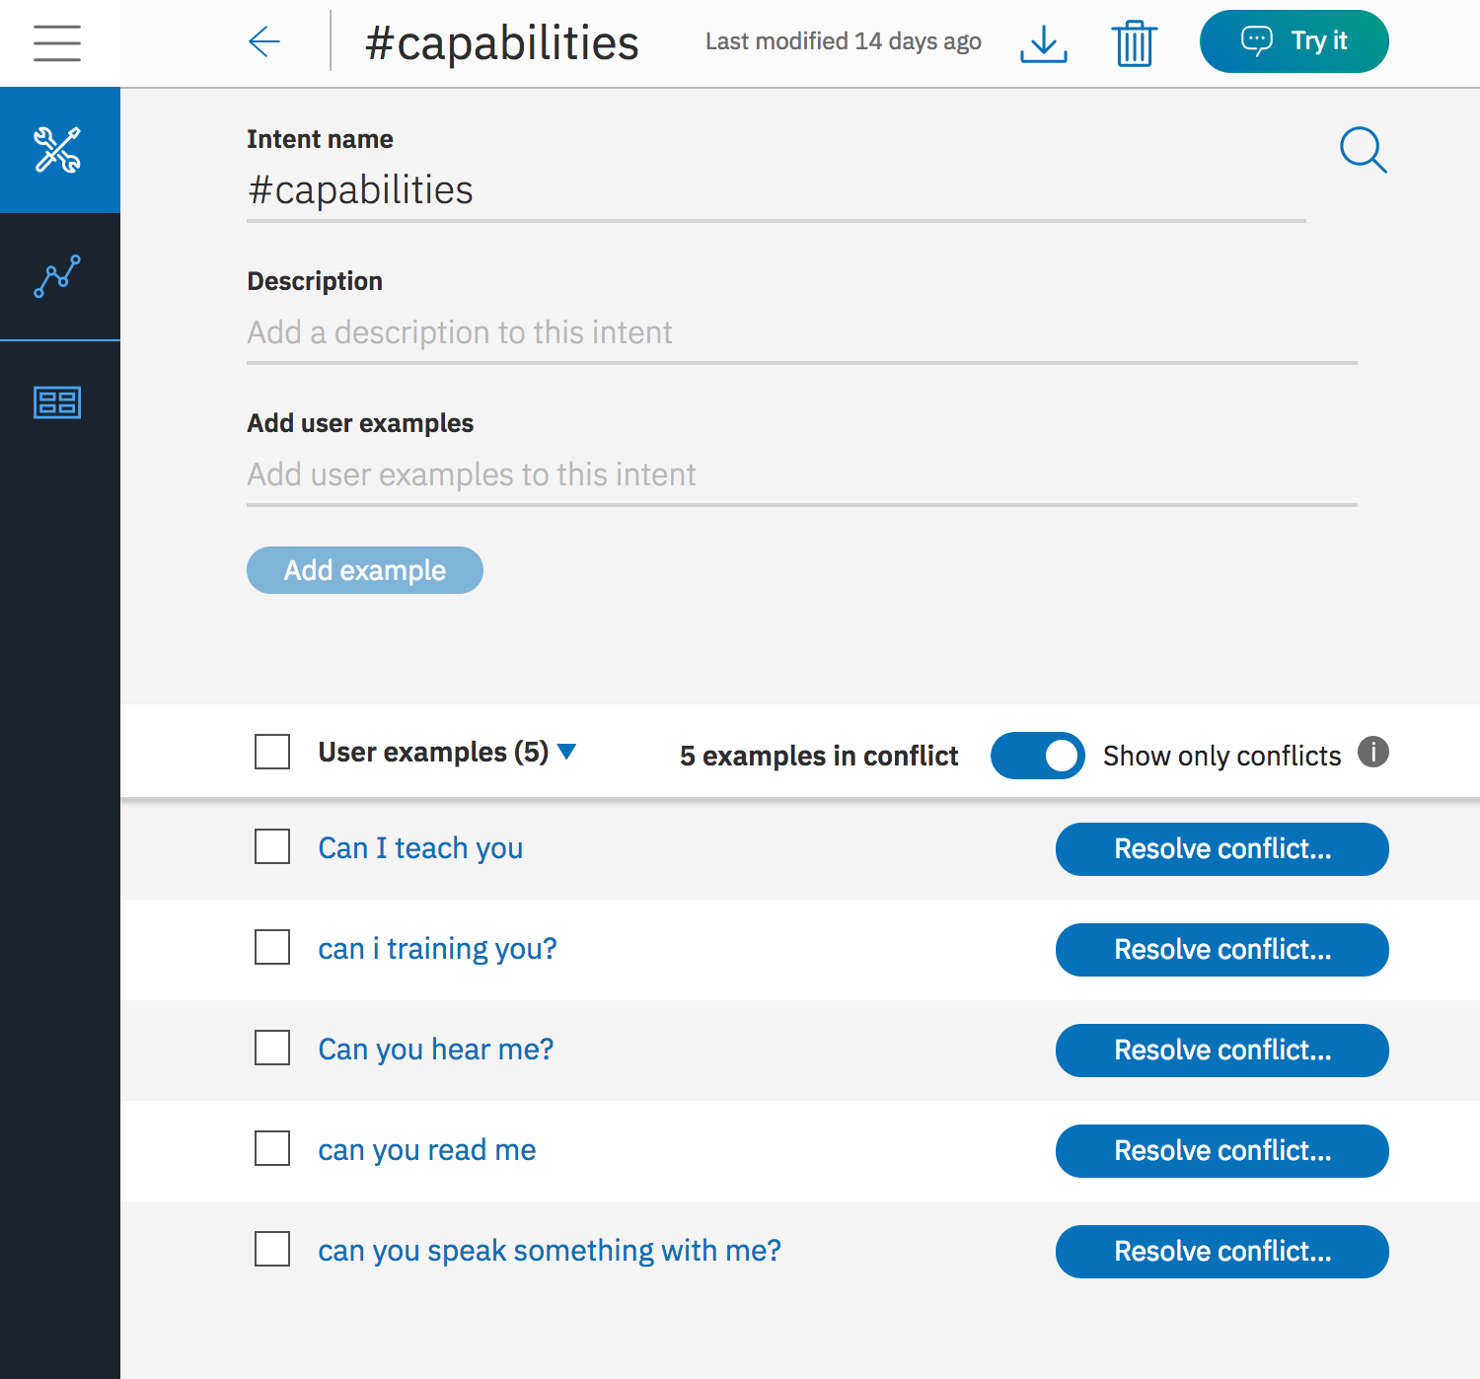
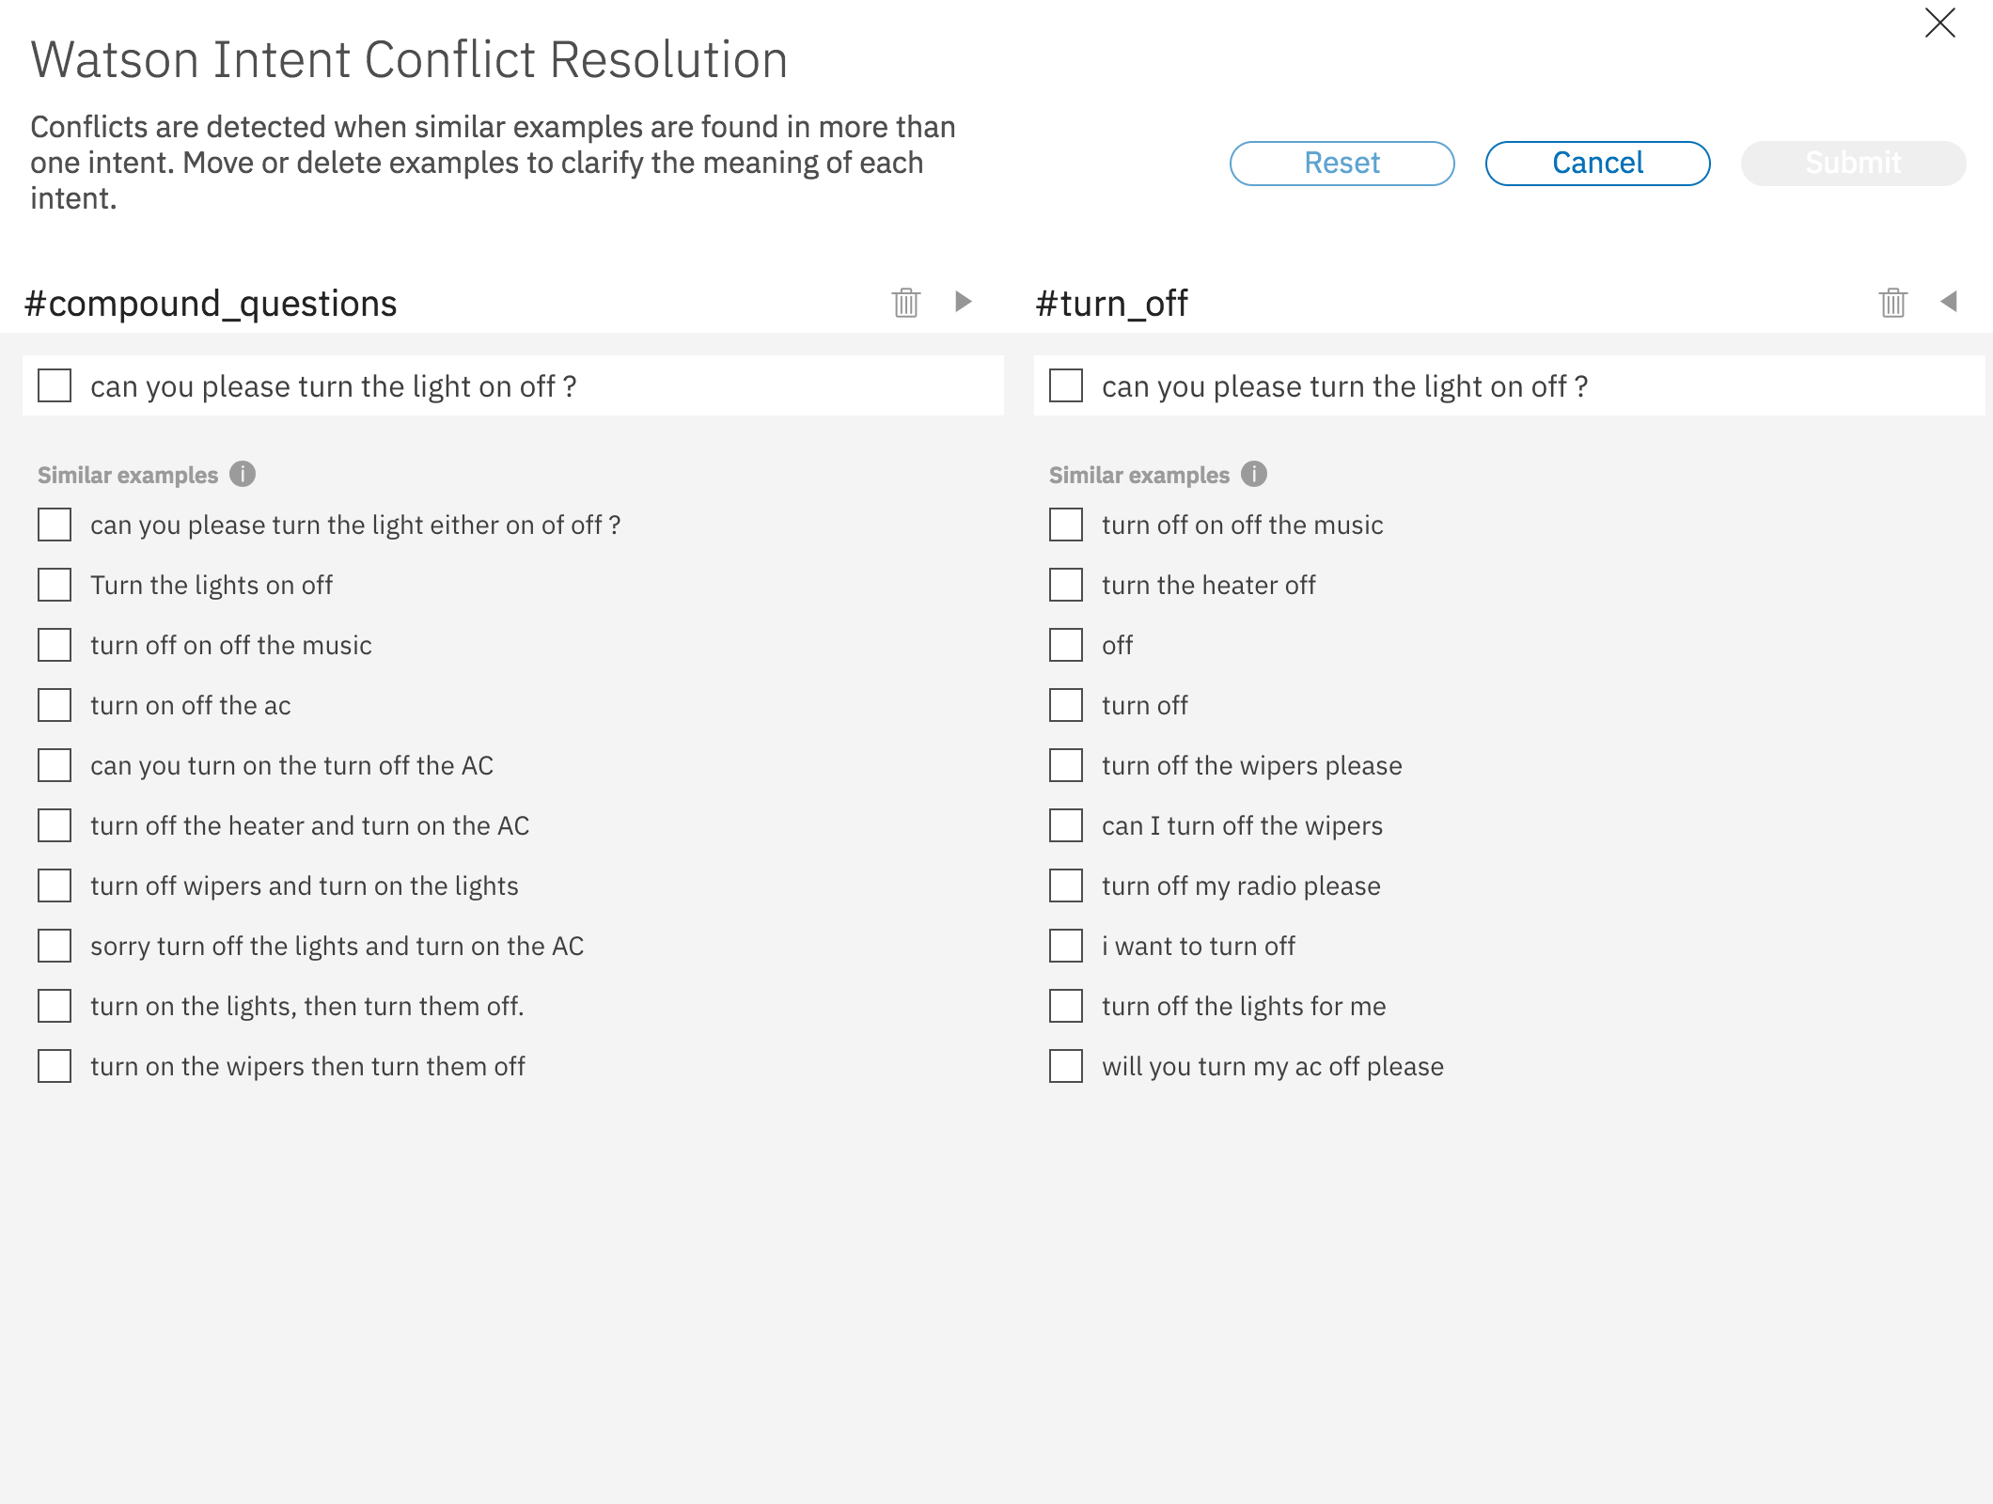
Intent Conflict Resolution
As users add more and more user utterances, intents can overlap with similar examples
Intent Conflict Resolution automatically detects conflicts across intents
Business benefit: better train assistants to understand end-users intents, increasing call deflection.
*once Plus is GA
Go to documentation →
IBM Confidential 2019

Slide 6
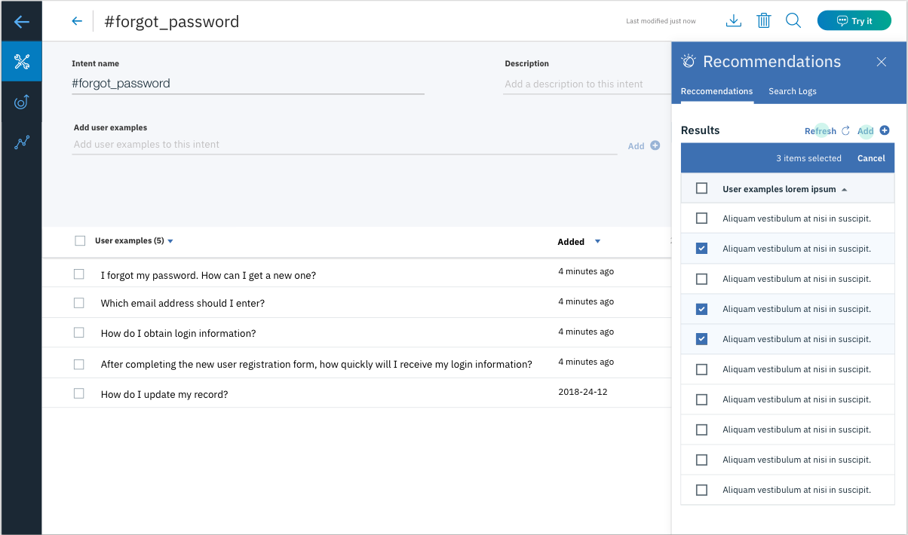
Intent recommendations (leverage human-to-human logs)
GA (Plus, Premium)
Upload human to human chat logs, and search through the corpus to add real user utterances to train intents.
Watson will recommend similar sentences based on what’s currently in the intent
Business benefit: bootstrap your Assistant with your logs, leading to quicker time to value.
Go to documentation →
IBM Confidential 2019

Slide 7
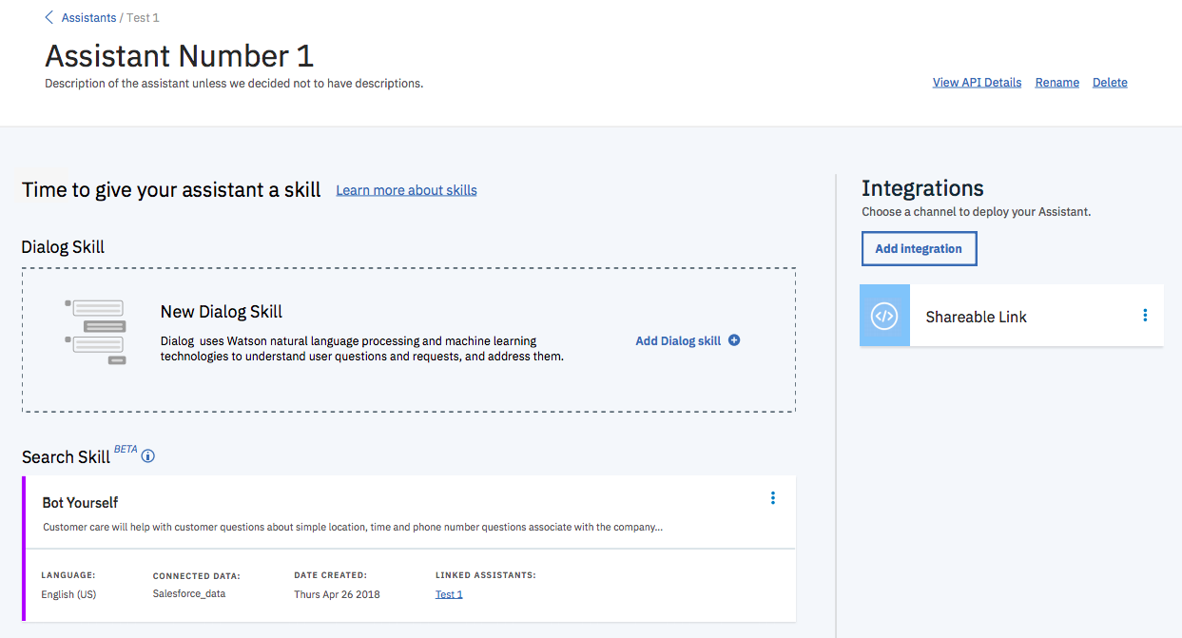
Search Skill (Discovery Integration)
Improve the coverage of your assistant by calling out to a “search skill” to Watson Discovery from any dialog node
Search results are formatted automatically by search skill
Business benefit: quickly integrate your Assistant to handle long-tail questions with Watson Discovery.
Please note: Clients will need to have entitlements to Discovery
IBM Confidential 2019

Slide 8
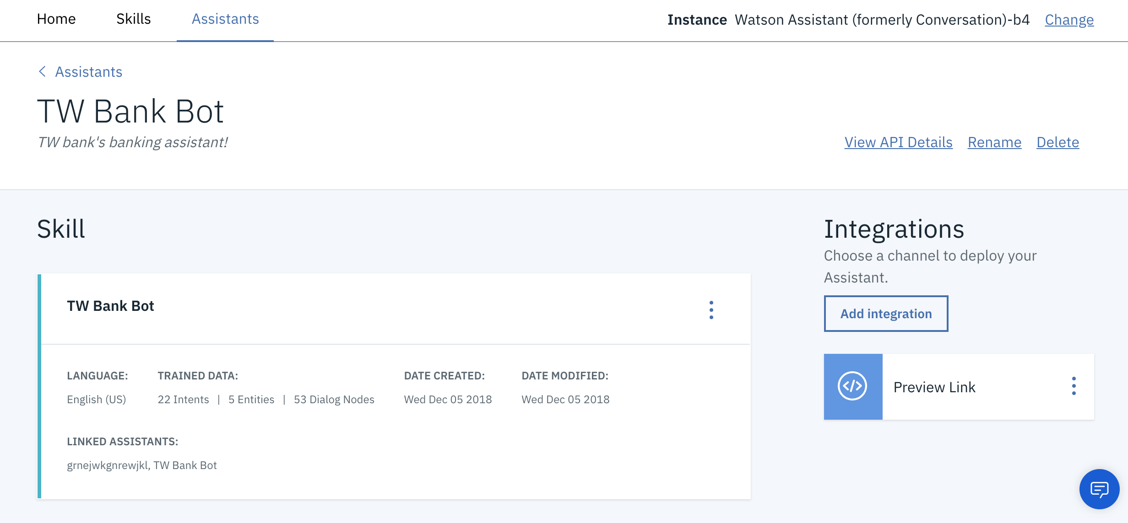
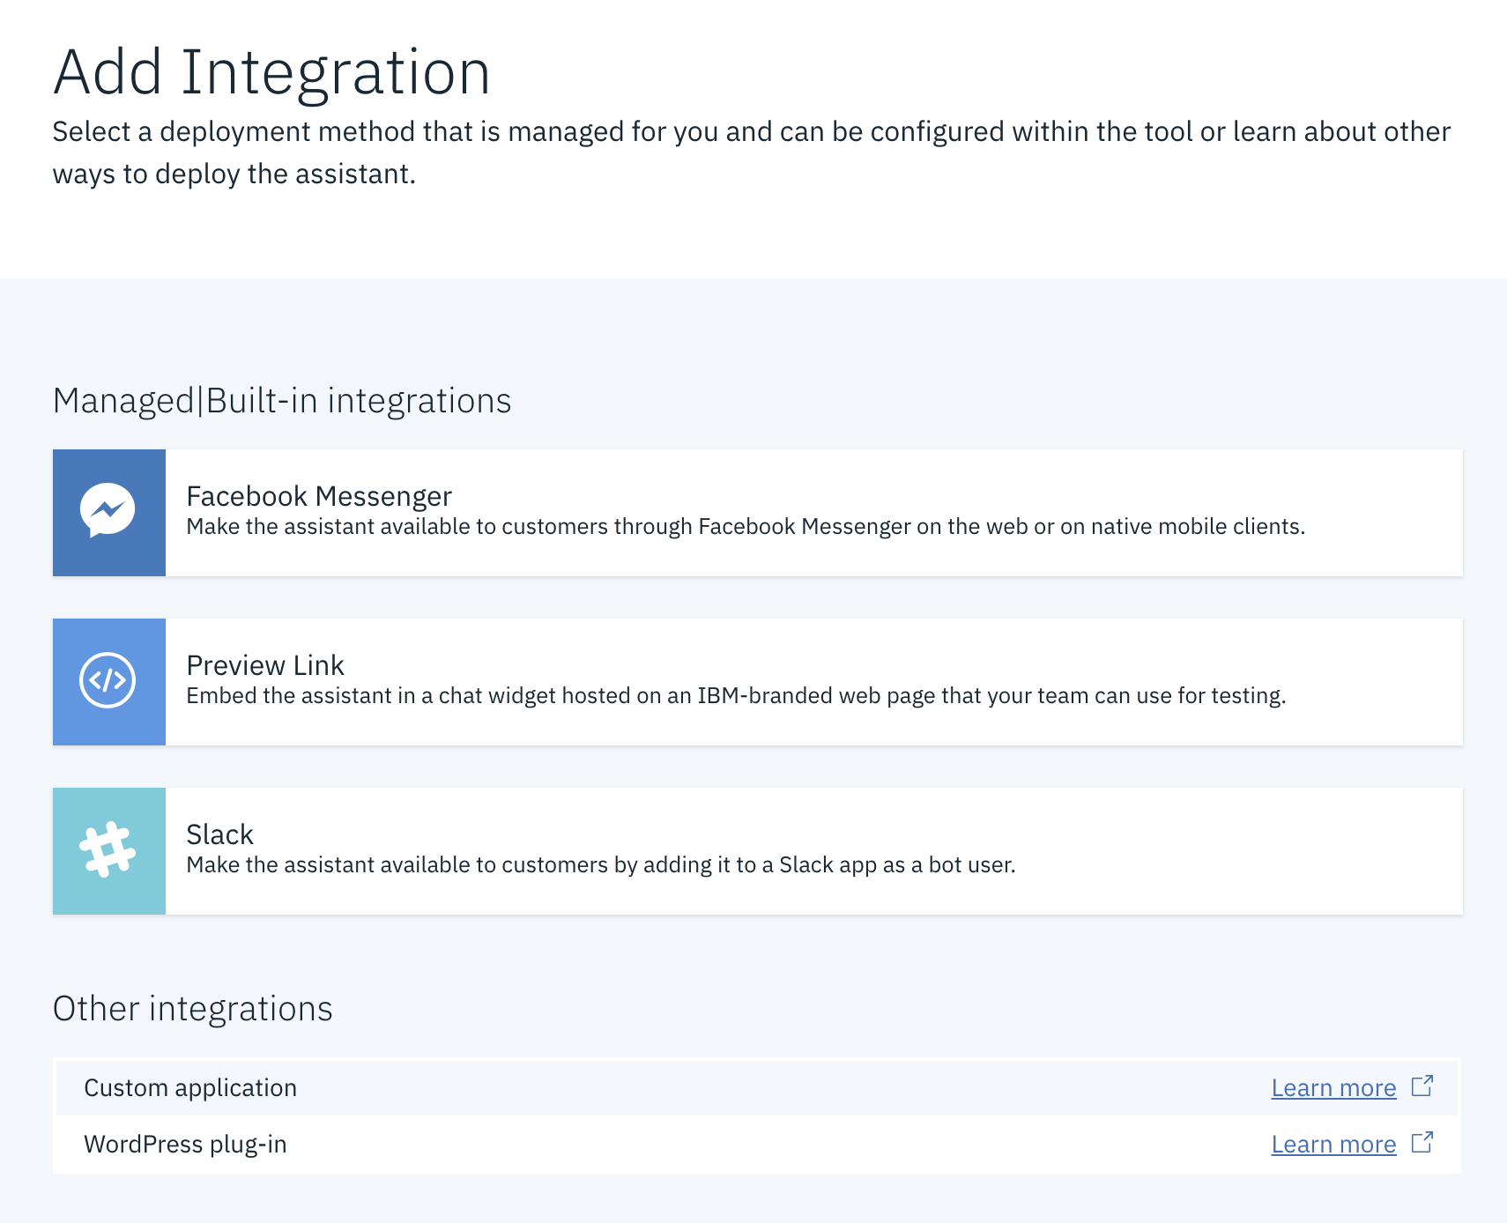
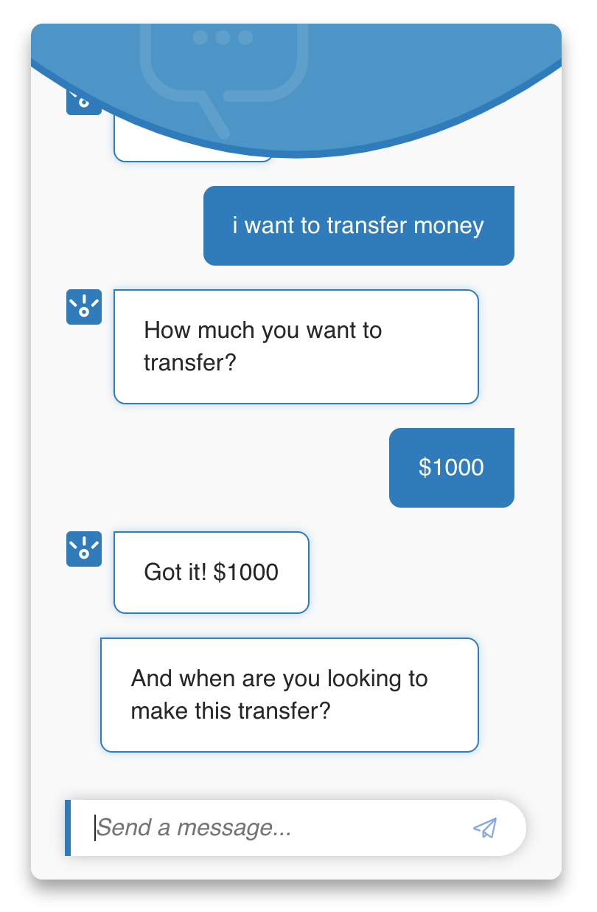
Supported Integrations
1
Out the box configurable integrations to Service Desks – starting with
2
Custom application
Facebook Messenger
Preview Link, Slack
Voice Agent (Telephony) External link icon
Opens the Voice Agent with Watson service overview page on IBM Cloud™.
WordPress plug-in External link icon
[24]7.ai chatbot integration (Beta)
Intercom,
Zendesk (Beta)
Genesys to follow.
IBM Confidential 2019
Notes:
Zendesk, Intercom, Genesys

Slide 9
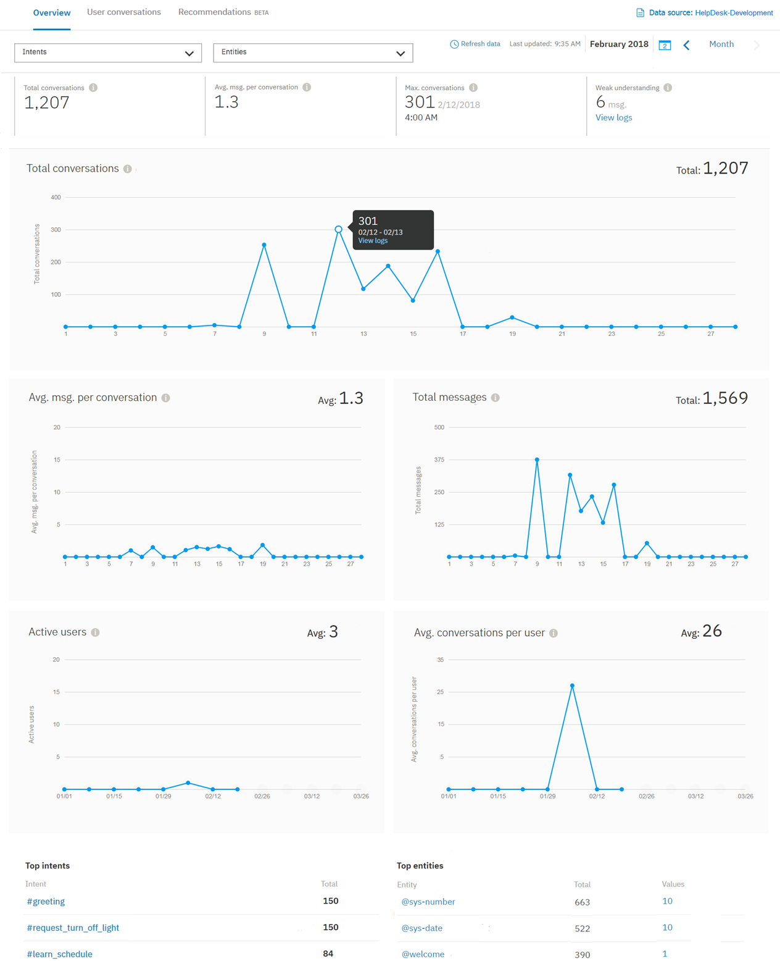
Analytics
1
Review Metrics
2
Train Skill
IBM Confidential 2019
Notes:
Zendesk, Intercom, Genesys

