Slide 1



IBM-Watson Assistant-ServiceNow-for-Employees
Make it easy for employees to get what they need, when they need it, with an enterprise conversational experience
June 8, 2020
Alison Hickey
AI Specialty Seller, Data & AI
Alison.Hickey@ibm.com
Arun Wagle
Senior Data & AI Specialist
Arun.wagle@ibm.com
Aneri Bamne
Technical Specialist
Aneri.Bamne@ibm.com

Slide 2

Chatbot Demonstration
9

Slide 3







Watson Assistant
is the AI-powered foundation of smart customer experiences.
Centralize your customer communication and problem resolution
Get started fast with your existing logs and web content
Go live without needing a developer
Dynamically manage vague questions
Assistant Skills
Dialog
Search
Agent
Customer
Channel
Resolution
Provides explicit answers
IBM Watson / © 2020 IBM Corporation

Slide 4
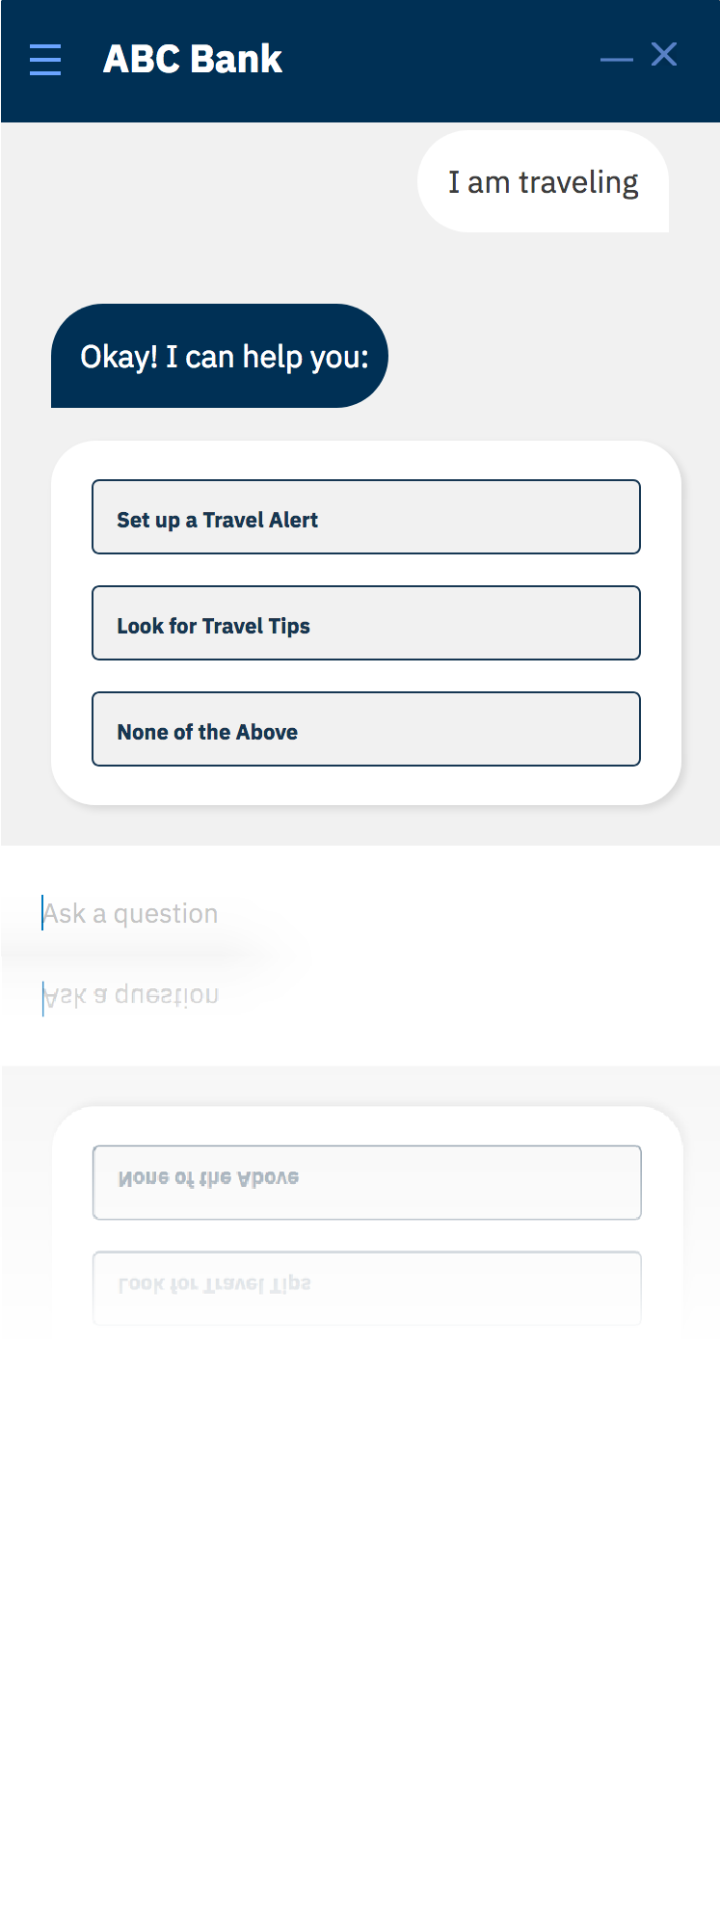
Watson Assistant
for Customer Self-Service
Transform your customer experience with the world’s #1 conversational computing platform.
Centralize disparate routes for customers to solve problems
Watson has multiple “skills,” including the ability to reach a human agent, meaning this is the only route your users need
Personalize your customer experience and improve CSAT
Watson can provide concrete and consistent responses based on its understanding of the request and of the end user
24/7 access on any channel
Watson has OOTB integrations and a conversational API to support custom apps, so it can connect to any communication channel
Let your human agents focus on solving higher value problems
Watson can deflect more than 50% of your inbound messages, meaning your agents get to focus on more nuanced issues
IBM Watson / © 2019 IBM Corporation

Slide 5









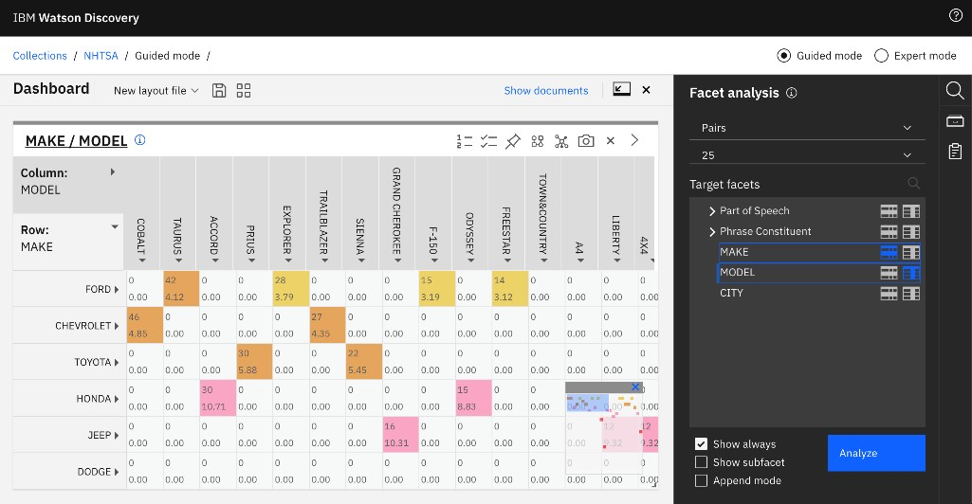


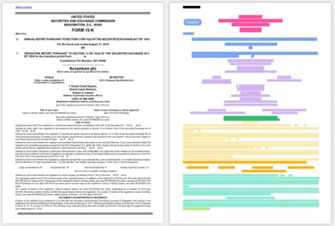













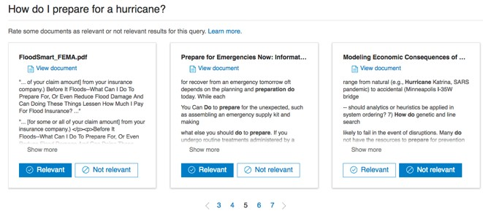
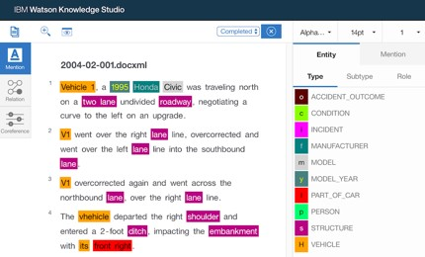




Watson Discovery
is the AI insights engine that outperforms traditional search.
Smart Document Understanding
Train AI to visually understand where answers live in documents
Content Mining
Analyze unstructured data to get insights you didn’t know to ask
Content Repository Connectivity
Watson Assistant Search Skill
Answer Retrieval
Extract and Identify Passages
Relevancy Training
Train AI to understand what documents are most relevant
Watson Knowledge Studio
Train AI to understand domain specific language
Easily connect Watson Assistant to surface answers in conversations
Experts Customers
IBM Public Cloud ● IBM Cloud Pak for Data ● Multi-Cloud

Slide 6
Conceptual Architecture
16

Slide 7














Conceptual Architecture
Other Watson Services
Text-to-Speech
Watson Assistant
Speech-to-Text
User
Twilio
Interface
Web
Dialog Skill
Assistant Layer
Mobile
SMS
Voice Agent With Watson
Search Skill
SMS + Voice
Hosted end-to-end experience
Session State Management
Channel Integrations
Business benefit: shrink the effort and amount of time needed to bring
Assistant + Skills
an Assistant to market.
17
IBM Confidential 2019

Slide 8
Watson Platform
18

Slide 9















Watson Platform is designed for the Enterprise
Watson is changing the customer engagement lifecycle
Language
Speech Vision
Analytics
Speech to Text
Text to Speech
Visual Recognition
Watson Studio Watson ML
Watson Assistant
Language Classifier
Tone Analyzer
Data Insights
Natural Language Understanding
Language Translator
Watson Knowledge Studio
Personality Insights
Discovery
Discovery News
Empowering Associates Transforming Customer Interactions
Understanding The Voice of the Customer
19

Slide 10
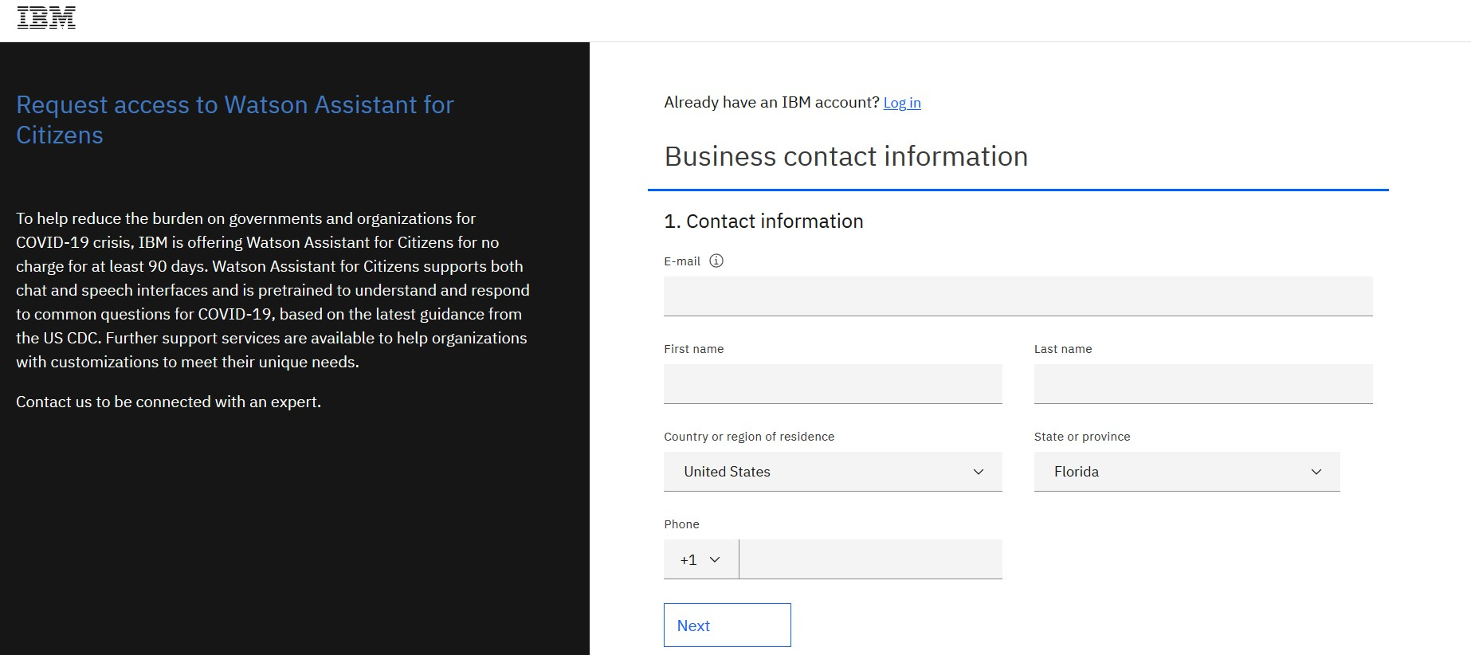

How to Register for COVID-19 Watson Assistant for Citizens (for Banking and Financial Services Customers)
https://www.ibm.com/watson/covid-response

Slide 11
Next Week FREE IBM Virtual Touch Webinars
Date | Topic | Link
April 16, 12:00 Noon (Eastern Time) Thursday | Open Source Data Repositories - Postgres Databases. IBM MongoDB and Enterprise DB Offerings. Where do they fit? | ibm.biz/BdqzVB
April 17, 12:00 Noon (Eastern Time) Friday | It's not too late to meet IFRS 16/ASC 842 with IBM Planning Analytics. | ibm.biz/BdqzVd

