Slide 1
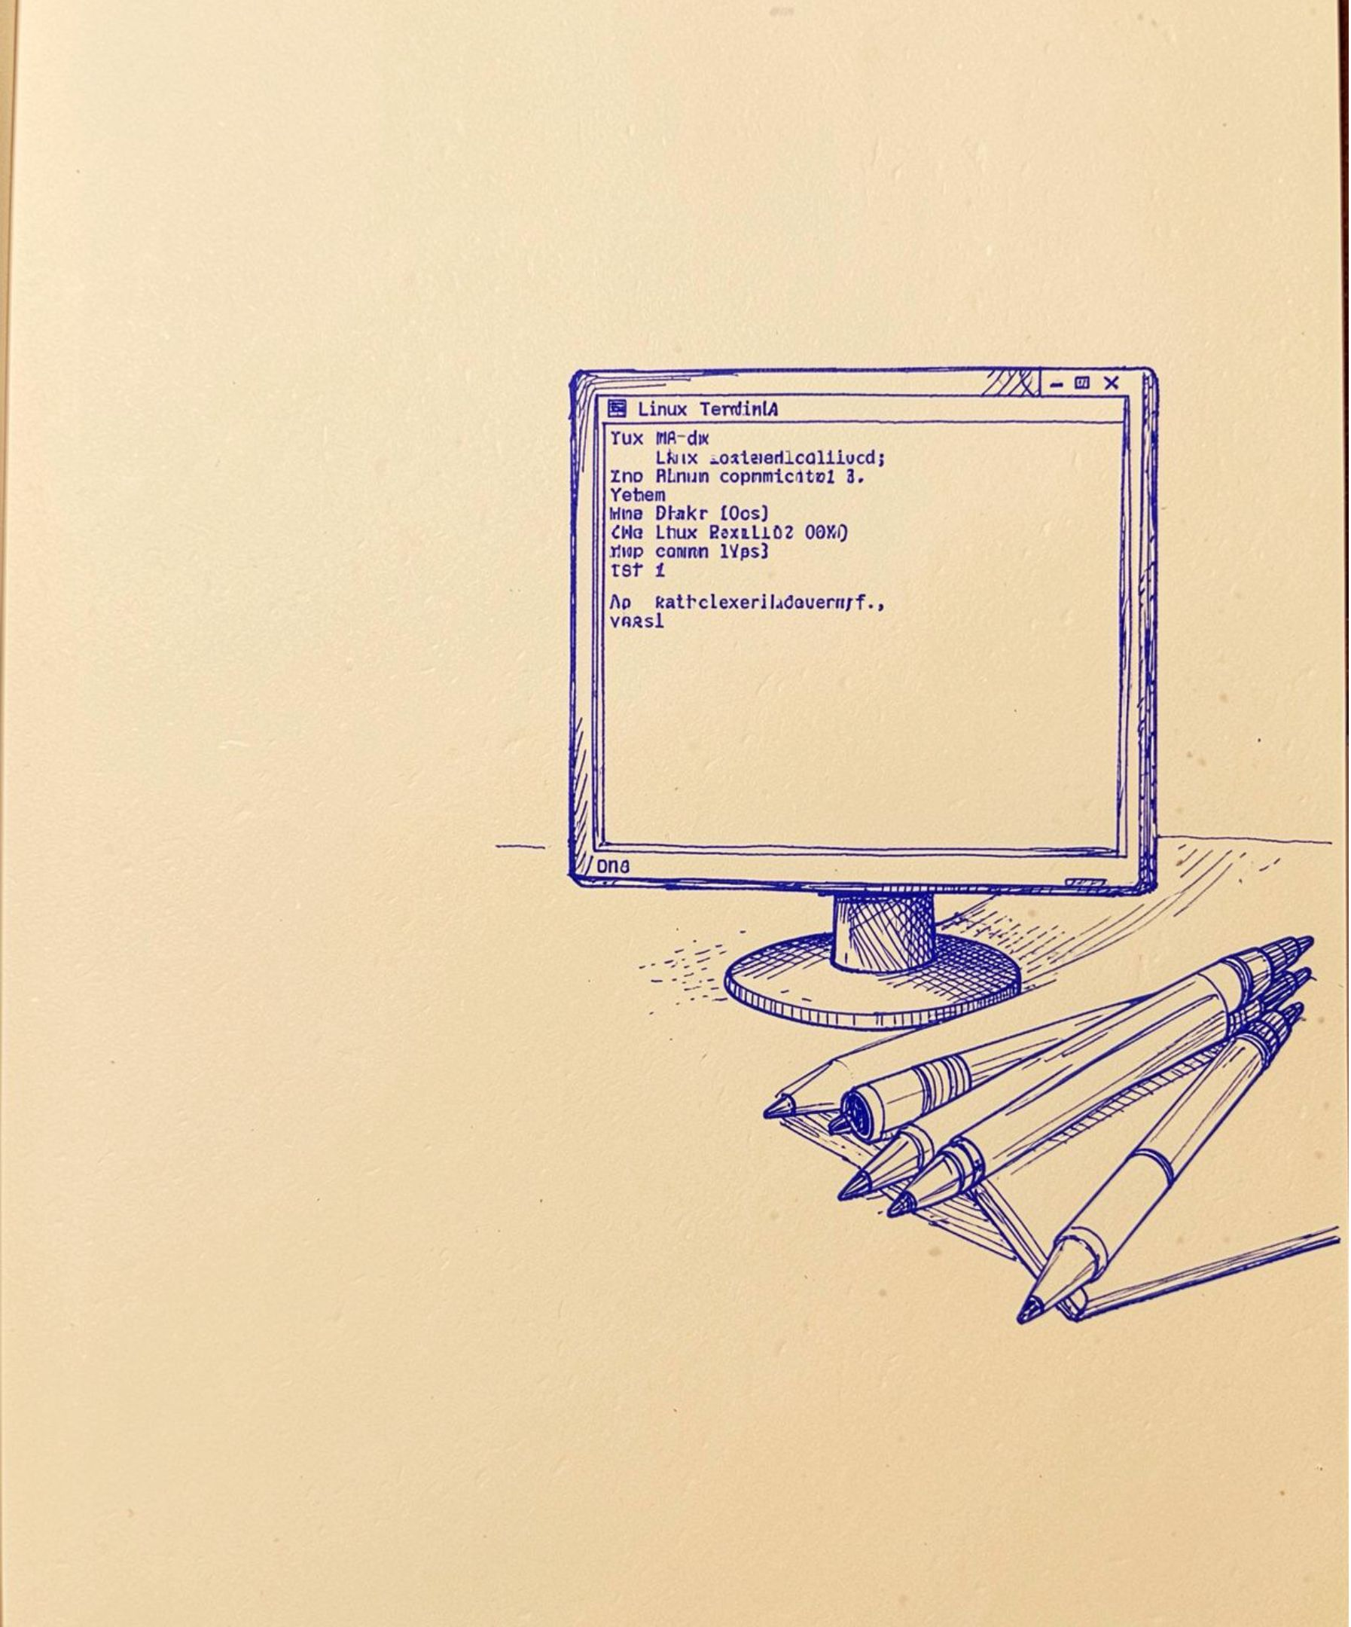
REVIEW 4 · OPERATING SYSTEMS
Multi-User Linux Shell
— ShellForge
Design and implementation of a custom command interpreter in C.
Team: Aniketh, Prashanth, Arun, Ashwithnath
Technology: C, Linux/Ubuntu, WSL, GCC

Slide 2




01 · PURPOSE
ShellForge turns OS concepts into a working shell
Custom Linux command-line shell
Login-based multi-user session
Developed in C on Ubuntu using WSL.
Accepts and processes commands.
Built-ins, programs, pipes, and Ctrl+C
Main objective
Supports built-in commands, external programs, pipes, and Ctrl+C handling.
Demonstrate operating-system concepts through a working application.
02

Slide 3
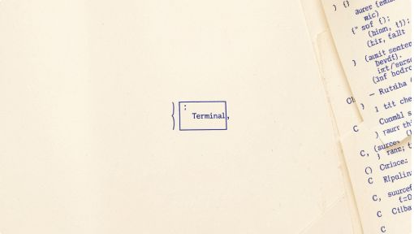

02 · ARCHITECTURE
Eight focused modules make the shell understandable
The flow is explicit: main.c routes a session through authentication, input, signals, parsing, and execution.
Session Start
Auth & Input
Parse & Signals
Execute & IPC
03

Slide 4
03 · SYSTEM CALLS
Core system calls connect input to execution
Each call has one job in the command path.
PARSE + MEMORY
PROCESS + SYNC
IPC + SIGNALS
strtok()
fork() · execvp()
pipe() · dup2()
Divides commands into tokens.
Create children and launch programs.
Manage communication.
malloc() · realloc() · free()
waitpid()
SIGINT · SIGCHLD
Support growing input.
Coordinates child processes.
Manage interruption and cleanup.
04

Slide 5





04 · WORKING FEATURES
Authentication, commands, pipes, and signals are built in
Username and password verification starts the session.
Built-ins include cd, pwd, clear, help, env, and exit.
External commands run through fork() and execvp().
Pipelines connect commands such as ls | wc. The shell remains active after Ctrl+C and accepts long commands with many arguments.
05

Slide 6
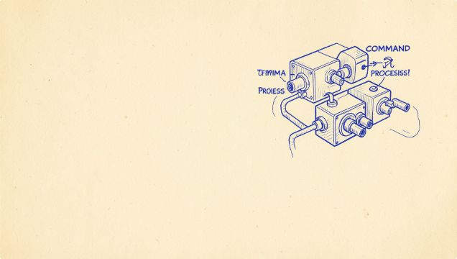

05 · PIPELINE FLOW
A pipeline turns two processes into one command flow
fork()
The current implementation supports one pipeline connecting two commands.
pipe()
dup2()
execvp()
TESTED EXAMPLE
ls | wc
Reported output: 9 lines, 9 words, 64 bytes.
06

Slide 7

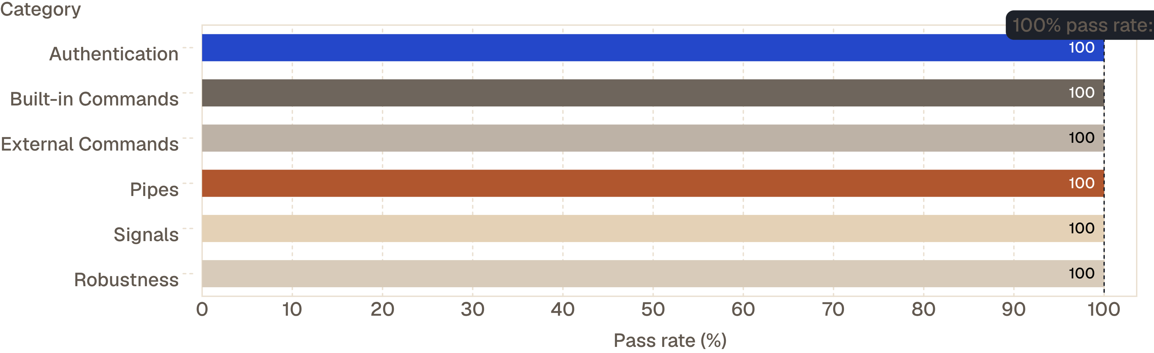
06 · ACCURACY OF RESULTS
21 of 21 test cases passed
Every tested category achieved a 100% pass rate.
Coverage included authentication, commands, pipes, invalid inputs, Ctrl+C, long inputs, and zombie-process checking.
07

Slide 8
07 · SUSTAINABILITY
Modularity creates a foundation for sustainable growth
Innovation: combines authentication with shell execution, dynamic input, real-time process communication, signal-based management, and zombie-process prevention.
Next improvements: secure password hashing, multiple pipelines, redirection, background processes, command history, user-specific directories and permissions, and session logging.
08

Slide 9



08 · VALUE
ShellForge makes low-level OS concepts tangible
A working shell turns technical competence into an educational Linux utility.
Utility to society
Technical competence
Major calls
An educational Linux shell that helps students understand process management, IPC, and Linux system calls.
C, Linux/Ubuntu, WSL, GCC, GNU Make, and Git.
fork(), execvp(), waitpid(), pipe(), dup2(), and signal().
09

Slide 10
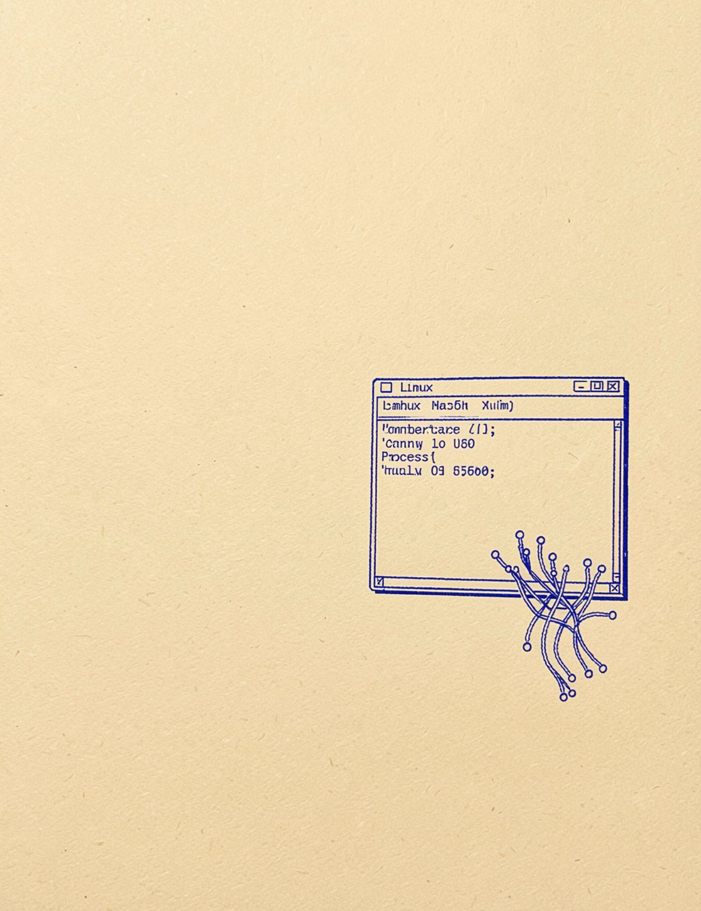
09 · CLOSE
ShellForge delivers a working multi-user shell
Authentication works successfully. Built-in and external commands execute. Process creation, pipe-based IPC, and signal handling are implemented.
21/21 test cases passed.
TEAM: ANIKETH, PRASHANTH, ARUN, ASHWITHNATH
Thank you. Questions?

