Slide 1
Stock Maket
SlideMake.com

Slide 2

Introduction to the Stock Market
The stock market is a marketplace where shares of publicly traded companies are bought and sold.
It serves as a platform for companies to raise capital and for investors to buy ownership in those companies.
Understanding the stock market is essential for making informed investment decisions and building wealth.
1
Notes:
Image source: https://i.ytimg.com

Slide 3

How the Stock Market Works
The stock market operates on supply and demand, where prices fluctuate based on buyers and sellers.
Investors can trade stocks through various exchanges, such as the New York Stock Exchange (NYSE) or NASDAQ.
Trading can occur in real-time, allowing investors to react quickly to market changes and news.
2
Notes:
Image source: https://rupayrajat.com

Slide 4
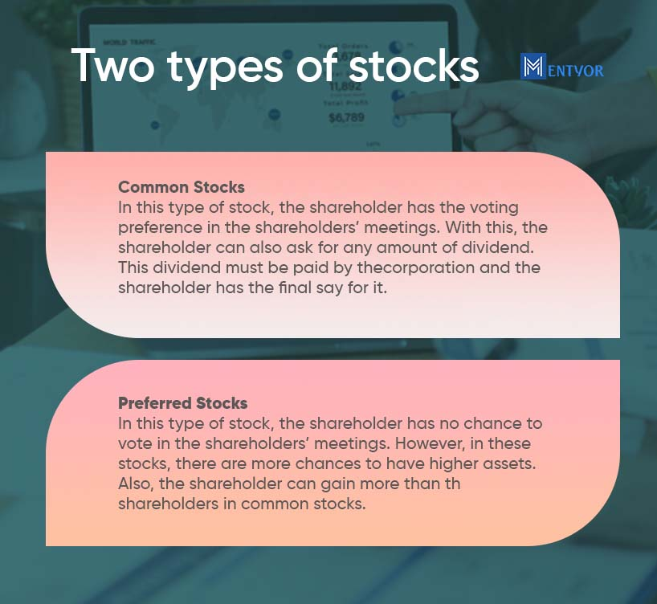
Types of Stocks
There are two main types of stocks: common stocks and preferred stocks.
Common stocks provide voting rights and potential dividends, while preferred stocks typically offer fixed dividends.
Investors choose stocks based on their risk tolerance, investment goals, and market conditions.
3
Notes:
Image source: https://blog.mentyor.com

Slide 5
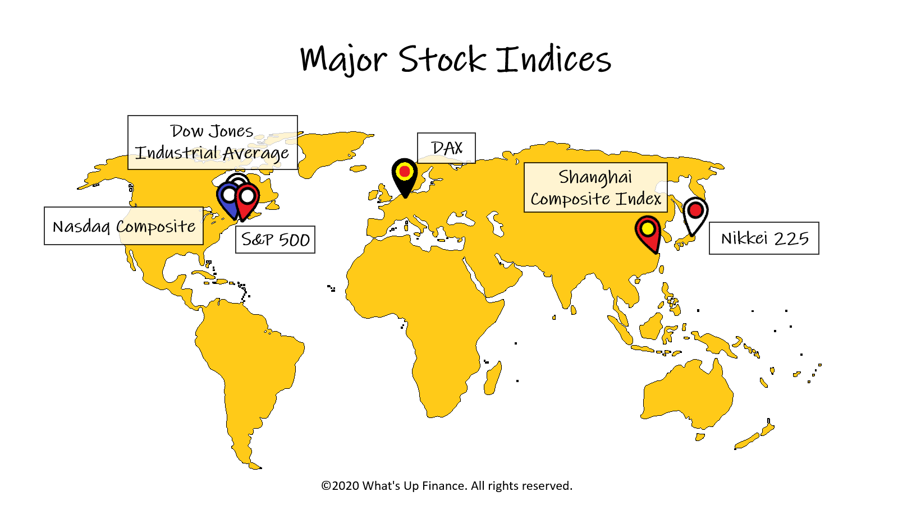
Key Stock Market Indices
Major stock market indices, such as the S&P 500 and Dow Jones Industrial Average, track the performance of selected stocks.
These indices serve as benchmarks for investors to gauge market trends and overall economic health.
Monitoring indices can help investors make strategic decisions regarding their portfolios.
4
Notes:
Image source: https://whatsupfinance.com

Slide 6

Risks and Rewards of Investing
Investing in the stock market carries inherent risks, including market volatility and the potential for loss.
However, long-term investments in stocks can yield significant returns compared to other asset classes.
Diversification and research are key strategies to mitigate risks and enhance potential rewards.
5
Notes:
Image source: https://infinityinvesting.com

Slide 7

Conclusion and Future Outlook
The stock market continues to evolve with technological advancements and changing economic conditions.
Staying informed about market trends, economic indicators, and global events is crucial for successful investing.
As the market grows, new opportunities arise, making it an exciting area for both new and experienced investors.
6
Notes:
Image source: https://shallowinsan.com

