Slide 1
Marriage Status

Slide 2
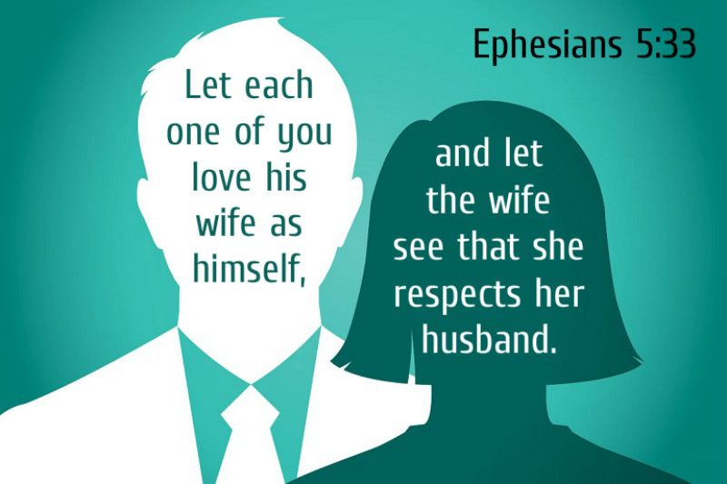
MEMORY VERSE

Slide 3
Text: Ephesians 5:22-29
In marriage, both partners should show love and respect.
Wives should show respect to their husbands, like how we all respect God.
Husbands should love their wives unconditionally, just like Jesus loved the church.
Marriage is a symbol of this love and respect, where each partner cares for the other.

Slide 4


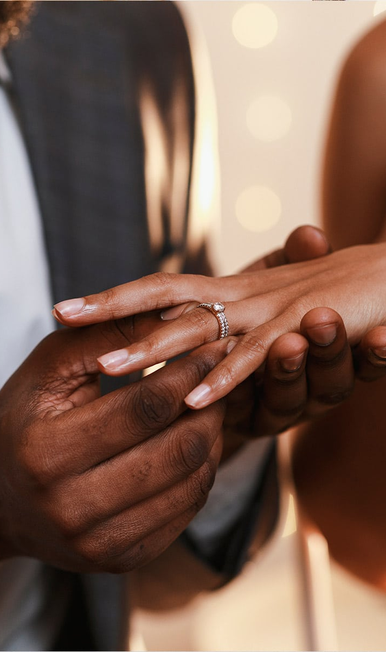
Introduction
Marriage is a state of being united as man and woman in a consensual and contractual relationship recognised by law.
According to the bible, marriage is a honourable institution (Heb 13:4) and a lifetime commitment (Mat 19:6).
However, it is generally observed that some marriages are in a state of coma or completely dead, while some merely exist.
What is the status of your marriage as a believer?
It is interesting to know that God desires that we all have living marriages.

Slide 5
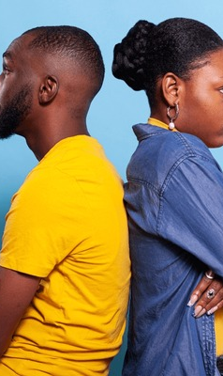
Marriage Status
Marriage in coma: this refers to a loveless marriage where communication breaks down and resentment builds. Partners become inconsiderate and dwell on each other's flaws.
Dead marriage: this stage signifies a complete absence of love and emotional connection. While sharing the same space, they become strangers with no genuine concern for each other.
Living marriage: ideal stage is characterised by understanding, patience, and sacrifice. Partners enjoy each other's company and have learned to navigate their differences.

Slide 6
Characteristics of a Living Marriage (1)
Faithful Foundation: The couple prioritizes God in their relationship, basing their decisions on his teachings.
Enduring Love: their love goes beyond physical attraction ("eros"). It's a selfless, unconditional love that weathers any storm, inspired by God's example.
Mutual Support System: Spouses are there for each other through life's ups and downs, offering unwavering support.
Forgiveness as a Cornerstone: Conflicts are seen as opportunities for growth. Partners readily forgive and seek forgiveness, fostering a stronger bond.
Kindness & Understanding: Respect and understanding are woven into the fabric of their relationship.

Slide 7
Characteristics of a Living Marriage (2)
Shared Goals & Dreams: they take an active interest in each other's pursuits and aspirations, building a future together.
Gratitude & Appreciation: they cultivate an attitude of gratitude, celebrating each other's contributions.
Acceptance & Growth: they recognize and accept each other's flaws while working together to become better individuals.
Quality Time Investment: they prioritize spending meaningful time together, strengthening their connection.

Slide 8
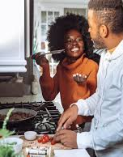
Conclusion
By nurturing these characteristics, couples can build a flourishing partnership that transcends self-interest and creates a haven of love, respect, and mutual fulfillment.

