Slide 1
FDS Diagnostic Tool Plots User Guide
Version 0.2.0 Beta
Yavor Panev
yavor.panev@arup.com

Slide 2
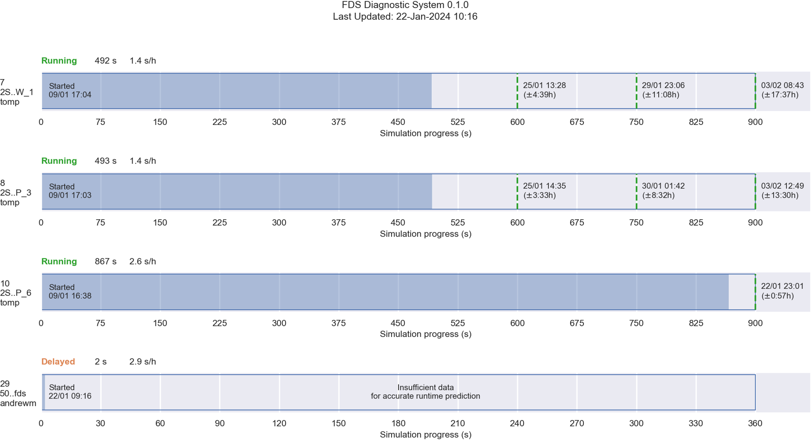
All simulations summary plot
1
2
Time and date of the diagnostic
Cluster ID / Simulation name/ User
Simulation status
Current time progress
Simulation speed
Time predictions for specific time horizon (uncertainty provided in brackets)
Completion time predition
3
4
5
6
7

Slide 3
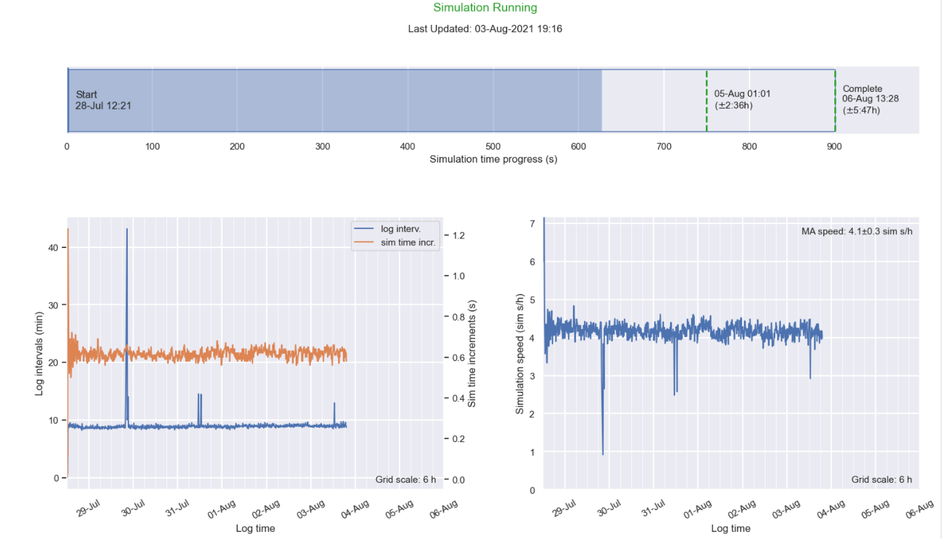
Simulation progression plot
1
2
Simulation status
Time prediction
Simulation time incremental advancement per log (right scale) to the .out file
Time difference between two successive logs to the .out file
Simulation progression speed
Progression speed moving average and conf. interval based on last 30 entries
6
3
5
4

Slide 4
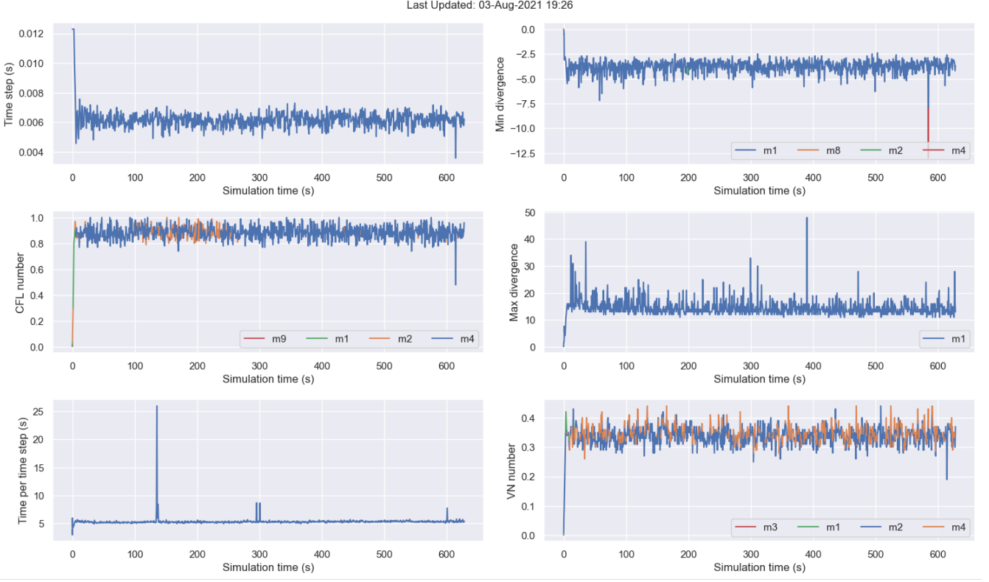
Mesh based plots
1
All plots are based on min or max value for the respective parameter of interest
When quantity is mesh dependant colour coding represent the corresponding mesh to which the plotted value belongs
2

Slide 5
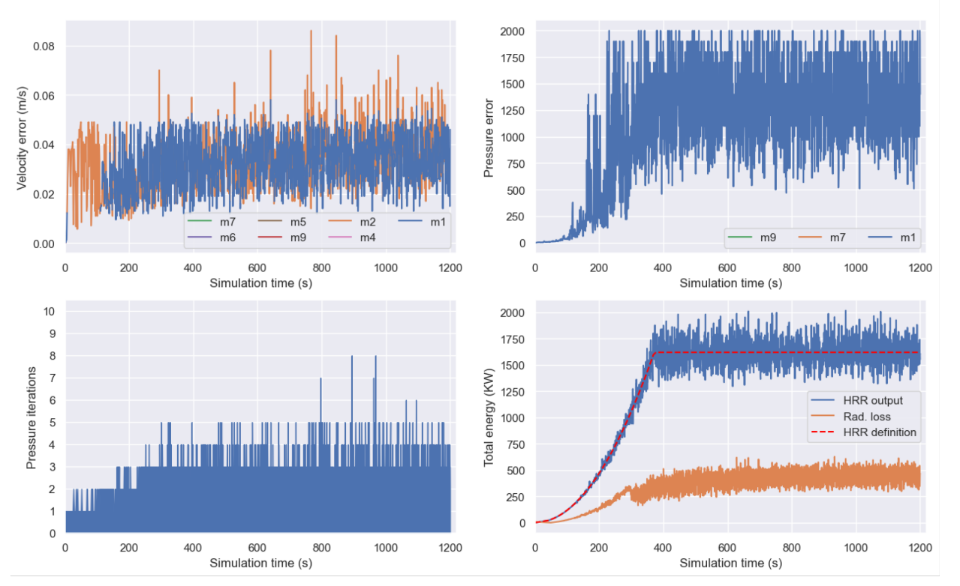
Cycle based plots
1
All plots are based on min or max value for the respective parameter of interest
When quantity is mesh dependant colour coding represent the corresponding mesh to which the plotted value belongs
Dashed line represents HRR definition as input in the .fds file
2
3

Slide 6
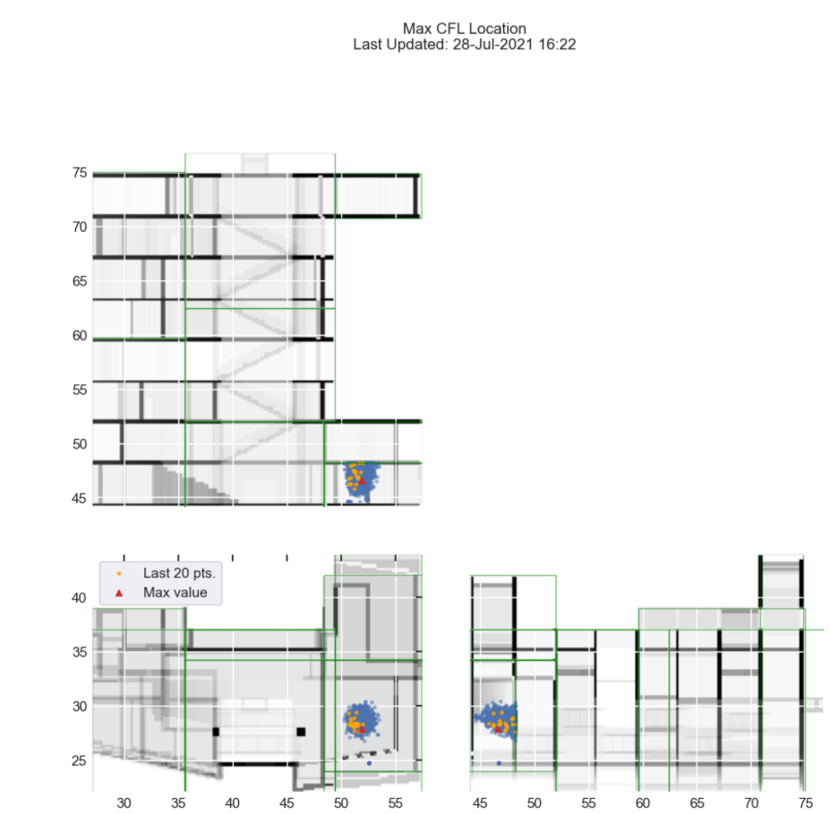
Location based plots
1
XZ view
XY view
YZ view
Axis values correspond to the actual model position in accordance with the .fds input.
Green boxes represent mesh boundaries in each projection
5
3
2
4

