Slide 1
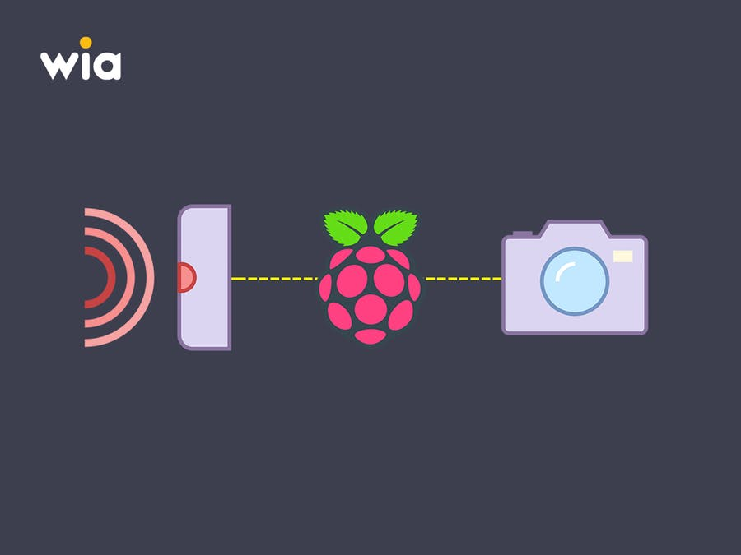
RasPI Motion Activated Security Camera

Slide 2
Group Name: RasPI-Incubetor
Ibnul Hayat Khan
2017000000251
Arup Debnath
2017000000083
Md. Sazid Hasan
2017000000203
Sadia Benta Awal
201000000109

Slide 3
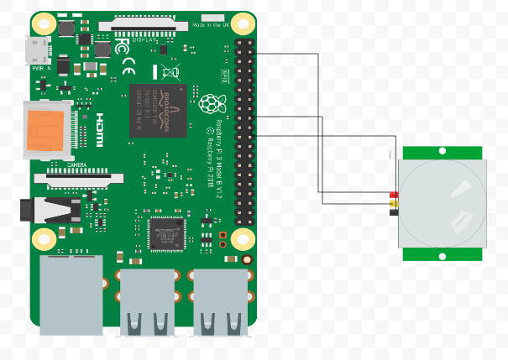
Project Overview
RaspberryPI Detects motion and make the PIR sensor pin HIGH using a python script.

Slide 4
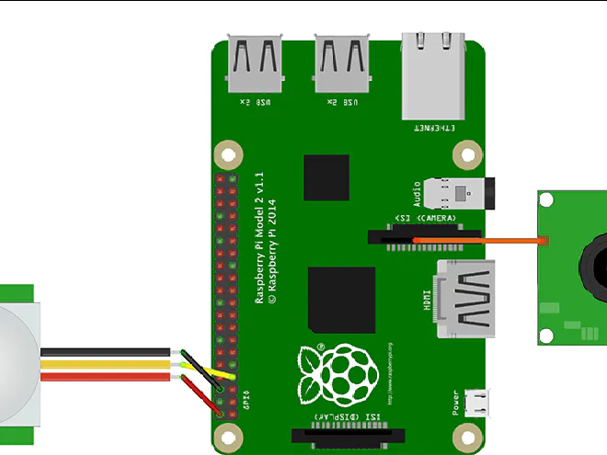
Project Overview
Then Python script initialize the camera, capture one snap and save it in SD card.

Slide 5
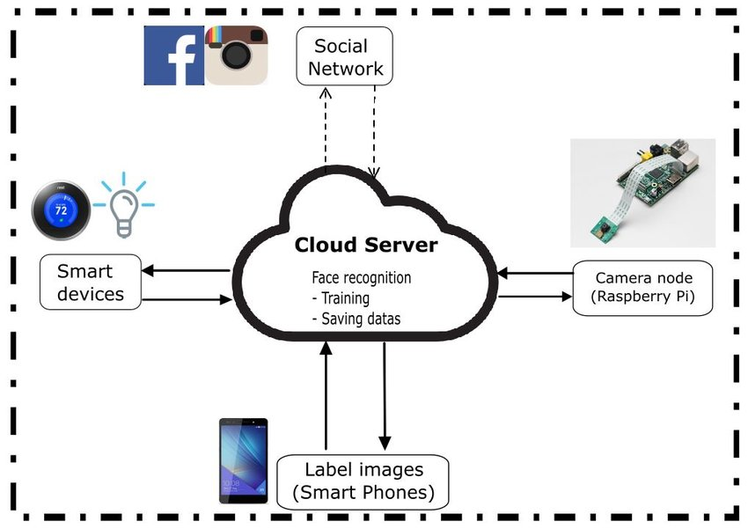
Project Overview
Send it the cloud server using server side language (PHP)

Slide 6

Project Overview
After that, By using ‘Smart Security’ app we can be notified when someone entered in our surveillance area
Home page UI

Slide 7
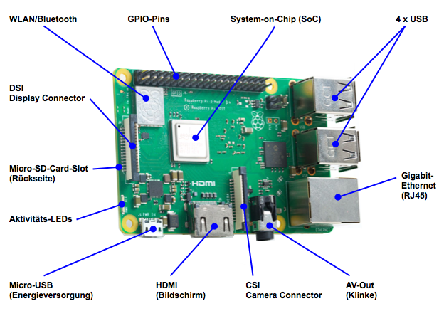
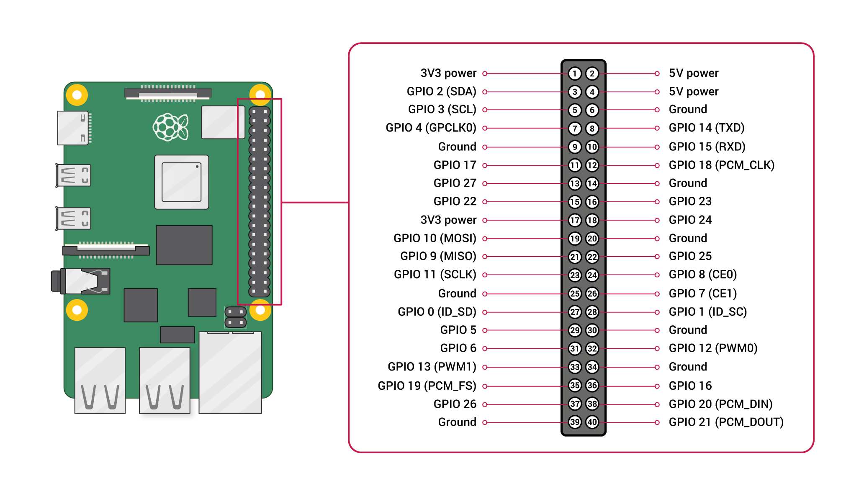
Components Description:
Raspberry PI:
Model: Raspi 3 B+

Slide 8
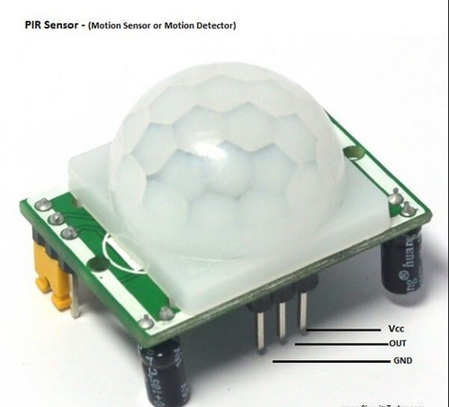
Components Description:
PIR(Passive infrared sensor)sensor-for detect motion

Slide 9
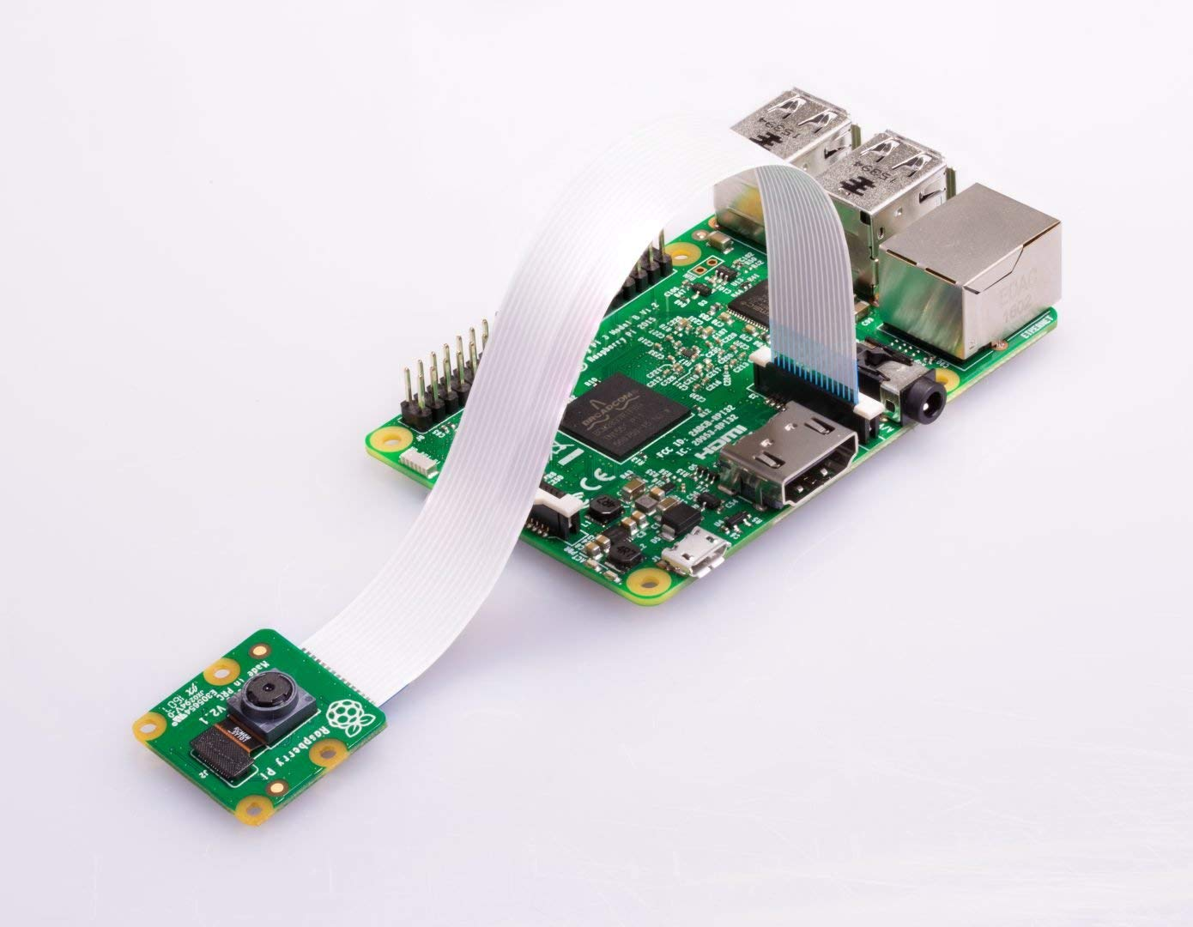
Components Description:
Camera:
Raspi Camera Module:

Slide 10
Block Diagram:

Slide 11
Advantages:
It is a low cost surveillance system
Anyone can access the camera from anywhere through internet
It has a instant notification system which is not available in the very costly camera.

Slide 12
Future Work:
We will inprove our motion detection algorithm and want to use the more efficient sensors .
we intend to provide a wireless relay connection and wireless sensors
We are trying to improve the UI design and picture quality

