Slide 1

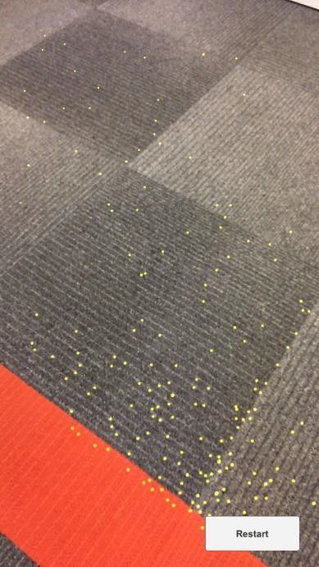
To place the Pittsburgh kiosk, follow the steps below:
1 | Scan the floor where you would like the kiosk to be placed. Sweep your device around to collect yellow feature points.

Slide 2
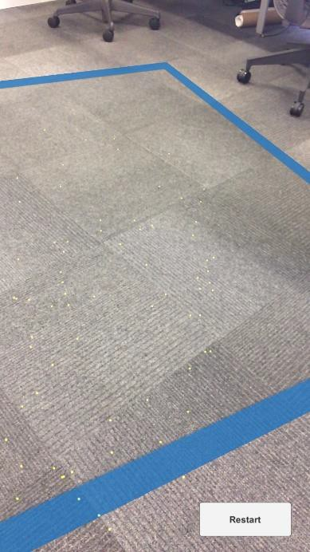
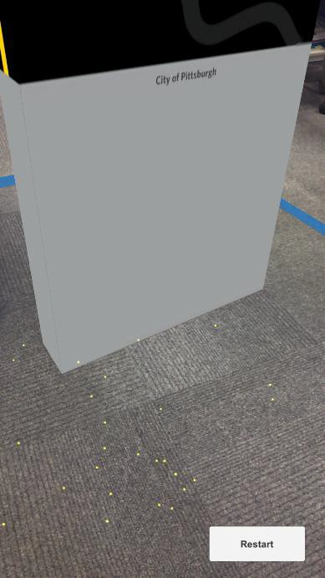
2 | Once your device collects enough feature points, it will generate a blue outline.
3 | Touch the screen anywhere within this blue outline to place the Pittsburgh kiosk in space and lock it to the floor

Slide 3
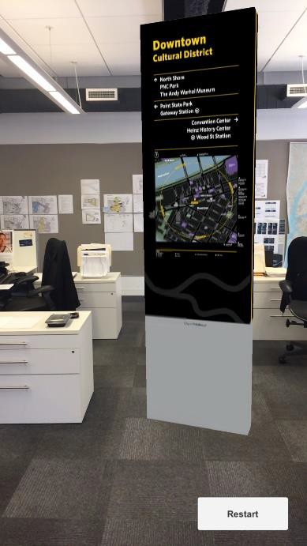
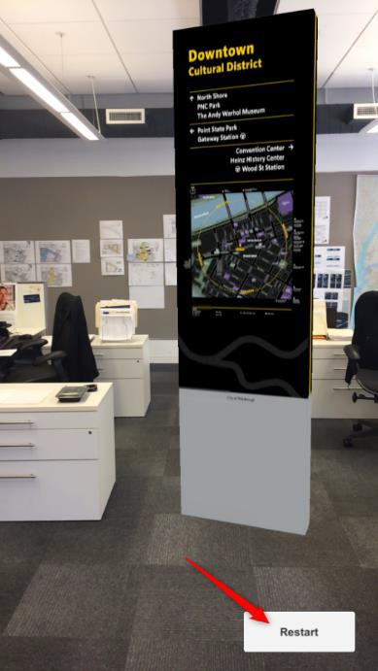
4 | You are now free to walk around the kiosk and view from all angles through your device’s camera
5 | If at any time you get stuck, hit the restart button on the bottom right of the screen to start again from step 1 (note: blue planar surface outline may not be generated but you will still be able to place the kiosk anywhere you like after you scan the area)

