Slide 1
THAPAR INSTITUTE OF ENGINEERING & TECHNOLOGY | UCS321 – EST PROJECT
Forecasting Air Quality Index around IndianOil Refinery Zones using ARIMA and LSTM Models
Chennai Corridor Study (CPCL Manali Refinery Zone, 2016–2020)
Group 2W1 | UCS321 – EST Project | November 2026
Arush Saini (1025230031) • Jiya Wadhwa (1025230094) • Darsh Marwaha (1025230032)
Tahoor (1025230126) • Arshita Doomra (1025230123)
Notes:
Good morning everyone. Today our team presents our UCS321 Engineering Design project on forecasting the daily Air Quality Index around Indian Oil Corporation refinery zones, focusing on the CPCL Manali refinery corridor in Chennai. In this presentation, we compare classical ARIMA and ARIMAX time-series models against deep learning LSTM architectures across 1-day and 7-day forecast horizons, as well as a real-world lockdown stress test. Let us begin with the problem statement and our main engineering objectives.

Slide 2
Problem Statement & Objectives
"Indian Oil Corporation seeks to forecast the Air Quality Index (AQI) around its refinery zones. Using historical pollutant levels, an ARIMA and LSTM-based forecasting model is needed to predict AQI values and support proactive emission control."
▪ Daily Horizons: Forecast ambient AQI 1 day ahead and 7 days ahead.
▪ Dual Paradigms: Benchmark classical ARIMA/ARIMAX against tuned LSTM and hybrid models.
▪ Strict Leakage Control: Chronological Train, Validation, Test, and COVID Stress splits.
▪ Uncertainty & Alerts: Provide calibrated prediction intervals and CPCB threshold alert metrics.
UCS321 – EST Project | IndianOil (CPCL Manali) AQI Forecasting
Slide 2 / 18
Notes:
Our problem statement comes directly from the Indian Oil Corporation brief: we need to predict AQI around refinery zones using historical pollutant levels so environmental teams can get early warnings. To solve this cleanly, we set four objectives. First, predict both 1-day-ahead and 7-day-ahead daily AQI. Second, build and compare classical ARIMA family models against deep learning LSTM variants. Third, enforce strict chronological splitting with zero data leakage. And fourth, evaluate alert thresholds, statistical significance, and prediction uncertainty.

Slide 3
Location Choice & Dataset Overview
▪ CPCL Manali: 10.5 MMTPA IndianOil subsidiary refinery in north Chennai.
▪ Daily Granularity: Matches 24-hour CPCB standards; filters hourly noise.
▪ City-Level Selection: Manali TN002 (256d) and TN003 (31.3% missing) failed quality rules.
▪ 2016–2020 Series: 1,643 continuous days; 2015 excluded for 82-day outage.
▪ Four Features Sets: CORE (PM2.5, CO, O3, NO2, SO2) and ALL9.
Split | Date Window | Days | Mean AQI
Train | 2016-01-01 to 2018-12-31 | 1,096 | 112.86
Validation | 2019-01-01 to 2019-08-31 | 243 | 103.42
Test | 2019-09-01 to 2020-02-29 | 182 | 95.73
Stress | 2020-03-01 to 2020-06-30 | 122 | 78.81
Full Series | 2016-01-01 to 2020-06-30 | 1,643 | 107.04
UCS321 – EST Project | IndianOil (CPCL Manali) AQI Forecasting
Slide 3 / 18
Notes:
We chose Chennai because Indian Oil operates the CPCL Manali refinery there. Using the Kaggle CPCB daily dataset, we applied a formal data-quality rule: Manali station TN002 only had 256 days of history, and Manali station TN003 was missing 31.28 percent of its data with a 411-day gap. So following our rule, we selected the Chennai city-level daily series starting January 2016, excluding 2015 due to an 82-day monitoring outage. As you see in the table, we split the 1,643 days chronologically into Train, Validation, Test, and an isolated 2020 COVID lockdown stress window.

Slide 4
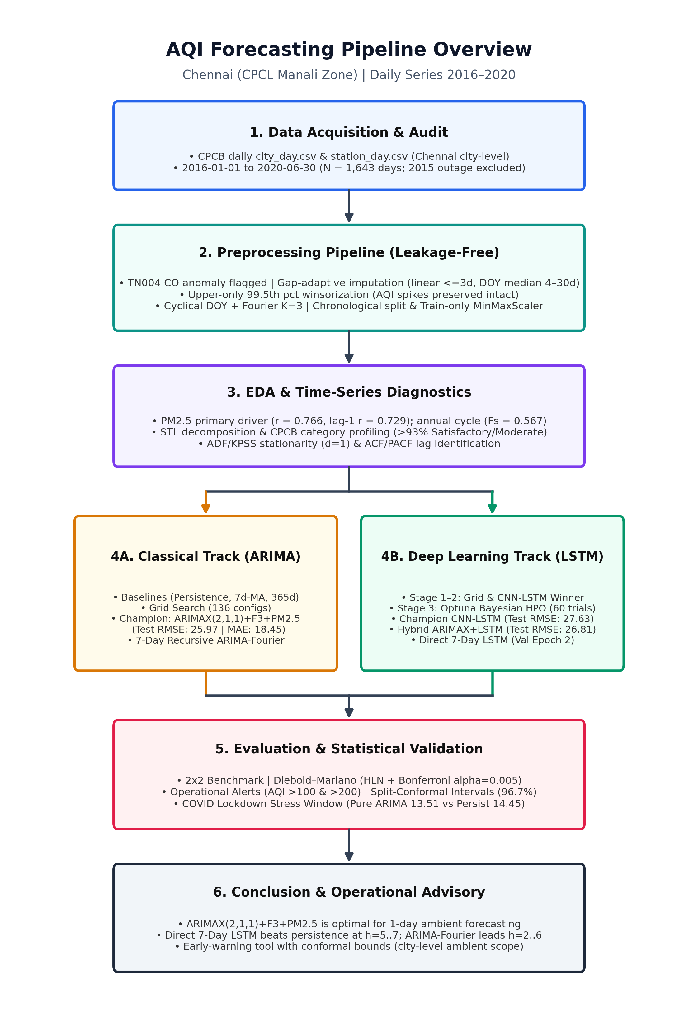
End-to-End Methodology Pipeline
▪ Leakage-Free Prep: Imputers, upper clipping, and scalers fit on Train only.
▪ Diagnostics: STL, Spearman correlation, ADF/KPSS, and ACF/PACF.
▪ Parallel Modeling: Classical ARIMA/ARIMAX alongside staged LSTM and Hybrid.
▪ Fair Evaluation: Diebold–Mariano tests, alerts, intervals, and stress testing.
UCS321 – EST Project | IndianOil (CPCL Manali) AQI Forecasting
Slide 4 / 18
Notes:
This flow diagram summarizes our full six-stage engineering workflow. After acquiring and auditing the Chennai daily series, we run a strictly ordered preprocessing pipeline where all scalers and imputation statistics are fitted only on the 2016 to 2018 training split. Next, exploratory analysis guides model orders and feature selection. We then run two parallel modeling tracks: classical ARIMA and ARIMAX on the left, and staged deep learning LSTMs plus a residual hybrid on the right. Finally, every model meets on identical Test and lockdown Stress benchmarks.

Slide 5
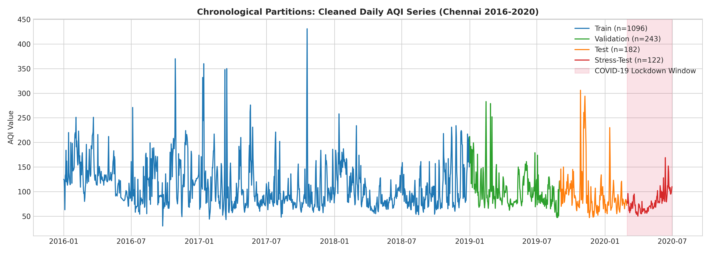
Preprocessing & Sensor Anomaly Removal
▪ TN004 CO Fault: 15 anomaly days in Aug–Sep 2016 flagged and re-imputed.
▪ Target Max Fixed: Peak drops from faulty 449 to Diwali 2017 (431).
▪ Gap Imputation: <=3d linear fill; 4–30d DOY train median; 0% missing after.
▪ Upper Clipping: Pollutants clipped at 99.5th pct; AQI spikes preserved.
UCS321 – EST Project | IndianOil (CPCL Manali) AQI Forecasting
Slide 5 / 18
Notes:
During data inspection, we discovered a major sensor fault at station TN004 in August and September 2016, where CO readings jumped wildly and pushed city AQI up to 449 while PM2.5 stayed normal and station TN001 read 64. We confirmed 15 faulty days against station records, set them to missing, and re-imputed them using our gap-adaptive method. That brought the real peak to Diwali 2017 at 431. We also clipped pollutant inputs at the upper 99.5th percentile while leaving target AQI spikes untouched so real pollution episodes remain intact.

Slide 6
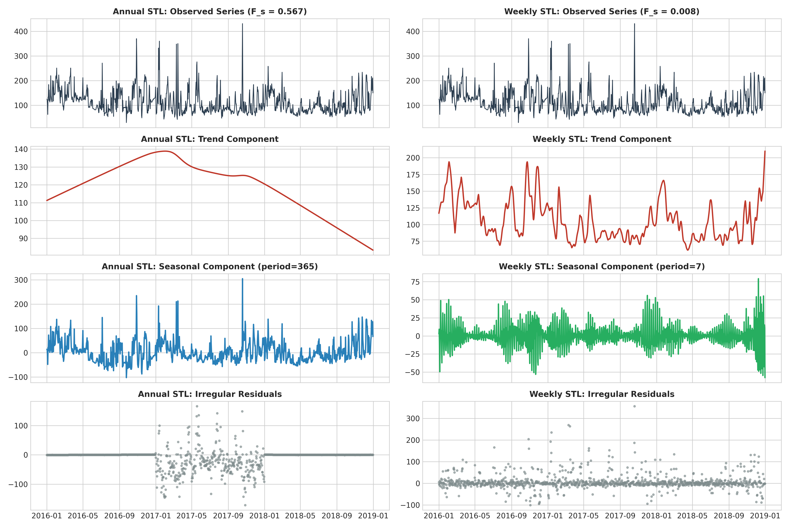
EDA 1: Trend, Seasonality & Key Drivers
▪ Downward Drift: Mean AQI fell from 112.86 (Train) to 95.73 (Test); slope −7.62/yr.
▪ STL Seasonality: Annual seasonal strength Fs = 0.567; negligible weekly (Fs = 0.008).
▪ No Weekly Cycle: Day-of-week averages stay flat across the week.
▪ Primary Driver: PM2.5 correlates strongly with next-day AQI (lag-1 r = 0.729).
UCS321 – EST Project | IndianOil (CPCL Manali) AQI Forecasting
Slide 6 / 18
Notes:
Looking at exploratory analysis, STL decomposition and descriptive diagnostics reveal clear patterns on the training data. First, there is a multi-year downward trend in AQI from 112.86 in Train down to 95.73 in Test, with a slope of minus 7.62 AQI per year. Second, STL shows strong annual seasonality with strength Fs equal to 0.567—driven by winter inversion peaks and monsoon washout lows—while weekly seasonality is essentially zero at 0.008. Finally, PM2.5 is the strongest chemical predictor for next-day AQI, with a lag-1 correlation of 0.729.

Slide 7
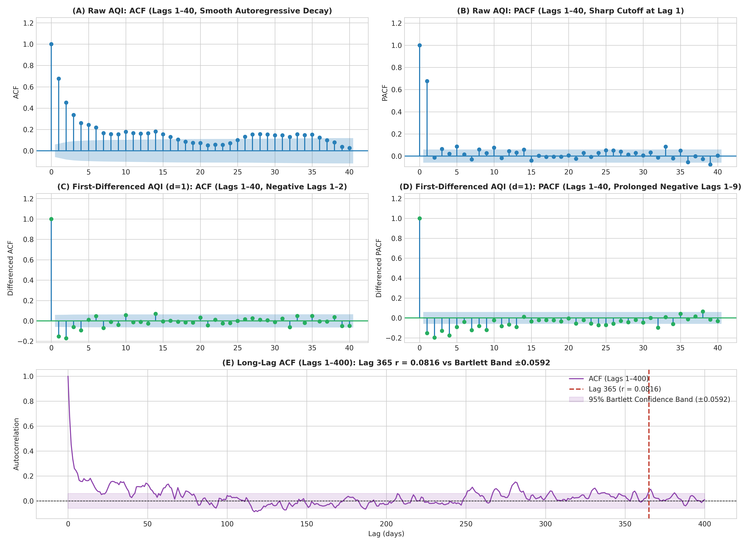
EDA 2: Stationarity & Differencing (d=0 vs d=1)
▪ Conflicting Raw Tests: Raw ADF p = 9.05e-7 vs KPSS p = 0.01.
▪ Differencing (d=1): Both agree stationary: ADF p = 1.99e-27, KPSS p = 0.10.
▪ PACF Lag-1 Cutoff: Sharp lag-1 PACF (0.678) guides low AR order.
▪ d=1 Beats d=0: Validation shows d=1 (RMSE 28.91 vs 30.13) tracks drift.
UCS321 – EST Project | IndianOil (CPCL Manali) AQI Forecasting
Slide 7 / 18
Notes:
Stationarity testing gave us a textbook empirical nuance. On raw AQI, the ADF test rejected a unit root, but KPSS rejected stationarity due to the gradual multi-year trend. Once we applied first differencing with d equals 1, both ADF and KPSS agreed the series was stationary. Notice the negative lag-1 ACF after differencing, which can signal over-differencing, so we tested both d equals 0 and d equals 1 fairly on the Validation set. Ultimately d equals 1 won because it adapts better to multi-day local level drift.

Slide 8
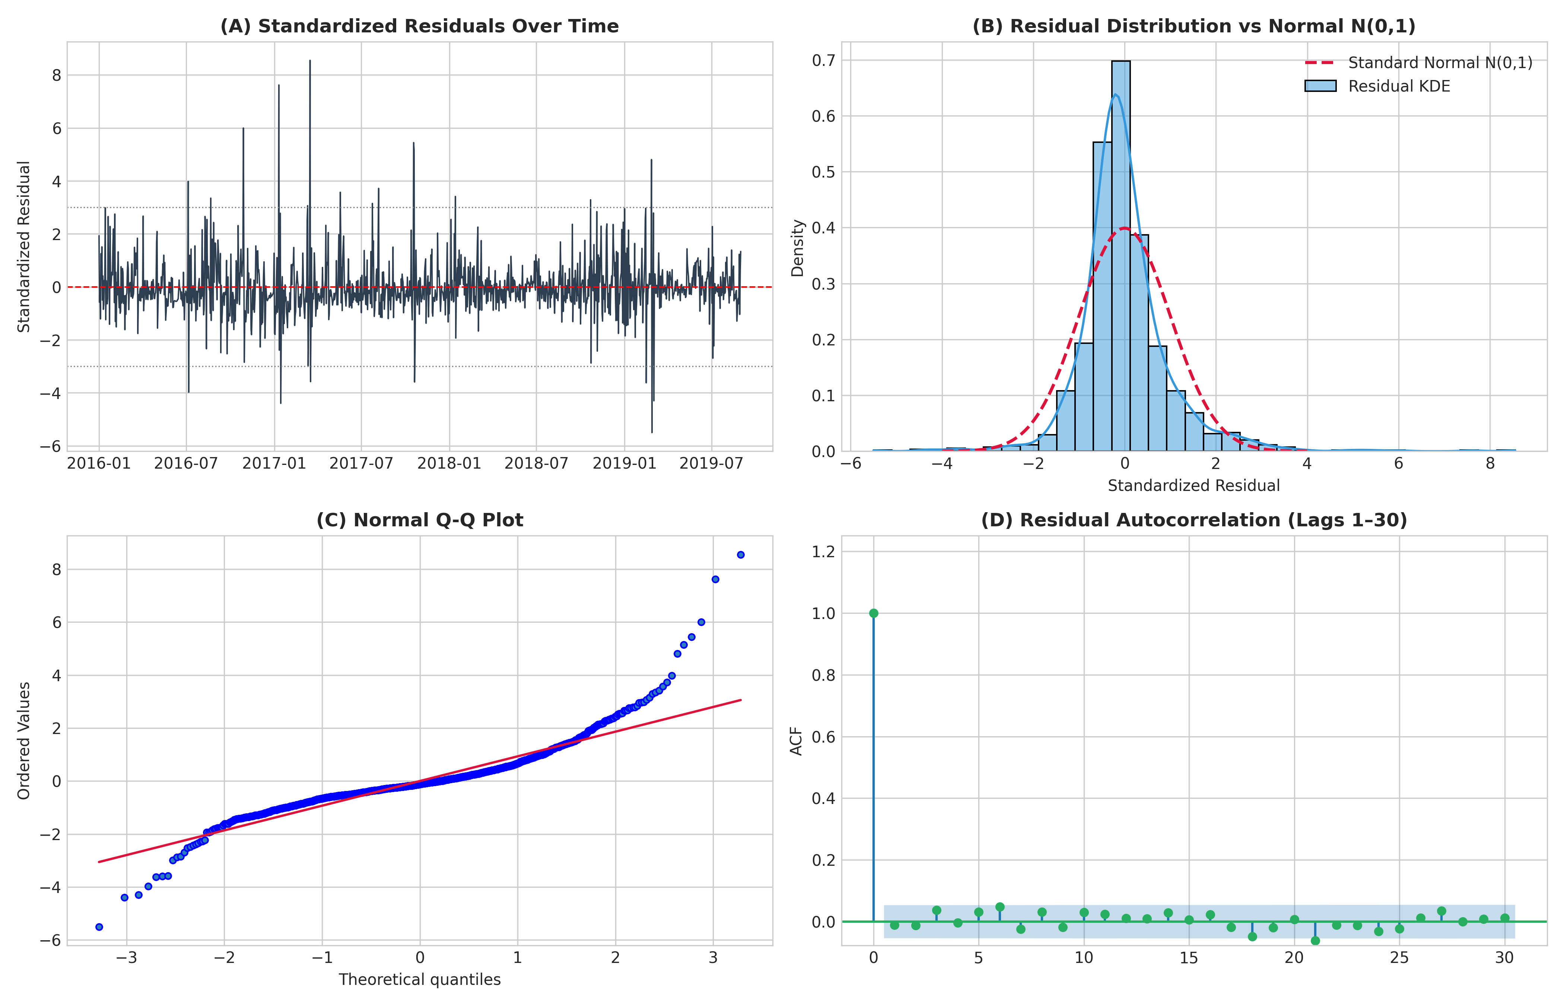
Classical Track: ARIMA & ARIMAX Modelling
▪ Three Baselines: Persistence (32.10), 7-Day MA (42.44), Seasonal 365d (71.61).
▪ 80+ Grid Search: Evaluated ARIMA, +Fourier (K=1..3), and +PM2.5(t-1).
▪ Champion Model: ARIMAX(2,1,1) + Fourier(K=3) + PM2.5 (Val RMSE 28.91).
▪ Clean Diagnostics: Ljung–Box p = 0.607 at lag 20; unbiased white-noise core.
UCS321 – EST Project | IndianOil (CPCL Manali) AQI Forecasting
Slide 8 / 18
Notes:
In the classical modeling track, we replaced computationally heavy 365-day seasonal differencing with K equals 3 pairs of annual Fourier sine and cosine terms. We searched over 80 configurations spanning Pure ARIMA, ARIMA with Fourier harmonics, and ARIMAX adding lagged PM2.5. Note that AIC cannot be compared across d equals 0 and d equals 1, so we ranked candidates strictly by Validation RMSE. Our champion, ARIMAX(2,1,1) with 3 Fourier pairs and lagged PM2.5, reached 28.91 Validation RMSE and passed Ljung–Box white-noise diagnostics.

Slide 9
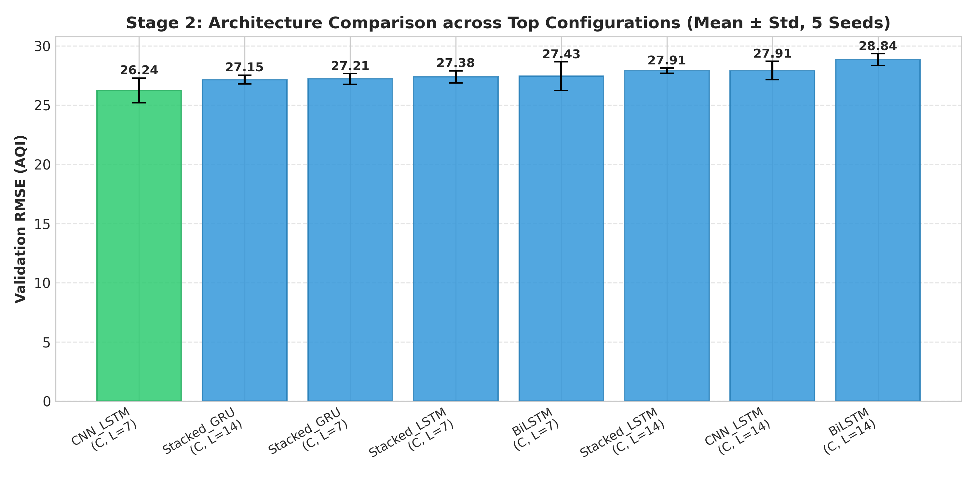
Deep Learning Track: Staged LSTM Pipeline
▪ Stage 1 (80 runs): Lookback L=7 with CORE features won (Val RMSE 27.38).
▪ Stage 2 (40 runs): CNN-LSTM beat GRU, BiLSTM, Stacked LSTM (26.24).
▪ Stage 3 (60 trials): Optuna TPE tuned units (80,48), Huber loss (Val 25.50).
▪ 5-Seed Ensembles: Retrained on Train+Val; plus Hybrid & Direct 7-Day.
UCS321 – EST Project | IndianOil (CPCL Manali) AQI Forecasting
Slide 9 / 18
Notes:
For deep learning, instead of guessing one LSTM architecture, we ran a structured three-stage search with 5 random seeds each. First, an 80-run grid crossed four feature sets with four lookbacks, showing that a short 7-day window with CORE pollutants performed best at 27.38 Validation RMSE. Second, our 40-run tournament crowned a 1-D CNN-LSTM architecture at 26.24 RMSE. Third, 60 Optuna Bayesian trials tuned hyperparameters with Huber loss, reaching 25.50 on Validation before retraining 5-seed ensembles on Train plus Validation.

Slide 10
Master Benchmark Results (Test Split, 1-Day Ahead)
Model Family | Specific Model | RMSE | MAE | MAPE (%) | R² | CPCB Acc | QWK
Classical Champion | ARIMAX(2,1,1)+F3+PM2.5 | 25.97 | 18.45 | 20.25 | 0.6657 | 76.92% | 0.6471
Ensemble Hybrid | Hybrid ARIMAX + LSTM | 26.81 | 19.91 | 22.58 | 0.6435 | 74.73% | 0.6296
DL Champion | CNN-LSTM (L=7, CORE) | 27.63 | 21.21 | 23.92 | 0.6214 | 68.68% | 0.5384
Classical | Pure ARIMA(2,1,1) | 30.58 | 19.23 | 19.33 | 0.5362 | 74.18% | 0.5587
Deep Learning | Univariate LSTM (L=7) | 31.73 | 22.87 | 25.43 | 0.5008 | 70.88% | 0.5226
Baseline | Naive Persistence (182d) | 32.10 | 19.56 | 19.40 | 0.4889 | 73.63% | 0.5951
Baseline | 7-Day Moving Average | 42.44 | 26.49 | 27.19 | 0.1067 | 64.84% | 0.3405
Baseline | Seasonal Naive (365d) | 71.61 | 53.86 | 61.80 | -1.5426 | 36.81% | -0.0554
UCS321 – EST Project | IndianOil (CPCL Manali) AQI Forecasting
Slide 10 / 18
Notes:
Here are our master 1-day-ahead results on the 182-day Test set. Classical ARIMAX(2,1,1) with Fourier terms and lagged PM2.5 achieved the strongest overall performance: Test RMSE 25.97, MAE 18.45, R-squared 0.6657, and 76.92 percent CPCB category accuracy. Notice that the Hybrid ARIMAX plus residual LSTM came second at 26.81 RMSE, followed by CNN-LSTM at 27.63. Under a conservative Bonferroni correction across 10 Diebold–Mariano tests, only the ARIMAX versus Hybrid difference remains statistically significant at alpha equals 0.005.

Slide 11
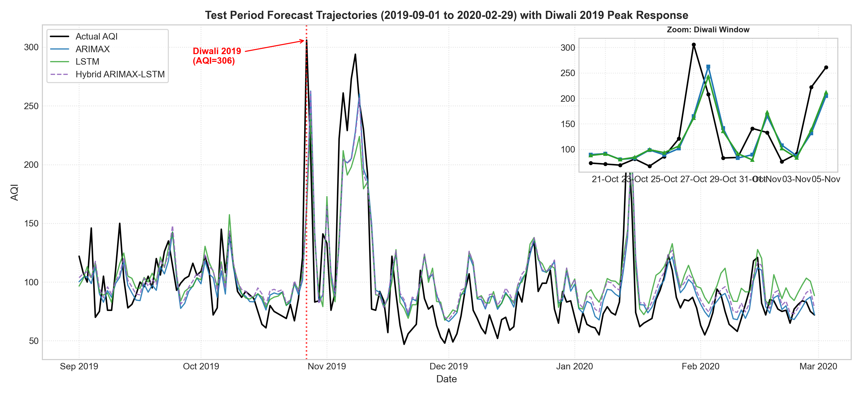
Test Trajectory Overlay & Festival Spike Audit
▪ Close Baseline Tracking: Normal days (<134.9 AQI) tracked with 18.78 ARIMAX RMSE.
▪ Festival Failure Mode: 2 of top 5 worst days: Diwali (306, err -140.8), Bhogi (230, err -92.2).
▪ Non-Matched Spikes: Remaining 3 worst days reflect unmodeled stagnation.
UCS321 – EST Project | IndianOil (CPCL Manali) AQI Forecasting
Slide 11 / 18
Notes:
This overlay shows daily predictions on the Test window with a zoomed inset on Diwali 2019. On normal days below 134.9 AQI, ARIMAX tracks observations closely with 18.78 RMSE. However, every model under-predicts sudden spikes because preceding-day sensors cannot see unannounced events. Auditing the 5 worst-forecast days, exactly 2 match verified cultural festivals: Diwali on October 27 where AQI hit 306 and models missed by over 140 points, and Bhogi on January 14 where AQI hit 230. The remaining 3 worst days have no calendar match.

Slide 12
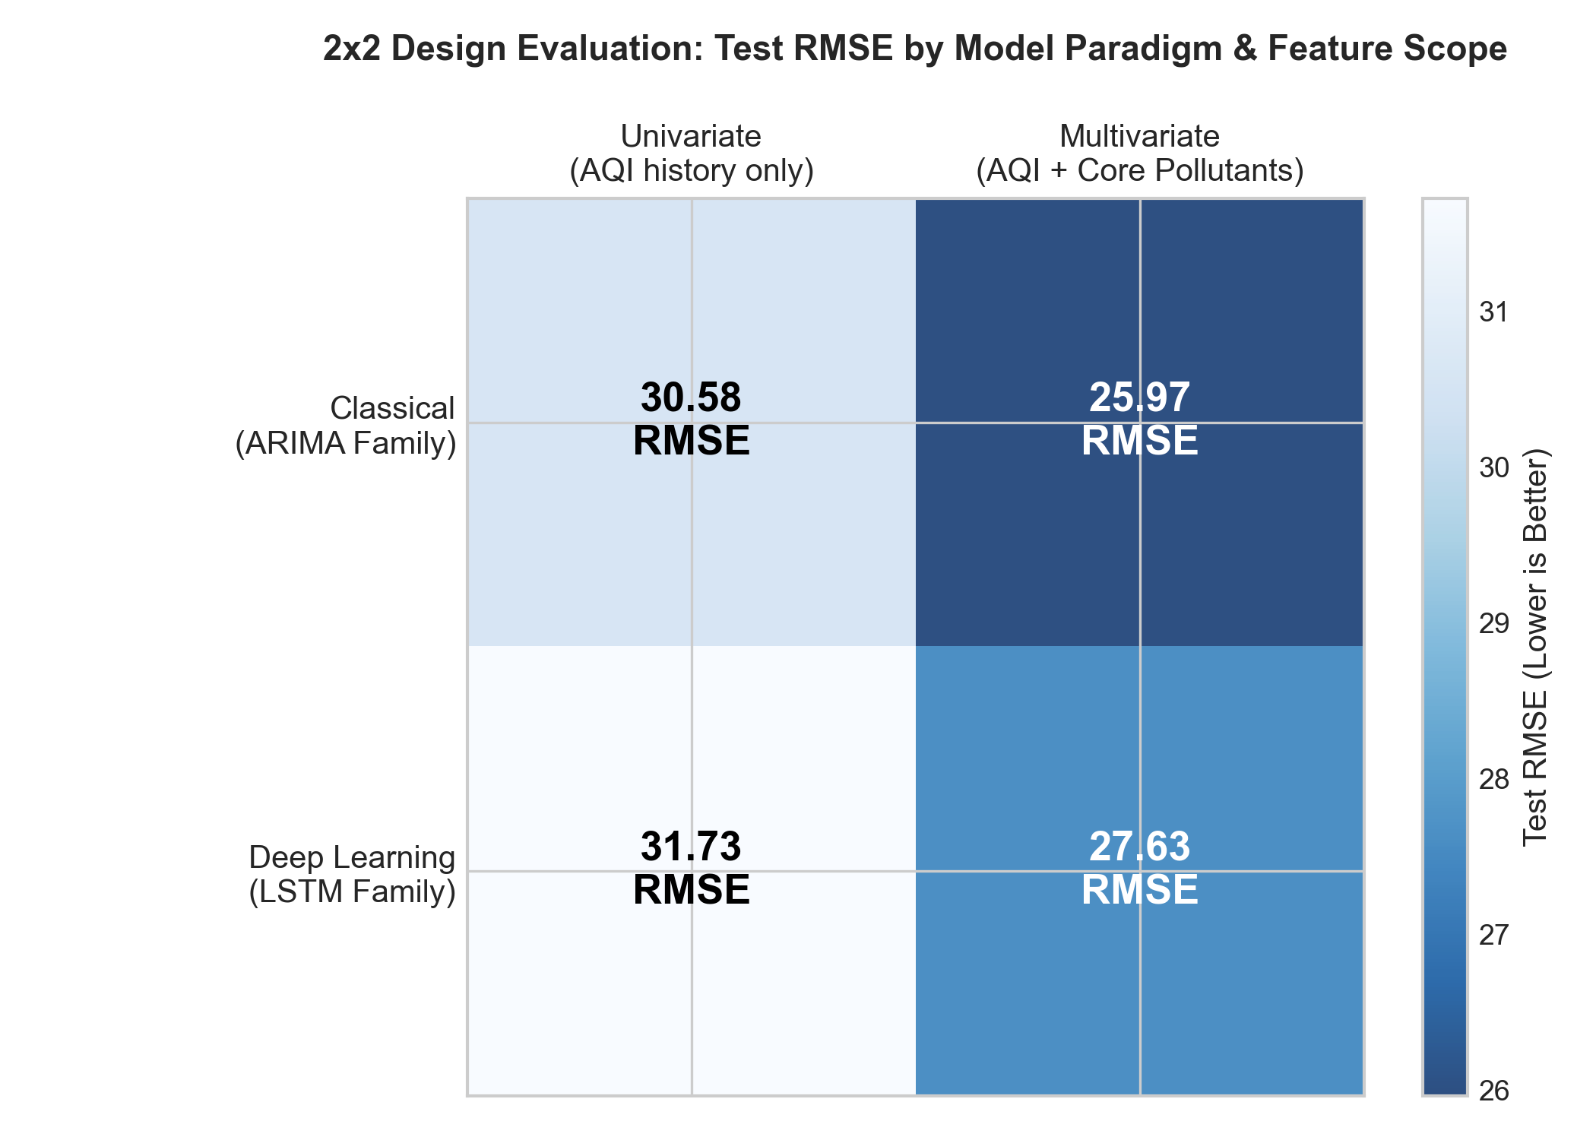
Paradigm vs Information Scope (2x2 Grid)
▪ Classical Gain: Adding PM2.5 cuts Test RMSE 15.1% (30.58 to 25.97).
▪ DL Gain: Adding CORE features cuts RMSE 12.9% (31.73 to 27.63).
▪ Consistent Lead: Classical outperforms DL across both univariate and multivariate.
▪ Core Takeaway: Pollutant inputs matter more than network complexity here.
UCS321 – EST Project | IndianOil (CPCL Manali) AQI Forecasting
Slide 12 / 18
Notes:
Our 2-by-2 factorial comparison separates model family from feature information. Adding PM2.5 to classical ARIMA cuts Test RMSE by 15.1 percent, from 30.58 down to 25.97. Similarly, adding our 5 CORE pollutants to univariate LSTM cuts RMSE by 12.9 percent, from 31.73 down to 27.63. Across both information scopes, the parsimonious classical models outperform deep learning, suggesting that on 1,096 training days, exogenous chemical signals drive larger gains than added neural complexity.

Slide 13
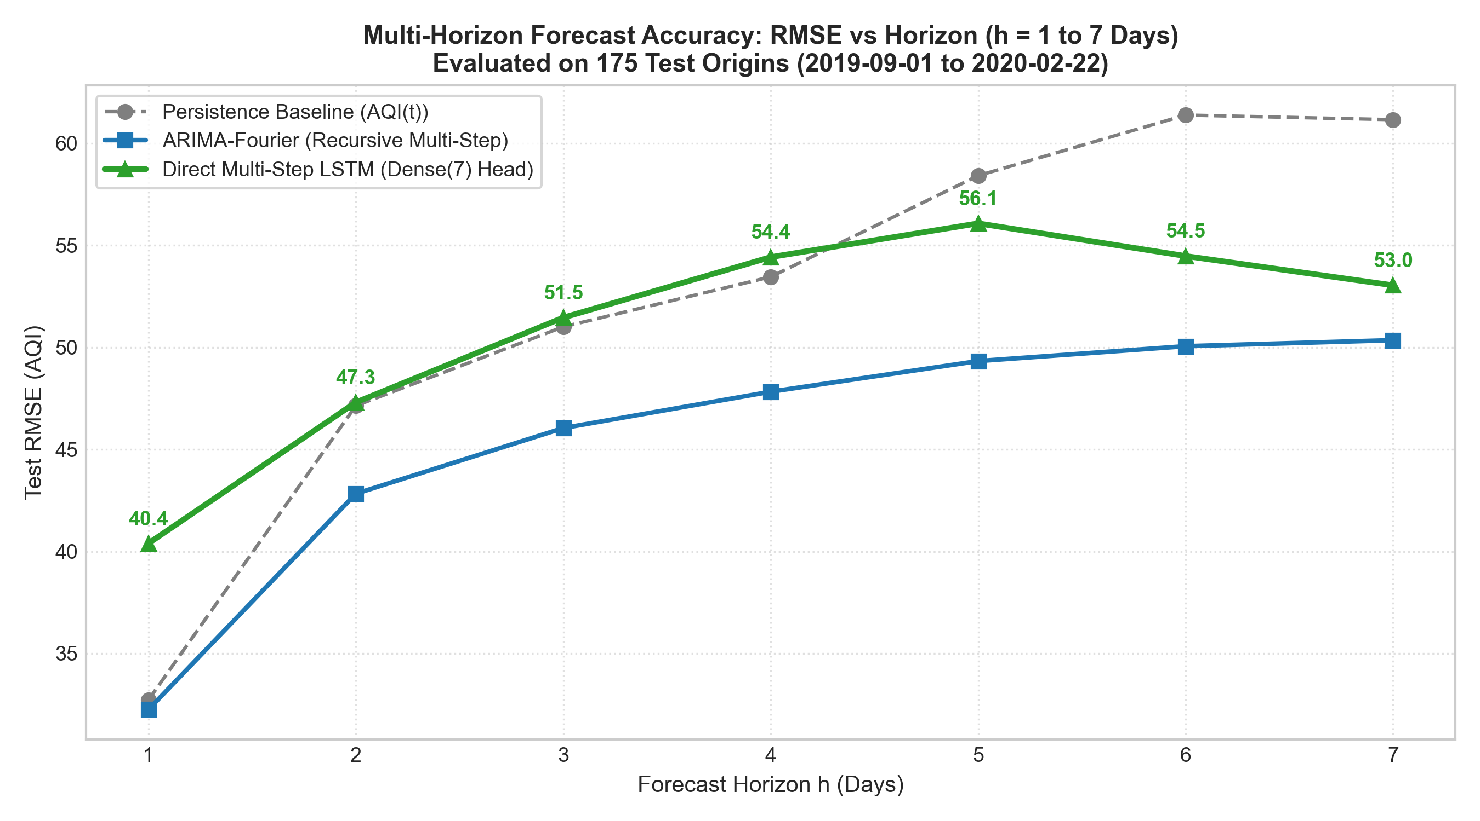
Multi-Horizon 1–7 Day Forecasting (175 Origins)
▪ Leakage-Free Epochs: 7-day LSTM stopped at Epoch 2 (min Val RMSE 33.88).
▪ Beats Persist at h=5–7: LSTM wins h=5 (56.08), h=6 (54.48), h=7 (53.04).
▪ Loses at h=1–4: LSTM (40.39 at h=1) trails Persistence (32.72) early on.
▪ ARIMA-Fourier Leads: Lowest RMSE (32.25 to 50.35) across all horizons.
UCS321 – EST Project | IndianOil (CPCL Manali) AQI Forecasting
Slide 13 / 18
Notes:
For 7-day-ahead forecasting across 175 aligned Test origins, we selected the Direct Multi-Step LSTM training epochs strictly on the Validation set without touching Test data. Validation error across all 7 horizons reached its minimum at Epoch 2, reflecting the 2016–18 versus 2019 level shift. Retrained for 2 epochs, the 7-day LSTM beats persistence only at horizons 5, 6, and 7, while persistence and recursive ARIMA-Fourier lead horizons 1 through 4. Overall, ARIMA-Fourier achieves the lowest multi-day RMSE, consistent with Fourier terms constraining dispersion.

Slide 14
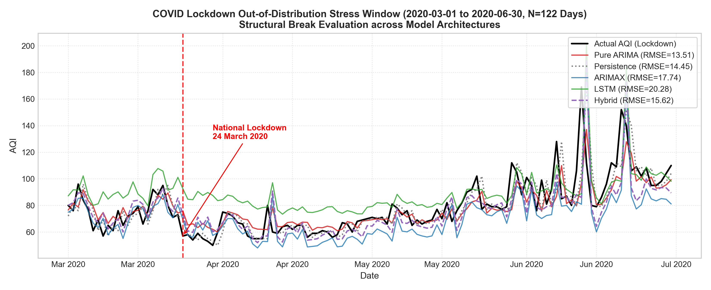
COVID-19 Lockdown Stress Test (Mean AQI = 78.81)
▪ Pure ARIMA Best: Lowest stress RMSE (13.51, MAE 9.06, bias -1.15).
▪ Persistence Second: RMSE 14.45, MAE 9.41, near-zero bias (-0.31).
▪ Complex Models Lagged: ARIMAX (17.74) and CNN-LSTM (20.28) performed worst.
▪ Opposite Biases: LSTMs: +7.84 / +10.55 bias; ARIMAX bias: -8.32.
UCS321 – EST Project | IndianOil (CPCL Manali) AQI Forecasting
Slide 14 / 18
Notes:
Evaluating without retraining on the 122-day COVID lockdown window, where mean AQI dropped to 78.81, revealed sharp differences in regime resilience. Pure ARIMA achieved the lowest stress RMSE at 13.51, followed closely by naive persistence at 14.45. By contrast, models using exogenous pollutants or seasonal terms degraded: ARIMAX reached 17.74 RMSE with negative mean bias of minus 8.32, while Univariate and Multivariate CNN-LSTM reached 15.98 and 20.28 RMSE with positive over-prediction biases of plus 7.84 and plus 10.55.

Slide 15
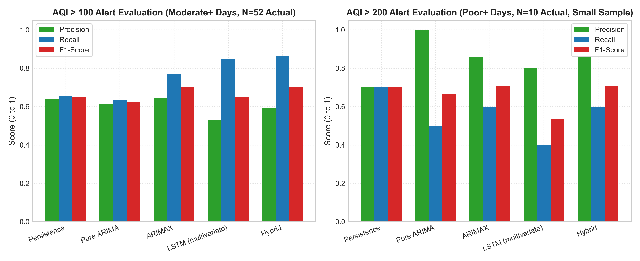
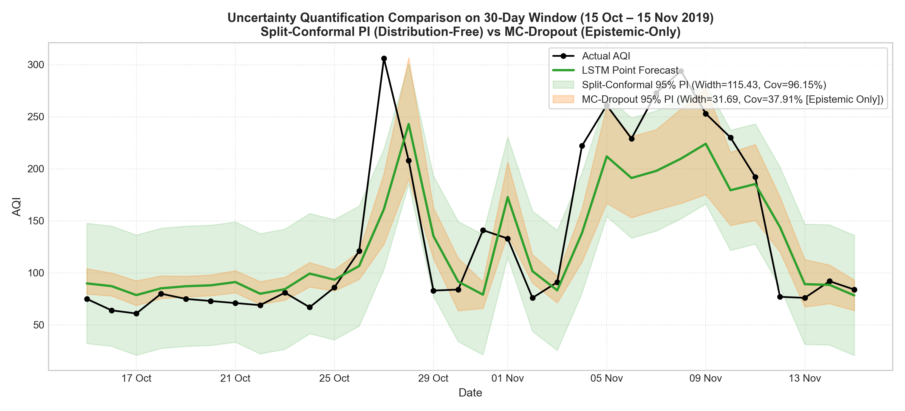
Operational Alerts & Uncertainty Quantification
▪ Alerts (ARIMAX): AQI >100 F1 = 0.702 (52 days); AQI >200 F1 = 0.706 (10 rare days).
▪ Conformal vs MC: Split-conformal covered 96.7% (caveat: non-exchangeable drift); MC covered 37.9%.
UCS321 – EST Project | IndianOil (CPCL Manali) AQI Forecasting
Slide 15 / 18
Notes:
On the left, we evaluate operational alert thresholds. At AQI above 100, ARIMAX reaches 64.5 percent precision and 76.9 percent recall for an F1 of 0.702. At AQI above 200, precision rises to 85.7 percent, though only 10 such days occurred in Test. On the right, split-conformal intervals calibrated on Validation errors achieved 96.70 percent Test coverage for ARIMAX and 96.15 percent for LSTM, whereas MC-Dropout severely undercovered at 37.91 percent. Note that time-series drift means exchangeability is not strictly satisfied.

Slide 16
Key Project Findings
▪ Day-Ahead Champion: ARIMAX(2,1,1)+F3+PM2.5 achieved top Test RMSE (25.97) and MAE (18.45).
▪ Exogenous PM2.5 Crucial: Pollutant inputs lowered error 15.1% (Classical) and 12.9% (DL).
▪ Bonferroni Caution: Only ARIMAX vs Hybrid (p=0.0001) stayed significant after 10-test adjustment.
▪ Multi-Step & Lockdown: Epoch-2 LSTM beats persistence only at h=5–7; Pure ARIMA leads lockdown (13.51).
▪ Potential Operational Use: Informational city-level early warning; fence-line monitoring needed to isolate refinery emissions.
UCS321 – EST Project | IndianOil (CPCL Manali) AQI Forecasting
Slide 16 / 18
Notes:
To summarize our five core findings: first, ARIMAX(2,1,1) with Fourier harmonics and lagged PM2.5 outperformed all deep learning and hybrid competitors on 1-day Test RMSE and MAE. Second, exogenous PM2.5 drove 13 to 15 percent error reductions across both paradigms. Third, Bonferroni correction reminds us that differences among top models are modest. Fourth, Pure ARIMA proved most resilient during the COVID structural break. Finally, this model provides valuable city-level ambient early warning, though isolating refinery contributions requires perimeter sensors.

Slide 17
Limitations & Future Scope
Key Limitations
Future Scope
▪ City-Level Scope: Does not isolate CPCL Manali fence-line emissions.
▪ No Meteorology: Wind speed, humidity, and mixing height unavailable.
▪ Rare Severe Days: Only 10 Test days >200 AQI; unmodeled festival spikes.
▪ Perimeter CEMS: Integrate stack exhausts and refinery fence-line monitors.
▪ Weather Coupling: Add NWP wind vectors and boundary-layer forecasts.
▪ Event Indicators: Encode Diwali/Bhogi flags and rolling model recalibration.
UCS321 – EST Project | IndianOil (CPCL Manali) AQI Forecasting
Slide 17 / 18
Notes:
Looking honestly at limitations, our series reflects Chennai city-wide CPCB ambient stations rather than dedicated CPCL Manali fence-line sensors, and lacks meteorological fields like wind velocity or mixing height. Also, only 10 days exceeded 200 AQI in Test, and sudden festival events remain unpredictable without calendar indicators. In future work, coupling on-site CEMS stack telemetry with Numerical Weather Prediction forecasts, explicit Diwali and Bhogi binary flags, and adaptive rolling updates would directly close these gaps.

Slide 18
Thank You — Questions & Discussion
UCS321 – EST Project | Thapar Institute of Engineering & Technology
November 2026 | Champion Model: ARIMAX(2,1,1) + Fourier(K=3) + PM2.5 (RMSE: 25.97)
Group 2W1: Arush Saini, Jiya Wadhwa, Darsh Marwaha, Tahoor, Arshita Doomra
Notes:
Thank you for your attention. All code, executed notebooks, frozen benchmark tables, and technical documentation are reproducibly archived in the project repository. We welcome your questions on our data pipeline, model selection, statistical testing, or lockdown stress evaluation.

