Slide 1
Heart Disease Diagnostic Analysis
BY- Arushi

Slide 2
Project Details
Project Title
Technologies
Domain
Project Difficulty Level
Programming Language Used
Tools Used
Heart Disease Diagnostic Analysis
Business Intelligence
HealthCare
Advanced
Python
Jupyter Notebook, MS Office Tools, MS PowerBI

Slide 3
Aim of the Project
The aim of the project is to analyse and predict the probability of occurrence of Cardiovascular Diseases. This will help us prevent and cure from CVDs. To achieve this we will use dataset which contains 76 features or attributes from 303 patients; however, published studies chose only 14 features that are relevant in predicting heart disease.

Slide 4
Problem Statement
Health is real wealth in the pandemic time we all realized the brute effects of covid-19 on all irrespective of any status. You are required to analyse this health and medical data for better future preparation. A dataset is formed by taking into consideration some of the information of 303 individuals

Slide 5
Architecture
Business/Data Understanding
Data Prepration/Cleaning
Data Modelling
Data Evalution
Deployment
Reporting
HLD
LLD Architecture
Wireframe

Slide 6
Dataset Information
1. age (Age in years)
2. sex : (1 = male, 0 = female)
3. cp (Chest Pain Type): [ 0: asymptomatic, 1: atypical angina, 2: non-anginal pain, 3: typical angina]
4. trestbps (Resting Blood Pressure in mm/hg )
5. chol (Serum Cholesterol in mg/dl)
6. fps (Fasting Blood Sugar > 120 mg/dl): [0 = no, 1 = yes]
7. restecg (Resting ECG): [0: showing probable or definite left ventricular hypertrophy by Estes’ criteria, 1: normal, 2: having ST-T wave abnormality]
8. thalach (maximum heart rate achieved)
9. exang (Exercise Induced Angina): [1 = yes, 0 = no]
10. oldpeak (ST depression induced by exercise relative to rest)
11. slope (the slope of the peak exercise ST segment): [0: downsloping; 1: flat; 2: upsloping]
12. ca [number of major vessels (0–3)
13. thal : [1 = normal, 2 = fixed defect, 3 = reversible defect]
14. target: [0 = disease, 1 = no disease]

Slide 7
Explanation of important attributes
AGE - Age is an independent risk factor for cardiovascular disease (CVD) in adults. Normal aging is generally accompanied by a thickening and stiffening of the left ventricular walls which results in heart attacks .
SEX - Men have a higher incidence of heart failure, but the overall prevalence rate is similar in both sexes, since women survive longer after the onset of heart failure. Women tend to be older when diagnosed with heart failure and more often have diastolic dysfunction than men.Women have smaller arteries than men, so coronary artery disease develops differently, and more diffusely. Also, CAD in women tends to afflict smaller arteries that feed the heart.
CHOLESTROL - With high cholesterol, you can develop fatty deposits in your blood vessels. Eventually, these deposits grow, making it difficult for enough blood to flow through your arteries
Max Heart Rate - It has been shown that an increase in heart rate by 10 beats per minute was associated with an increase in the risk of cardiac death by at least 20%, and this increase in the risk is similar to the one observed with an increase in systolic blood pressure by 10 mm Hg.

Slide 8
Explanation of important attributes
Blood Pressure - Without appropriate blood pressure control, the heart can weaken over time and heart failure may develop. High blood pressure also leads to thickening of the blood vessel walls. When combined with cholesterol deposits in the blood vessels, the risk of heart attack and stroke increases
Fasting Blood Sugar - A fasting blood sugar level of 99 mg/dL or lower is normal, 100 to 125 mg/dL indicates you have prediabetes, and 126 mg/dL or higher indicates you have diabetes. high blood sugar can damage blood vessels and the nerves that control your heart. People with diabetes are also more likely to have other conditions that raise the risk for heart disease: High blood pressure increases the force of blood through your arteries and can damage artery walls.

Slide 9
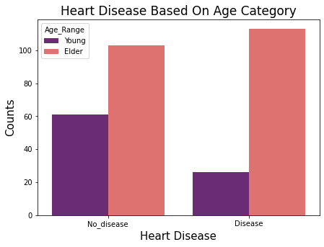
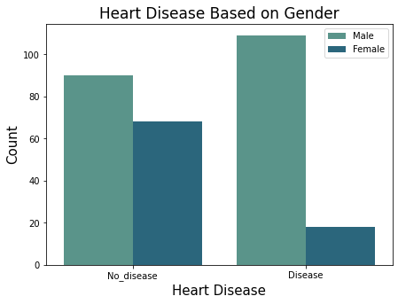
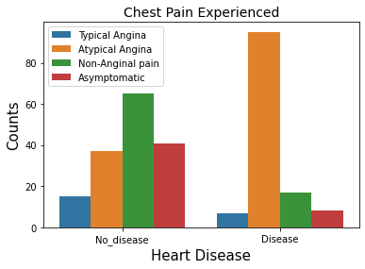
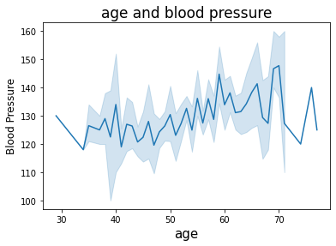
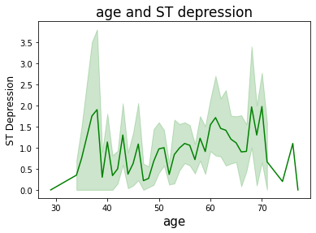
Visualizations

Slide 10
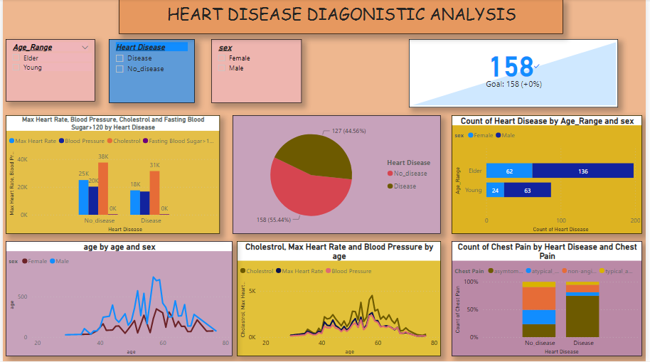

Slide 11
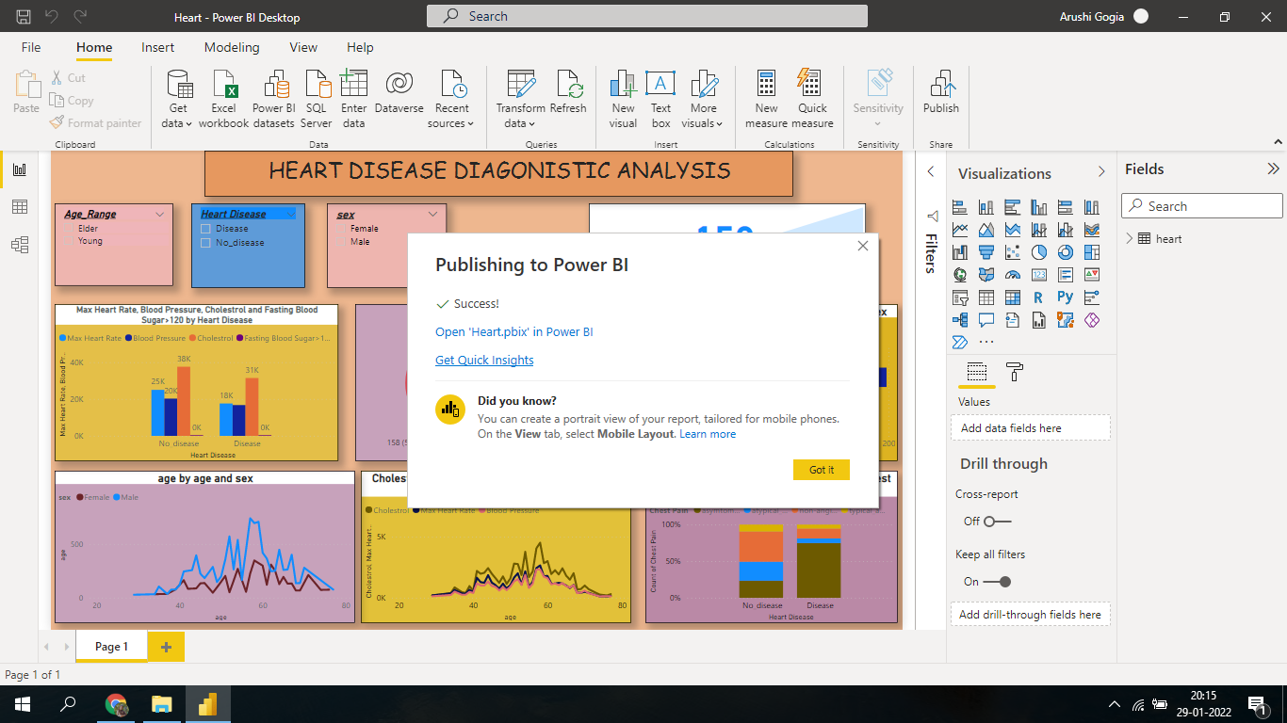

Slide 12
Key Performance Indicators
Age Distribution
Gender Distribution
Chest Pain Experienced
Blood Pressure and Cholesterols Level and maximum heart rate played important role in heart diseases

Slide 13
Conclusions
1. It is seen that people between age 29 to 50 are less prone to have heart diseases.
2. It can see that a higher number of men are suffering from Asymptomatic type of Chest Pain.
3. It seems people having asymptomatic chest pain have a higher chance of heart disease.
4. Elder Age People are most affected by Heart Disease compared to young . Men between 50 to 60 and women between 55 to 65 .
5. Blood Pressure Rate is almost equal in Males and Females
6. Females have little bit of higher cholesterol than males
7. Higher Blood Pressure Level results Chances Of Heart Disease
8. It is seen that Blood Pressure and cholestrol increases between age of 50 to 60 and somehow continue the pattern till 70
9. ST increases between the age of 30-40
10. 46% people are suffering from heart disease

Slide 14
Add a Slide Title - 5
THANK YOU

