Slide 1
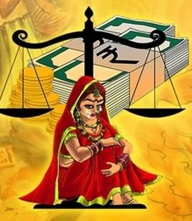
heading1
content1

Slide 2

heading2
content2

Slide 3
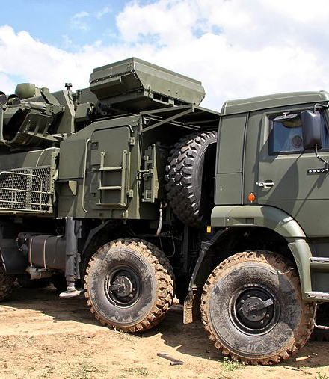
heading3
content3

Slide 4
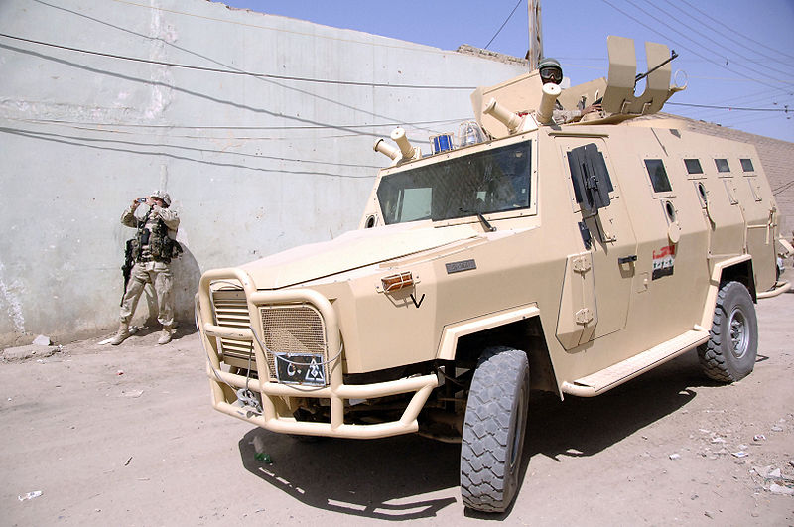
heading4
content4

Slide 5
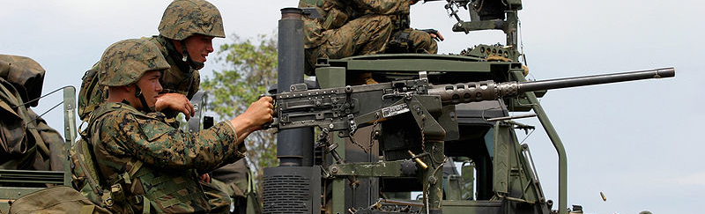
heading5
content5

Slide 6
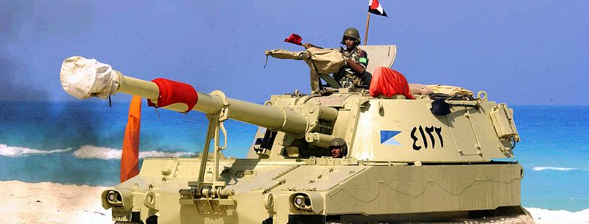
heading6
content6

Slide 7
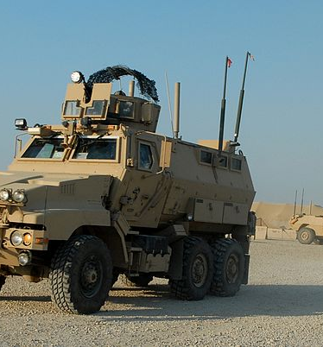
heading7
content7

