Slide 1
Lending Club Case Study
Group Members:
Group not assigned
Arushi Agarwal

Slide 2
Objective
Lending Club, an online loan marketplace, facilitates personal loans, business loans and financing of medical procedures.
This assignment performs analysis upon given data and provides insights about the driving factors behind the loan default .In other words, helps to identify the strong features which tend to default.
The aim is to identify patterns which indicate if a person is likely to default, which may be used for taking actions such as denying the loan, reducing the amount of loan, lending (to risky applicants) at a higher interest rate, etc.
These insights would be helpful in understanding risk management and similar factors attached to it and further build an optimized structure considering the consumer attributes and loan attributes.

Slide 3
Overview
Business related constraints:
Δ Loan Accepted :
Default
Non-Default
Δ Loan Rejected :
Not considered in the analysis
Types of data analysis to be performed:
Univariate Analysis
Segmented Univariate Analysis
Bivariate Analysis
Sectors available:
Customer Behavioral Data
✓

Slide 4
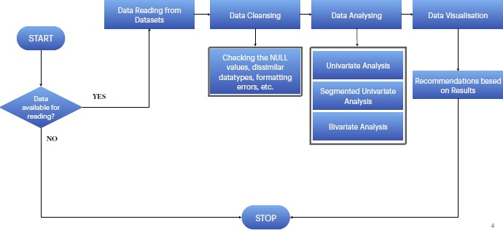
Problem Solving Methodology

Slide 5
Data Reading & Cleansing
Read the datasets using programming logic with specified encodings and separators
Drop columns with NULL values ,all random values or single category value
Convert the datatypes to generalize the values
Conversion for date representations
Create a final dataset for analysis and visualization.

Slide 6
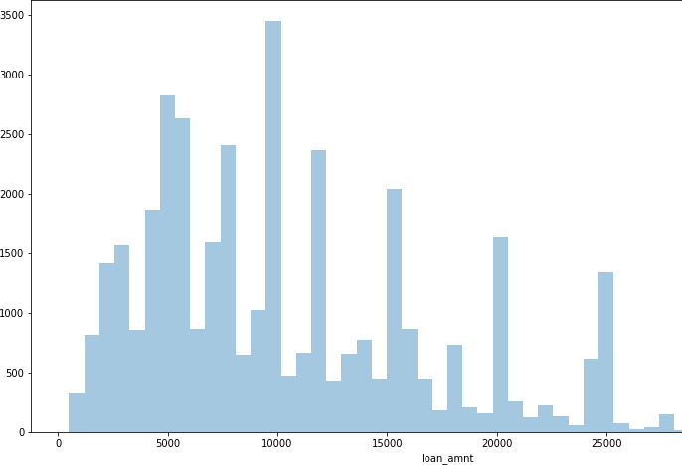
Univariate Analysis
Check distributions of loan
amount.

Slide 7
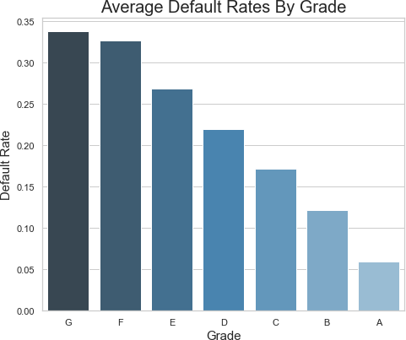
Segmented Analysis
Default Rate By Grade:
Higher grades are resulting into higher default rates. Grades G,F,E and D are proving to be highly unsafe and shoud be avoided.

Slide 8
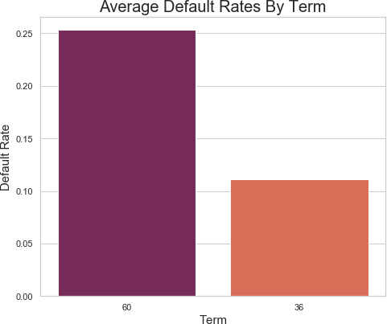
Segmented Analysis
Default Rate By Term:
Loans with term of 60 months are resulting to higher defaults. Let's break this further by purpose and see which category of loans are riskier.

Slide 9
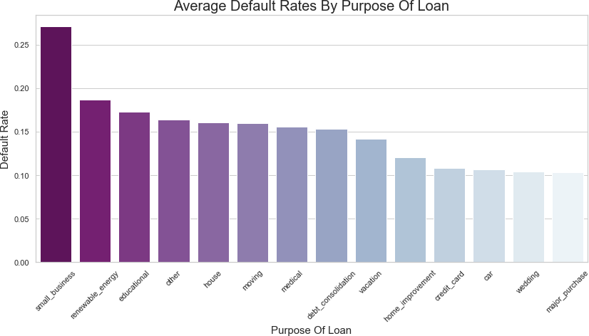
Segmented Analysis
Default Rate By Purpose:
Now this is an interesting insight. Small businesses loan category is proving to be very risky followed by renewable energy and educational loans. Let's break this further down by term, interest rate factors in bivariate analysis.

Slide 10
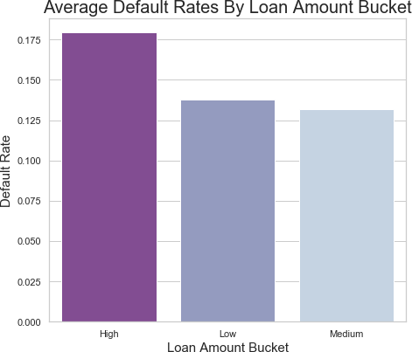
Segmented Analysis
Default Rate By Loan Amount Bucket:
So only the high loan amount buckets are proving to be risky. Let's analyze this further breaking down by term and category.

Slide 11
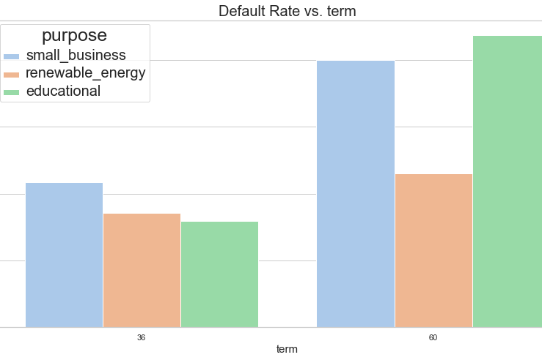

Slide 12
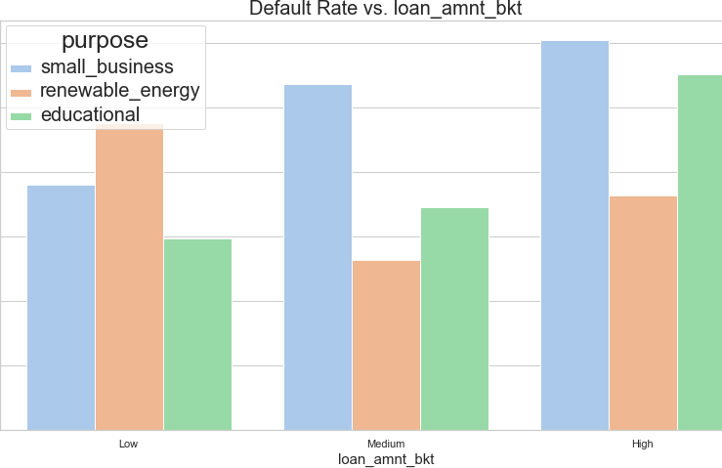

Slide 13
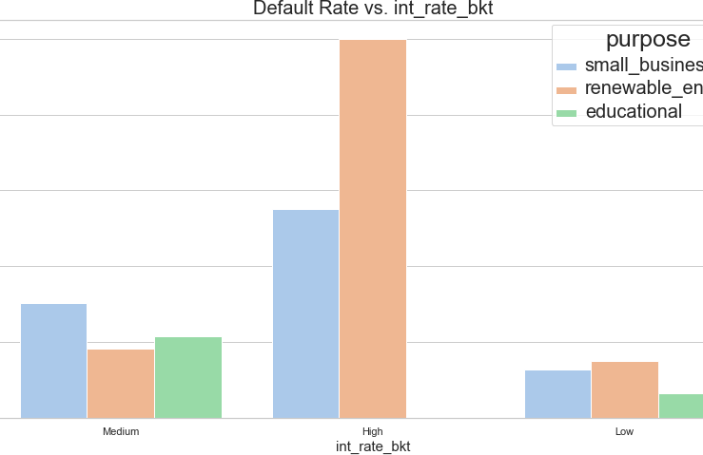

Slide 14
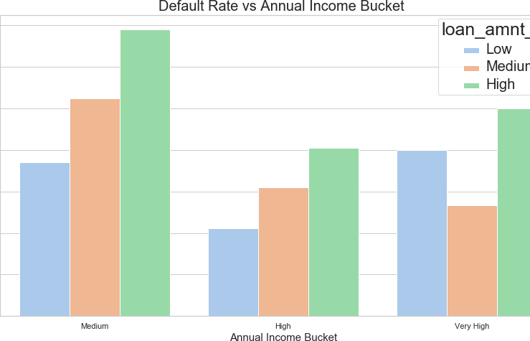

Slide 15
Assignment Conclusion
Looking at the graphs previously, Lending Club reduce giving higher term loan to Smaller Businesses and Educational purposes because more than 35% of these are defaulting.
Small Businesses and Renewable energy are again among top defaulters in each interest rate bucket. LC should be highly cautious while giving out loans for these purposes, specially among higher interest rate buckets. Renewable energies are 100 % defaulters in high interest buckets.
Loans should not be approved for educational purposes and small businesses in high loan amount bucket because more than 25% of them are defaulting.
Small businesses are resulting into highest defaulters in all annual income buckets specially it is very high in medium annual income buckets,
In segmented univariate analysis, we had found out that people with medium annual income are resulting into higher defaults. Now we understand why, this is because people with medium annaul income are applying for higher loan amounts and hence defaulting. These loans should be stopped by LC.

