Slide 1
MUTUAL FUND ANALYTICS PLATFORM
End-to-End Data Engineering, ETL Pipeline & Interactive Dashboard
Prepared by: Arushi Garg
Data Analyst Intern
Bluestock Fintech Pvt. Ltd. June 2026

Slide 2
THE PROBLEM WE SOLVED
Problem
Solution
Data scattered across multiple AMFI sources
No risk-adjusted fund comparison tool
No benchmark tracking for investors
Investor behaviour completely unanalysed
Monthly reports are slow static PDFs
Built a complete Mutual Fund Analytics Platform covering ETL + Database + Dashboard + Risk Engine
01

Slide 3
DATA SOURCES & SCALE
40
FUND SCHEMES
87,000+
ROWS DATA
32000+
INVESTOR TXNS
4.5YEARS
NAV DATA
Sources: AMFI India | mfapi.in REST API | NSE India | BSE India
10 Datasets | 10 Fund Houses | 40 Schemes | 5,000 Investors
02

Slide 4
HOW WE BUILT IT — 5 LAYER ARCHITECTURE
EXTRACT
AMFI CSV Files
mfapi.in RESTAPI
NSE/BSE Data
Raw Data Collection
TRANSFORM
• Python
• Pandas
• Data Cleaning
• Missing Value Handling
• Date Standardization• Feature Engineering
LOAD
• SQLite Database
• SQLAlchemy
• Star Schema
• 5 Tables
• Indexed Storage
VISUALISE
• Power BI
• 4-Page Dashboard
• KPI Cards
• Interactive Slicers
• Drill-through Reports
ANALYSE
• Jupyter Notebooks
• NumPy & SciPy
• EDA
• 15+ Charts
• Risk Metrics
03

Slide 5
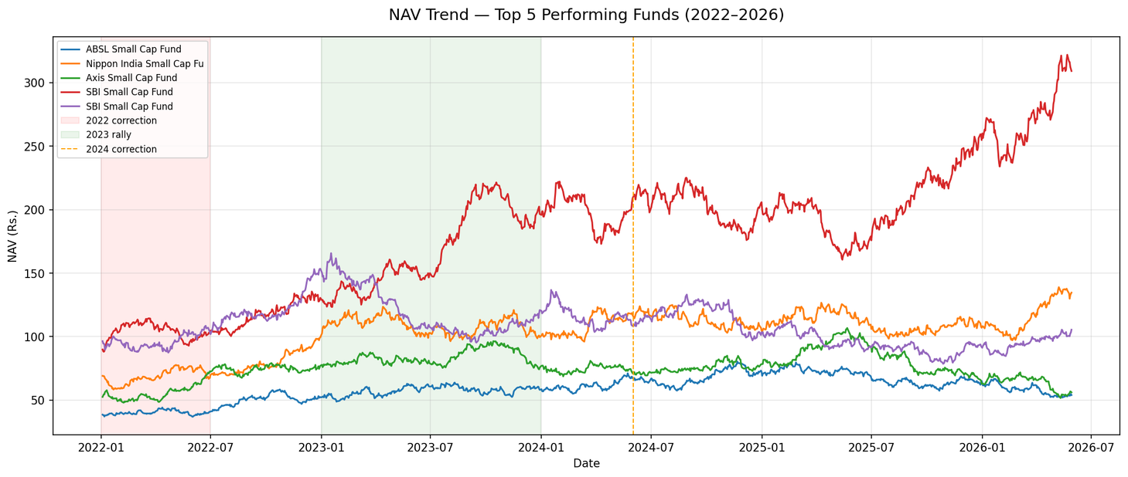
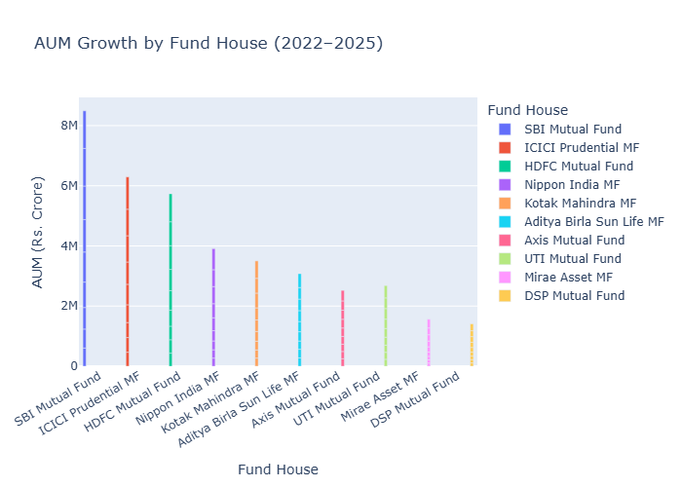
WHAT THE DATA SHOWED US
SBI Mutual Fund leads with highest AUM in India
All equity fund NAVs showed strong upward trend 2022-2026
Large Cap funds showed lower volatility vs Mid/Small Cap
04

Slide 6
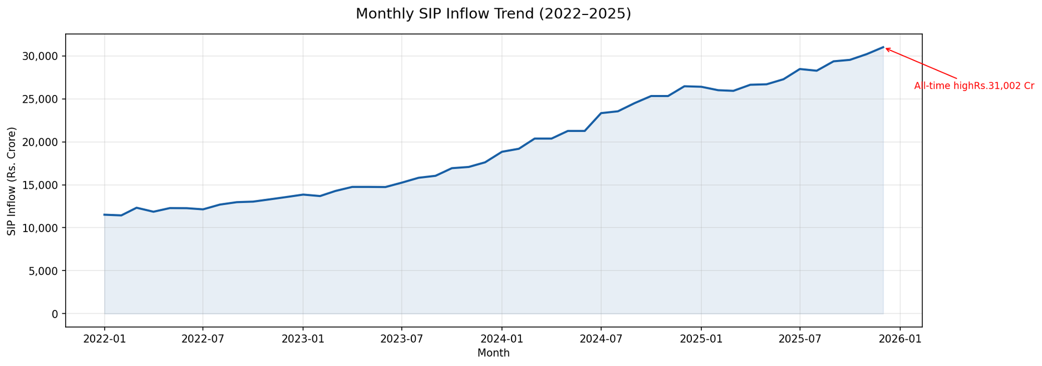
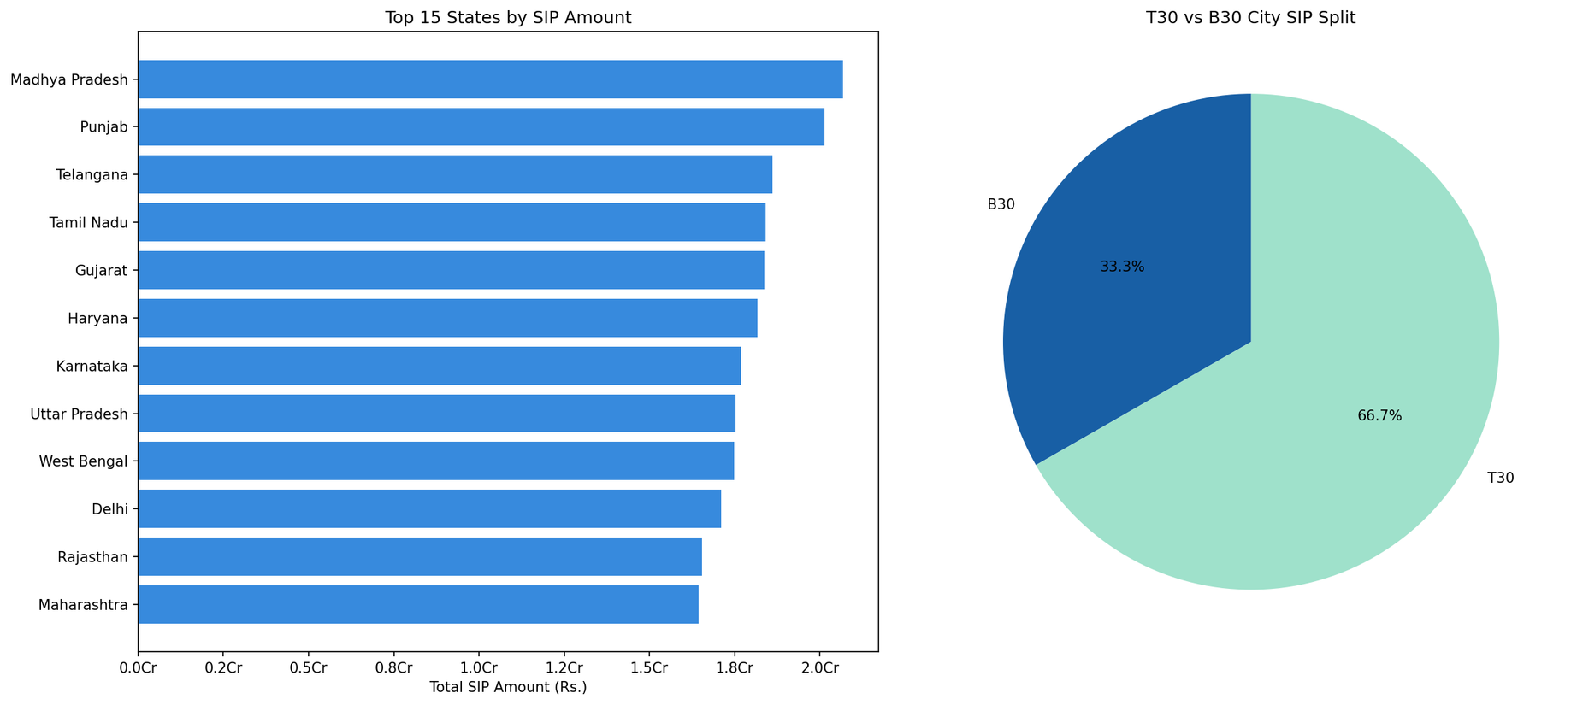
SIP GROWTH STORY & INVESTOR INSIGHTS
SIP inflows hit ALL TIME HIGH of Rs. 31,002 Cr in Dec 2025
Total folios DOUBLED from 13.26 Cr to 26.12 Cr (2022-2025)
Age group 26-35 contributes highest average SIP amount
05

Slide 7
HOW WE MEASURED FUND PERFORMANCE
CAGR
Compound Annual
Growth Rate
Measures the
yearly growth
rate of a fund
SHARPE
RATIO
Measures return
earned per unit
of total risk
taken
ALPHA
Measures how
much a fund
outperforms its
benchmark index
BETA
Measures a
fund's sensitivity
to market
movements
VALUE AT RISK
(VaR)
Measures the
maximum
expected
daily loss at
95% confidence
MAXIMUM
DRAWDOWN
Measures the
worst peak-to-
trough decline
of a fund
06

Slide 8
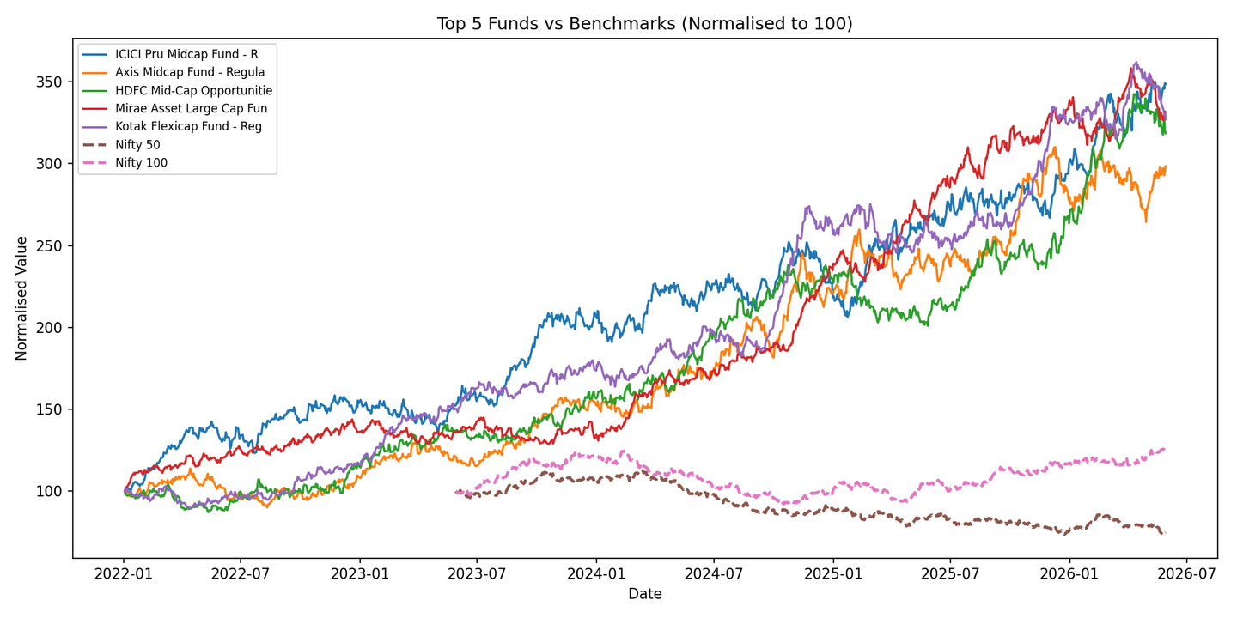
FUND RANKINGS — COMPOSITE SCORECARD
Scorecard Weights:
3 Year Returns ———— 30%
Sharpe Ratio ———— 25%
Alpha ———— 20%
Expense Ratio ————15%
Max Drawdown ———— 10%
Result: Data-driven ranking of all 40 funds from 0-100 score
07

Slide 9
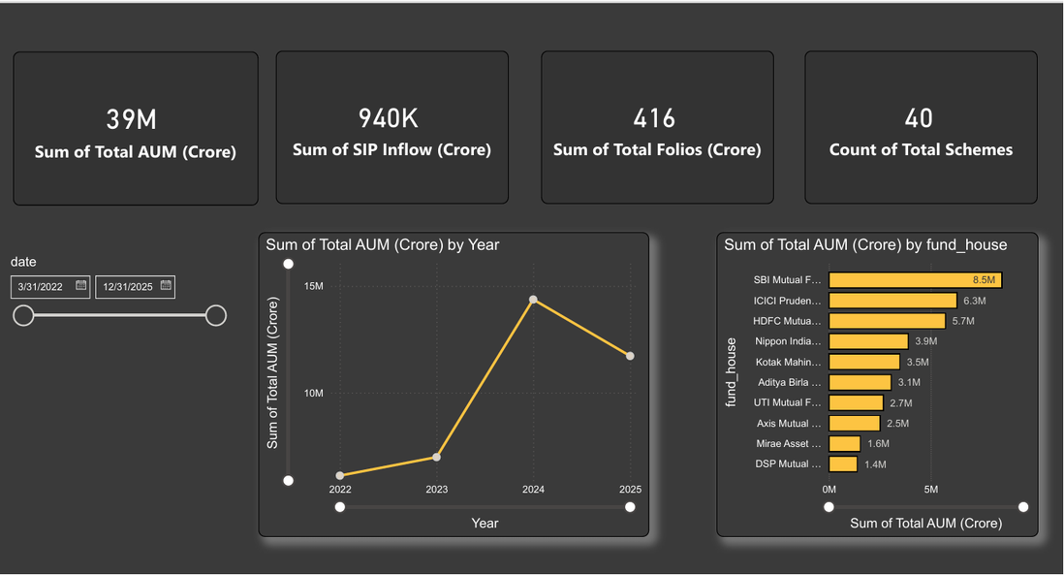
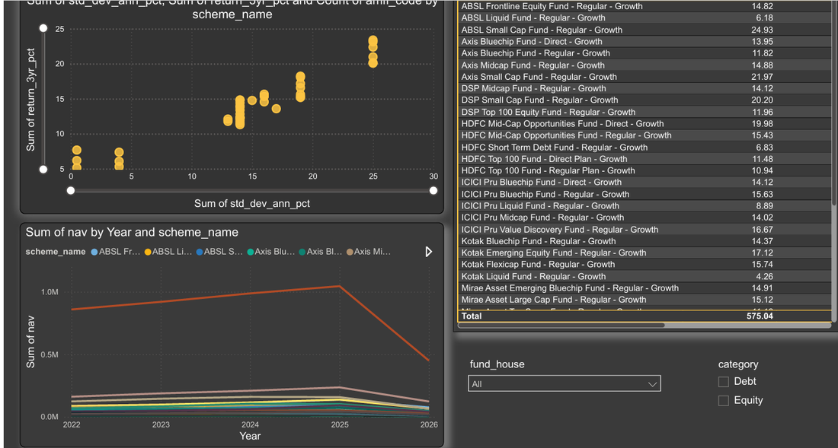
DASHBOARD PAGE 1 & 2
PAGE 2 — Fund Performance
PAGE 1 — Industry Overview
08

Slide 10
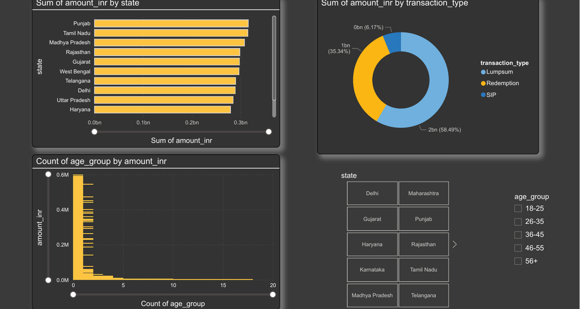
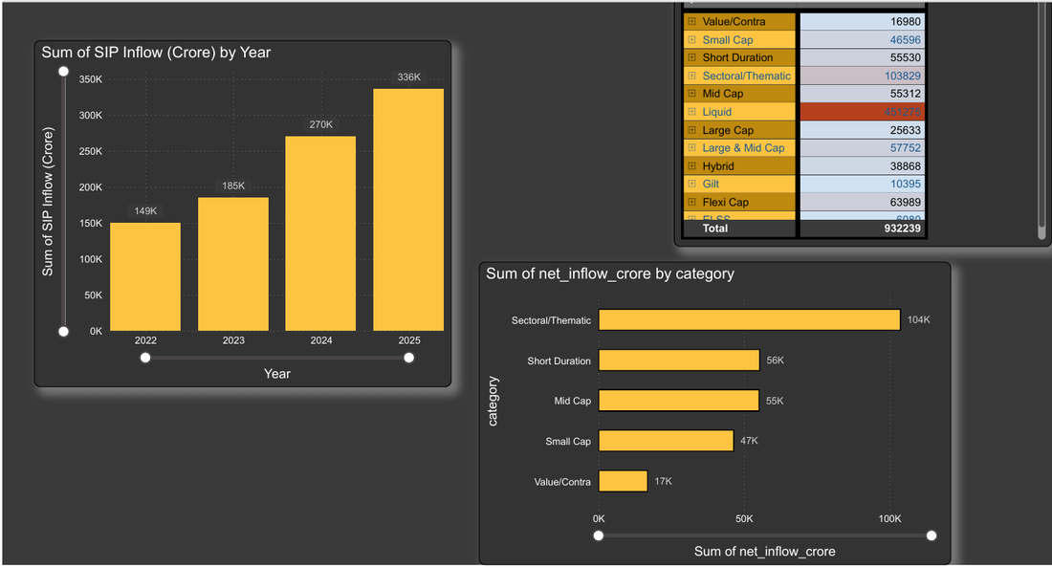
DASHBOARD PAGE 3 & 4
PAGE 4 — SIP & Market Trends
PAGE 3 — Investor Analytics
08

Slide 11
WHAT WE FOUND & WHAT WE RECOMMEND
FINDINGS
SBI MF dominates with highest AUM
SIP hit record Rs.31,002 Cr in Dec 2025Equity funds best on risk-adjusted basis
Age 26-35 most active SIP investors
Many funds show negative alpha
Small Cap carries 2x higher daily risk
RECOMMENDATIONS
Conservative investors → Large Cap, Sharpe > 1
Aggressive investors → Mid/Small Cap with +Alpha
Always choose Direct plan over Regular plan
Focus B30 cities for SIP growth opportunity
Send automated reminders to at-risk SIP investors
08

Slide 12
THANK YOU
Arushi garg
data analyst intern
bluestock fintech pvt.Ltd.
june 2026
Github: https://github.com/arushigarg880/bluestock-capstone
"Transforming raw AMFI data into actionable investment intelligence"

