Slide 1

Early Cluster Prediction for Patients with Multi-Morbidities
Arushi Nautiyal

Slide 2

Introduction
Multiple long-term conditions, known as multimorbidity (MLTC-M), defined as the co-occurrence of two or more chronic diseases in an individual is a growing global health challenge.
In England alone, 6.75 million people are living with more than one long-term disease.
This project focuses on early disease cluster prediction, where clusters are formed based on observed co-occurrence in patients' medical histories and associating patients with those clusters.
Patients may transition between clusters, making them stable or unstable based on their attraction to different clusters during their medical trajectory
Notes:
Multiple long-term conditions, known as multimorbidity (MLTC-M), refer to the presence of two or more chronic diseases in an individual, significantly impacting their quality of life and posing challenges to the healthcare system.[1] In England, 6.75 million people live with more than one longterm disease, highlighting the scale of the issue [3]. Research areas focus on understanding MLTCs by identifying disease patterns, predicting disease clusters and studying disease trajectory similarities [2]. Better understanding of these patterns can lead to improved clinical decision-making and patient management. This project focuses on early disease cluster prediction, where clusters are formed based on observed co-occurrence in patients' medical histories and associating patients with those clusters. Patients may transition between clusters, making them stable or unstable based on their attraction to different clusters during their medical trajectory. The patient trajectory comprises age at diagnosis, health condition, gender, and demographic data.

Slide 3
Methodology
Data: This project uses primary care data for approximately 220,000 individuals in the UK, obtained through the UK Biobank.
Clustering Technique: Latent Dirichlet Allocation (LDA) is used for topic modelling method whose aim is to find topics a document belongs to, based on the words in it and then probability is calculated for words' association to different topics(cluster here).
Patient Trajectories: Using Trend analysis and term relative weight of patients' diseases to find if a patient prominently belongs to a particular cluster.
Early Cluster Prediction: Prediction is done at each stage. At first, diseases weight in various topics are compared for prediction, and at later stages, prediction is based on trend and the cumulative diseases weights.

Slide 4
Raw Data To Stability Analysis (Referred)
Dataset:
RAW_MLTC_SEQUENCES
Cached pipeline stages
computeStagesPerPatient()
computeTrajectoryAssociations()
Patient timelines
Dataset:
STAGES_PER_PATIENT
Dataset: ALL_TRAJECTORIES
Dataset: BOWs
Dataset: LDA_MODEL
Dataset:
TERMS_REL_WEIGHTS_IDF
Dataset: LTC_BINARY
Patient binary
matrix
Create BOWs
LDA Topics modelling
Adjust term weights per topic
createBOWs()
bagOfWords2Topics()
compute_terms_topics_associations()
Stability analysis
generate stability dataframe
Dataset: STABILITY_DATAFRAME

Slide 5
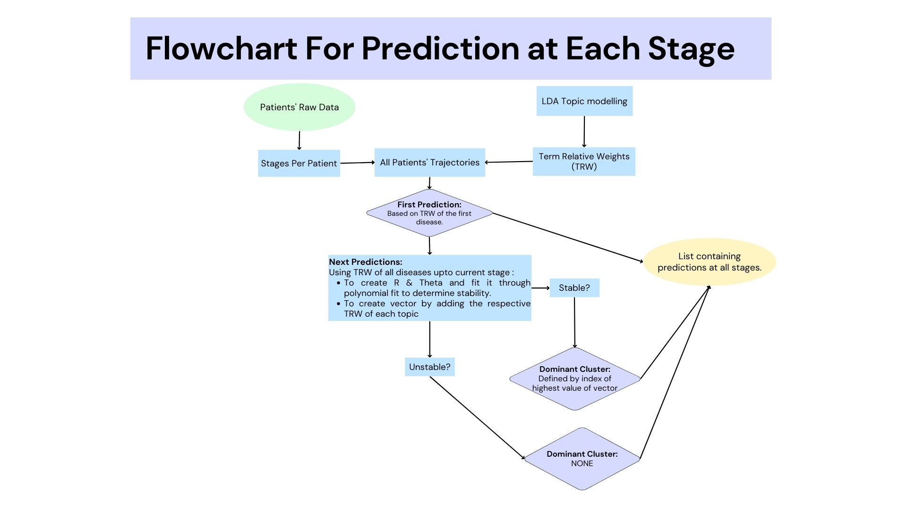

Slide 6
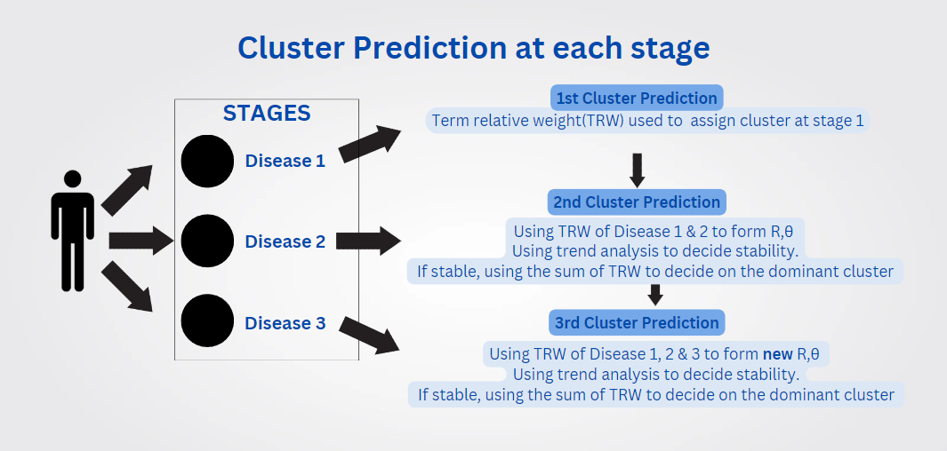

Slide 7
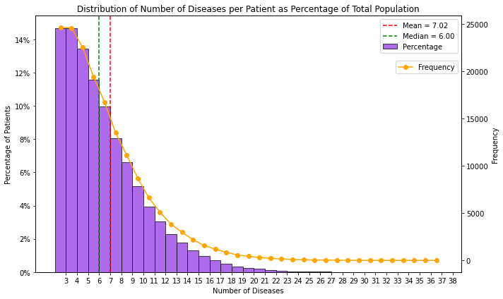
Findings:

Slide 8
F1-score Calculations
For topic count 4, F1-scores are calculated as below.
Please Note: For Unstable population, the dominant cluster is marked as (n+1)th cluster.
Stage | Topic 0 | Topic 1 | Topic 2 | Topic 3 | Topic 4(NaN Cluster)
0 | 0.5629 | 0.4368 | 0.3614 | 0.2793 | 0
1 | 0.6161 | 0.5211 | 0.4481 | 0.4369 | 0.3474
2 | 0.7259 | 0.6726 | 0.5703 | 0.5763 | 0.5076

Slide 9
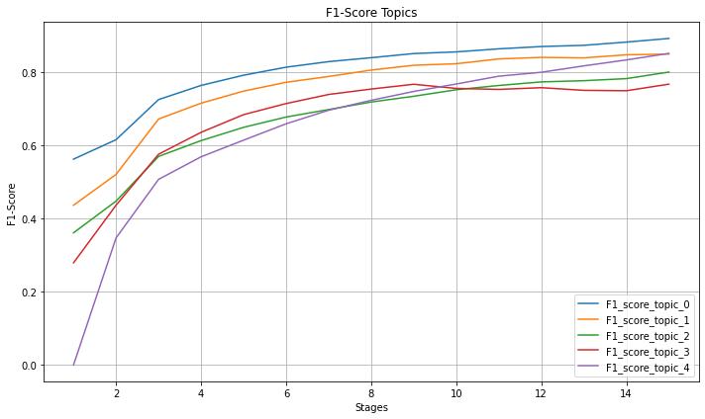
F1-score Progression for n=4.
F1_score_topic_4 represents NaN cluster( unstable trajectory).

Slide 10
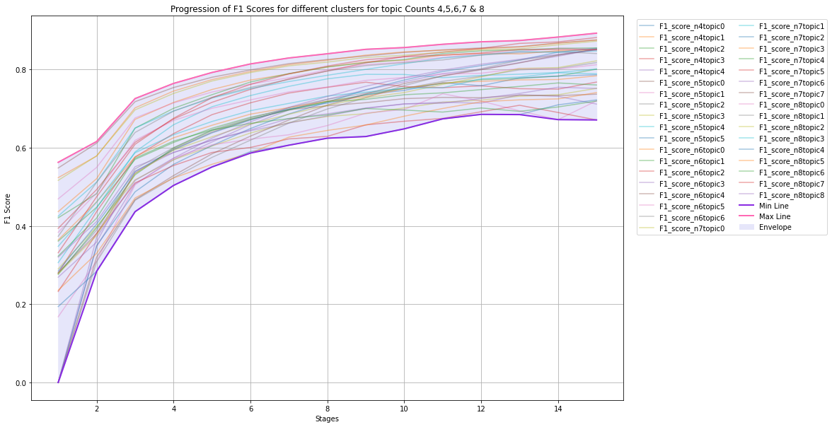
Range of F1 score for n=4,5,6,7,8

Slide 11
Conclusion
This project backs up the previous research and extends the pre-existing method and breaks it down into stages, adding precision per stage as a new dimension.
LDA modelling along with concept of stability is used to decide the prediction.
F1-score is used to measure the correctness of the prediction.
Future Work:
This research can be further improvised by considering different clustering methods or considering path similarities.
The use of R & theta is determining the cluster rather than just using TRW.
Only considering weighted scores do not account for multimorbidity by chance and may suffer generalizability problem

Slide 12

THANK YOU!

