Slide 2
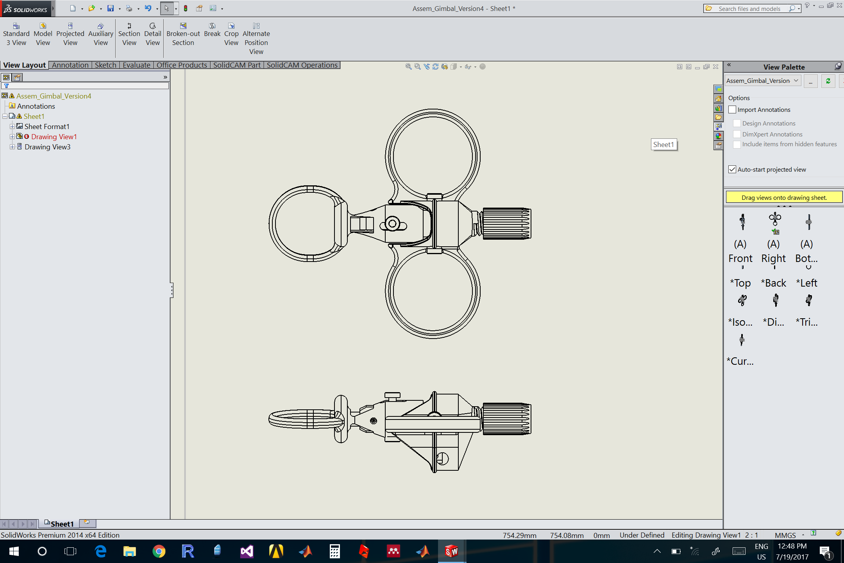
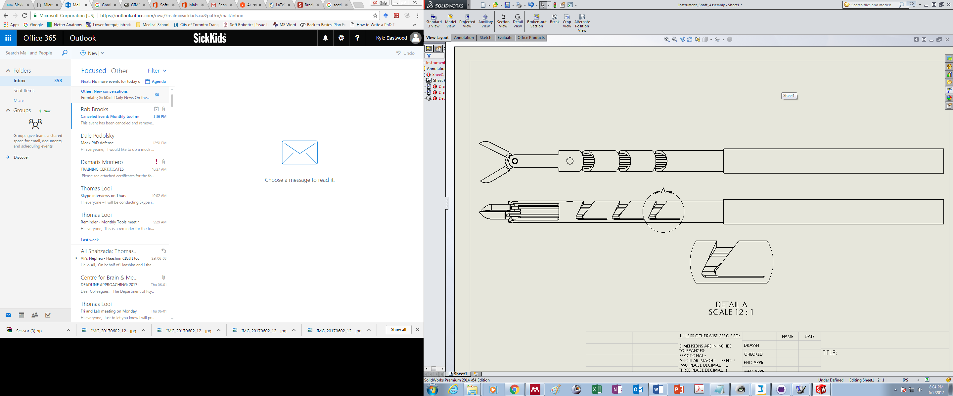
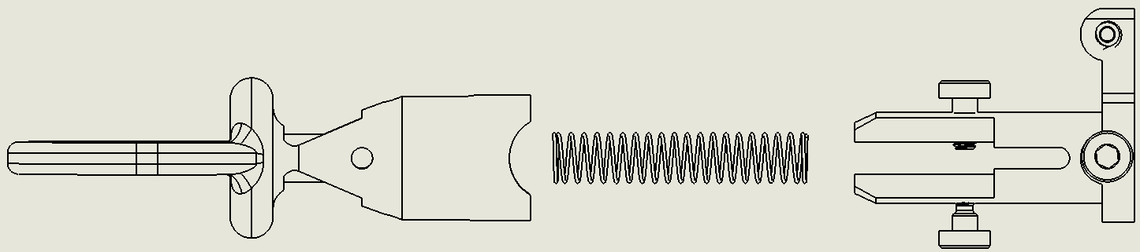
230
239
231
242
238
232
232
233
234
237
235
236
243
240
246
245
231
235
238
239
232
232
233
234
244
239
246
243
241
247

Slide 3
Thumb Trigger
Thumb Gimbal
Compression Spring

Slide 5
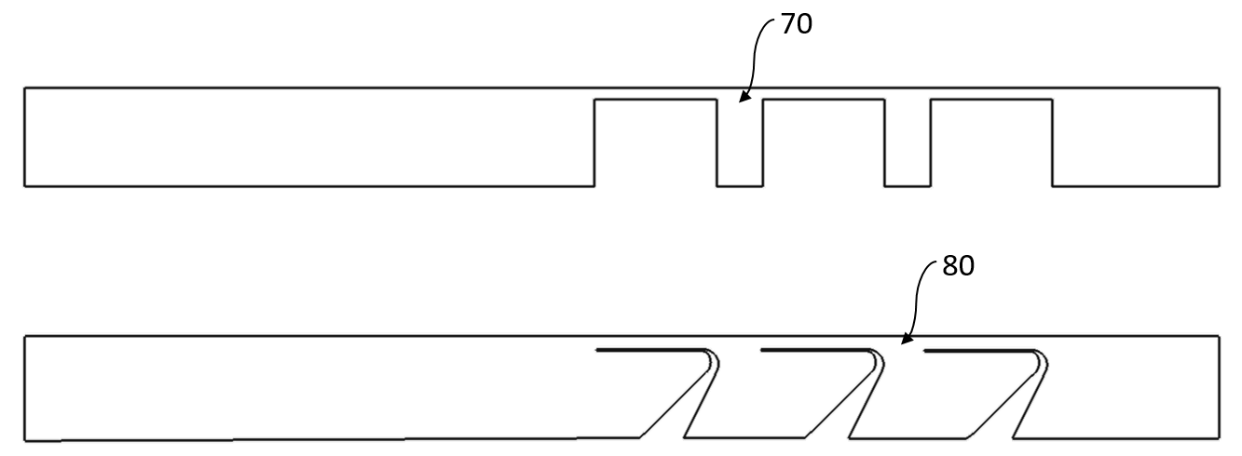
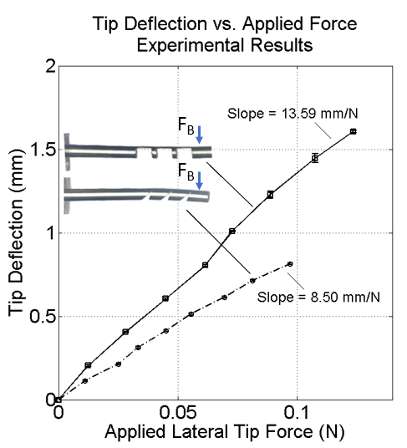
71
81

Slide 7
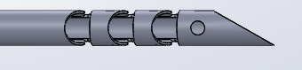



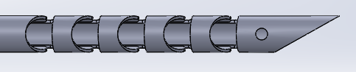
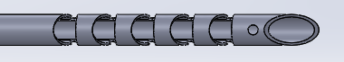
Dissector to the left:
Dissector to the right:
Dissector on the front:
Dissector to the left:
Dissector to the right:
Dissector on the front:

Slide 8
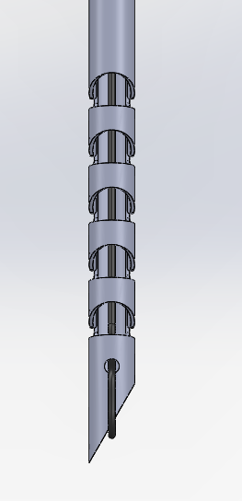
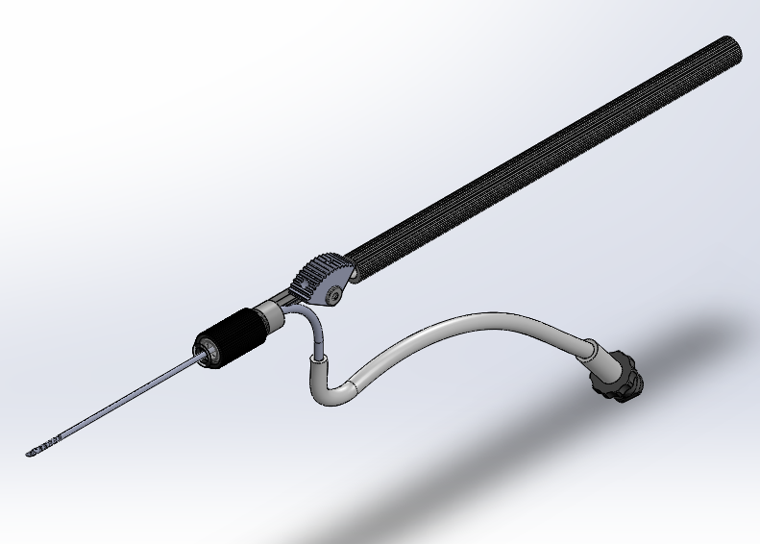
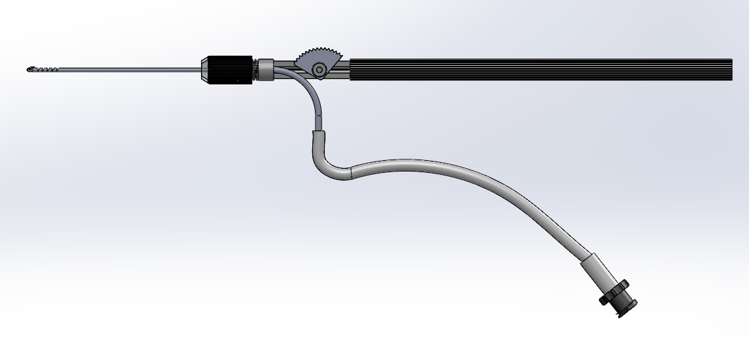
Nitinol CCM wrist
Finger Piece
Handle
Nitinol curved suction connector
Suction Tubing
Female Luer Connector

