Slide 1


PARTNERSHIP OFFER
2.0
Strategic partnership
We are creating the main assembly point for startups, investors and the venture market of Uzbekistan
Speaker
Akmal
Nuriddin
2026
Founder OS Architect
Untitled Ecosystem Lead
PITCH DEC

Slide 2
CONTENT
What will we discuss
01
Problem
Solution
02
Why the market needs changes: the pain of startups and coworking spaces
UNTITLED 2.0 - infrastructure layer for founders
03
Your ROI
04
Partnership model
What does a coworking space get from the partnership?
Win-Win integration on a barter basis
05
Roadmap
06
Contacts
Plan for the next 60 days
Contact us to discuss

Slide 3
01 / PROBLEM
Selling tables to freelancers -
this is not building an ecosystem
The Pain of Startups
The pain of coworking spaces
Conclusion
90%
High churn rate of tenants. Startups burn money and move out.
The market needs a system filter and infrastructure that turns garage ideas into businesses with solid unit economics.
projects in Uzbekistan are drowning in manual operating systems and do not live to see the first investments. They don't need motivational meetups, but tools.
The locations lack a quality community that retains residents for years.
The market is oversaturated with “motivation”, but lacks real tools for growth

Slide 4
02 / DECISION
UNTITLED 2.0 — Infrastructure layer for founders
What are we doing
We come to startups, conduct a rigorous audit, implement AI agents, collect financial models and package projects for venture funds.
We are not media
We are the first Founder OS (Operating System for Startups) in Uzbekistan.
Our role
The main quality filter between founders and capital. We bring projects to investment readiness.
AI audit of OS
Financial modeling
Packaging for investors
Our content
Viral content
We film the entire process of “fixing” startups and turn them into viral reality shows, podcasts and blitz interviews.
Founder OS
Operating system for startups in Uzbekistan

Slide 5
02 / DECISION
Founder OS 2.0: From Manual Chaos to Venture Deal
We don't give advice. We sit down with the founder and rebuild the business at the system level.
In-depth audit and business model
AI Integration and Automation
▸
Revealing “holes” in current operational processes
▸
We implement individual AI agents into work processes
▸
We digitize sales funnels and user journeys
▸
Smart bots for lead qualification and support automation
▸
We transform the product from a “garage MVP” into a scalable system
→
Save up to 40 hours per month
▸
Task tracking and CRM architecture without complex code
Unit Economics and Finance
Investment packaging
▸
Killing fantasies: calculating real CAC and LTV
▸
Reference Pitch Deck - only numbers and logic, no "water"
▸
Transparent financial models (UZS/USD) and Runway calculation
▸
Tough content and go-to-market strategy
▸
We bring the startup to the break-even point
▸
Preparing for Pitch Nights and meetings with venture capital funds
Result
The startup receives the "Investment Ready" status and is included in our closed Deal Flow for transfer to funds

Slide 6
03 / YOUR ROI
Why is it beneficial for you to become our Headquarters (HQ)
Lead Generation
Aggressive PR
Startups that go through our Founder OS and raise $50k-$100k rounds become your anchor private office tenants.
All Founder Reality formats, VC Talks podcasts with investors and interviews will be filmed at your location.
We send them to you
Native coverage to the entire IT audience of the country
Retention of Residents
Access to Capital
Current residents receive free access to the Founder OS core (templates, AI bots, consultations).
We bring top investors, business angels and fund managers to your platform as part of our closed Industry Dinners.
A powerful argument for the sales department
Direct contact with key market players
Result
4 in 1
You become the main assembly point of the venture market
source of value

Slide 7

04 / PARTNERSHIP MODEL
Win-Win Integration
Barter basis for 6-12 months
01
Unlimited access to the work area
For 2 founders of the project - Akmal and Nuriddin. A full-fledged workplace with infrastructure.
What do we give in return?
Access to meeting rooms
Media resource and PR
02
Network of founders and investors
For filming podcasts and meetings with startups (for booking). Professional space for content.
Resident integration
Lead generation
Access to the event zone
Retention tools
03
1-2 times a month to conduct closed meetups with founders and investors (Industry Nights) and Pitch Nights.
Financial terms
$0
100% barter
UNTITLED makes you your official and only home base for the next 6-12 months

Slide 8
05 / ROADMAP
Plan for the next 60 days
April – May 2026
8
«Founder Reality»
trips
Audit and implementation of AI tools in real startups. Filming debriefings at your location.
Timeline
Launch Founder OS Bot
April 2026
Launch Founder OS Bot
Release of a Telegram bot with a knowledge base. Mention of you as a general partner in the interface.
April-May 2026
8 Founder Reality trips
April-May 2026
«VC Talks»
4 VC Talks podcasts
4
Interviews with leading venture funds of Uzbekistan: AloqaVentures, UzVC, PnP and others.
May 2026
podcast
1-й Industry Night
Industry Dinner
Important
1
We are looking for only one anchor partner. The location that enters the project now will take all the traffic from the venture market.
dinner
Private dinner with local investors and business angels at your event site.

Slide 9
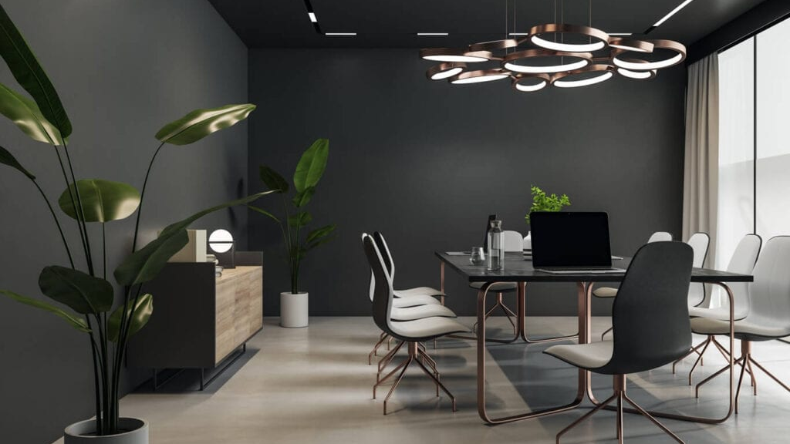
CONTACTS
Architecture is more important than hype
Let's make your coworking space the place where the main deals are made on Uznet
Akmal
Nuriddin
Founder OS Architect
Untitled Ecosystem Lead
System architecture and AI. Responsible for technical infrastructure, business processes and AI tools.
Operations, community and media. Responsible for partnerships and content strategy.
Contact us
+998937687300 / +998881250666
instagram: untitled.uz
UNTITLED 2.0 © 2026

