Slide 1
Comparison of LSTM and Multi-dimensional CNNs for Time Series Forecasting
Presenter - Arusyak Hakobyan
Supervisor - Arnak Poghosyan

Slide 2
Agenda
Brief introduction to neural networks, time series forecasting and financial analysis
Problem Setting
Dataset and Features
Solutions: CNN and LSTM
Comparison
Future plan

Slide 3
Brief Introduction

Slide 4
Neural Networks
useful in finding patterns and modeling complex relationships between inputs and outputs in data

Slide 5
Time Series Forecasting
time series data
sequence of observations stored in time order

Slide 6
Time Series Forecasting
time series data
sequence of observations stored in time order
time series forecasting
predicts future events by analyzing the trends of the past

Slide 7
Time Series Forecasting
time series data
sequence of observations stored in time order
time series forecasting
predicts future events by analyzing the trends of the past
Examples: weather forecasting,earthquake prediction

Slide 8
Financial Analysis
process of assessing a company’s performance and making recommendations about how it is going to perform in the future

Slide 9
Problem Setting

Slide 10
Problem Setting
stock price prediction

Slide 11
Problem Setting
stock price prediction
efficient-market hypothesis(EMH)

Slide 12
Problem Setting
stock price prediction
efficient-market hypothesis(EMH)
our goal:
develop convolutional neural networks
compare the result with LSTM

Slide 13
Dataset and Features

Slide 14
Dataset and Features
Data used
Apple Inc. historical data
Source
Yahoo Finance
Details
daily data for 10 years 2009/11/05 - 2019/11/05

Slide 15
Dataset and Features
7 features, 2518 observations
Date
Open - starting price at which the stock is traded on a particular date
Close - closing price at which the stock is traded on a particular date
High - maximum price of the share for the specified date
Low - minimum price of the share for the specified date
Adj Close - the last price of the share for the specified date
Volume - total number of buyers and sellers exchanging shares over a
given period of time

Slide 16
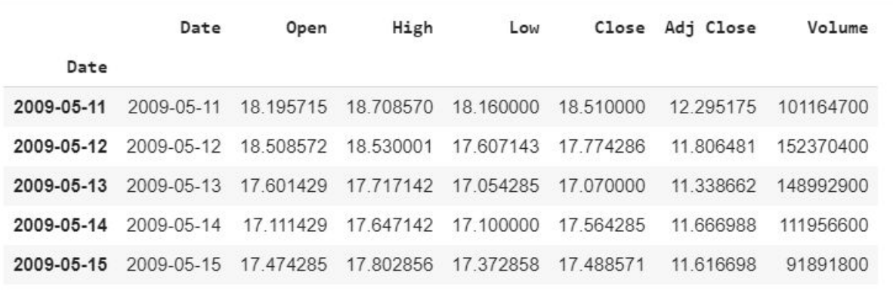
Dataset and Features

Slide 17
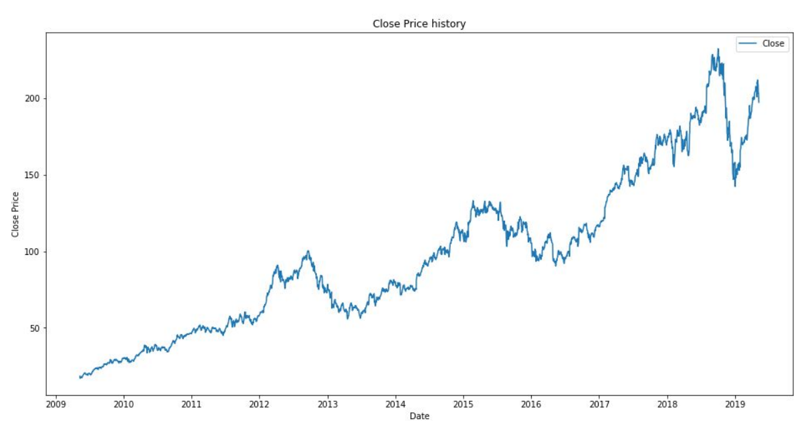
Dataset and Features

Slide 18
Solutions

Slide 19
CNNs
What is it?
Deep artificial neural networks
Mainly used for classification
Why use CNN?
Initially designed to map image data to an output variable
Works well with data having a spatial relationship
Ex. text analysis, financial data?

Slide 20
Multi-dimensional CNN
*single-step using one value

Slide 21
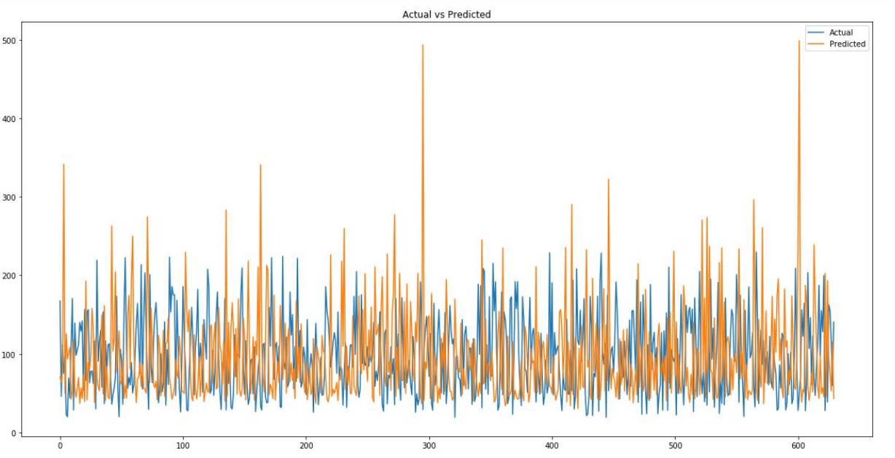

Multi-dimensional CNN
*single-step using one value

Slide 22
Multi-dimensional CNN
*single step using multiple values

Slide 23
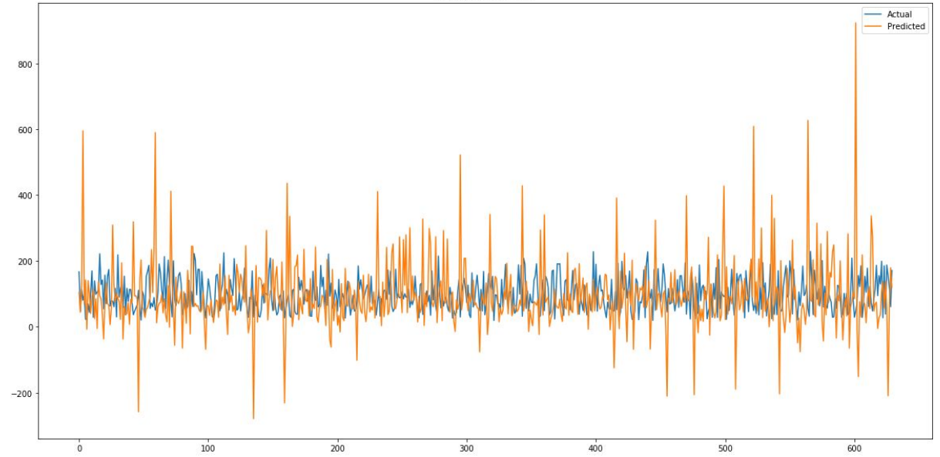

Multi-dimensional CNN
*single step using multiple values

Slide 24
Long-Short-Term Memory
(LSTM)

Slide 25
LSTM
What is it?
special kind of RNN
is capable of learning long-term dependencies
Why use CNN?
most successful RNN as it overcomes the problems of training a recurrent network
great tool for NLP
Ex. text or speech data analysis

Slide 26
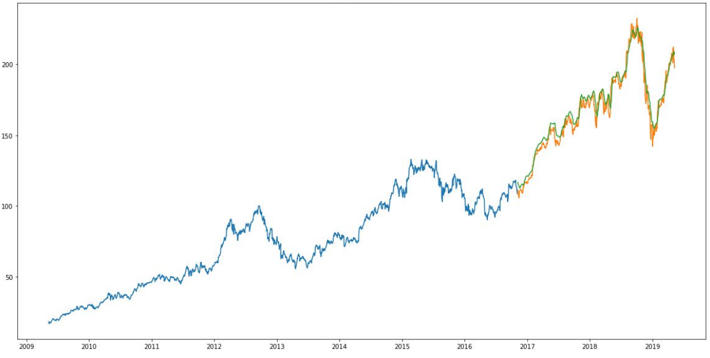

LSTM

Slide 27
Comparison

Slide 28
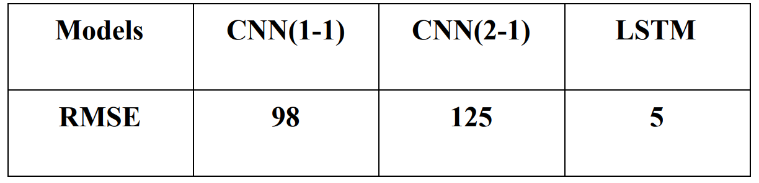
Comparison

Slide 29
Future Plans

Slide 30
Future Plans
Build better CNN model
Try mixed model of LSTM and CNN

Slide 31
References
A Beginner's Guide to Convolutional Neural Networks (CNNs). (n.d.). Retrieved from https://skymind.ai/wiki/convolutional-network
A Beginner's Guide to Multilayer Perceptrons (MLP). (n.d.). Retrieved from https://skymind.ai/wiki/multilayer-perceptron
A Gentle Introduction to Convolutional Layers for Deep Learning Neural Networks. (2019, April 02). Retrieved from https://machinelearningmastery.com/convolutional-layers-for-deep-learning-neural-networks/
DeMuro, J., & DeMuro, J. (2018, August 11). What is a neural network? Retrieved from https://www.techradar.com/news/what-is-a-neural-network
Financial Analysis - Overview, Guide, Types of Financial Analysis. (n.d.). Retrieved from https://corporatefinanceinstitute.com/resources/knowledge/finance/types-of-financial-analysis/
Gupta, T., & Gupta, T. (2017, January 05). Deep Learning: Feedforward Neural Network. Retrieved from https://towardsdatascience.com/deep-learning-feedforward-neural-network-26a6705dbdc
Kumar, N., & Kumar, N. (2019, April 01). Deep Learning: Feedforward Neural Networks Explained. Retrieved from https://hackernoon.com/deep-learning-feedforward-neural-networks-explained-c34ae3f084f1

Slide 32
More References
Lyla, Y., & Lyla, Y. (2019, January 02). A Quick Start of Time Series Forecasting with a Practical Example using FB Prophet. Retrieved from https://towardsdatascience.com/a-quick-start-of-time-series-forecasting-with-a-practical-example-using-fb-prophet-31c4447a2274
Sandeep. (2019, April 06). Neural Networks and Data Mining. Retrieved from https://www.vskills.in/certification/tutorial/data-mining-and-warehousing/neural-networks-and-data-mining/
Stock market prediction. (2019, May 10). Retrieved from https://en.wikipedia.org/wiki/Stock_market_prediction
Understanding LSTM Networks. (n.d.). Retrieved from https://colah.github.io/posts/2015-08-Understanding-LSTMs/
What is Financial Analysis? (n.d.). Retrieved from https://www.financialplannerworld.com/what-is-financial-analysis/
What is LSTM? (2018, April 19). Retrieved from https://hub.packtpub.com/what-is-lstm/
What is time series forecasting? - Definition from WhatIs.com. (n.d.). Retrieved from https://whatis.techtarget.com/definition/time-series-forecasting
When to Use MLP, CNN, and RNN Neural Networks. (2018, April 25). Retrieved from https://machinelearningmastery.com/when-to-use-mlp-cnn-and-rnn-neural-networks/

Slide 33

Thanks!
Any questions?

