Slide 1
Summary of Data Linkage proposals, 2017-2025
Ali Ruth

Slide 2
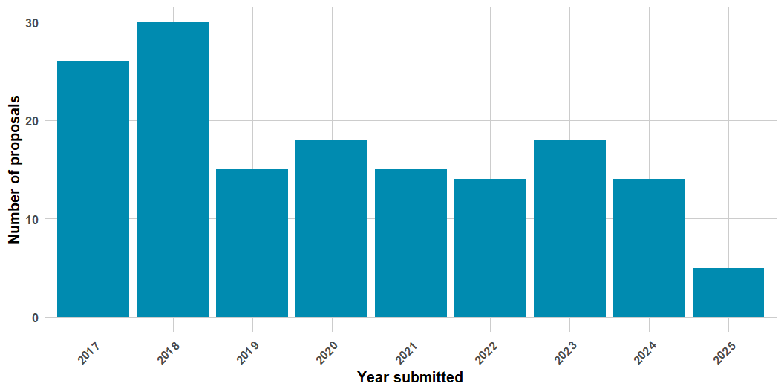
Proposals received 2017-2025

Slide 3
Total requests by survey
Survey | Total_requests
NHIS | 69
NHANES | 78
NHCS | 5

Slide 4
Total requests by survey
year_submitted | NHIS | NHANES | NHCS
2017 | 13 | 6 | 0
2018 | 12 | 18 | 0
2019 | 9 | 5 | 1
2020 | 9 | 9 | 0
2021 | 6 | 10 | 0
2022 | 2 | 11 | 3
2023 | 10 | 9 | 0
2024 | 6 | 7 | 1
2025 | 2 | 3 | 0

Slide 5
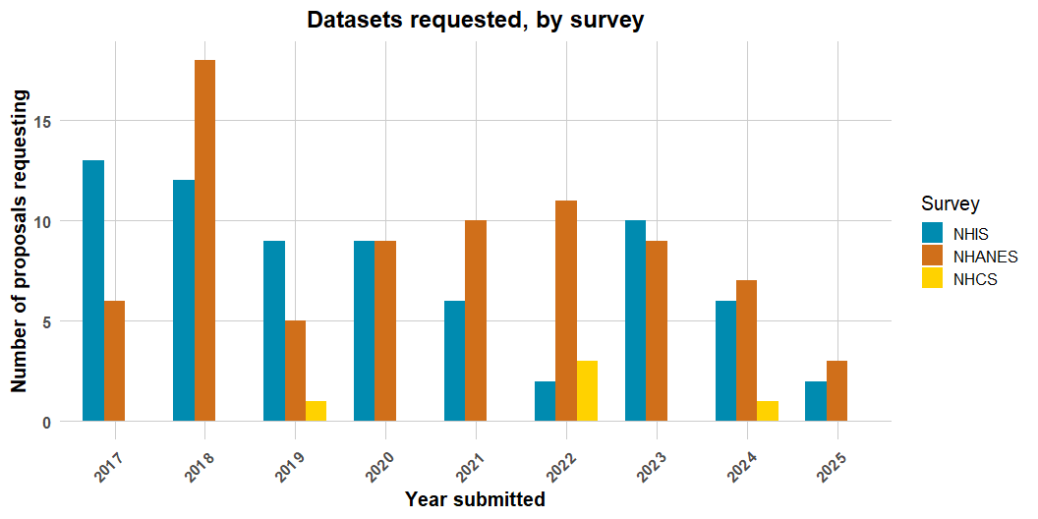
Total requests by survey

Slide 6
Total requests by linkage
Linkage | Total_requests
LMF | 98
CMS | 35
HUD | 29
ESRD | 7
SSA | 2
VA | 1

Slide 7
Total requests by linkage
year_submitted | LMF | CMS | HUD | ESRD | SSA | VA
2017 | 14 | 6 | 4 | 0 | 1 | 0
2018 | 22 | 7 | 3 | 0 | 0 | 0
2019 | 8 | 3 | 6 | 0 | 0 | 0
2020 | 10 | 2 | 7 | 0 | 1 | 0
2021 | 10 | 3 | 2 | 4 | 0 | 0
2022 | 12 | 2 | 0 | 2 | 0 | 0
2023 | 11 | 5 | 2 | 1 | 0 | 0
2024 | 9 | 5 | 3 | 0 | 0 | 1
2025 | 2 | 2 | 2 | 0 | 0 | 0

Slide 8
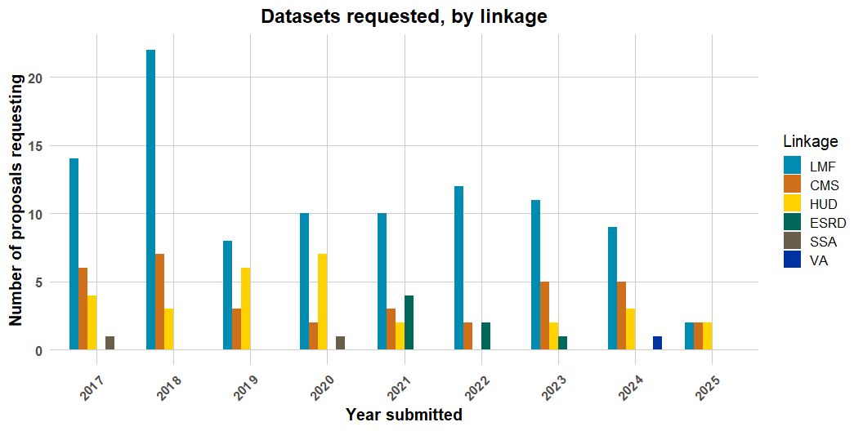
Total requests by linkage

Slide 9
Data extracts created for the RDC
year_submitted | files_created
2017 | 14
2018 | 11
2019 | 7
2020 | 5
2021 | 6
2022 | 3
2023 | 8
2024 | 7
2025 | 1

Slide 10
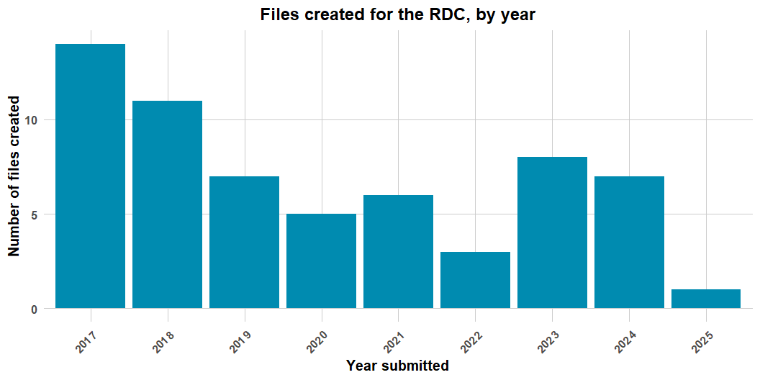
Data extracts created for the RDC

Slide 11
Notes on creating slides in Quarto

Slide 12
Notes on creating slides in Quarto
Goal: Create a reproducible workflow in R to generate either slides or a report with underlying RDC data utilizing NCHS formatting standards
Rationale: Time saved by automatically formatting slides uniformly each time even if the underlying dataset changes

Slide 13
Notes on creating slides in Quarto
Process
Had to build new slide template from scratch for Quarto compatibility
Needed to ensure consistency of underlying data fields
Tracked and resolved different rendering errors

Slide 14
Notes on creating slides in Quarto
Next steps
Ascertain where to centrally store code
Build in 508 compliance
Resolve Rmd error messages
Figure out efficient processes for editing/collaboration
Improve table formatting

