Slide 1
NEUROBLATE LITT
Tumor Board Case Summary
Recurrent right frontal glioma
FACILITY
PERFORMING
REFERRING
Westchester Medical Center
Dr. Hanft
Dr. Tatyana Gitlevich
PROCEDURE
Probe SideFire® 3.3mm
Energy 13.5 kJ
Laser-on 21:23
Pulses 646
Targets / traj. 1 / 1
Date June 15, 2026
✓ Robotic probe driver used
The NeuroBlate System is a surgical tool and is not a treatment for any specific disease state or condition. For informational purposes only; does not replace the formal operative report and does not describe clinical outcomes. Rx Only.
Case WMC-058 · Recurrent right frontal glioma
1

Slide 2
INDICATION
Recurrent glioma
Recurrent right frontal glioma
CLINICAL CONTEXT
WHY LITT IN THIS CASE
Recurrent glioma after prior therapy presents a familiar problem: the lesion is often deep, in or near prior surgical fields, and re-resection carries cumulative risk. LITT offers focal cytoreduction of the enhancing target through a single stereotactic trajectory under continuous MR thermometry. Because glioma is infiltrative, ablation addresses the targeted volume rather than microscopic disease throughout the brain, and is best framed as one tool within a multimodal plan that preserves future options.
LITT was chosen to deliver focal cytoreduction of the enhancing recurrence through a single minimally invasive trajectory under real-time thermometry, while keeping re-resection, re-irradiation, systemic therapy, and trials on the table. The supporting evidence: in the LAANTERN glioblastoma analysis, which included recurrent IDH-wildtype patients, post-procedure survival fell within the range of published series (de Groot 2022), with short hospitalization across the tumor registry (Kim 2020).
The NeuroBlate System is a surgical tool and is not a treatment for any specific disease state or condition. For informational purposes only; does not replace the formal operative report and does not describe clinical outcomes. Rx Only.
Case WMC-058 · Recurrent right frontal glioma
2

Slide 3
FOR COMPLETION
Operative Notes
To be completed by the performing surgeon.
The NeuroBlate System is a surgical tool and is not a treatment for any specific disease state or condition. For informational purposes only; does not replace the formal operative report and does not describe clinical outcomes. Rx Only.
Case WMC-058 · Recurrent right frontal glioma
3

Slide 4
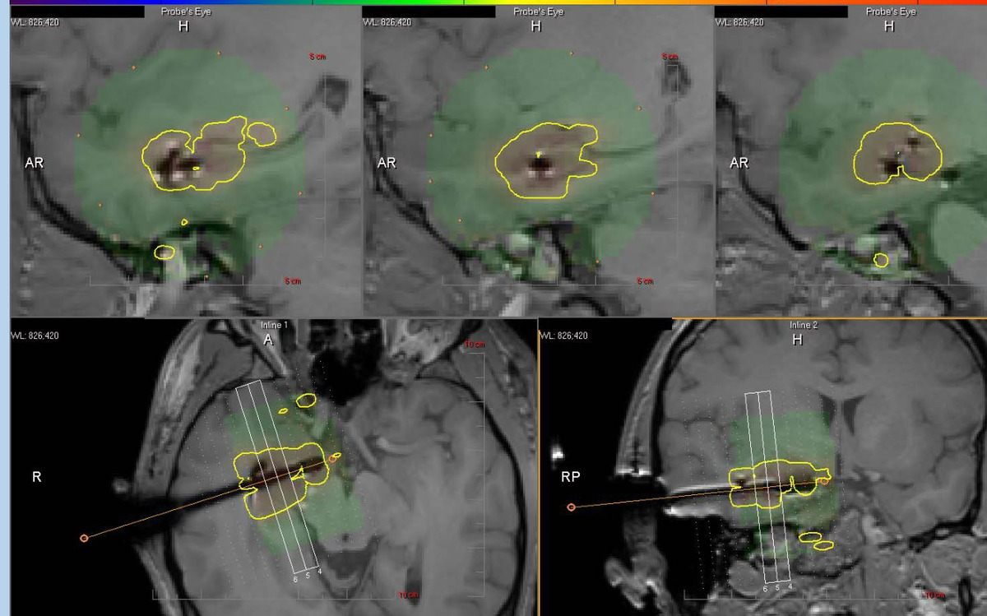
IMAGING · 1 OF 2
Treated area under live MR thermometry
Yellow TDT — higher threshold
Yellow contour = the lower-dose TDT line (≈43°C for 2 minutes). It marks where thermal injury is developing — an earlier contour that the higher-dose blue line may expand through as controlled heating continues.
The NeuroBlate System is a surgical tool and is not a treatment for any specific disease state or condition. For informational purposes only; does not replace the formal operative report and does not describe clinical outcomes. Rx Only.
Case WMC-058 · Recurrent right frontal glioma
4

Slide 5
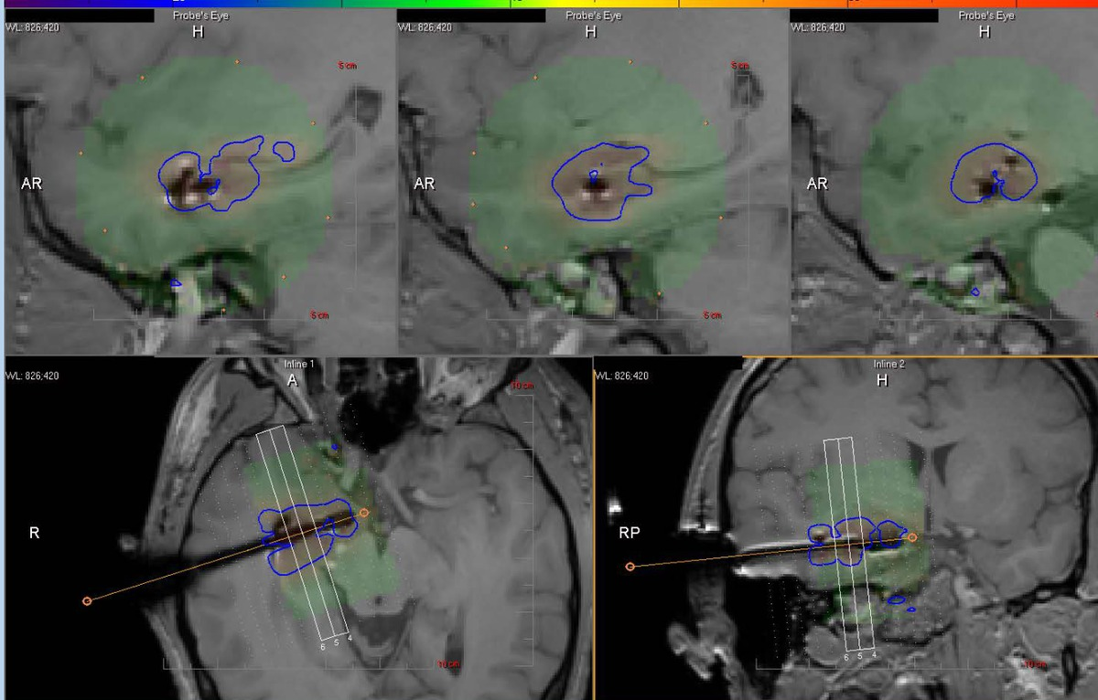
IMAGING · 2 OF 2
Treated area under live MR thermometry
Blue TDT — lower threshold
Blue contour = the higher-dose TDT line (≈43°C for 10 minutes). It marks the more confident zone of irreversible thermal damage — the stronger predictor of ablative coverage. The operator drives this contour through the target while keeping critical anatomy outside it.
The NeuroBlate System is a surgical tool and is not a treatment for any specific disease state or condition. For informational purposes only; does not replace the formal operative report and does not describe clinical outcomes. Rx Only.
Case WMC-058 · Recurrent right frontal glioma
5

Slide 6
POST-LITT FOLLOW-UP
What to watch
Early MRI may look worse before it looks better. Transient ablation-zone enlargement, rim enhancement, and edema may reflect post-ablation evolution rather than immediate tumor progression.
Do not overcall one scan. Interpret imaging together with neurologic status, steroid requirement, timing from LITT, and the serial MRI trend.
Remember the biology. LITT treats the targeted enhancing volume; glioma remains infiltrative and can progress outside the ablation zone.
Neuro-oncology planning remains central. Systemic therapy, re-irradiation, trial eligibility, or additional intervention should be guided by pathology, molecular profile, performance status, and imaging trend.
Escalate concern if. Neurologic decline, rising steroid need, unexpected mass effect, rapid progression outside the treated target, or an imaging and clinical mismatch.
CASE-SPECIFIC
Use tissue to guide next treatment. Pathology and molecular findings should be integrated with post-LITT imaging and systemic-treatment planning.
These follow-up points support interpretation of the post-procedure course and do not replace the treating physician's clinical judgment, operative report, pathology review, or institution-specific follow-up protocol.
The NeuroBlate System is a surgical tool and is not a treatment for any specific disease state or condition. For informational purposes only; does not replace the formal operative report and does not describe clinical outcomes. Rx Only.
Case WMC-058 · Recurrent right frontal glioma
6

Slide 7
SELECTED LITERATURE
Key references & society guidance
KEY REFERENCES
GUIDELINES & SOCIETY STATEMENTS
1
de Groot JF et al. Neuro-Oncol Adv. 2022;4(1):vdac040.
1
AANS-CNS Joint Section on Tumors. Position Statement. 2021.
Prospective LAANTERN cohort of IDH-wildtype glioblastoma reporting survival in selected newly diagnosed and recurrent patients within the range of published resection series.
Society position statement endorsing MR-guided LITT as an option for adult CNS tumors and radiation necrosis, especially lesions unsuitable for or inaccessible to resection.
2
Kim AH et al. Neurosurgery. 2020;87(3):E338-E346.
Prospective multicenter registry of brain-tumor ablation showing short hospitalization, high discharge-to-home rates, and 12-month outcomes with preserved quality of life.
3
Rennert RC et al. Neurosurgery. 2020;86(4):538-547.
Prospective multicenter LAANTERN safety analysis reporting short hospital stays, limited ICU use, and a low peri-procedural complication rate across centers.
Most NeuroBlate evidence is prospective registry or cohort data (LAANTERN), not a randomized comparison against open surgery. References are provided as supporting context for selected-patient consideration, not as superiority claims.
The NeuroBlate System is a surgical tool and is not a treatment for any specific disease state or condition. For informational purposes only; does not replace the formal operative report and does not describe clinical outcomes. Rx Only.
Case WMC-058 · Recurrent right frontal glioma
7

