Slide 1
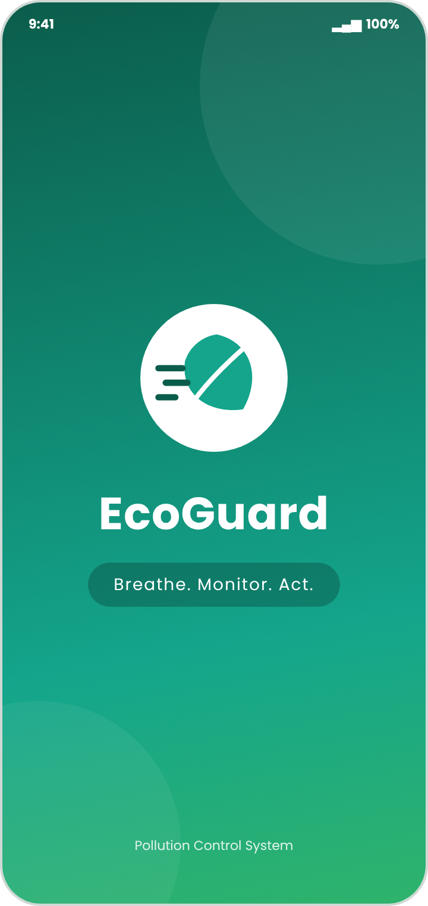
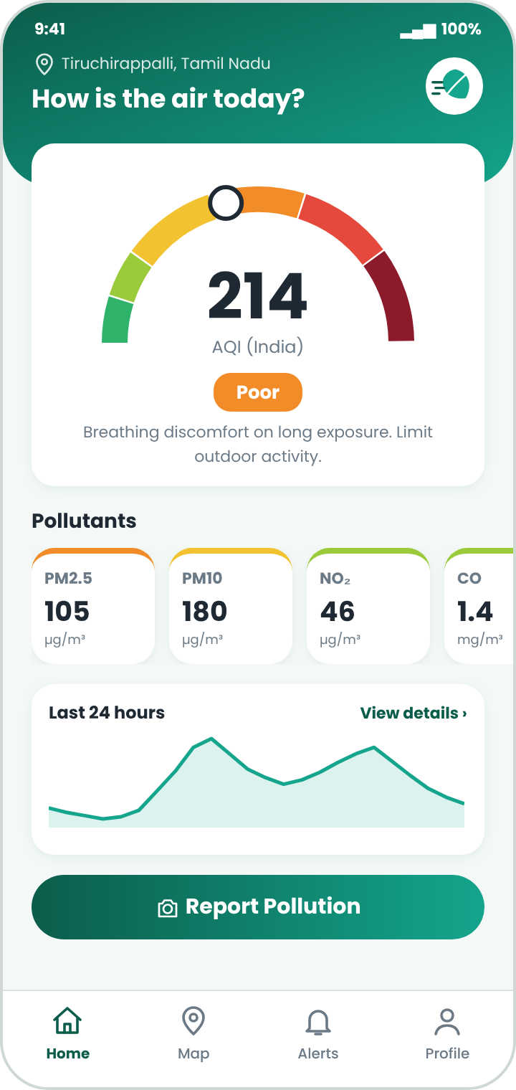
INTERNSHIP PRESENTATION
UI/UX Design of EcoGuard
Pollution Control System Mobile Application
Breathe. Monitor. Act.
Aruvi V · 810023104027
Department of Computer Science and Engineering
University College of Engineering (BIT Campus)
Anna University, Tiruchirappalli – 620 024
Notes:
Good morning. I am Aruvi V. This presentation covers my summer internship project: the UI/UX design of EcoGuard, a pollution control system mobile application.

Slide 2




Internship at a Glance
COMPANY
DURATION
Media Wave Technologies, Tiruchirappalli
27 working days · 15 June – 15 July 2026
DOMAIN
MENTOR
UI/UX Design, with Figma as the main tool
Sivanika S (Software Developer), Joint Supervisor
Tools used: Figma (design and prototype) · Google Fonts · Icon libraries · Image assets
Notes:
The internship ran for 27 working days at Media Wave Technologies in Tiruchirappalli. I worked in the UI/UX design domain under my mentor Sivanika S.

Slide 3




The Problem and Our Objectives
THE PROBLEM
Simple, colour-coded AQI
Air-quality data shown clearly at a glance
Air pollution is a growing public-health concern, yet the data in many apps is raw, technical and hard to act on.
Timely alerts with advice
Every alert says what the user should do
Quick incident reporting
Photo, location and category in three steps
Citizens need clarity. Operators need quick control.
Clear operator controls
Sensor status and confirm-before-action buttons
Notes:
Most air-quality apps show raw numbers. Our objective was to make the information simple, actionable and consistent for both citizens and control-room operators.

Slide 4


Existing Apps vs EcoGuard
EXISTING APPS
ECOGUARD
Technical data that is hard to interpret
Large AQI gauge with a one-line meaning
Inconsistent colour coding
Standard AQI colour scale used everywhere
Generic alerts with no advice
Actionable alerts and health advice
Reporting needs many steps
Three-step reporting: photo, location, category
Forced sign-up before viewing data
Guest access for everyone
Notes:
Left side shows what existing platforms do. Right side shows how EcoGuard fixes each problem.

Slide 5
Design Thinking Approach
1
2
3
4
5
6
7
Empathize
Define
Ideate
Wireframe
Visual Design
Prototype
Test
Understand users and pain points
Turn findings into clear problems
Explore layouts and data displays
Plan structure and hierarchy
Colours, type, icons, spacing
Connect screens into a journey
Check usability and consistency
User research and competitor analysis fed every stage, from personas to final testing.
Notes:
We followed the seven stages of Design Thinking, from Empathize to Test.

Slide 6

User Research and Personas
RESEARCH METHODS
Divya Ramesh, 22
Interviews · Surveys · Competitor analysis · Observation of existing apps
Citizen · College Student
Goals: check air quality before going out, get health advice, report pollution.
Pain points: confusing numbers, generic alerts, long forms.
WHAT WE LEARNED
Understand air quality at a glance
Know what to do when it is poor
Report smoke or dust quickly
Operators need an uncluttered view
No forced sign-up before viewing
Suresh Kumar, 38
Operator · Control-Room
Goals: monitor sensors and respond quickly when limits are crossed.
Pain points: crowded dashboards, delayed alerts.
Notes:
Two personas guided the design: Divya, a citizen who wants simple advice, and Suresh, an operator who needs fast control.

Slide 7
User Flow of the Application
1
2
3
4
Splash Screen
Login / Sign Up
Home Dashboard
Explore
Brand and tagline
Or continue as guest
Live AQI gauge
Pollutants, map, advice
5
6
7
8
Alert
Report Pollution
Control Panel
Track Status
When a limit is crossed
Photo → location → category
Operator takes action
Resolved and feedback
The flow keeps navigation predictable and reduces user effort.
Notes:
This is the user flow. Citizens go from the splash screen to the dashboard, view details, receive alerts and report incidents. Operators use the control panel.

Slide 8
The EcoGuard Design System
COLOUR PALETTE
TYPOGRAPHY
Aa
Bold sans-serif for headings and buttons
Clean sans-serif for body and labels
Large numerals for AQI values
Deep Green
Teal
Soft White
Dark Grey
AQI SCALE
REUSABLE COMPONENTS
Pill buttons, input fields, tab switch
AQI gauge, pollutant and alert cards
Station markers, sensor rows, dialogs
Bottom bar: Home, Map, Alerts, Profile
Good
Satisf.
Moderate
Poor
V. Poor
Severe
Notes:
The design system keeps the app consistent. The green and teal palette is calm, and the AQI colour scale follows the internationally recognised scheme.

Slide 9
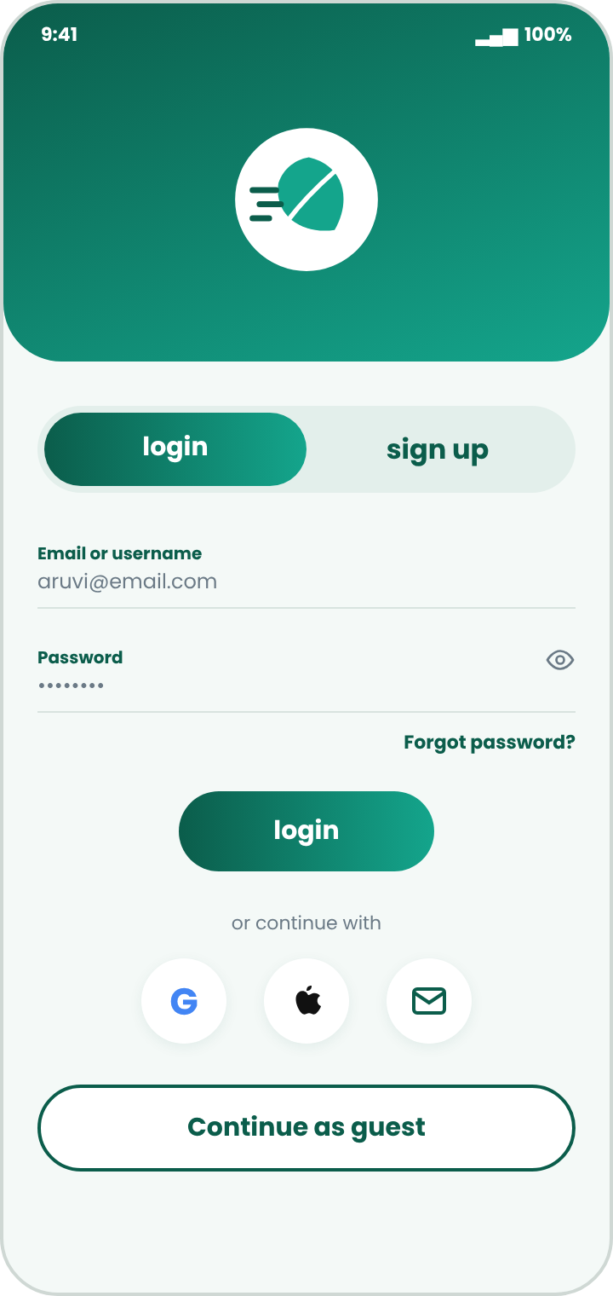
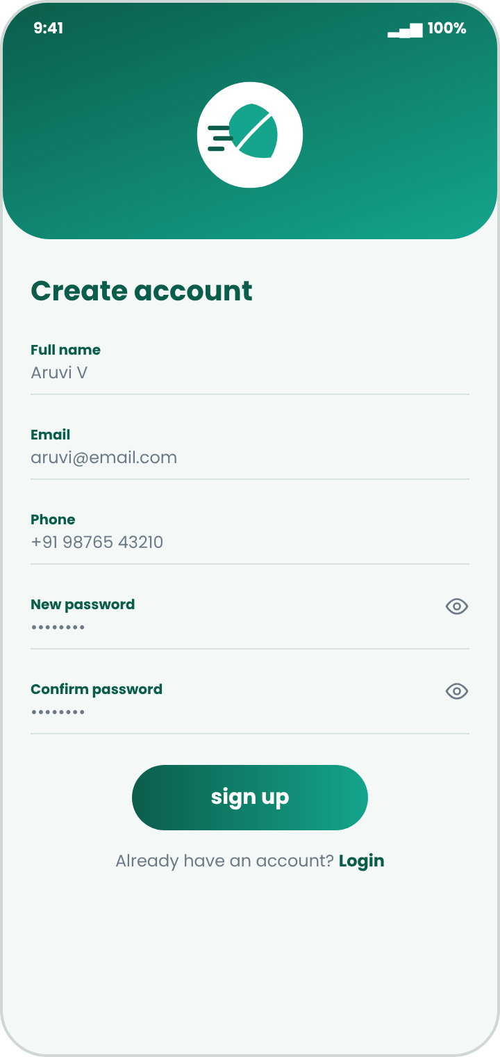
High-Fidelity Screens: Getting Started
Splash
Login
Sign Up
Home Dashboard
Guest access, social sign-in and a large colour-coded AQI gauge make the first minute simple.
Notes:
The first screens: splash, login with guest access, sign up, and the home dashboard with the live AQI gauge and pollutant cards.

Slide 10
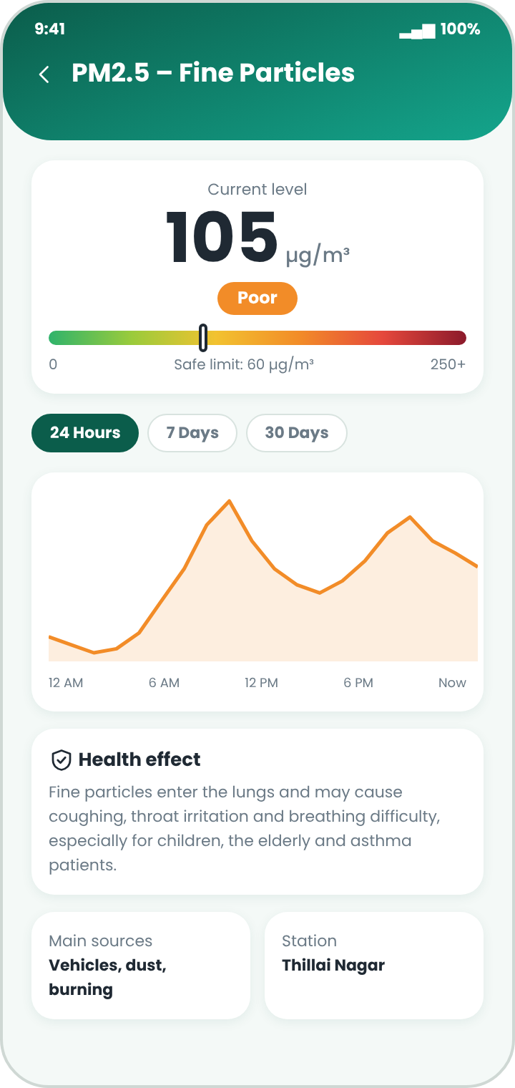
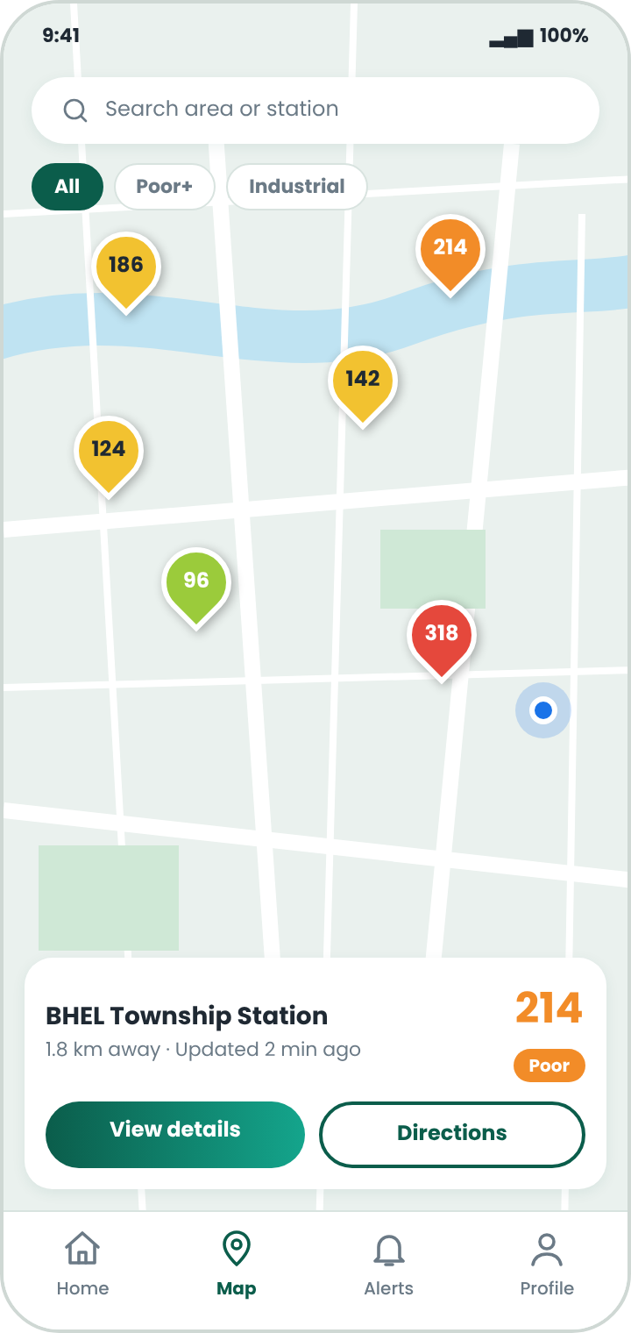
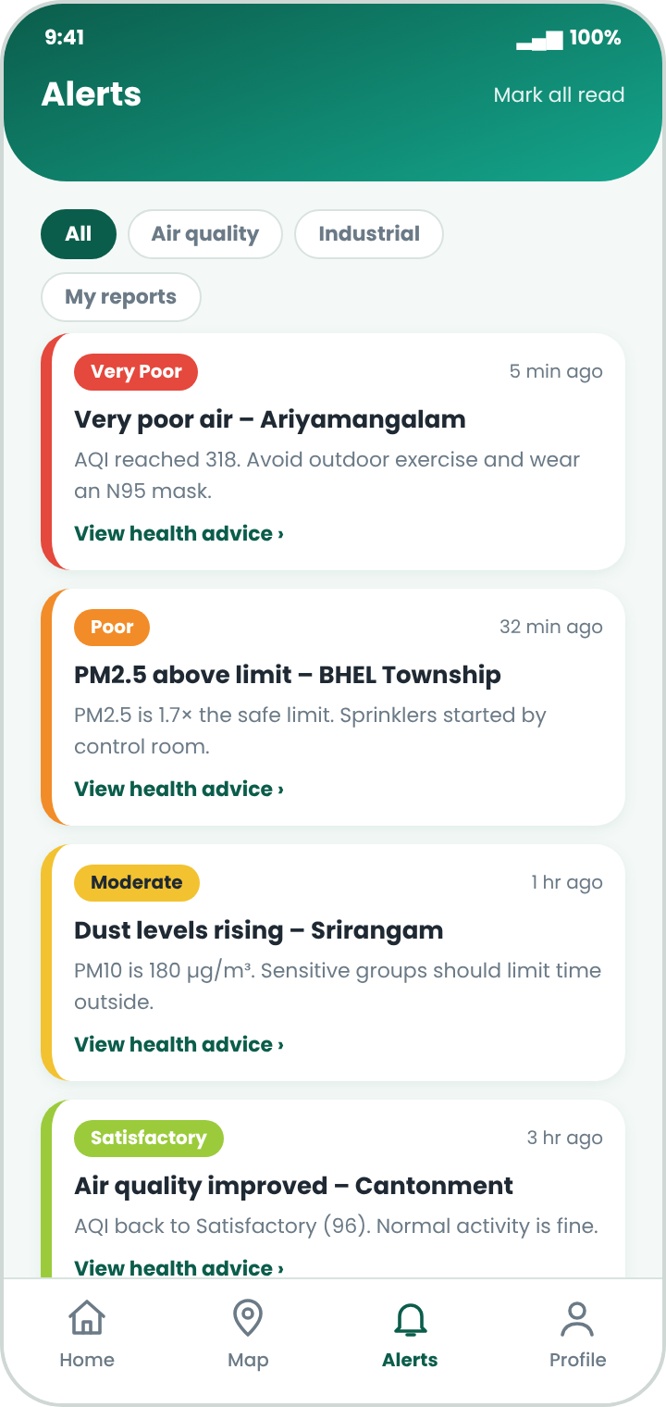
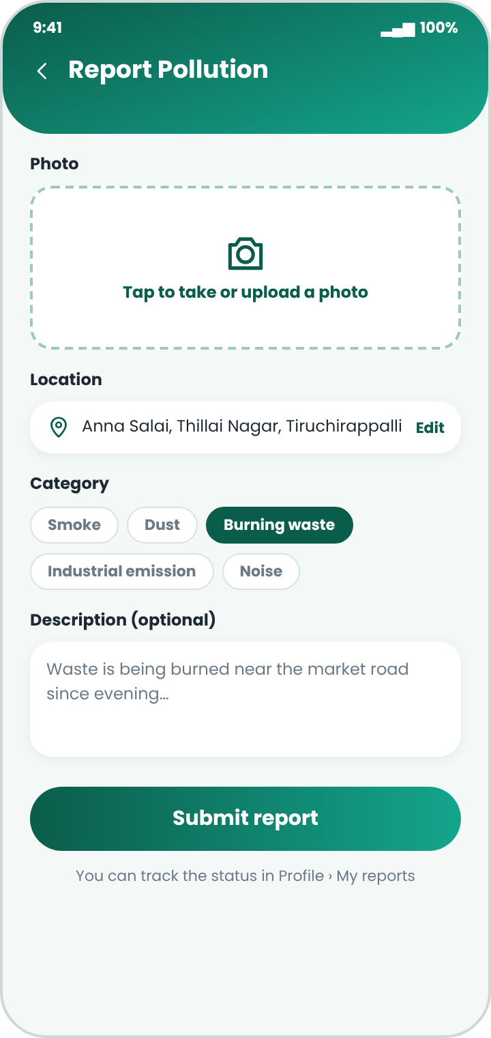
High-Fidelity Screens: Monitor and Report
Pollutant Details
Monitoring Map
Alerts
Report Pollution
Trend graphs, nearby stations, actionable alerts and three-step reporting.
Notes:
These screens help users understand pollutants, find nearby stations, read alerts and report incidents.

Slide 11
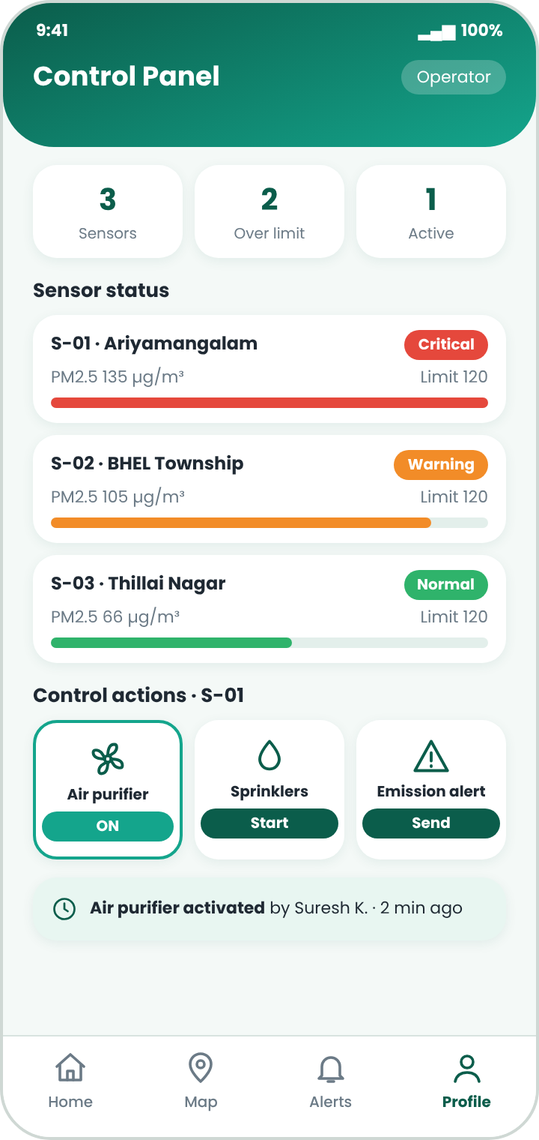
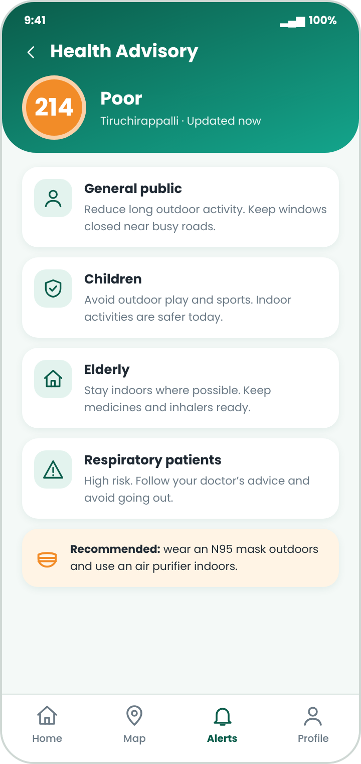

High-Fidelity Screens: Control and Advice
Operator Control Panel
Sensor status, threshold bars and confirm-before-action controls such as purifier and sprinklers.
Health Advisory
Advice for the general public, children, the elderly and people with respiratory conditions.
Control Panel
Health Advisory
Notes:
For operators, the control panel shows sensor status and requires confirmation before any action. The health advisory screen gives advice for different groups.

Slide 12
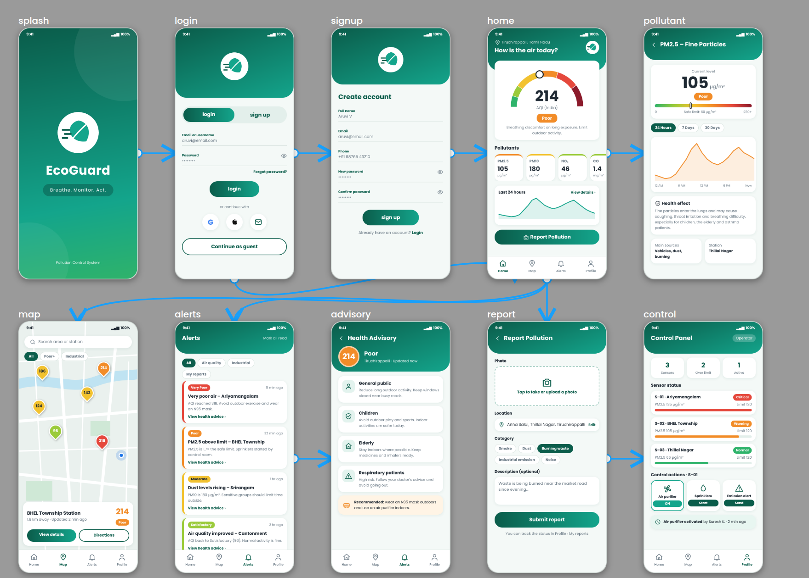


Interactive Prototype in Figma
Screen navigation
All screens connected in one journey
Alert and reporting flow
Demonstrated end to end
Journey simulation
Realistic preview for developers
Notes:
All ten screens were connected in Figma to create an interactive prototype that simulates the user journey.

Slide 13

Testing and Results
Functional testing
8 / 8
Login, guest flow, navigation, alerts, reporting and control actions
test areas passed
UI testing
Splash, Login and Sign Up
Home Dashboard navigation
Pollutant details and trends
Monitoring map
Alerts and Health Advisory
Report Pollution · Control Panel
Responsive design
Colour accuracy, readability, button size, layout and responsiveness
Usability testing
Navigation flow, design issues and ease of use
Notes:
Functional, UI and usability tests were carried out on the prototype. All eight test areas passed.

Slide 14
Conclusion and Learning Outcomes
10
7
27
screens designed
design stages
working days
SKILLS GAINED
WHAT WAS DELIVERED
User research and personas
Wireframing and prototyping in Figma
Design systems and data visualisation
Usability testing and documentation
A clear, calm and trustworthy EcoGuard interface
A reusable design system
An interactive prototype ready for developer handoff
Notes:
The internship gave me practical exposure to a full UI/UX workflow, from research to prototype and testing.

Slide 15



Future Work
AI-based pollution forecasting
Thank You
Voice queries such as “What is the air quality today?”
Personalised health alerts
Breathe. Monitor. Act.
Community reports map with upvoting
Aruvi V
810023104027
Multi-language support, including Tamil
Frontend, backend and IoT sensor integration
Notes:
Future work includes forecasting, voice queries, personalised alerts, Tamil support and real sensor integration. Thank you.

