Slide 1

FFLIP ROBO TECHNOLOGIES
HOUSING PRICE PREDICTION
Project -2
Prepared by :
ABHISHEK KUMAR

Slide 2


AGENDA
Introduction
Problem Statement
Conceptual Background of the Domain Problem
Steps involved in the modeling process
Analytical Problem Framing
Details of Dataset
Data Preprocessing
Visualization
Correlation Between different features (Heat-Map)
Model Development and Evaluation
Hyperparameter tunning and final model
Conclusion and Future scope

Slide 3

INTRODUCTION
Houses are one of the necessary needs of every person around the globe. Therefore, the housing and real estate market is one of the markets that is one of the major contributors to the world’s economy. It is a very large market and various companies are working in the domain. Data science comes as a very important tool to solve problems in the domain to help the companies increase their overall revenue, profits, improve their marketing strategies, and focus on changing trends in house sales and purchases.
A US-based housing company named Surprise Housing has decided to enter the Australian market. The company uses data analytics to purchase houses at a price below their actual values and flip them at a higher price. For the same purpose, the company has collected a data set from the sale of houses in Australia. The data is provided in the CSV file below.

Slide 4

Problem Statement
Buying a house is a stressful thing in current world.
Buyers are generally not aware of factors that influence the price of house prices.
It is a very large market and various companies are working in the Industry. Data science comes as a very important tool to solve problems in the field to help the companies increase their overall revenue, profits, improve their marketing strategies, and focus on changing trends in house sales and purchases.
Predictive modelling, Market mix modelling, and recommendation systems are machine learning techniques used to achieve the business goals for housing companies. Our problem is related to one such housing company
We are required to build a model using machine learning. This model will then be used by the management to understand how exactly the prices vary with the variables. They can accordingly manipulate the strategy of the firm and concentrate on areas that will yield high returns. Further, the model will be a good way for the management to understand the pricing of a new market.

Slide 5


They believe that housing prices depend upon:
The square foot area
Neighbourhood
The no. of bedrooms
Area in the city
But it depends upon many factors also Such as:
No. of storeys.
Area outside the house.
Rooms on one floor.
Age of house.
AGE
Square foot area
Floors
House price
No. of Rooms

Slide 6

Conceptual Background of the Domain Problem
A US-based housing company named Surprise Housing has decided to enter the Australian market. The company uses data analytics to purchase houses at a price below their actual values and flip them at a higher price. For the same purpose, the company has collected a data set from the sale of houses in Australia.
The company is looking at prospective properties to buy houses to enter the market. You are required to build a model using Machine Learning to predict the actual value of the prospective properties and decide whether to invest in them or not. For this company wants to know:
Which variables are important to predict the price of a variable?
How do these variables describe the price of the house

Slide 7

STEPS INVOLVED IN THE MODELLING PROCESS
The steps involved in the process are:-
Importing the required packages into our python environment
Importing the house price data and doing some EDA on it
Data Visualization on the house price data
Feature Selection & Data Split
Modelling the data using the algorithms
Evaluating the built model using the evaluation metrics

Slide 8

Analytical Problem Framing
As we have provided with two sets of data, one is for train and another test dataset. Here we need to build a machine learning model using train data set and then by using that model we will make predictions for the test data set.
Both the data sets are in CSV format, the training dataset has 11638 rows and 81 columns, and the test data set has 292 rows. Here for similar processing of both the datasets I will combine both the data sets and will do EDA, skewness treatment, data pre-processing, and other necessary steps.
And as we have to predict house prices in this problem so we will be using different regression models.

Slide 9
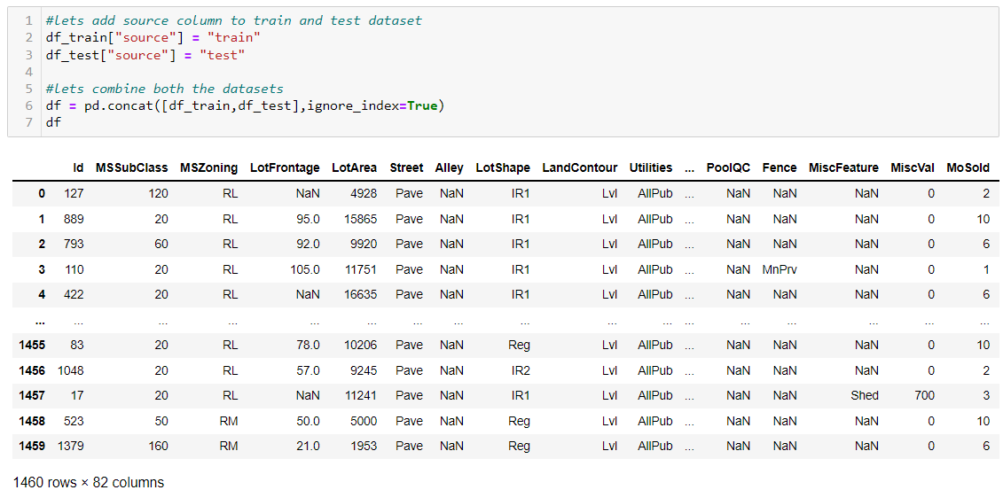

Data Sources
Here we have provided train and test data sets separately which are in CSV format.
Train data set is having 1168 rows and 81 columns and the test data set is with 292 rows and 80 columns. I have combined both of these data sets for EDA and equal data pre-processing for both. We will build a machine learning model using train data to predict the ‘Sale-Price’ of houses and by using this model we will predict the house price for the test data set.

Slide 10
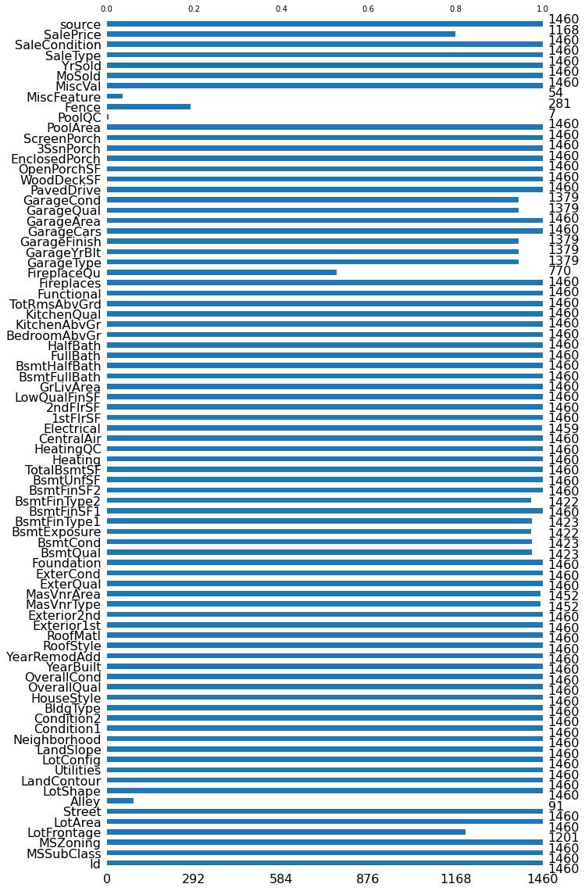
Missing values
Looking at the above figure we can say that our data is having a large number of missing values. And there are many ways to fill these values. I will drop some columns which are having more than 80% of missing values.
Missing values from some categorical columns which are many null values have been replaced by ‘None’. Missing values from numerical columns which are having a large number of null values are replaced with ‘0’.
And for columns are having fewer missing values I have replaced categorical data with mode and numerical data with the mean of that particular column.

Slide 11

DATA PRE PROCESSING
Data pre-processing is a very important process of preparing the raw data and making it suitable for a machine learning model. It is the first and crucial step while creating a machine learning model. I have used the following pre-processing steps
Filling or Treating Missing values
Handling Multicollinearity
Outliers treatment (Replaced outliers with percentile method)
Encoding (using Ordinal Encoder)
Scaling (Standard Scaler)
Skewness treatment

Slide 12
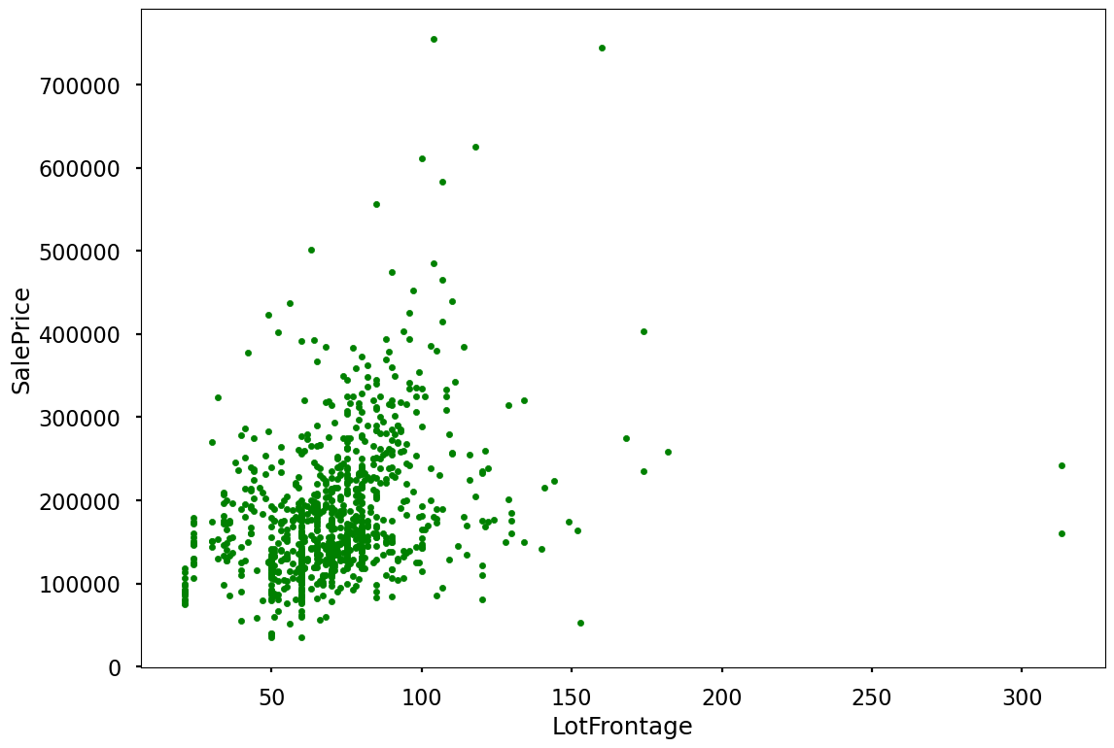
Visualization
To analyze the relationship between our features and the target variable I have done EDA to know the contribution of various features to the prediction. And got to know that which are the important features and which are not much. For EDA I have used different plots like distribution-plots, scatter-plots, box-plots, strip-plots, heat-map, etc.
This graph is showing the scatterplot Lot Frontage vs sales price
And if the linear feet of street-connected to the property is more the sales price is higher.

Slide 13
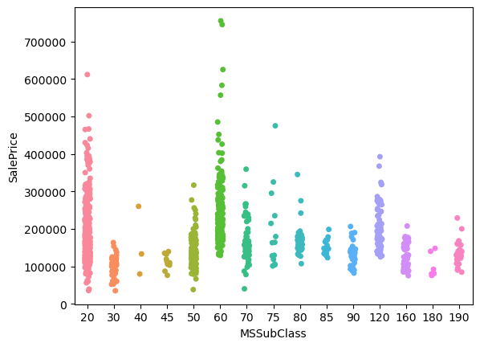
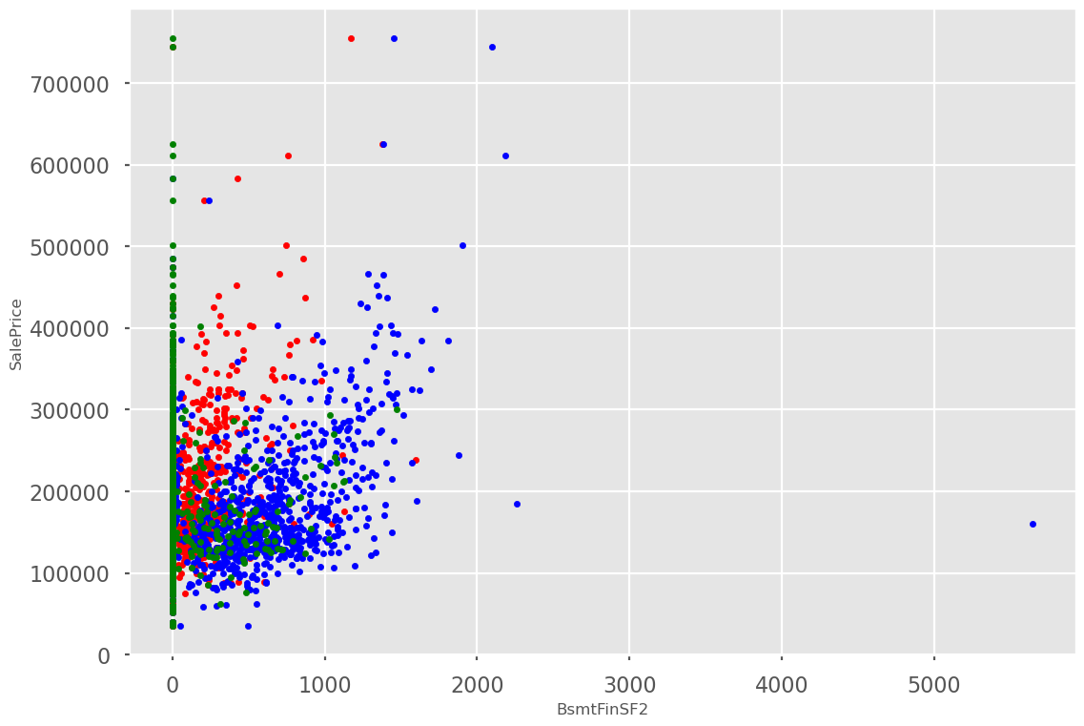
Looking at the first strip plot we can say that more MS Sub Class are 20 and 60 and have higher sale prices also.
The second scatter plot represents the relation for Mas Vnr Area, BsmtFinSF1, BsmtFinSF2 vs Sale Price.This will tell us that as the Masonry veneer area increases the price of the house also get higher.
And if the house is with more area of type 1 finished the price is higher. There are less number of houses with type 2 finish as the area for type two is given zero for most houses.

Slide 14
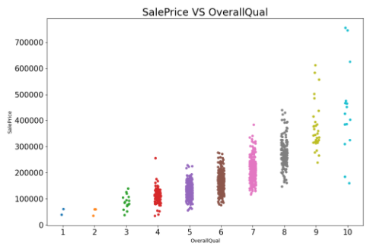
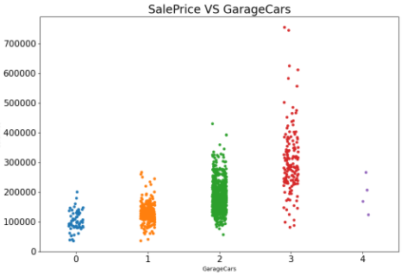
the First plot is showing the relation between overall quality and the sale price of the house. We can see there is a good linear relation between OverallQual and SalePrice, that is as quality increases the price of the house also gets higher.
The second plot will represent the strip-plot for GarageCars vs SalePrice. The sales price of a house increases with the Size of the garage in car capacity. But as the size of the garage increases beyond 3 the price comes down

Slide 15
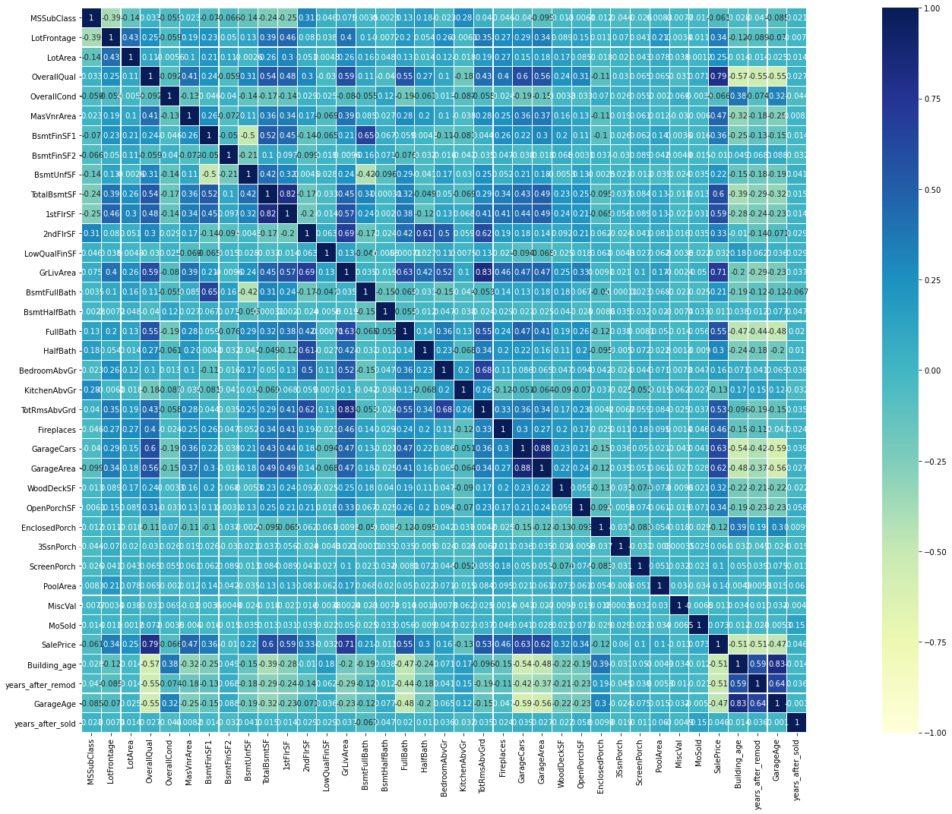

Correlation Between different features (Heat-Map)

Slide 16
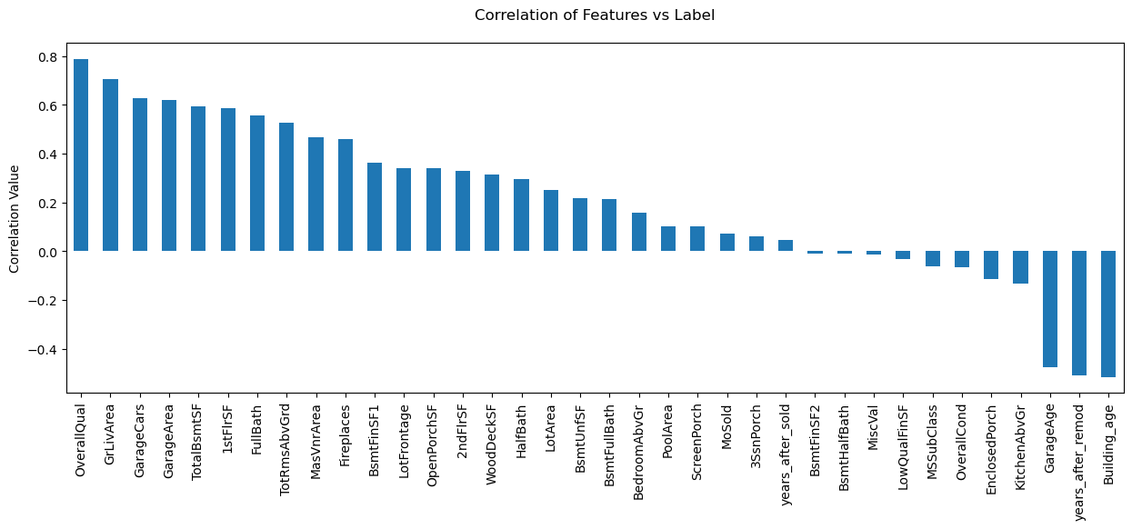
Features Vs target variable Features Vs target variable
Looking at the correlation heat map we can say that many features are in good correlation with our target variable and also many features are having very poor relation with the target variable. The columns derived from year data are having negative relation with Sales Price.
The above plot shows us the relation or contribution of various numerical features with our target variable.
Features like overall quality, grlivArea, GarageCars, garage area are having maximum positive relation with the target variable and features like building age, years_after_remod, GarageAge are in negative relation with the target variable

Slide 17

Model Development and Evaluation
For this project we need to predict the prices of houses, which means our target column is continuous so this is a regression problem. I have used various regression algorithms and tested them for prediction. By doing various evaluations I have selected Random Forest Regressor as the best suitable algorithm for our final model as it is giving good r2-score and the least difference in r2-score and CV-score among all the algorithms used, other algorithms are also giving me better accuracy but some are over-fitting and some are with an under-fitting problem which may be because of less amount of data
For getting good performance as well as accuracy and to check my model from over-fitting and under-fitting I have used K-Fold cross-validation.
I have used the following algorithms and evaluated them
Extra Tree Regressor
Random Forest Regressor
Decision Tree Regressor
Light GBM
Linear Regression
XGB Regressor

Slide 18
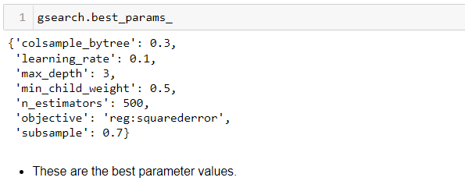
Hyperparameter Tuning
I have done hyperparameter tuning for 'XGBoost Regressor model' for the parameters like 'learning_rate' , ‘max_depth’, 'min_child_weight', 'subsample', 'colsample_bytree', 'n_estimators' and 'objective' using GridSearchCV.
After running the code for the above-mentioned parameters, I got the values that are indicated in the above figure as the best parametric values for our final model.

Slide 19
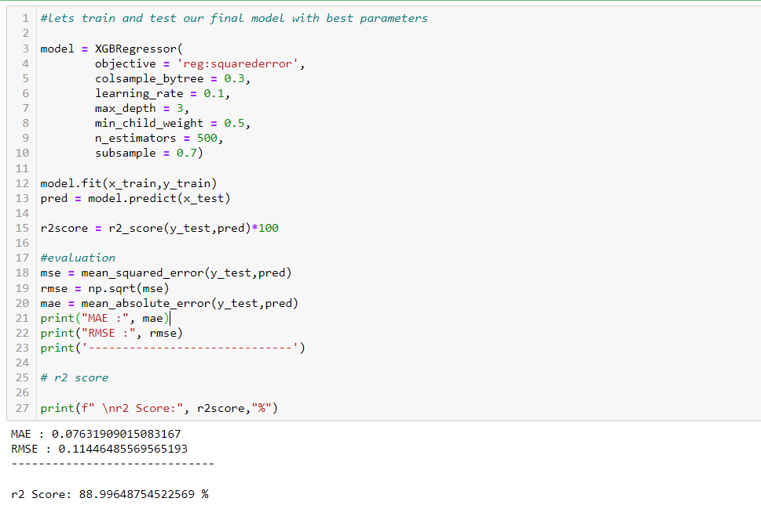

Final Model
Great! We have got improved our accuracy from 85.90% to 88.99% after Hyperparameter tuning

Slide 20
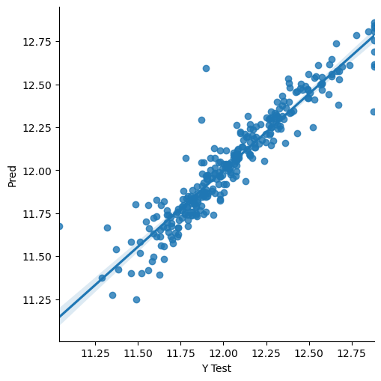

Let’s see the final Actual Vs Predicted sample
By looking at the above graph we can say our model is performing better now. So I will use this model for predicting the house prices using test data set.

Slide 21

Conclusion and Future scope
During this project I have faced the problem of less amount of data, We can improve the model accuracy with a large amount of data. And many columns are with same entries more than 80% of rows this will lead to a reduction in our model performance.
One more issue is there are a large number of missing values present in this data set, so we have to use correctly fill those missing values.
Column "OverallQual" is having highest (79%) correlation with target variable followed by the columns: 'GrLivArea'(71%), 'GarageCars'(63%) & 'GarageArea' (62%).
Column 'GarageArea' is highly correlated (88%) with column 'GarageCars’.
Column 'GarageAge' is highly correlated (83%) with column 'Building_age’.
column 'TotRmsAbvGrd' is highly correlated (83%) with column 'GrLivArea’.
'XGBoost Regressor model' is our best-fitting model.
After tunning the model, we got almost 90% of accuracy.
We can still improve our model accuracy with some feature engineering and by doing some extensive hyperparameter tuning.

