Slide 1
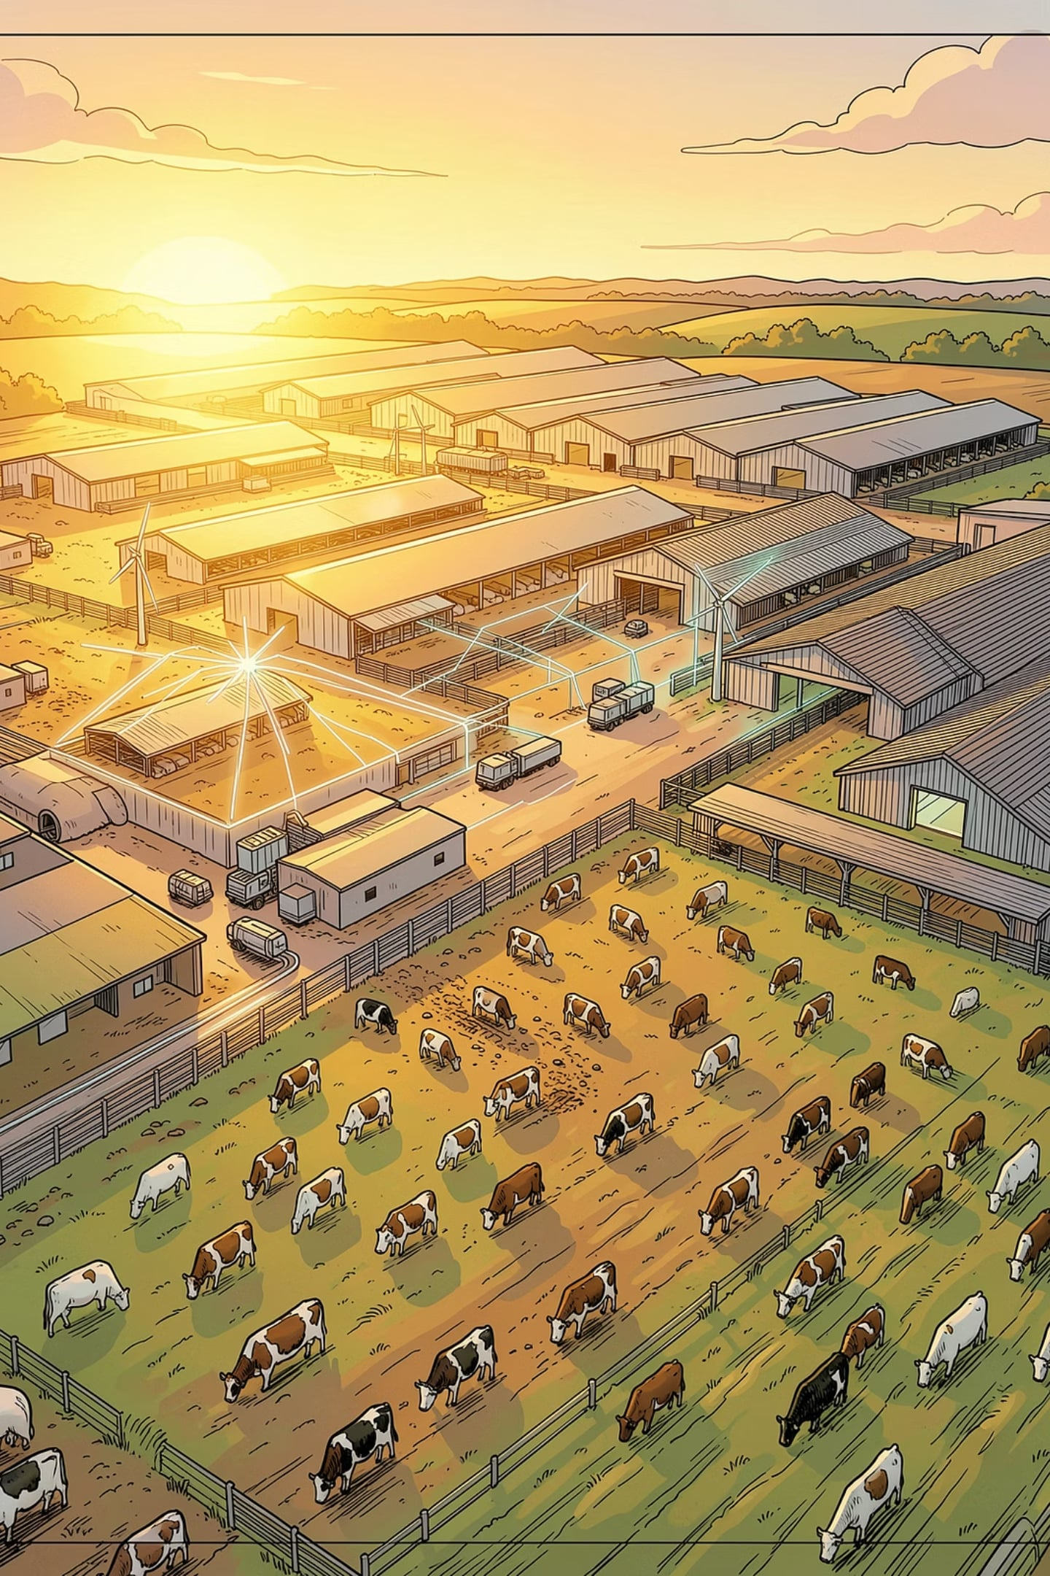
ARVELA
Building the Intelligence Layer for the Physical World
AI-native operational intelligence for traditional industries — starting with livestock.

Slide 2
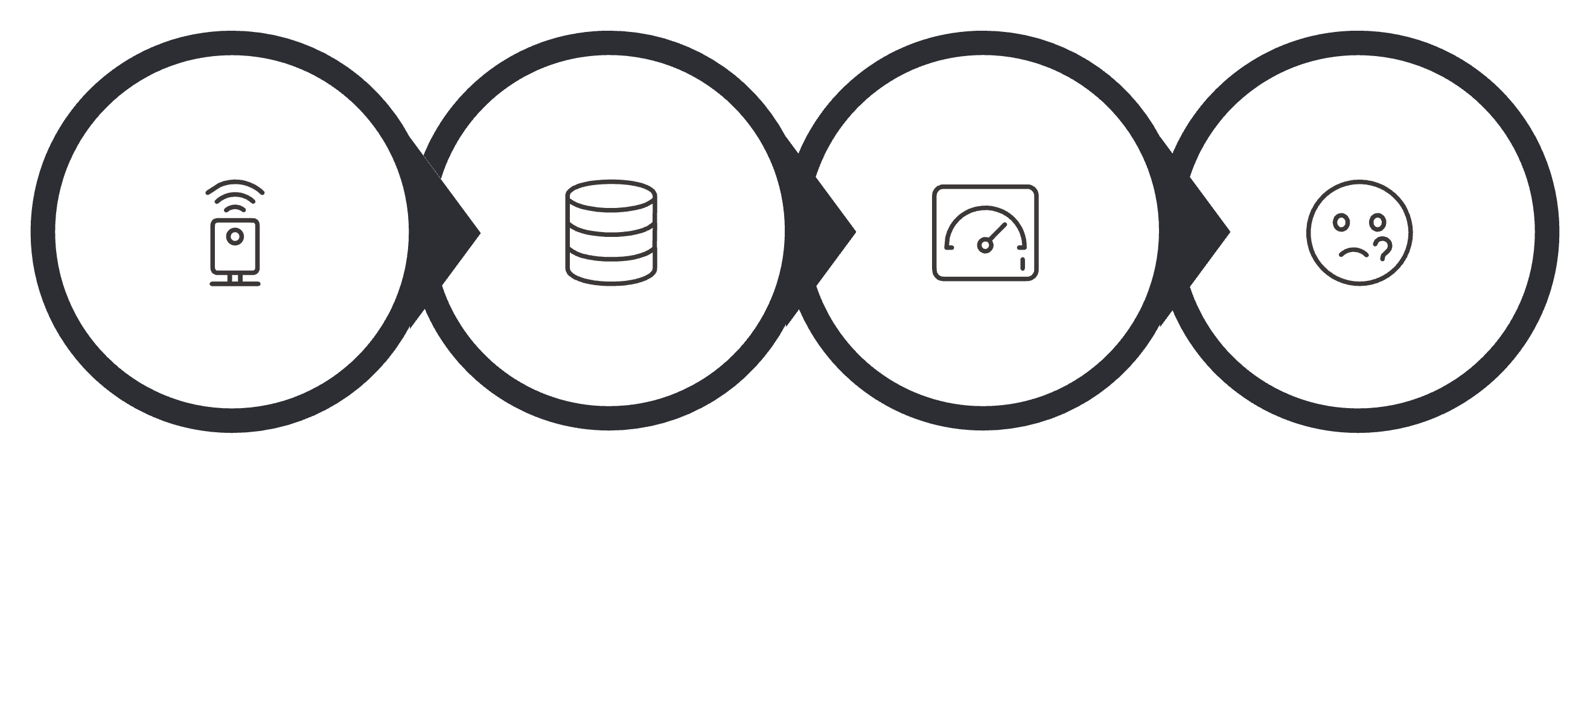
The Problem
Traditional industries generate enormous amounts of data — yet still make decisions with limited information. Farms already collect from GPS collars, RFID, boluses, weather stations, satellites, and IoT devices. The data exists. It's just disconnected.
Many Sensors
Many Systems
Many Dashboards
No Better Decisions
The result: more data, more complexity, and no meaningful improvement in decision-making.

Slide 3

The Opportunity
Operational data is becoming the world's largest untapped asset. AI changes everything — shifting industries from reactive monitoring to predictive action.
Reactive
Monitor assets. Respond to events after they happen. Manual decisions. Lost value.
Predictive
Anticipate risks. Automate decisions. Optimize operations. Capture value.

Slide 4

Our Solution
ARVELA is an AI-native Operational Intelligence Platform. We don't replace existing technologies — we connect them.
Understand Context
Predict Outcomes
Correlate signals to reveal current state.
Forecast risks and future performance trends.
Integrate Data
Recommend Actions
Connect systems and ingest operational streams.
Prescribe prioritized steps to resolve issues.
The platform continuously integrates operational data, understands what is happening, predicts what will happen, and recommends what should happen next.

Slide 5





First Market: Livestock
Livestock is the ideal entry point — low digitalization, high complexity, massive IoT adoption, and clear ROI. A single farm with 250 animals generates thousands of daily events. One intelligent platform makes sense of all of them.
Low Digitalization
High Complexity
High Economic Impact
Massive IoT Adoption
Clear ROI

Slide 6
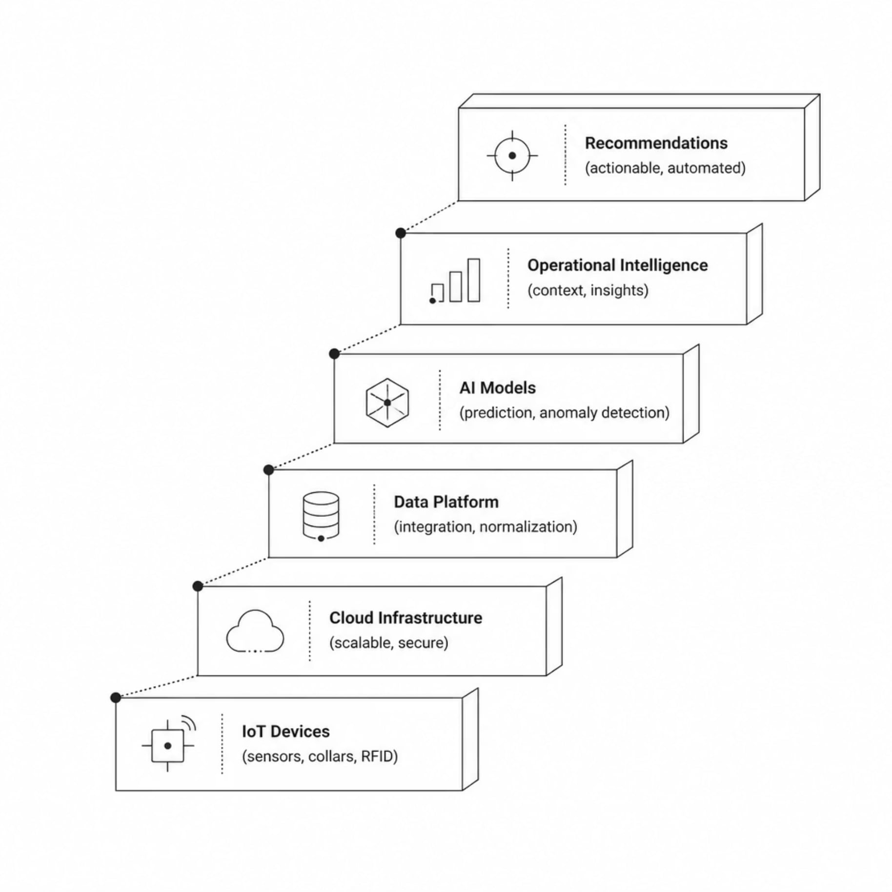

Technology Architecture
ARVELA's stack is built from the ground up for operational environments — purpose-built for the physical world, not adapted from enterprise software.
Every layer is designed to handle real-world data complexity at scale.

Slide 7

Competitive Position
ARVELA is hardware agnostic. We sit above existing infrastructure — delivering the intelligence layer that others cannot.
Company Type
Hardware
Software
Intelligence
GPS Companies
✓
—
—
IoT Companies
✓
—
—
Farm Management
—
✓
—
ARVELA
—
—
✓
Hardware agnostic. We integrate with any existing infrastructure — no rip-and-replace required.

Slide 8
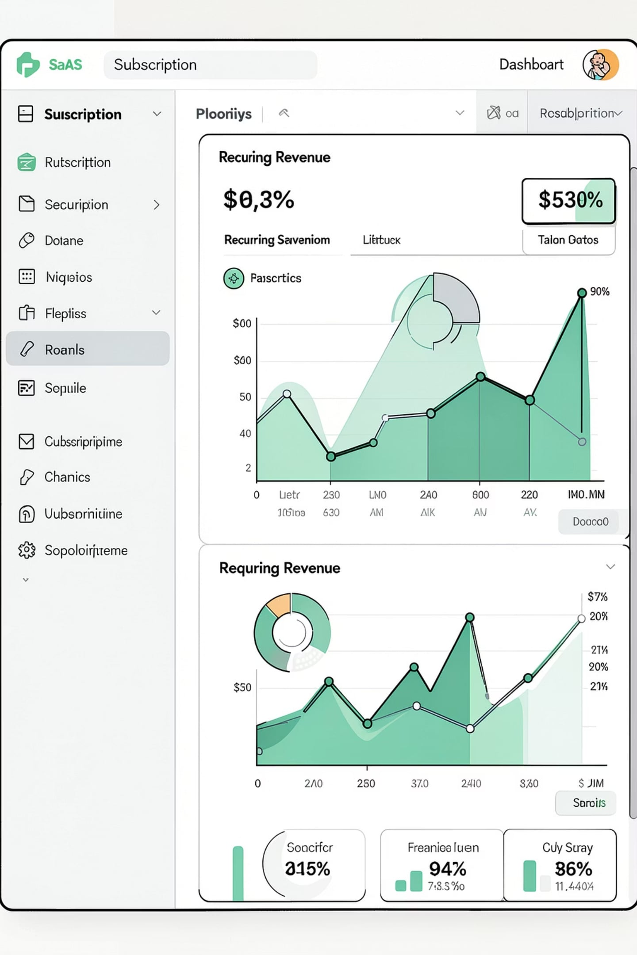





Business Model
ARVELA operates on a recurring SaaS model — software scales, hardware doesn't. Multiple revenue streams ensure resilience and growth.
Subscription
Core platform access with tiered pricing by farm size
Premium AI
Advanced predictive models and automation features
Enterprise
Custom deployments for large operators and cooperatives
API & Marketplace
Third-party integrations and professional services

Slide 9
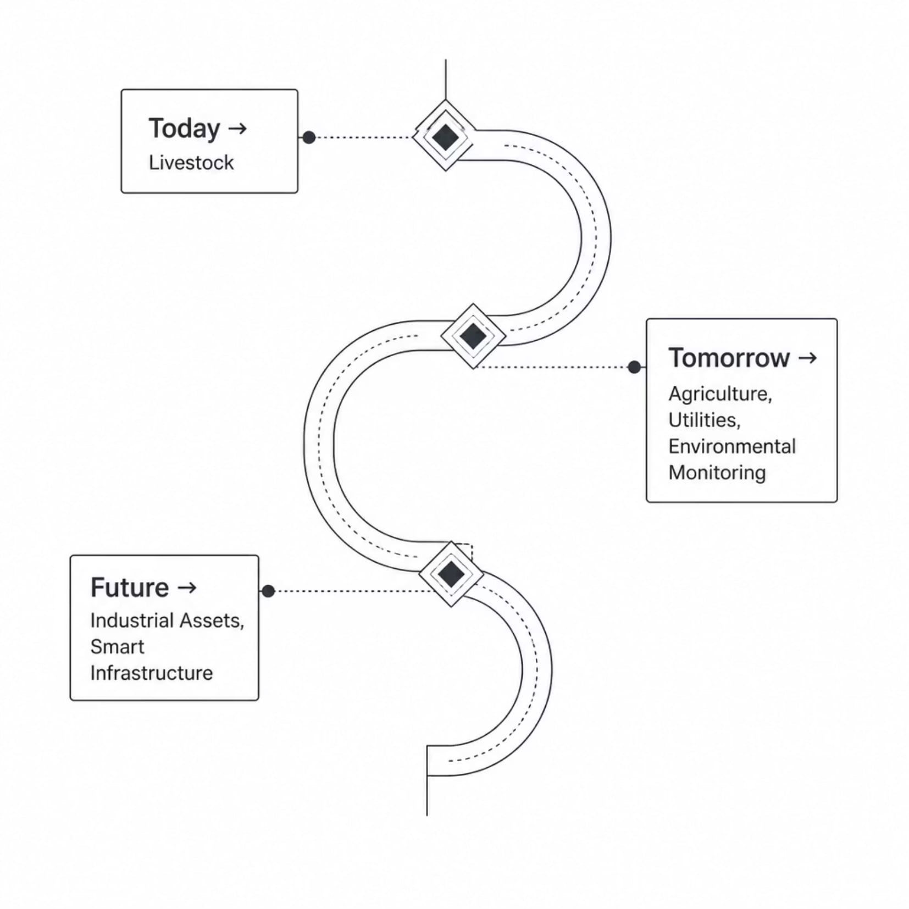

Market Vision & Why Now
Platform Expansion
One platform. Multiple industries. ARVELA starts in livestock and scales across every data-intensive physical operation.
The Timing Is Perfect
AI Maturity
Predictive models are production-ready
IoT Adoption
Sensor costs have dropped dramatically
Cloud Infrastructure
Scalable, affordable compute everywhere
Sustainability Pressure
Regulatory and market demand for efficiency

Slide 10
Traction & Team
Where We Are
The Team
01
Sergio — Founder
Company Founded
Software Engineering & Cloud
Artificial Intelligence
Enterprise Technology
University Lecturer
MVP architecture and technology roadmap defined
02
Market Validation
Building the intelligence layer for the physical world.
Meetings with Ministry, ASAJA, and hardware partners
03
Pilots Preparing
IMIDRA application submitted, first deployments in progress
Start with livestock. Scale everywhere.

