Slide 1
Analysis of Data Available From Field Vehicles Over Cloud Arvendra Singh Kushwah GTE Intern’22 Mentor- Vaibhav S Gunjal Assistant Mentor - Kshatresh Mishra

Slide 2
S. N. | Content | Slide
1. | Project Summary | 3
2. | Importance of EV Data Analysis | 4
3. | Literature Review | 5
4. | Feature 1 : Predicting Energy Consumption per Kilometre | 6
5. | Feature 2 : Predicting SOH of Motor | 20
6. | Designing GUI | 24
6. | Future Prospects | 28
7. | References | 29

Slide 3
Project Summary
Objective: Prediction for maintenance, life and combined parameters for vehicle health etc., to be shown to user to optimise vehicle usage w.r.t. range/efficiency etc.
Project Timeline
Week 1: | Induction and brief discussion over the project
Week 2: | Literature review on vehicle CAN architecture
Week 3: | Research on existing data analysis tools of EV vehicles and their vast applications
Week 4: | Predicting Energy Consumption per kilometre using Regression
Week 5&6: | Predicting Energy Consumption per kilometre using Classification
Week 7&8: | Predicting SOH of Motor
Week 9: | Designing GUI

Slide 4
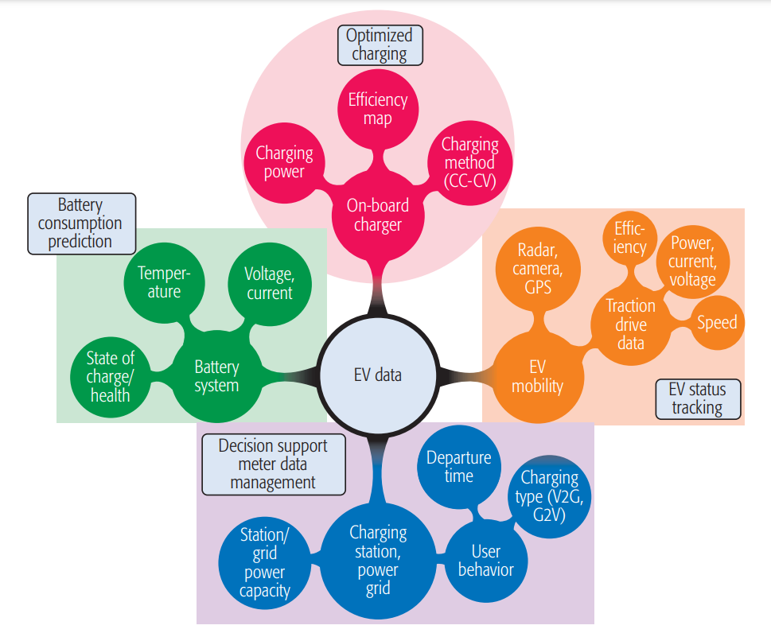
Importance of Data Analysis
The vast data that comes from the communication between the components of EV vehicle has a huge potential.
There are many uses of this big data such as
status tracking
optimized charging
efficient battery management
in increasing the range
in setting up of EV charging stations according to demand
achieving complete automation.
All these features will attract the consumers to EVs, and make the process of EV integration in our society smoother and the world more greener.

Slide 5
Literature Review
Explored the basic EV architecture, CAN architecture, and data it sends over to the cloud through Telematics
Examined different methods to classify and analyse this data in a manner which will be useful for the project
Scrutinized features which are more beneficial, imperative and implementable using the CAN data

Slide 6
Feature 1
Predicting Energy Consumption per Kilometre

Slide 7
Predicting Energy Consumption per Kilometre
Currently a user only gets to know that how much distance his vehicle covered from a fully charged battery (range of vehicle).
He will only notice something is wrong when there will be significant change like 5-10 kms in range of the vehicle.
By that time, there might be some damages which could have been prevented if noticed ahead of time.
Our goal here is to alert the user about even the smallest drop in efficiency of the vehicle
And to let him decide if the drop is caused by some factor which he changed during his drive like load etc.
Or else there is some thing wrong with vehicle and it is in need of service.

Slide 8
How we will be doing it?
We will predict the energy consumption per kilometre by studying a user’s drive pattern.
We are going to use the data that a Bajaj’s EV sends to cloud through telematics.
We get a lot of data that goes through CAN bus in a EV over to cloud.
We will extract the data that we will be needing to study a drive pattern.
For now we are only taking readings of vehicle speed in kmph, Voltage and current readings of the battery and ambient temperature, all with the time stamps

Slide 9
First Approach
Using ML Regression model

Slide 10
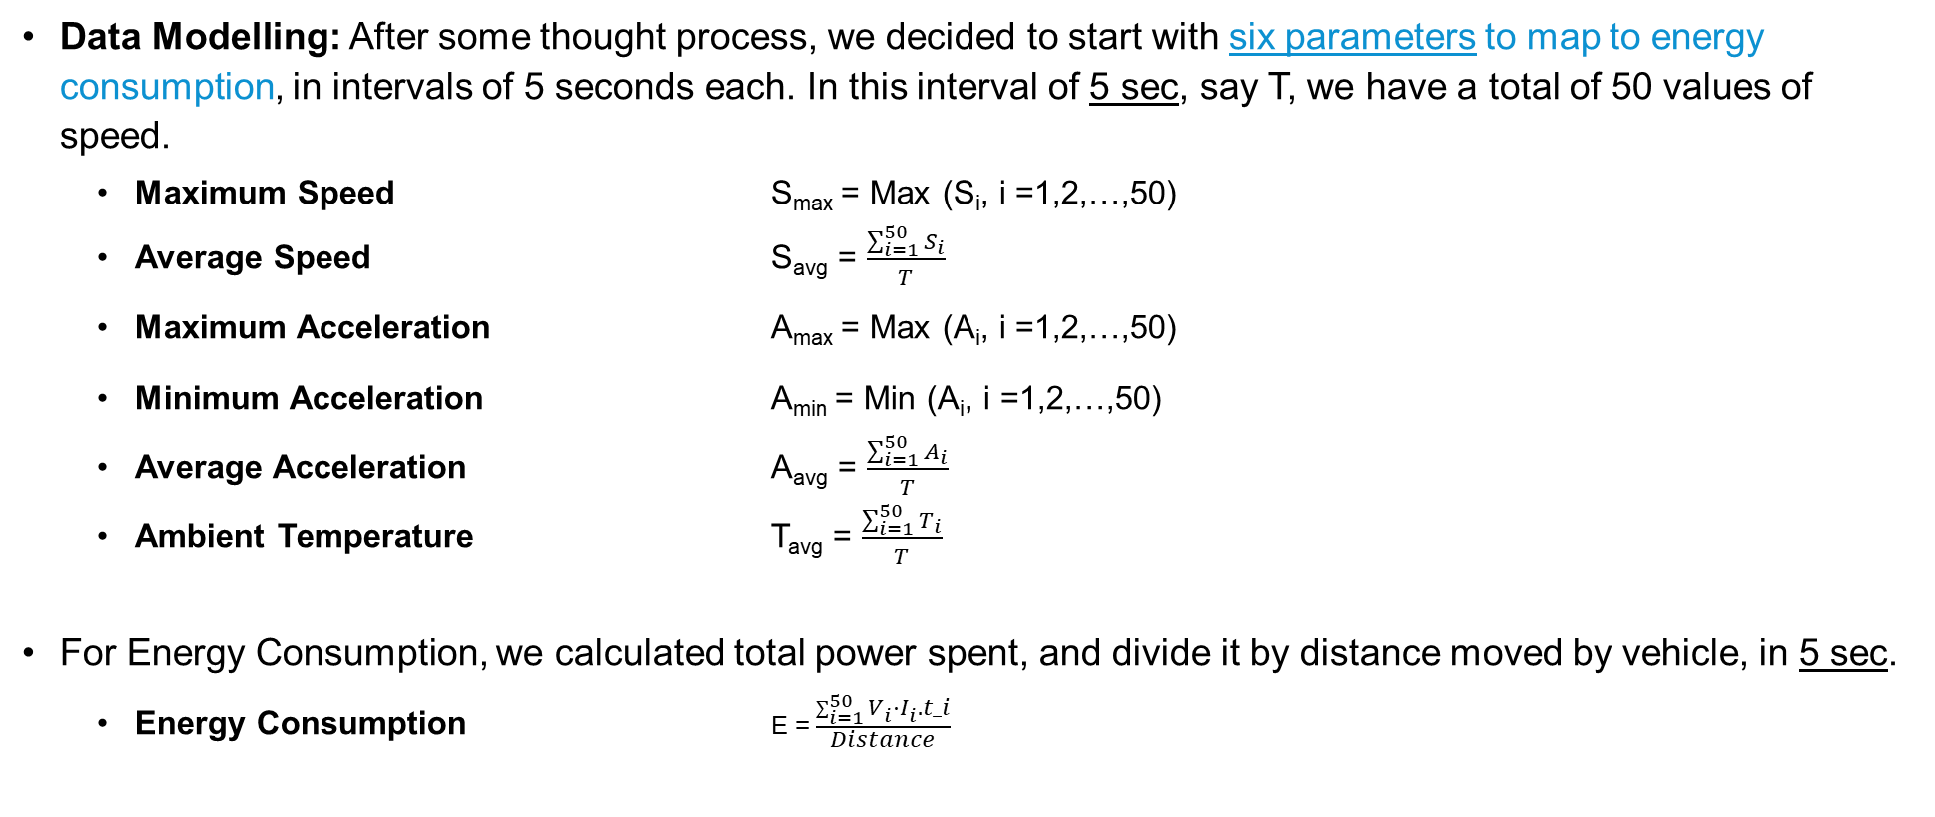
Data Modelling
Data Modelling: After some thought process, we decided to start with six parameters to map to energy consumption, in intervals of 5 seconds each. In this interval of 5 sec, say T, we have a total of 50 values of speed.
Maximum Speed S_{max} = Max (S_{i}, i =1,2,…,50)
Average Speed S_{avg} = $\frac{\sum_{i=1}^{50}{S_{i}}}{T}$
Maximum Acceleration A_{max} = Max (A_{i}, i =1,2,…,50)
Minimum Acceleration A_{min} = Min (A_{i}, i =1,2,…,50)
Average Acceleration A_{avg} = $\frac{\sum_{i=1}^{50}{A_{i}}}{T}$
Ambient Temperature T_{avg} = $\frac{\sum_{i=1}^{50}{T_{i}}}{T}$
For Energy Consumption, we calculated total power spent, and divide it by distance moved by vehicle, in 5 sec.
Energy Consumption E = $\frac{\sum_{i=1}^{50}{V_{i}}⋅I_{i}.t_i}{Distance}$

Slide 11
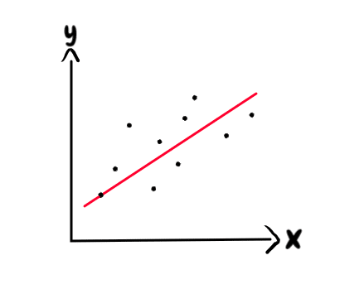
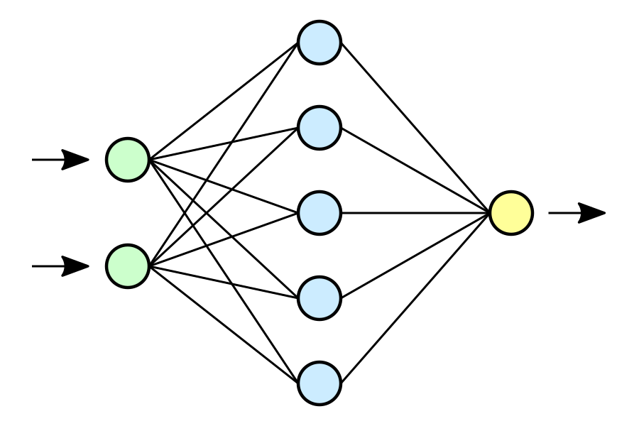
Results
Linear Regression
We first started with assuming a linear relation between our input parameters and energy consumption and developed a linear regression model.
But it only reached to an accuracy* of 52% on testing dataset
Artificial Neural Net
Then we switched to non linear regression models, and developed a Artificial Neural Network with four hidden layers and after fine tuning the model we reached the accuracy* of 84% on testing dataset
* Measured using r2 score

Slide 12
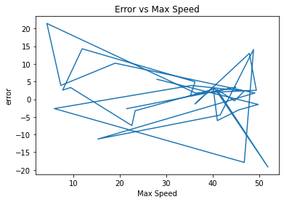
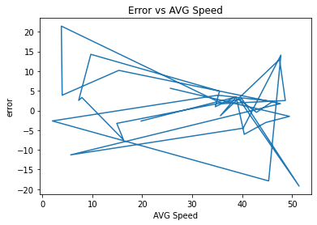
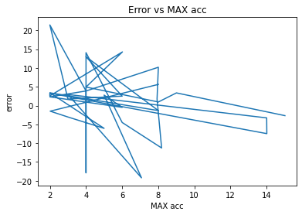
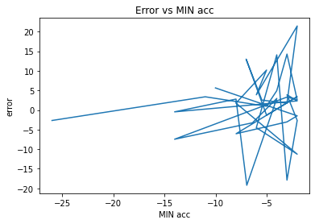
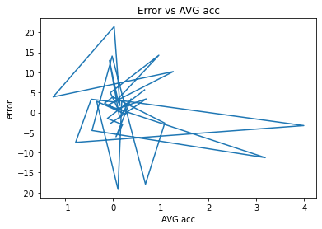
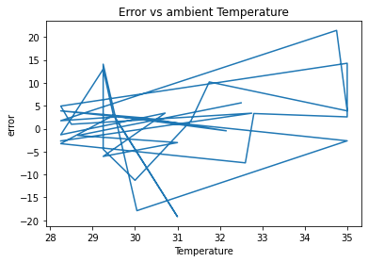
Error Analysis
Since the error has this much irregularity, even after much tuning we will not be able to bring it down to desirable range

Slide 13
Second Approach
Using Basic Classification model

Slide 14
Why use Classification?
The maximum accuracy achieved by our model using regression gets capped at 84%.
After examining our dataset with more details and concluded that using classification over regression might give us better accuracy based on the following factors:
Number of ways a person can drive a vehicle is limited excluding all practically impossible scenarios.
For a particular temperature, the mapping of input parameters over energy consumption will remain same for a fair amount of time
Hence, we can always look up the matrix storing the mapping of the limited input parameters over to energy consumption at given ambient temperature and get accurate value.

Slide 15
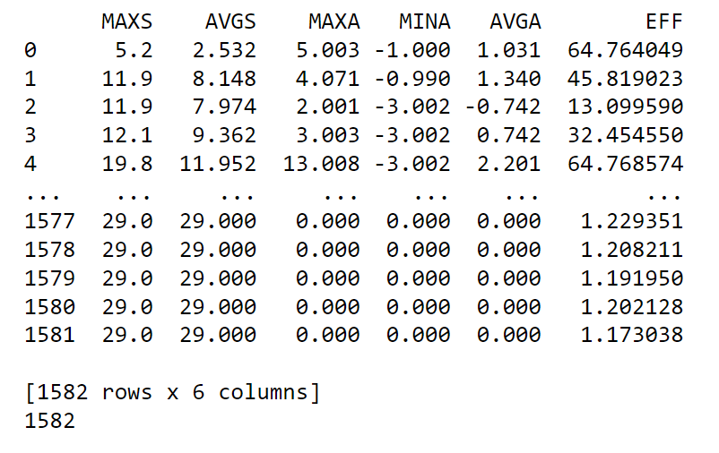
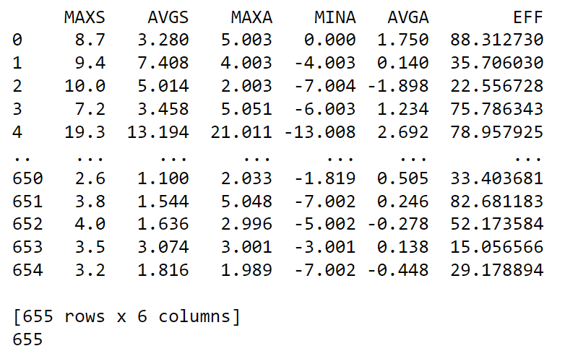
Data Modelling
We stored all five parameters and their corresponding measured energy consumed in Watt-hour per kilometre in a matrix for a given range of ambient temperature for both reference and input dataset.
Reference Dataset Matrix
Input Dataset Matrix

Slide 16
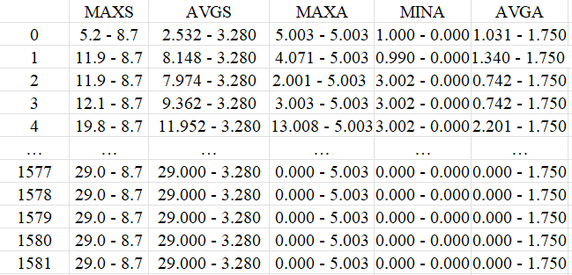
Data Modelling
Then for predicting energy consumption of each row of input matrix:
Step 1: We subtract the values in the row with respective column of the reference data set
Input Dataset Matrix

Slide 17
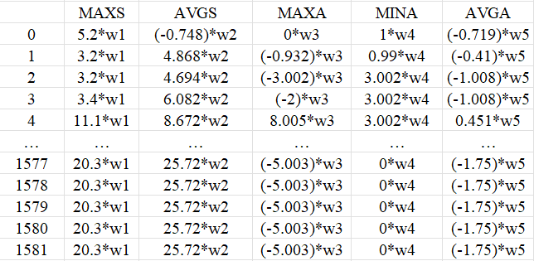
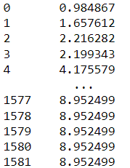
Data Modelling
Step 2: Take weighted sum of columns row wise, where weights are defined as correlation of that particular column with calculated energy consumption column.

Slide 18
Data Modelling
Step 3: Find indices of all the rows of the resultant column which have a value less than a threshold value, if there are no such rows then return the row with minimum value.
Step 4: Take average of the energy consumption values at those indices in the reference dataset.
If Threshold value = 1

Slide 19
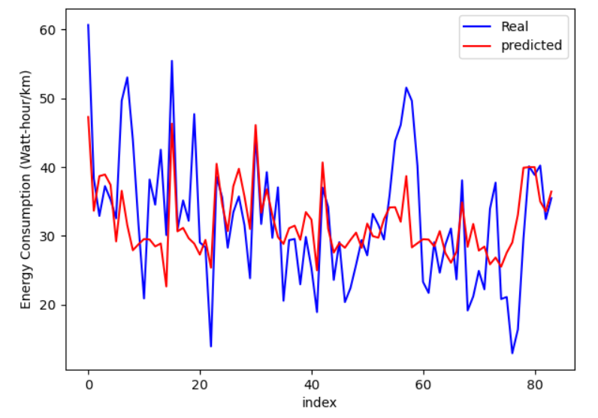
Using Classification
The moving average of 10 datapoints of real and predicted energy consumption comes out to be
The reference dataset and input dataset used here are from same vehicle.
The reference dataset have around 1600 data rows while input dataset have around 1000 rows
As we will reference dataset increases, we will be able to say with greater certainty if there is a drop in efficiency of the vehicle.

Slide 20
Automating the Process of Expanding the Reference Dataset
Create a dataset for the customer’s vehicle for drive cycles of one-week.
During this time we will not use reference dataset for prediction
After a week, this dataset is now large enough to predict for a particular temperature range
We start predicting energy consumption for new drive cycles and keep adding those in the customer’s dataset
As ambient temperature changes and leaves the temperature range, we reset the reference database

Slide 21
Feature 2
Predicting SOH of Motor

Slide 22
Predicting SOH of Motor
As of now, we have no method to know the current SOH of Motor, it is like a black box to our intelligent EV, we will only know if its faulty when it will stop working.
Our goal is to add a parameter of SOH of Motor, which we will be predicting using a similar approach as we did for predicting energy consumption.
Here SOH is simply represented by the predicted rise of temperature of motor with respect to actual rise of temperature.
For this we will be using; vehicle speed in kmph, Voltage and current readings of the battery, ambient temperature and motor temperature, all with the time stamps.

Slide 23
Data Modelling
We stored all the same five parameters now with the time intervals, ambient temperature and their corresponding measured battery temperature in a matrix, for both reference and input dataset.
Then using the same approach as we did for predicting energy consumption we predict the rise in motor temperature.

Slide 24
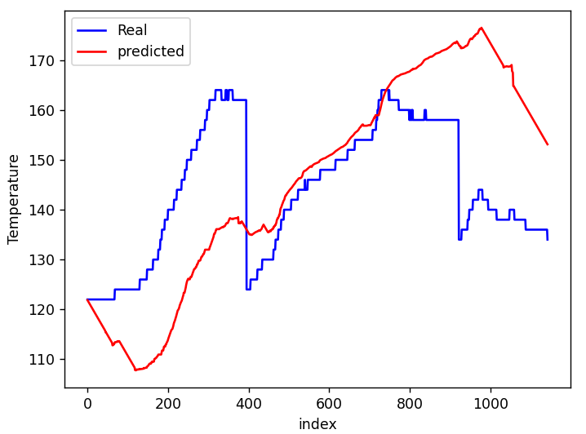
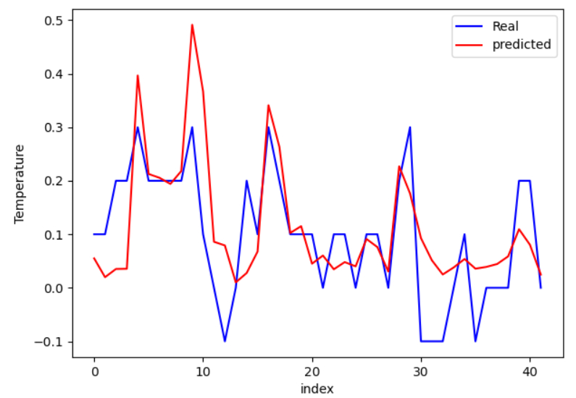
Results
As you can see that, this doesn’t accurately predict the amplitude of rise of temperature as it depends on many other factors
But we can see similarity in slope graph, because the rate of rise of temperature is a function of a drive pattern

Slide 25
Designing GUI

Slide 26
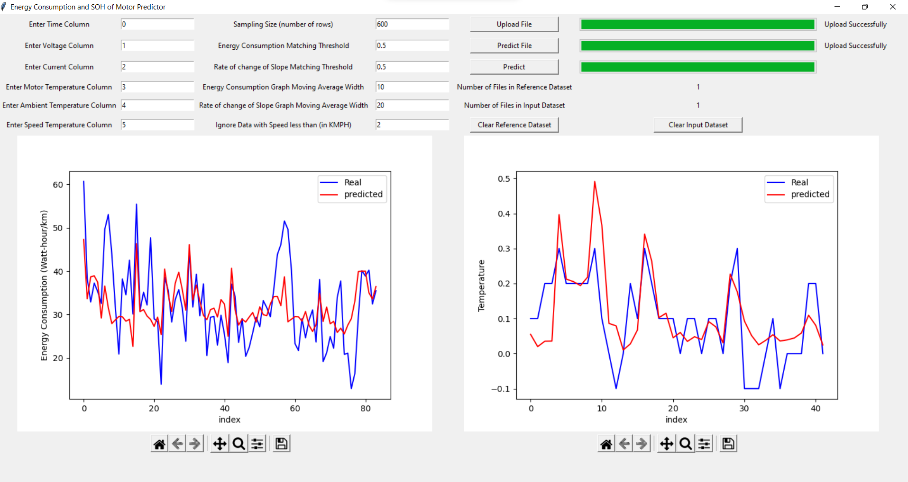
Designing GUI

Slide 27
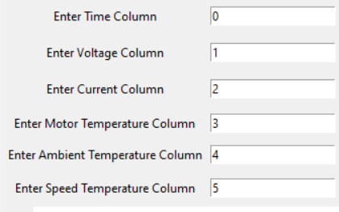
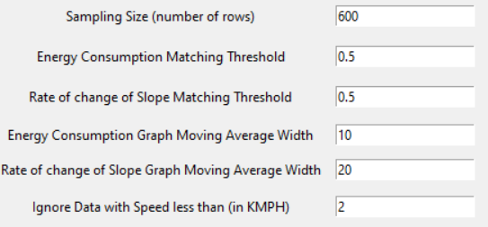
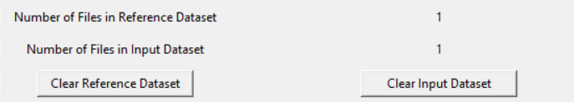
Designing GUI
These are the only six data points needed for our prediction models.
Hence we need to know before hand at what column in CSV files these data are stored.
Sampling Size is no. of rows of CSV used to generate one datapoint, generally one row has 0.02 sec time span, so for sampling over 5 sec, we will need around 500 sampling size.
When predicting, all the rows in reference datasets under this Threshold are averaged out
Moving Average parameter is to smooth out graph in smaller points for large datasets
Show number of CSV currently added in Reference Dataset and Input Dataset Respectively

Slide 28
Future Prospects
There are many more uses of this dataset and the algorithm, such as
Eliminating the use of one of the sensor for temperature at the battery as we can estimate it with high accuracy with the help of our dataset.
Suggesting a dynamic drive pattern (according to vehicle’s real time conditions) that customer can follow to maximize it’s range.
Recommend tips to the customer based on individual driving habits, to improve efficiency, range as well as lifespan of the vehicle.
We can focus on finding and developing such aspects of this dataset and implementing them.

Slide 29
References
Articles:
https://www.evnext.in/insights/2021/10/28/evs-and-big-data-analytics-customized-learning-electric-vehicle-software-digital-opportunities/
https://par.nsf.gov/servlets/purl/10047756
https://www.evnext.in/insights/2021/10/28/ev-and-iot-cloud-solutions-sensors-connectivity-database-electric-vehicle-software-digital-opportunities/
Conference Papers:
https://ieeexplore.ieee.org/document/9633348

Slide 30
Thank You!

Slide 31
Results
We will now calculate the deviation in slope graph and if it exceeds a certain threshold, we can conclude that rate of rise of temperature of motor is abnormal.
We can then club together both the results of predictions of energy consumption and SOH of battery, to say with certainty that vehicle is facing some issue and maybe in motor.

