Slide 1
ARVER distributed LUKS

Slide 2
Main Focus:
Disk-Encryption on Servers

Slide 3




Slide 4
So you just share the passwords?

Slide 6
How fast can you type all the needed passwords?

Slide 7
Wishlist

Slide 8
Per-admin rules
Key distribution
Automation
(Deniability)

Slide 9
Luks:
theDisk
Slot 1: Alice
Slot 1: Alice
Slot 2: (empty)
Slot 3: (empty)

Slide 10
alice#: arver --add-user bob theDisk

Slide 11

random LUKS key
(via SSH)
theDisk
Slot 2

Slide 12
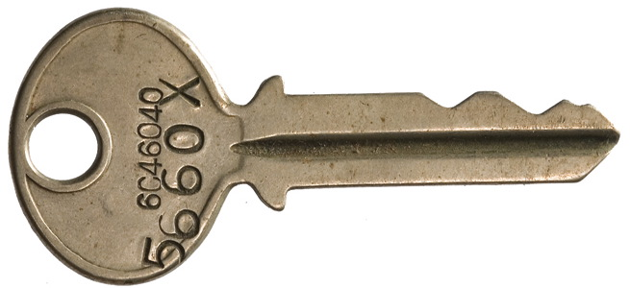


random LUKS key
Bobs GPG
PublicKey
Bobs ARVER key
for theDisk

Slide 13
random LUKS key
Bobs GPG
Publickey
Mail
Git
...
Bobs ARVER key
for theDisk

Slide 14
bob#: arver --open theDisk

Slide 15
Bobs GPG
PrivateKey
theDisk
Slot 2

Slide 16
Per-admin rules
Key distribution
Automation
(Deniability)

Slide 17
https://git.codecoop.org/projects/arver

