Slide 1

Speech Feature Extraction
CC - MFCC
Aman Ranjan Verma
1500212

Slide 2
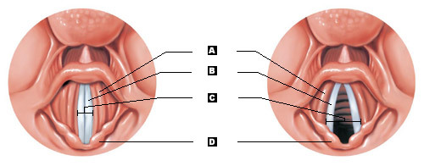
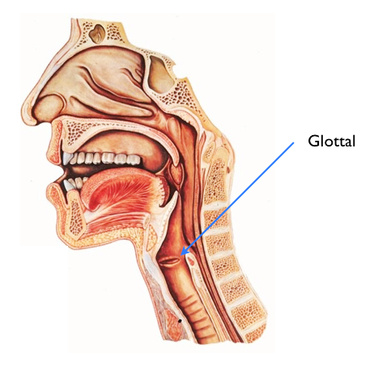
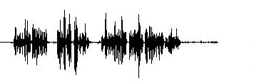
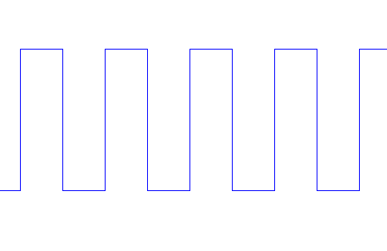
Cepstral Transform Coefficients (CC) Parameters extraction
h[n]
S[n]
e[n]

Slide 3
Why Vocal track ?
With the same excitation as input human being can produce different speech sound.
It means:
Different shape of vocal track produce different speech signal.
So, aim is to find out actual representation of the vocal track h[n] using e[n] and s[n].
e[n]
h[n]
S[n]

Slide 4
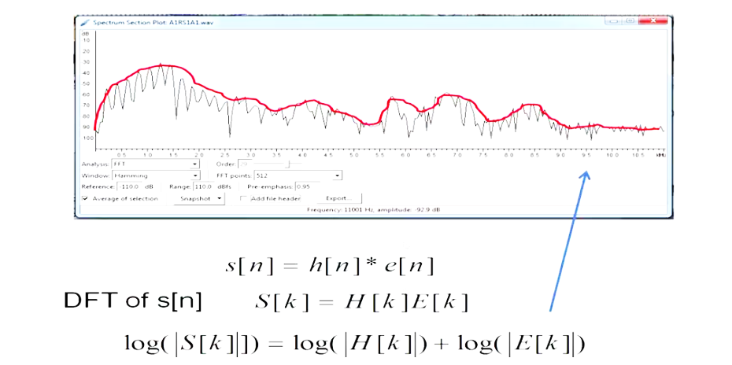
Cepstral Transform Coefficients (CC) Parameters extraction
e[n]
h[n]
S[n]

Slide 5
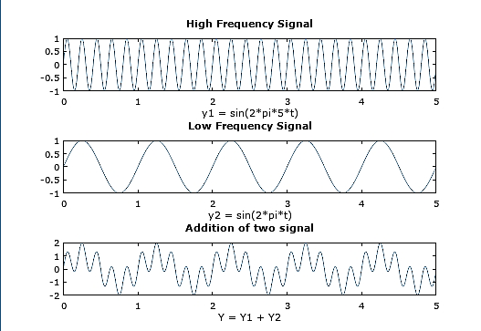
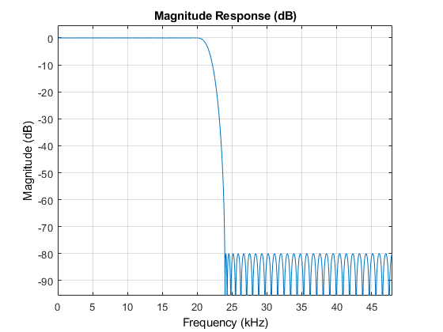
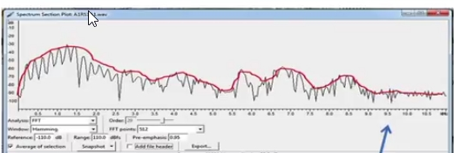
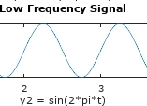
Homomorphic Speech Processing

Slide 6
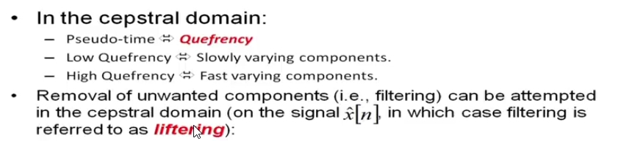
Homomorphic Filtering

Slide 7
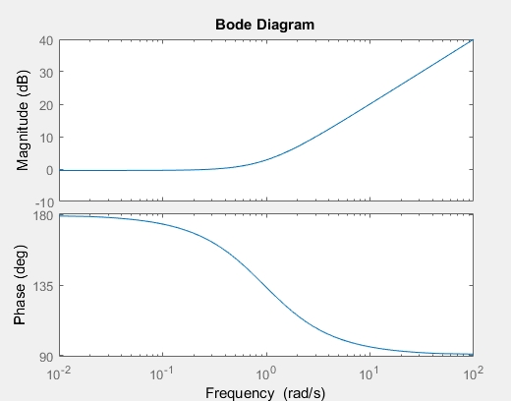
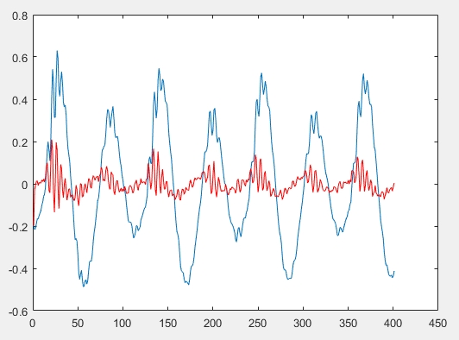
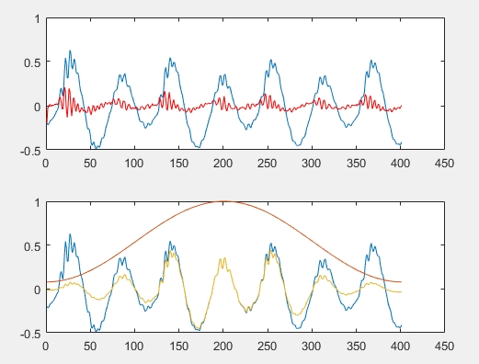
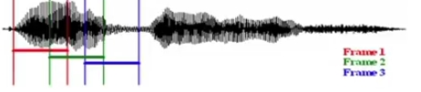
Signal Processing step for coefficient extraction
Pre-emphasis
Framing
Windowing
Homomorphic Speech Processing

Slide 8
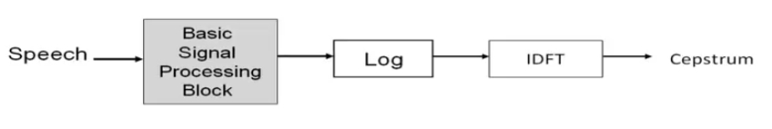
Signal Processing step for coefficient extraction
N point IDFT
1st k coefficient is taken into consideration. Generally k = 13

Slide 9
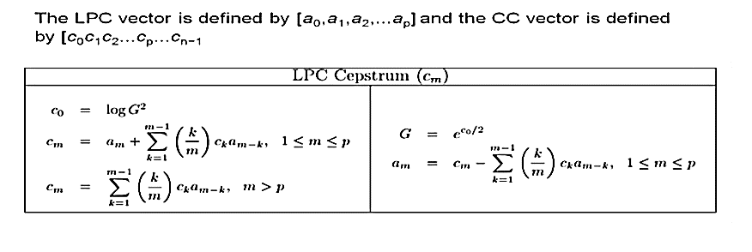
Linear Predictive Coding(LPC) CC

Slide 10
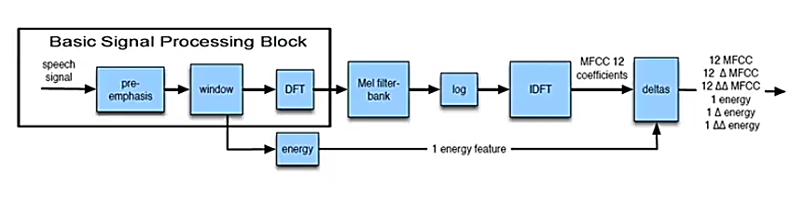
Mel Frequency Cepstral Coefficient MFCC
39 dimensional MFCC feature vector
DCT

Slide 11
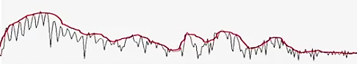
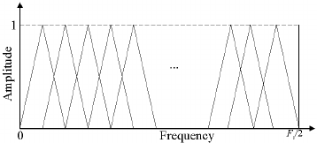
Linear Filter Bank
Frequency(Hz)
Linear filter doesn’t match with the human perception

Slide 12
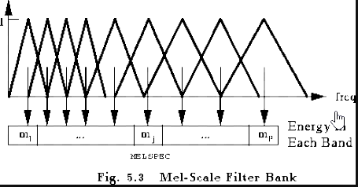
Mel Filter Bank
Frequency(Hz)

Slide 13

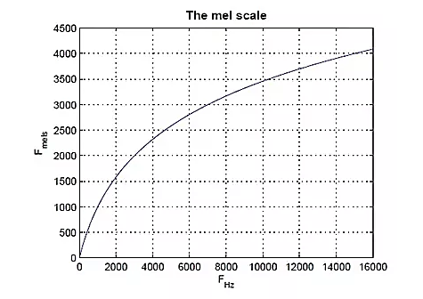
Mel Scale

Slide 14
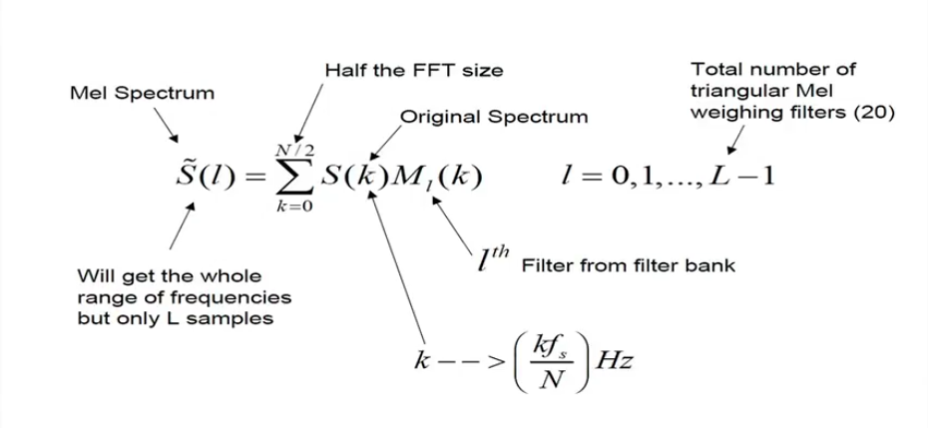
Mel Filter Bank

Slide 15
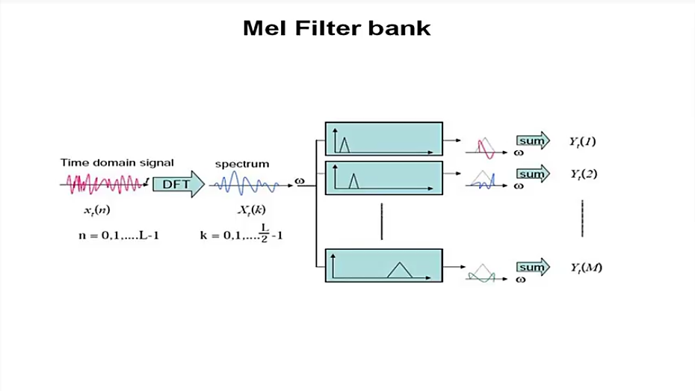
Mel Filter Bank

Slide 16
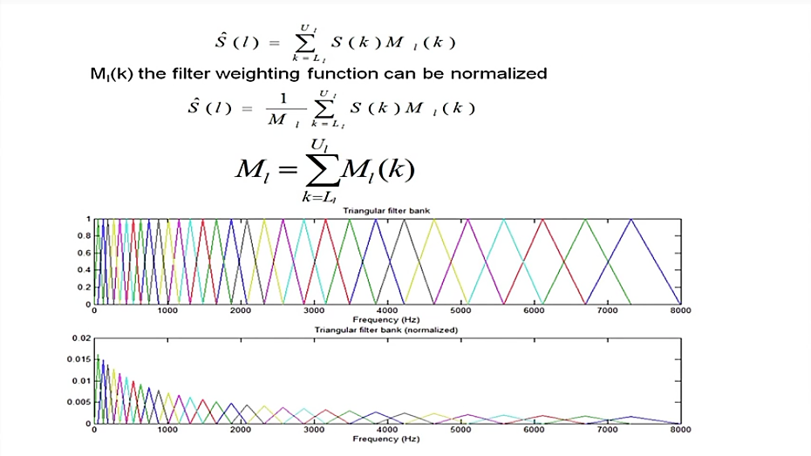
Mel Filter Bank

Slide 17
Homomorphic Speech Processing
DCT

Slide 18
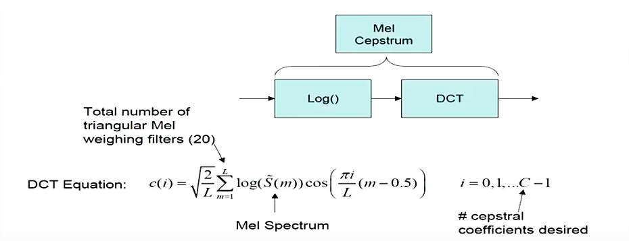
DCT(Discrete Cosine Transform)

Slide 19
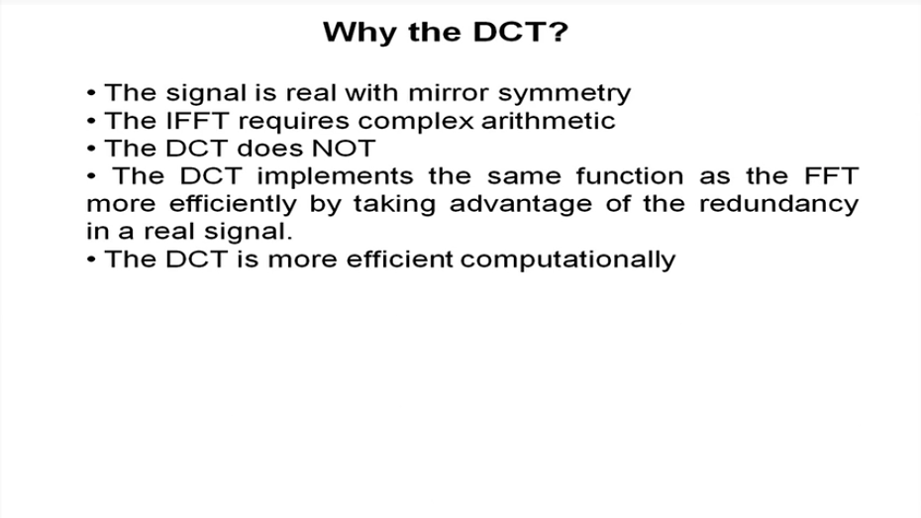
DCT(Discrete Cosine Transform)

Slide 20
Thank You

Slide 21
Preprocessing
Feature Extraction
Train Sample
Frame 1 | 1 | 2 | 3 | 4 | … | …. | 13
Frame 2 | 1 | 2 | 3 | 4 | … | …. | 13
Frame 3 | 1 | 2 | 3 | 4 | … | …. | 13
Frame 4 | 1 | 2 | 3 | 4 | … | …. | 13
…….. | 1 | 2 | 3 | 4 | … | …. | 13
…….. | 1 | 2 | 3 | 4 | … | …. | 13
……… | 1 | 2 | 3 | 4 | … | …. | 13
…….. | 1 | 2 | 3 | 4 | … | …. | 13
Testing Model
Training Model
MFCC Coefficients
Test Sample

