Slide 1
MIS to AEP
Migration Strategy
For Internal Circulation Only – Confidential & Sensitive Content

Slide 2


Briefing Agenda
01
Executive Summary
02
Why We Are Moving from MIS
03
What is Included In The Move
04
How We Will Know It Worked
05
Current OPEX /AMC Spend
06
Cost Benefits
07
08
Technical Migration Plan
Migration Risk & Dependencies
09
Next Steps
Information Technology
Deliver Trusted & Innovative
Digital Services for Everyone.
Driving Success through TEAMs
(Transformation, Engagement & Efficiency, Agility, Modernization)

Slide 3
Executive Summary
“Retiring MIS, consolidating into AEP, and laying the foundation for our data lakehouse.”
1
CONSOLIDATE
2
BUILD
3
RETIRE
Migrate its data & reporting into our existing AEP/BI system one source of truth.
Lay the clean foundation for the upcoming Data Lakehouse program.
Decommission the outdated, unsupported MIS platform (Oracle 11g, end-of-life hardware).
Bottom Line: This is the fastest, lowest-risk first step toward a single, modern data platform , cutting cost, risk, and duplicate data along the way.
Information Technology
Deliver Trusted & Innovative
Digital Services for Everyone.
Driving Success through TEAMs
(Transformation, Engagement & Efficiency, Agility, Modernization)

Slide 4
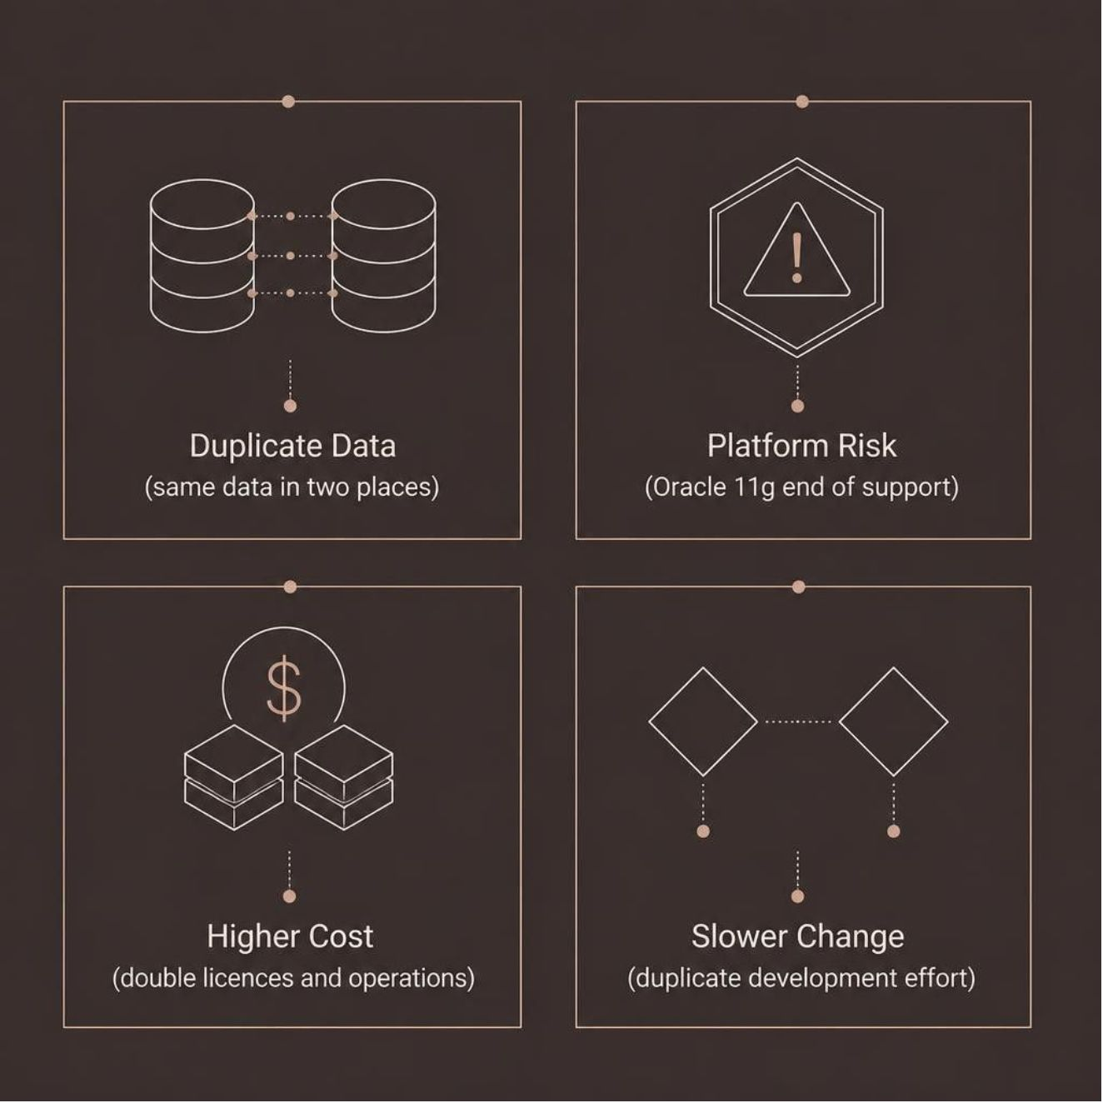
MIS → AEP | PROJECT PURPOSE
Why we are moving MIS to AEP
Make AEP the central platform for reporting and analytics.
Duplicate Data
Platform Risk
Same source data managed in both MIS and AEP simultaneously
Oracle 11g and ageing hardware have limited vendor support
Higher Cost
Slower Change
Separate licences, support, power and operations repeat every year
Two platforms require duplicate fixes and development effort
Information Technology
Deliver Trusted & Innovative
Digital Services for Everyone.
Driving Success through TEAMs
(Transformation, Engagement & Efficiency, Agility, Modernization)

Slide 5
MIS → AEP | SCOPE AND CONTROLS
What is included in the move
Review every MIS item and decide what happens next.
REVIEW THESE ITEMS
KEEP CONTROL DURING THE MOVE
• Data feeds
• Move required historical data to AEP
• Materialized views & stored procedures
• Keep audit and regulatory data safe
• ETL jobs and data transformations
• Decide what to move, rebuild, combine, archive or retire
• Dashboards and reports
• Keep critical MIS processes running until AEP is ready
• APIs
• Application integrations connected to MIS
TEMPORARY EXCLUSIONS
If an item cannot move now, record the owner, reason, risk, target date and
retirement plan. Keep MIS running until checks, testing, user acceptance and
parallel operation are complete.

Slide 6
MIS → AEP | SUCCESS MEASURES
How we will know it worked
The migration will be considered successful when
AEP IS READY
MIS CAN CLOSE
• Approved MIS reports and workloads are available from AEP.
• History is moved or securely archived
• Counts, totals and business rules match
• Expected infrastructure and license savings are confirmed
• Refresh and response targets are met
• Reports and services are working correctly in AEP
• Duplicate data and processing are reduced
• Business and technical owners approve retirement
• Users and downstream applications are successfully redirected
to AEP
SHARED OWNERSHIP
AEP, MIS, business, infrastructure, security and source-system teams govern
the work together. The migration charter records the final scope and measures.

Slide 7
RECURRING EVERY YEAR
Current OPEX / AMC Spend
$79,174
Recurring annual cost of platforms and licenses currently in operation
OPEX
ONE-TIME CAPEX (CAPITALISED)
Item
Qty
Each
Total
Item
Qty
Each
Total
Oracle Golden-Gate
8
$998.40
$7987.20
Dorado Storage [one time]
30
$1650
$49500
Other factors contributing to the cost
Oracle Database Enterprise Edition
8
$1398.45
$11187.60
SPARC T5 servers –book value is zero
2
$17000
$34000
Dedicated Headcount ,2 FTE (2 × $2,500/mo × 12)
2
$2500*12
$60000
Energy & Power (data center)
Rack & Hardware Maintenance
Backup maintenance
Oracle Premier Support (hardware and OS)
Subtotal (USD)
$79,174
Subtotal (USD)
$83,500.60
Information Technology
Deliver Trusted & Innovative
Digital Services for Everyone.
Driving Success through TEAMs
(Transformation, Engagement & Efficiency, Agility, Modernization)

Slide 8








5-Year Net Savings
Annual run-rate savings, one-time transition cost, and net savings over a 5-year horizon
Annual Run-Rate Savings
$79,174 / yr
One-Time Transition Cost
$64,800
Resource savings (Managed Service 2 FTE ) = $60,000
Licence savings (Oracle GoldenGate + Database) = $19,174
Additional 2 developers for 6-month transition/handover
2 × $5400/mo (additional) × 6 months = $64,800
5-Year Total Cost of Ownership (Net Savings)
Year | Annual Savings | One-Time Cost | Net Savings | Cumulative Savings
Year 1 | $79,174 | ($64,800) | $14,574 | $14,574
Year 2 | $79,174 | – | $79,174 | $93,748
Year 3 | $79,174 | – | $79,174 | $172,922
Year 4 | $79,174 | – | $79,174 | $252,096
Year 5 | $79,174 | – | $79,174 | $331,270
$331,270
net savings over 5 years after absorbing the one-time $64,800 transition cost
OTHER BENEFITS
Energy Savings
HW Maintenance
Reduced ESB Load
Architecture Consolidation
Scalability & Maintenance
Lower power & cooling draw from consolidated infrastructure.
Reduced AMC spend on ageing, unsupported hardware.
Fewer integration hops lighten the ESB and improve throughput.
Fewer platforms to license, patch and operate.
Elastic scaling cuts manual tuning and DBA overhead.
Information Technology
Deliver Trusted & Innovative
Digital Services for Everyone.
Driving Success through TEAMs
(Transformation, Engagement & Efficiency, Agility, Modernization)

Slide 9
Migration Risks & Dependencies
RISKS IDENTIFIED
3 High / 2 Medium
# | Risk Area | Description | Action Required | Impact
1 | Interface Dependency | CIM view is exposed from Legacy today. Post-migration, the AEP view must be exposed from THC instead. | Validate feasibility of exposing the required views from both Legacy and THC before cutover. | High
2 | AEP License Capacity | Existing AEP system is already running high on license usage, with no current headroom. | Clean up existing license allocation before onboarding additional data feeds. | Medium
3 | Delivery Resourcing | Migration development work requires dedicated, hands-on technical resourcing. | Onboard 2 developers on-site for the duration of the development phase. | Medium
4 | AEP DB Performance | AEP database may experience slowness once MIS workloads are migrated onto it. | Load-test AEP DB capacity and plan tuning/scaling ahead of migration. | High
5 | Reporting Continuity | GG based CAF reports currently depend on the existing MIS setup. | Define and validate the delivery mechanism for CAF reports post-migration. | High
Recommendation: Resolve the Legacy/THC interface dependency and validate AEP DB capacity before migration go-live
Information Technology
Deliver Trusted & Innovative
Digital Services for Everyone.
Driving Success through TEAMs
(Transformation, Engagement & Efficiency, Agility, Modernization)

Slide 10
Current MIS Architecture and Migration Complexity
MIS currently acts as a central reporting repository. It receives data from multiple operational systems through file transfers, database links and Oracle Golden-Gate replication. MIS then processes this data and provides datasets to reports, dashboards, APIs and other downstream applications.
Current Data Integration Architecture
Integration type | Approximate volume | Current operation | Migration requirement | Complexity
File-based feeds | 15+ feeds | Source systems generate files and transfer them to MIS for scheduled loading. | Rebuild file ingestion in AEP, including file validation, scheduling, error handling and reconciliation. | Medium
Database links | To be confirmed | MIS directly reads data from selected Oracle databases through database links. | Identify every database link and replace it with an approved AEP ingestion method. | High
Oracle GoldenGate | 150 feeds | GoldenGate continuously or periodically replicates source-system data into MIS. | Map replicated tables to AEP, configure new replication routes and validate data consistency. | High
MIS processing | To be assessed | Procedures, ETL jobs and scheduled processes apply transformations and business rules. | Rebuild, optimize or retire the processing logic in AEP. | High
Reporting layer | To be assessed | Qlik QVFs, dashboards, reports, APIs and applications consume data from MIS. | Redirect consumers to AEP after data validation and business acceptance. | High
Historical data | To be assessed | MIS stores historical information required for reporting, audit and analysis. | Decide what history to migrate, archive or retain temporarily. | Medium to High
Information Technology
Deliver Trusted & Innovative
Digital Services for Everyone.
Driving Success through TEAMs
(Transformation, Engagement & Efficiency, Agility, Modernization)

Slide 11
High Level Technical Migration Plan - Oracle MIS → AEP | ~24 Weeks
MIS to AEP Migration
1
2
3
4
5
6
7
Assessment &
Planning
Data Analysis &
Mapping
Migration
Development
Testing &
Validation
Deployment &
Go-Live
Post Go-Live
Support
~3 weeks
~5 weeks
~5 weeks
~6 weeks
~3 weeks
~2 weeks
Ongoing
Assess data volume, growth, history & retention requirements
Map Oracle tables and views to AEP Vertica entities
APIs, file interfaces
Source-system data feeds and ingestion processes
MIS vs AEP data reconciliation
Production cutover of GoldenGate/ETL pipelines
Monitor pipeline jobs, AEP DB perf & SLAs
Assess data quality & known reconciliation issues
Identify table, job and report dependencies
Database tables, materialized views & stored procedures
ETL jobs, scheduled processes and data transformations
SIT: ETL pipeline & integration tests
Deploy newly developed AEP reports/dashboards to production
L1/L2 triage of residual Oracle 11g defects
Define scope, RACI & success KPIs
Identify duplicate and obsolete data objects
Migrate Historical data required for reporting, audit and regulatory purposes
Application integrations connected to MIS
UAT: Data counts, and business rules are reconciled and signed off.
Parallel run: legacy MIS + AEPside-by-side
User training
Estimate AEP capacity, infrastructure & license requirements
Map historical-data & retention requirements
Tune AEP DB query & refresh performance
Performance & load testing on AEP DB
Final cutover; decommission Oracle MIS
Continuous optimisation
Information Technology
Deliver Trusted & Innovative
Digital Services for Everyone.
Driving Success through TEAMs
(Transformation, Engagement & Efficiency, Agility, Modernization)

Slide 12
Next Steps | Immediate Action Required
1
Stakeholder Sign-Off
Secure executive approval from Finance, Technology & Operations. Agree governance model and data ownership.
2
Proof of Concept
Confirm AEP already holds the same MIS data, plus additional datasets, and validate reconciliation accuracy against existing reports.
3
Procurement & Licensing
Provision incremental AEP/Dorado storage for migrated workloads if required. Initiate licence exit and termination of Oracle 11g, Golden-Gate
4
Delivery Team
Assemble cross-functional delivery team , Data Engineer, Architect. Arrange travel & onsite presence for 2 developers during the build phase.
Information Technology
Deliver Trusted & Innovative
Digital Services for Everyone.
Driving Success through TEAMs
(Transformation, Engagement & Efficiency, Agility, Modernization)

Slide 13
The Time to Act
Is Now

