Slide 1
PSOC Edge Smart HMI kit UI mockups

Slide 2









Better radar presence indication
°
SETTINGS
27
MODE
CONNECT
LOW
PRESENCE
COMMAND

Slide 3
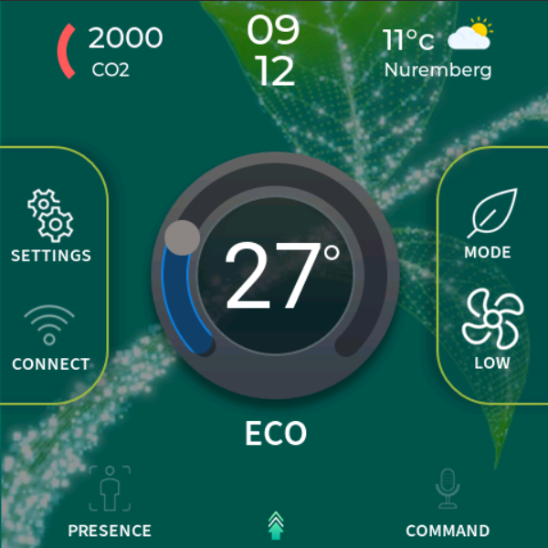

Background image
°
27
SETTINGS
MODE
CONNECT
LOW
PRESENCE
COMMAND

Slide 4
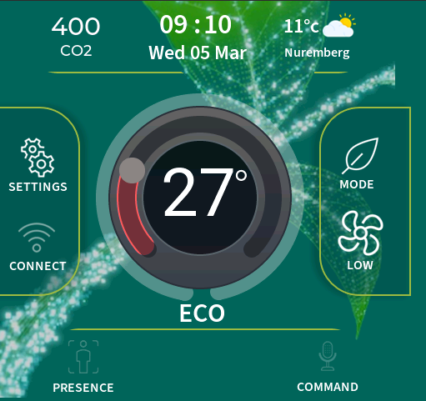
Temp control arc design merged into background image
°
SETTINGS
27
MODE
CONNECT
LOW
SETTINGS
MODE
CONNECT
LOW
PRESENCE
COMMAND
PRESENCE
COMMAND

Slide 5
Background image
°
27
°
SETTINGS
MODE
SETTINGS
27
MODE
CONNECT
LOW
CONNECT
LOW
PRESENCE
COMMAND
PRESENCE
COMMAND

Slide 6
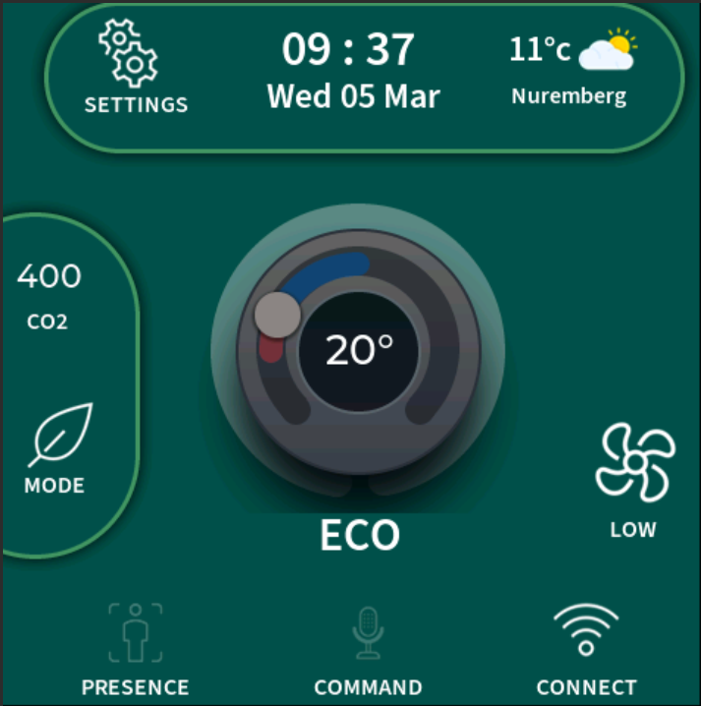


(temp / design draft)
>
Mon, 06 Aug
23 °C
08:45
Bangalore
22
Set to
°
24°C
Heating …
SETTINGS
PRESENCE
MODE
COMMAND
CONNECT

Slide 7
(temp / design draft) – tutorial idea (TODO

Slide 8
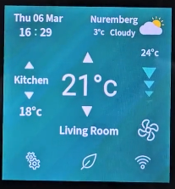

Active screen
View in Powerpoint (not in browser) or download to visualize UI mockup accurately
Control of temperature and fan speed for the selected room
Can timeout and go to “Idle” screen
Heating
Background /
color gradient
Mon, 06 Aug
Nuremberg
08:45
3°c Cloudy
Placeholder space for weather/ AQI info (updates when connected to internet)
22°C
Set to
Temperature set point value and animation (heating or cooling)
24°C
Older “EW” version
Current temperature
Tap to change fan speed/mode (animated icon)
Multi-function status bar
… Heating …
20 minutes until heated to 24°C
LOW
Settings / personalization
Wi-Fi/cloud status and settings
SETTINGS
PRESENCE
MODE
COMMAND
CONNECT
Presence detection enable/disable, detection status
Mode (eco, rapid, auto)
Voice input enable/disable, keyword detection status

